Slide 1
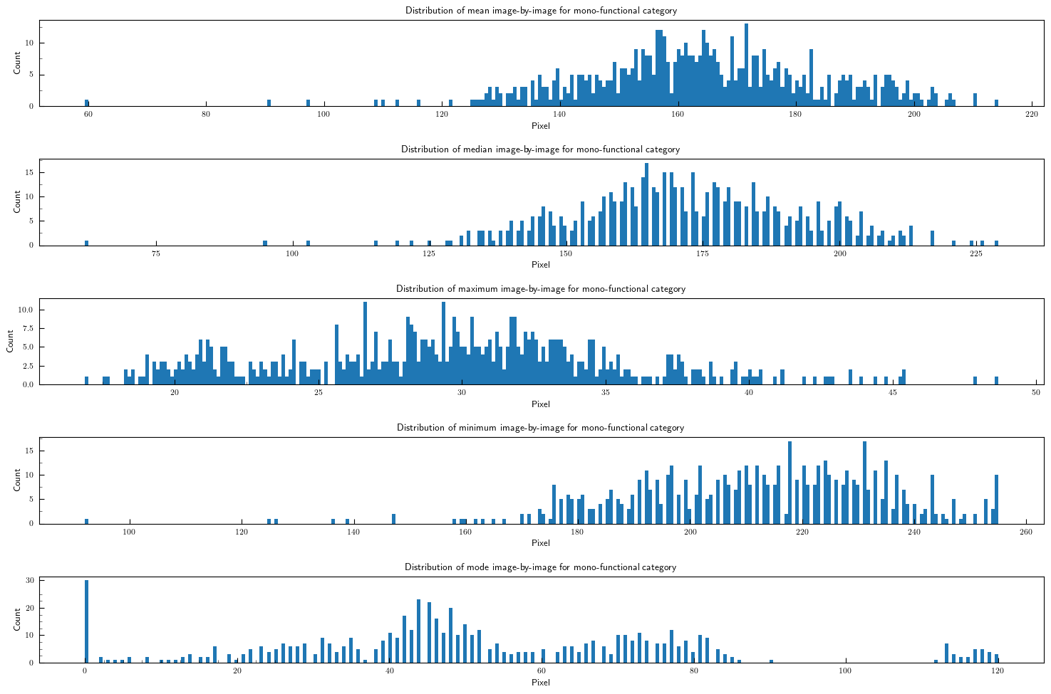

Slide 2
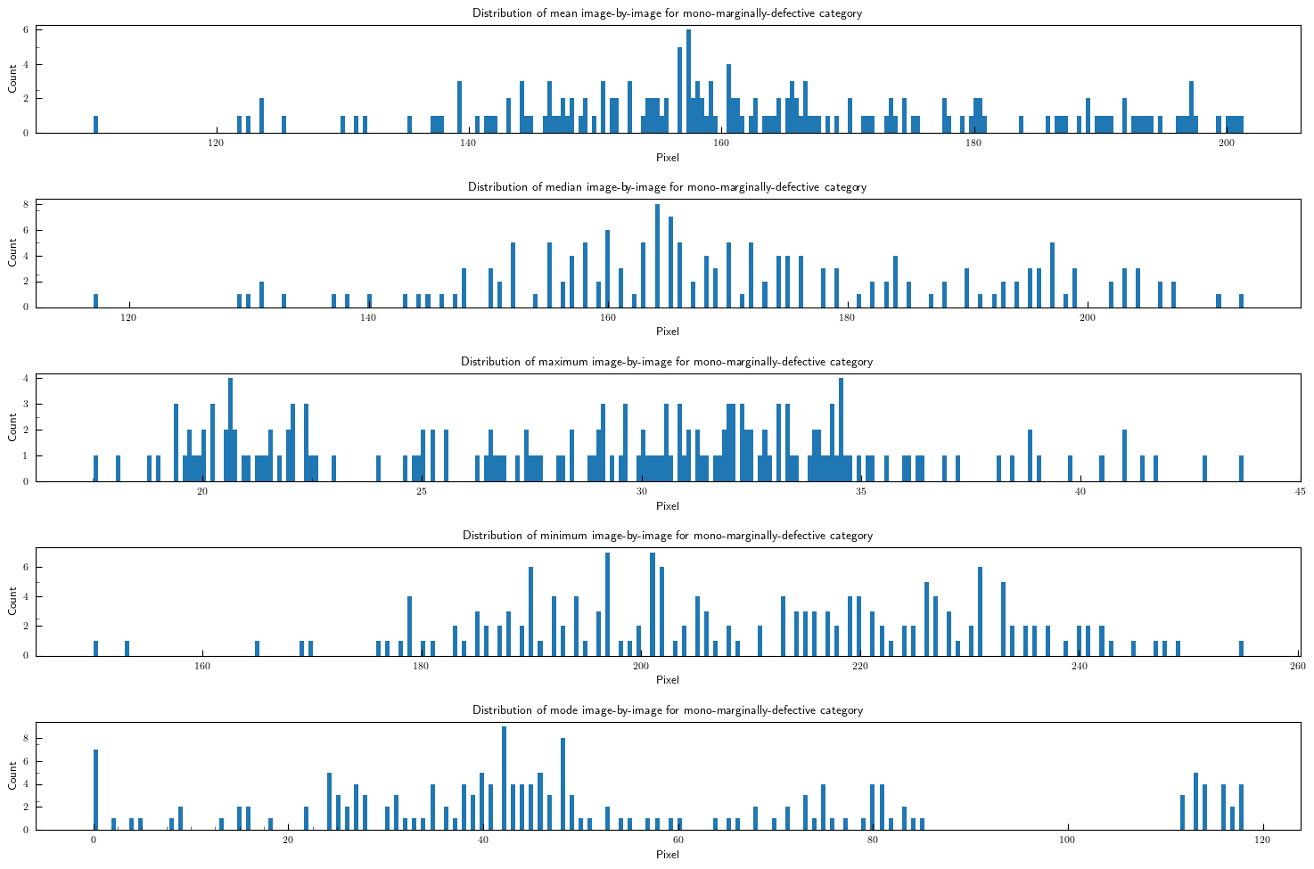

Slide 3
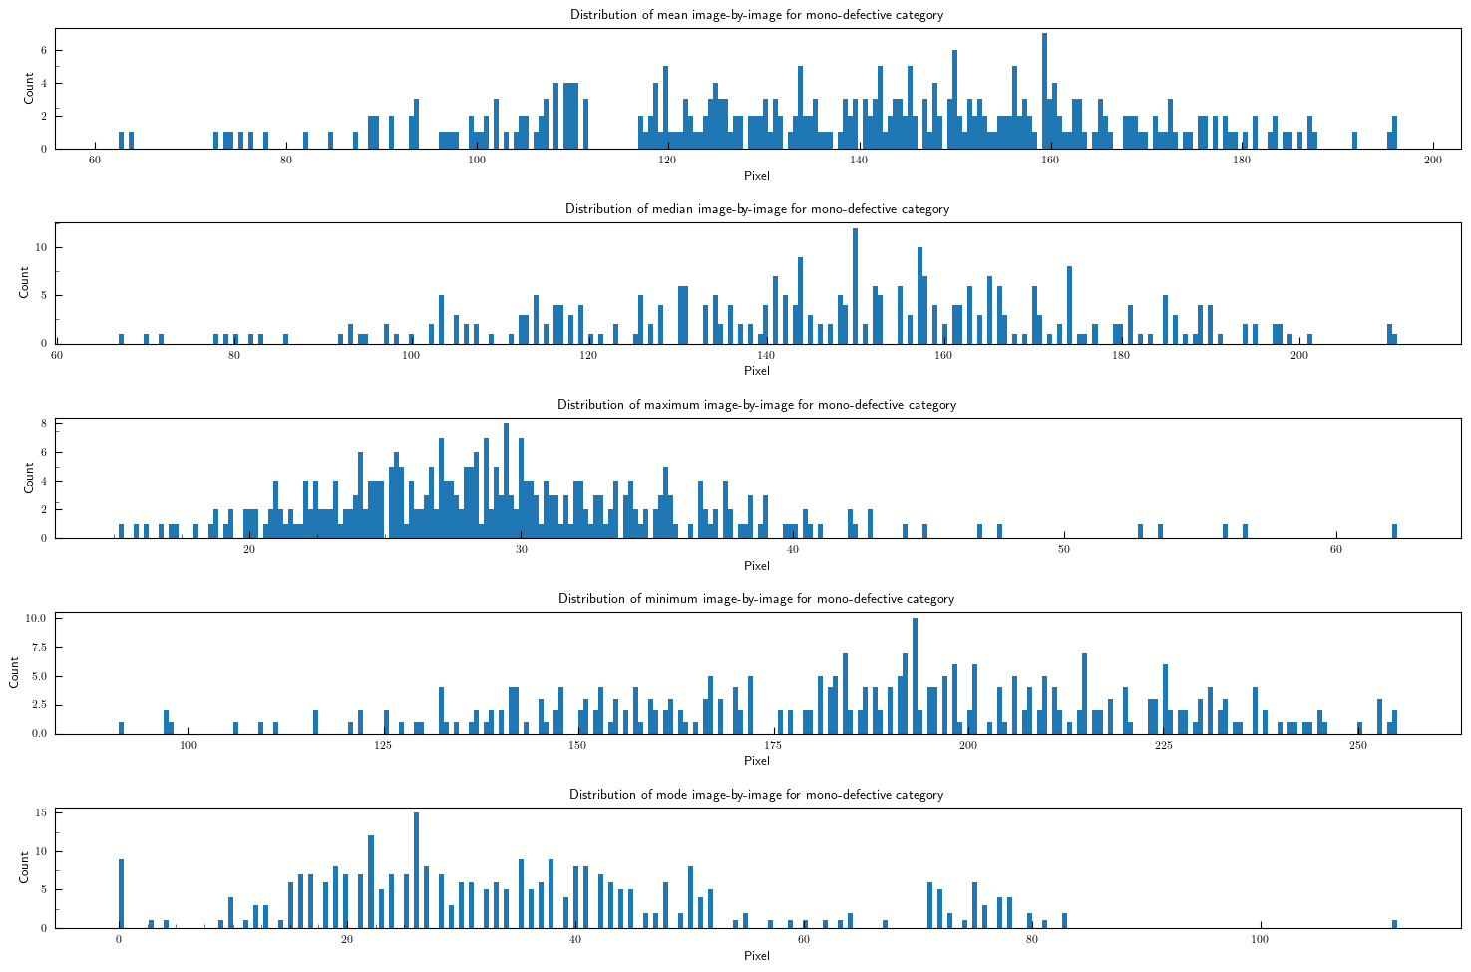

Slide 4
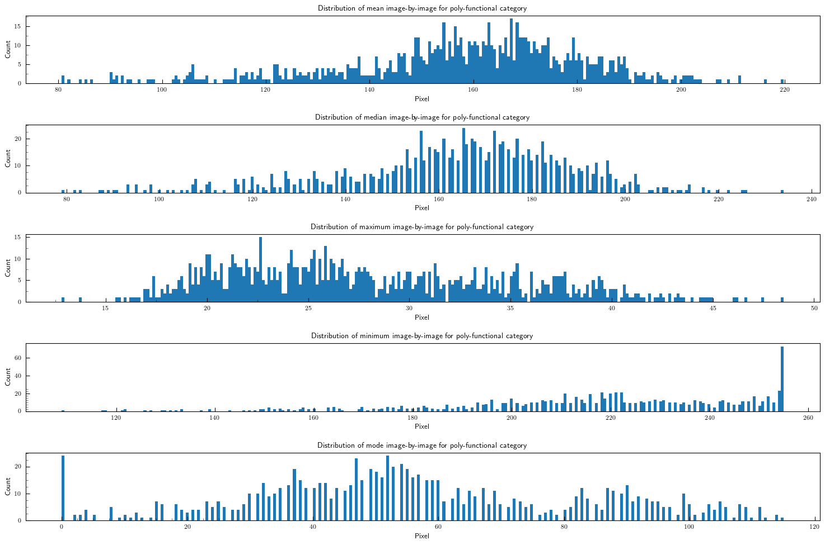

Slide 5
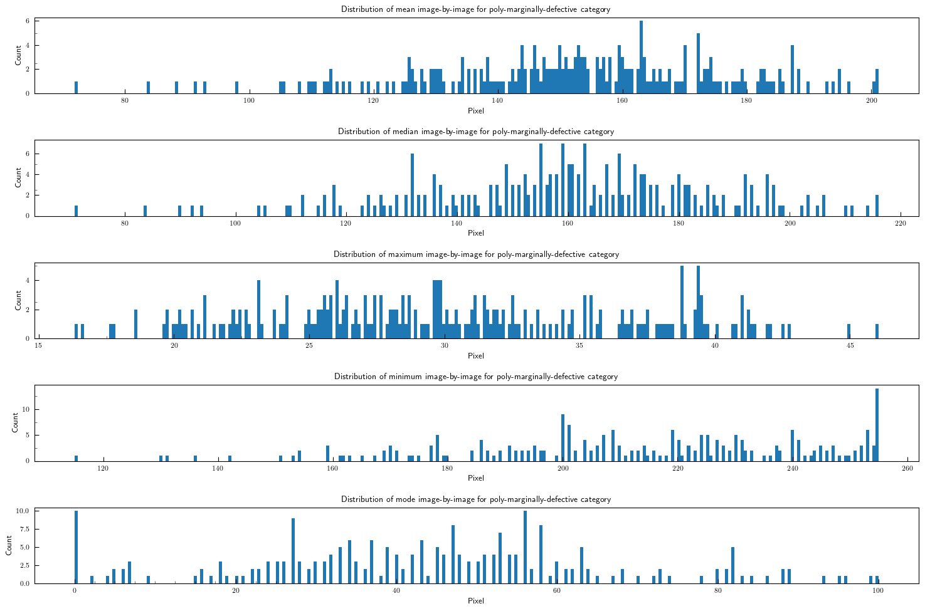

Slide 6
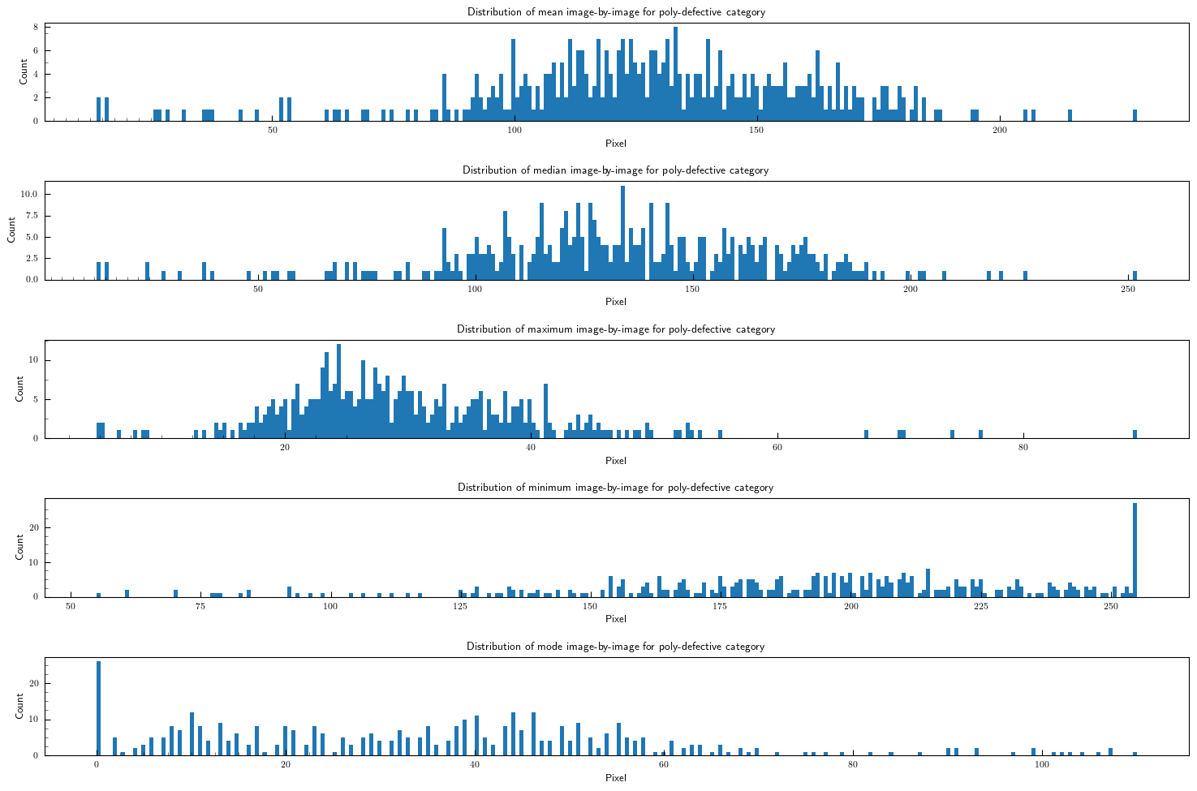

Slide 7
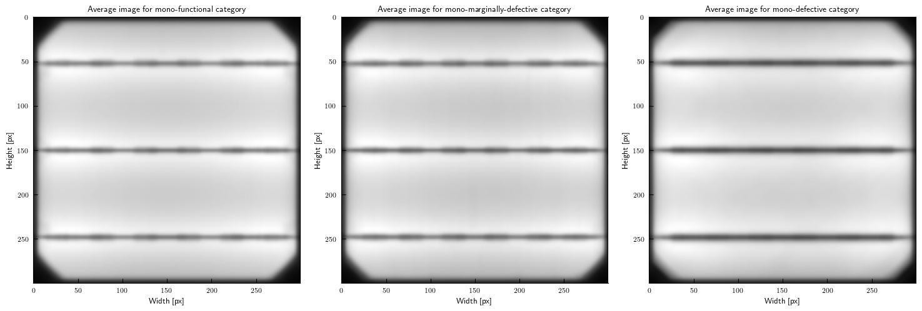

Slide 8
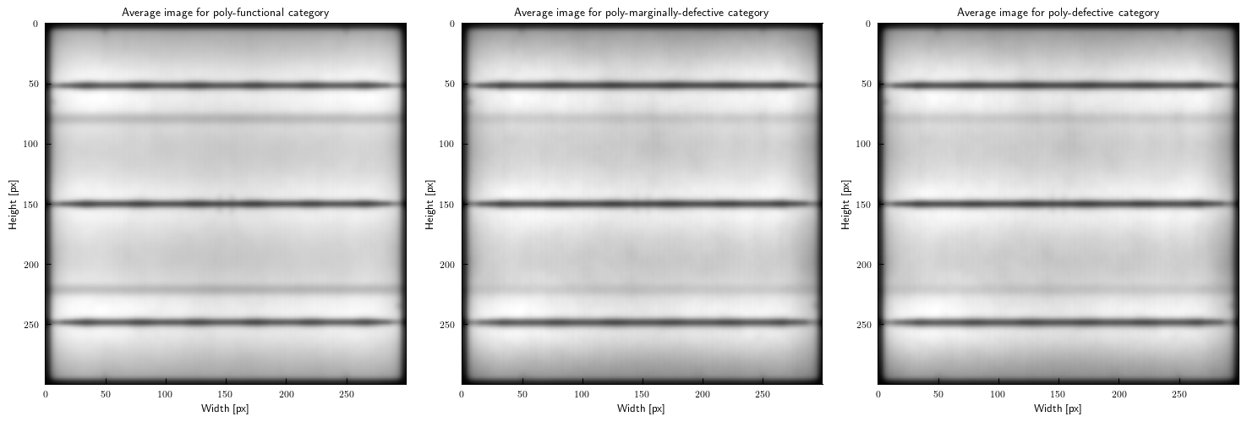

Slide 9
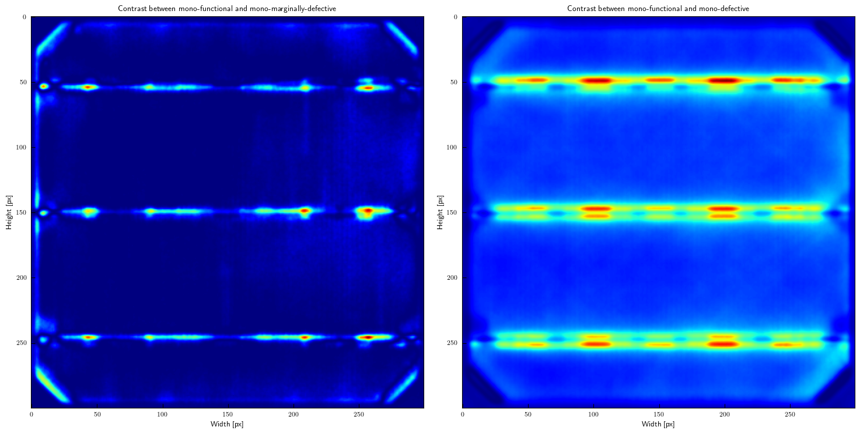

Slide 10
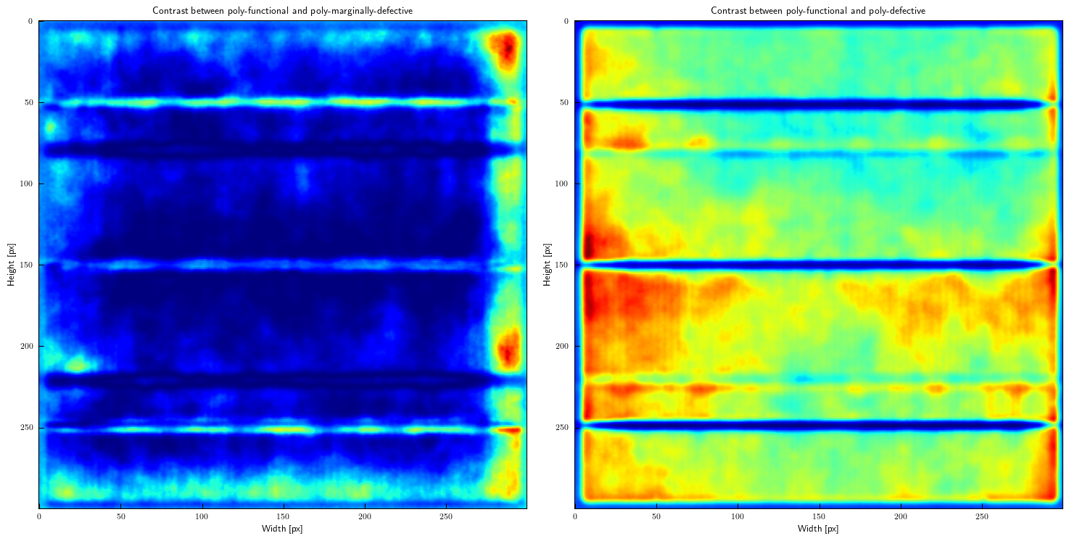

Slide 11
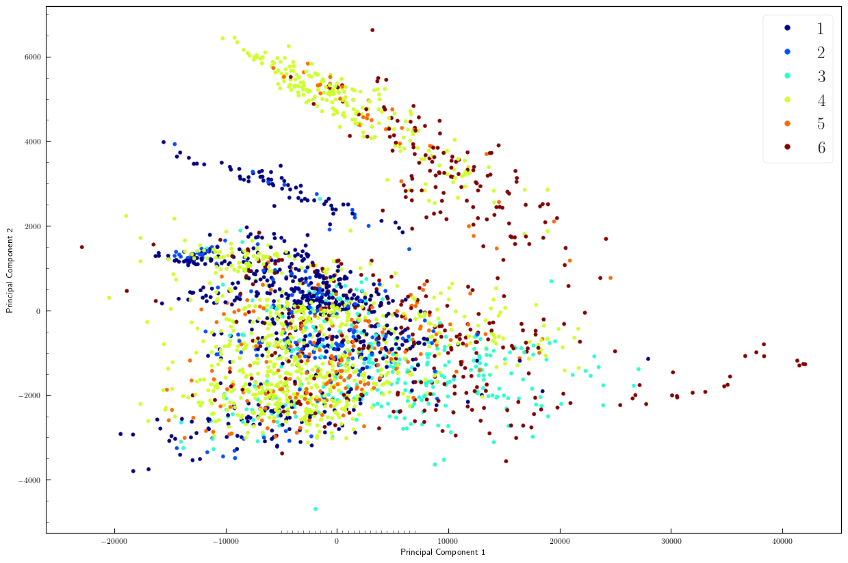

Slide 12
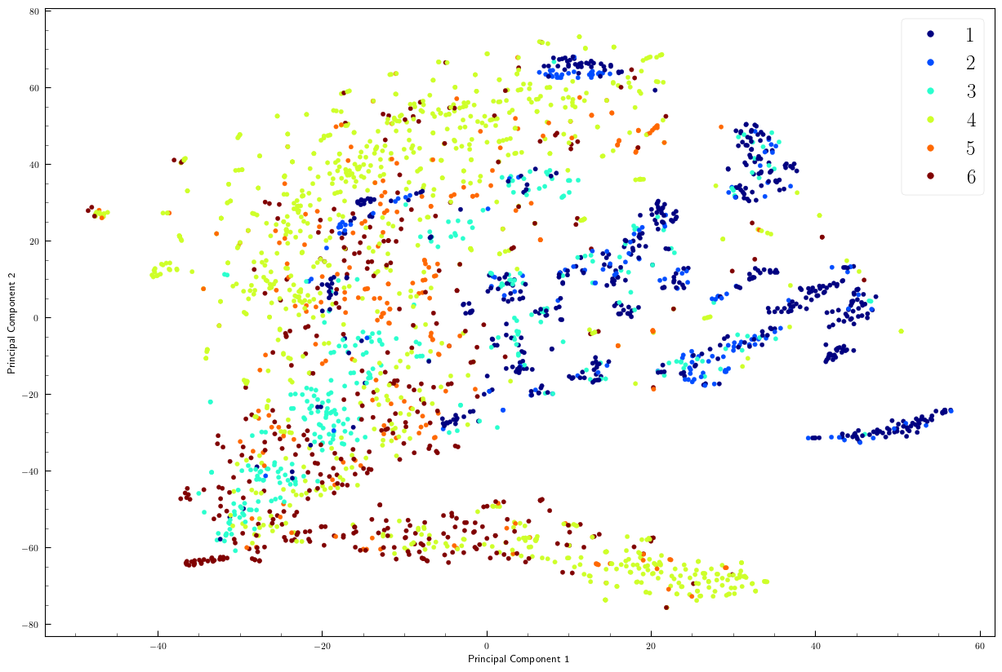

Slide 13

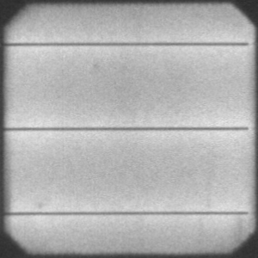




(ii) Random horizontal/vertical flipping
Metallic conducting strip (a.k.a. busbar)
Translation axes
(iii) Random horizontal/vertical shifting
(iv) Random zooming
(v) Random rotation by 90$°$
(i) Anatomy of a solar wafer

Slide 14

Number of epochs: 200
Batch size: 4
Optimizer: Adam($η={10}^{−5},β_{1}=0.9,β_{2}=0.999, ε={10}^{−9}$)

