Slide 1

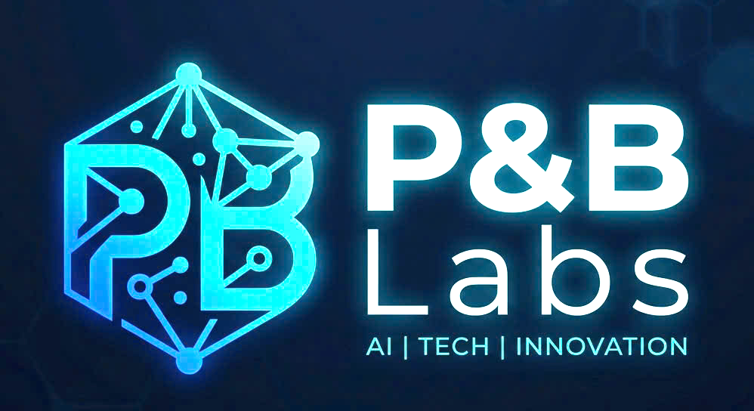
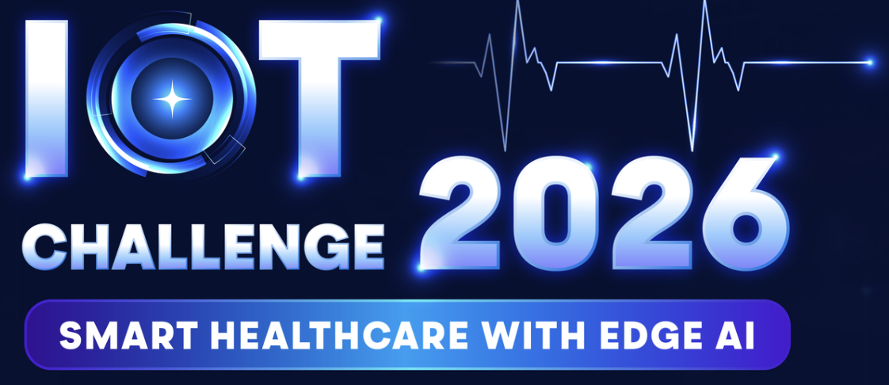
Project Title: Omni Arm
A Smart Prosthetic Arm System With AI - Based EMG Motion Intent Recognition, Health Monitoring, and Real - Time Emergency Alert for Caregiver Connectivity
May 13, 2026
Team Name: P&B Labs

Slide 2

Table content
Content
1. Problem statement & motivation
2. System overview
3. Edge AI solution — EMG signal processing & TinyML inference
4. Wireless technology — BLE & Wi-Fi
5. Hardware design
6. Mobile application & cloud integration

Slide 3

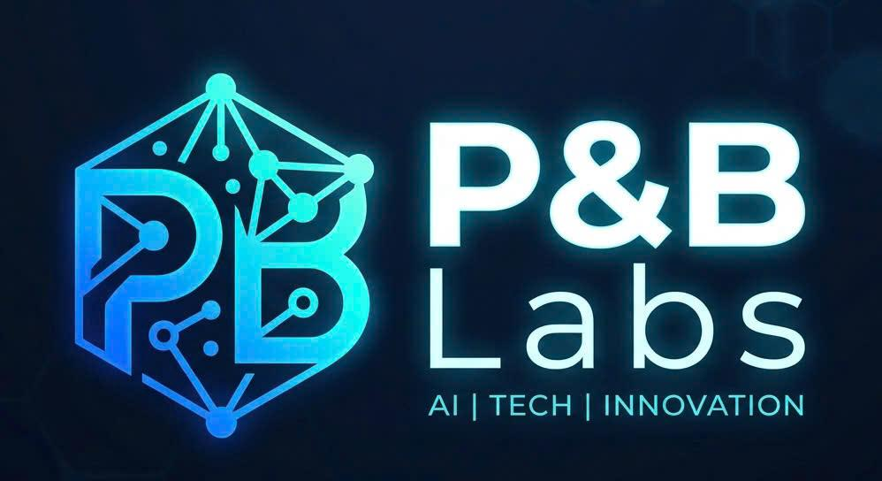
Introduction
Team Logo:
Team Name: P&B Labs
Team Size: 5
Team Lead Name: Tran Minh Triet
Team Members (5)
Name: Tran Minh Triet
University: Posts and Telecommunications Institute of Technology
Course and Year Group:Electronics and Telecommunications Engineering, Class of 2029
Contact Email: minhtriett463@gmai.com
Discord Handle: triet
Name: Nguyen Minh Quan
University: Posts and Telecommunications Institute of Technology
Course and Year Group: Electronics and Telecommunications Engineering, Class of 2029
Contact Email: nmquan3108@gmail.com
Discord Handle: minquan
Name: Nguyen Tan Hieu
University: Post and Telecommunications Institute of Technology
Course and Year Group: Electronics and Telecommunication Engineering, sophomore
Contact Email: Helos180506@gmail.com
Discord Handle: Helos
Name: Nguyen Duc Trung Kien
University: Ho Chi Minh University of Technology
Course and Year Group: Computer Science and Engineering, Class of 2028
Contact Email: kien.nguyenhcmut@hcmut.edu.vn
Discord Handle: creter_
Name: Hoang Ba Duy
University: Posts and Telecommunications Institute of Technology
Course and Year Group: Information Security, class of 2029
Contact Email: dp1.0a5.duy@gmail.com
Discord Handle: DuyH07

Slide 4
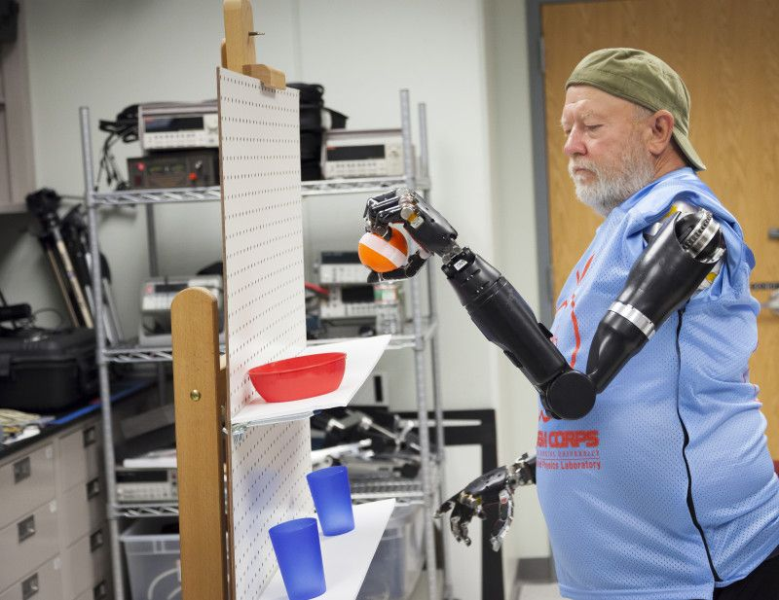
Objective
Objective
Problem Statement:
Lack of Preventive Care and Automated Warnings for Amputees
• Pain Point: According to The National Survey on People with Disabilities 2016, Vietnam has an estimated 6.2–7 million people with disabilities (over 7% of the population), with mobility impairments being the most prevalent category. Among adults aged 16 and above— a demographic at elevated risk for cardiovascular complications and stump infections. Despite this, current prosthetics largely lack continuous health monitoring and the capability to issue automated warnings during emergencies.
• Evidence: Without real-time tracking of vital signs and socket conditions (e.g., temperature/humidity), severe complications often go unnoticed. Furthermore, medical data proves that automatic alerts and rapid intervention during the "golden hour" following a fall or stroke drastically improve survival rates.

Slide 5
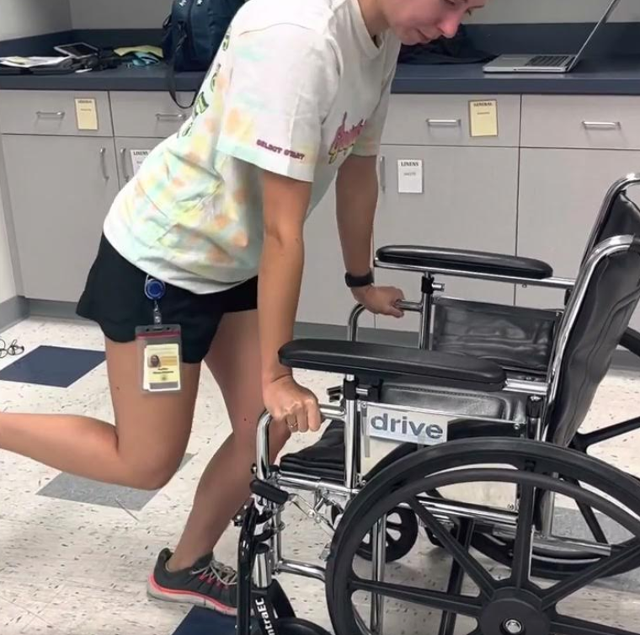
Objective
Objective
Problem Statement:
Vulnerability and Barriers to Independence
• Pain Point: Limb loss causes high rates of anxiety. Users are at severe risk if they experience a medical emergency or fall while alone without a way to call for help.
• Evidence: Medical data proves that intervention during the "golden hour" following an accident or stroke drastically improves survival rates. Clinical rehabilitation currently relies on subjective patient memory rather than continuous, real-time data. This lack of edge-monitoring delays personalized therapy adjustments and prolongs the patient's physical and mental suffering.

Slide 6
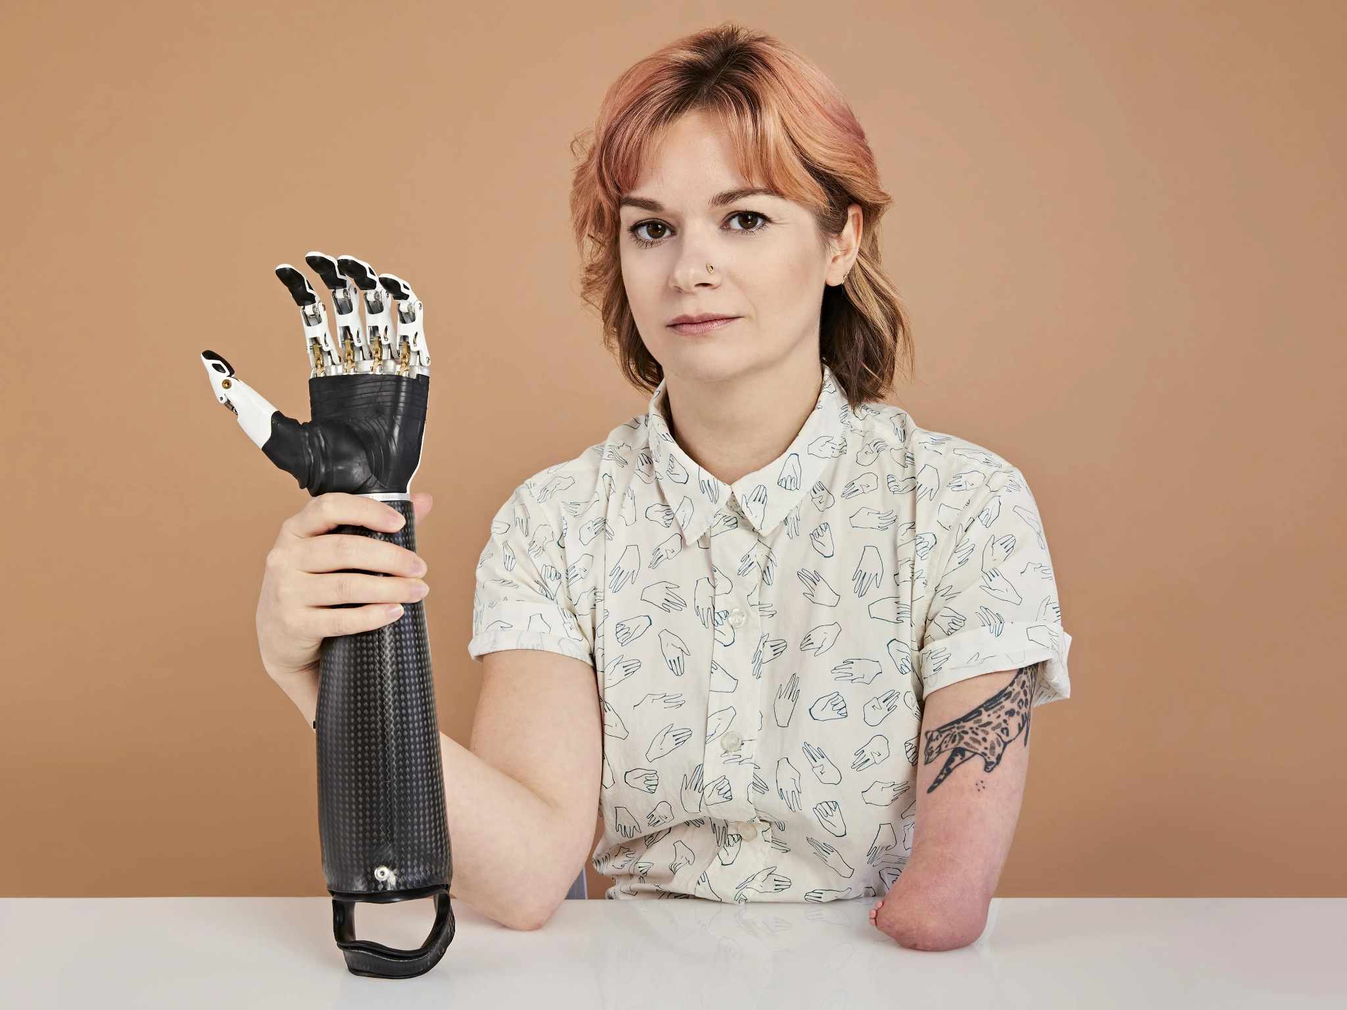
Objective
Objective
Solution:
Intuitive Control via EMG and AI
• Feature: Uses Machine Learning to decode the user's unique Electromyography (EMG) signals instead of inflexible physical sensors.
• Impact: Achieves >90% accuracy in movement intention, minimizing latency for smooth, instant reactions and reducing training time from months to weeks.
Integrated Health Assistant at the Point of Contact
• Feature: Micro-sensors for heart rate and temperature are built directly into the prosthetic socket touching the skin.
• Impact: Continuous temperature monitoring allows for early detection of inflammation or infection at the stump, acting as an invaluable preventative tool.

Slide 7

Objective
Objective
Solution:
Feature: Micro-sensors for heart rate, temperature, and blood oxygen saturation (SpO2) are built directly into the prosthetic socket touching the skin.
Data is processed locally via Edge AI to trigger subtle haptic vibrations on the device and syncs to a companion mobile app.
Impact: Continuous monitoring allows for early detection of inflammation, while real-time SpO2 tracking ensures healthy blood circulation at the stump, acting as an invaluable preventative tool against tissue necrosis. Empowers users with immediate physical alerts to remove the prosthetic before severe damage occurs, while securely sharing long-term health trends with their doctors for remote monitoring.

Slide 8
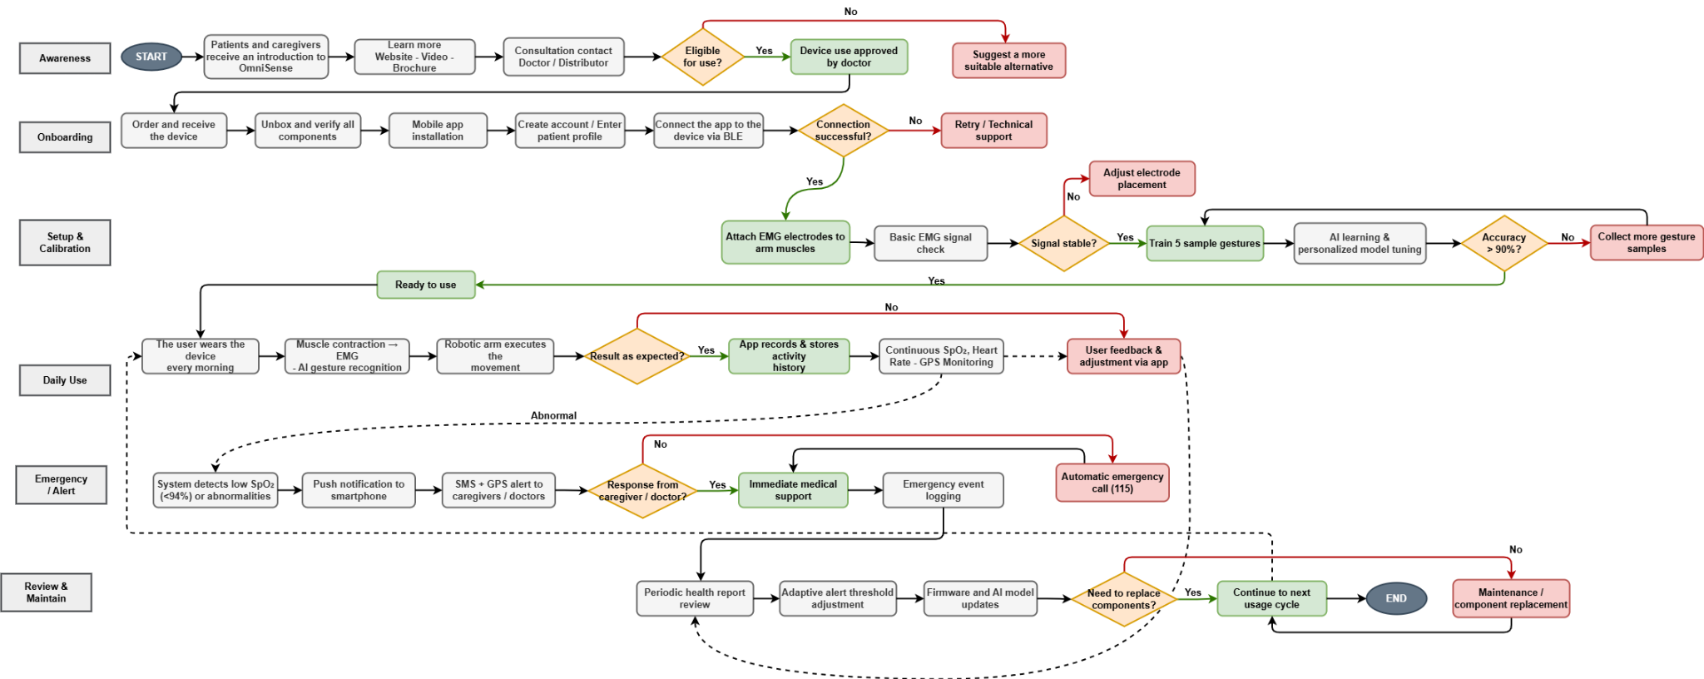
Objective
Objective
Customer Flow:

Slide 9
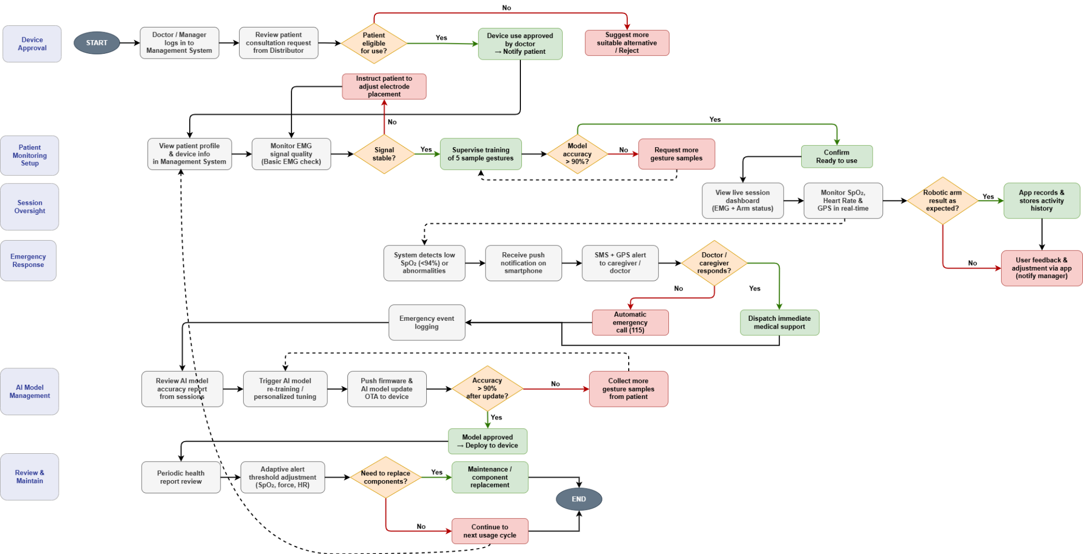
Objective
Objective
Manager Flow:

Slide 10
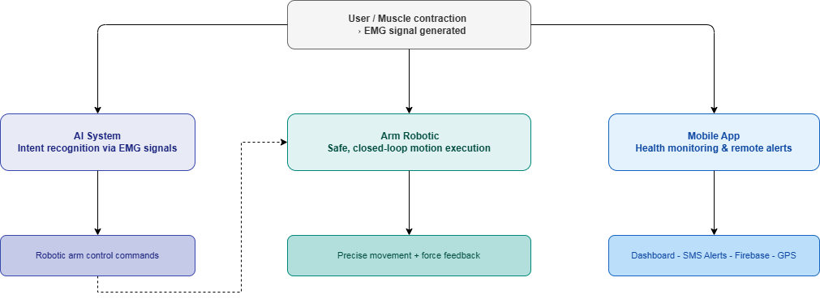
System Diagram
System Diagram
OVERVIEW:

Slide 11








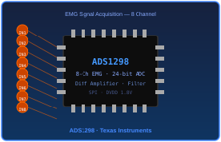
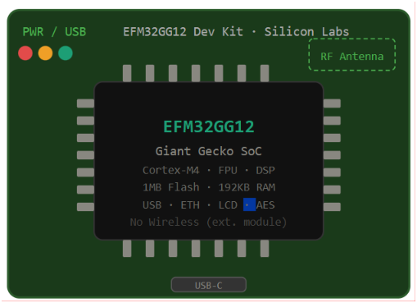
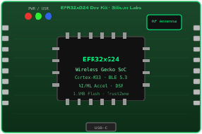
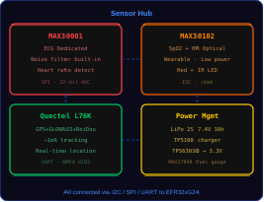
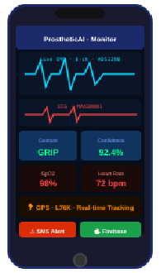




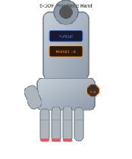

System Diagram
System Diagram
Architecture Overview:
EMG ACQUISITION
EFM32GG12
ERF32xG24 Egde AI
Cloud & Sensors
MOBILE APP
🔥 Firebase · Realtime DB · Auth
Prosthetic ARM

Slide 12
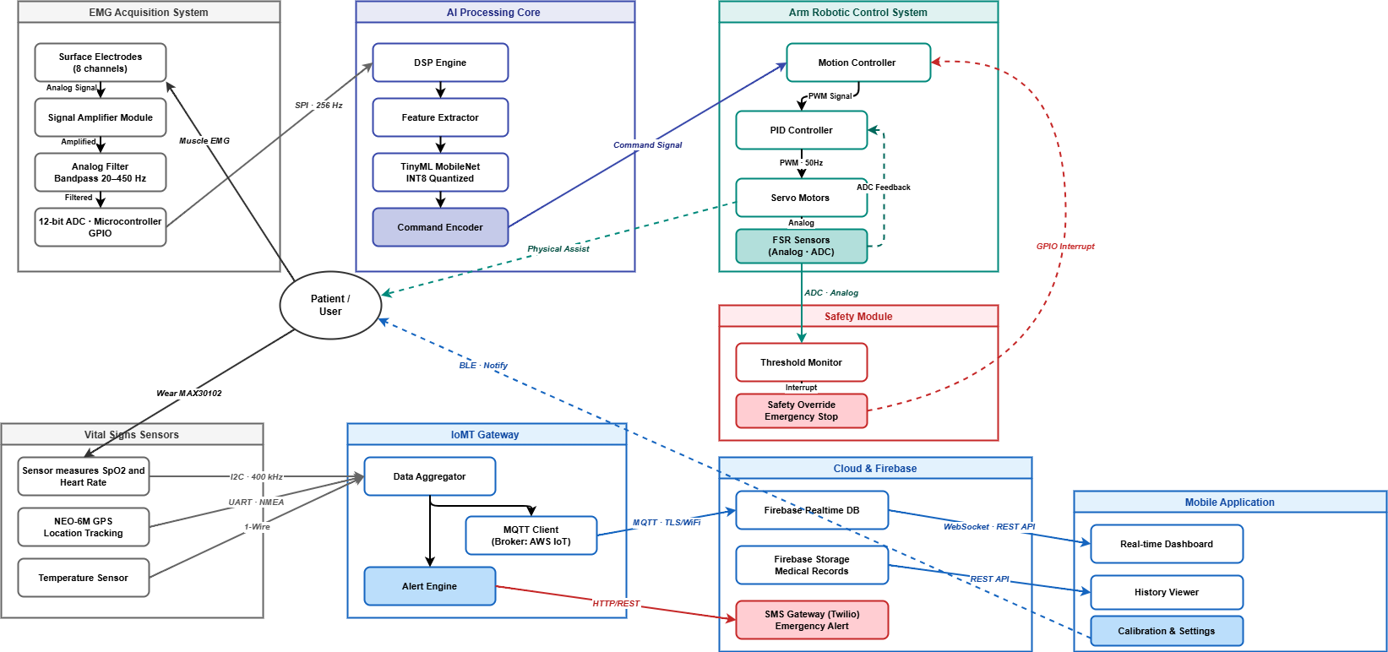
System Diagram
System Diagram
Component System Diagram:

Slide 13
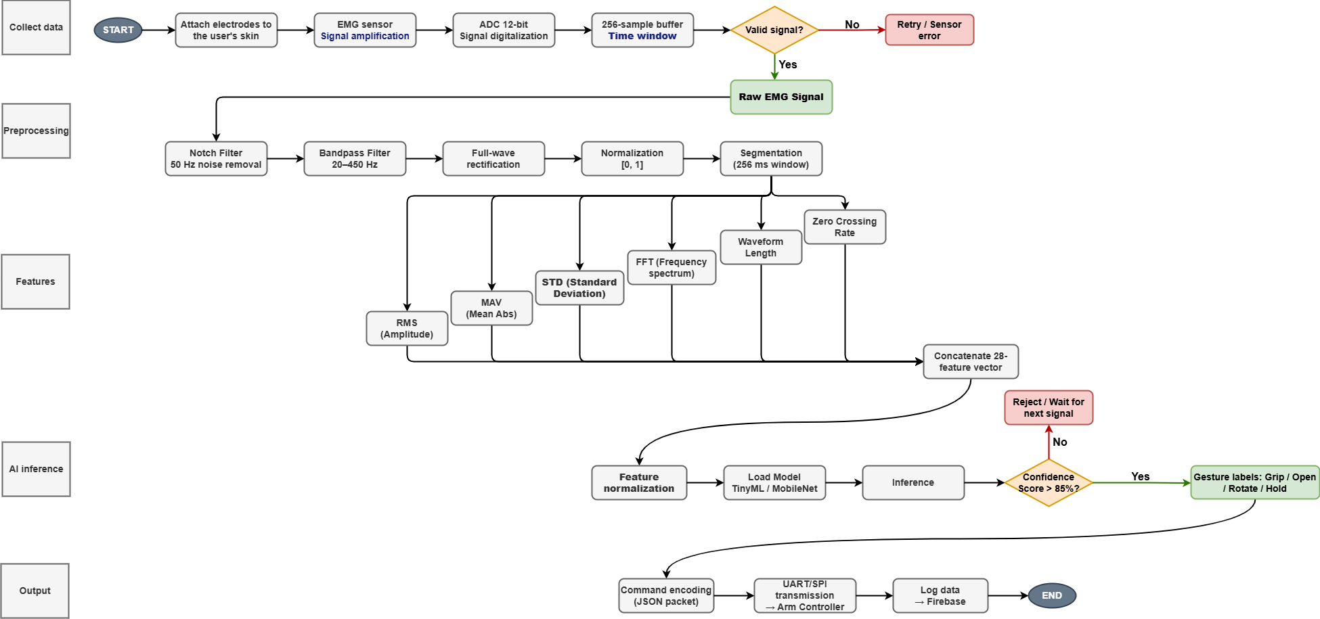
System Diagram
System Diagram
AI System Flow:

Slide 14
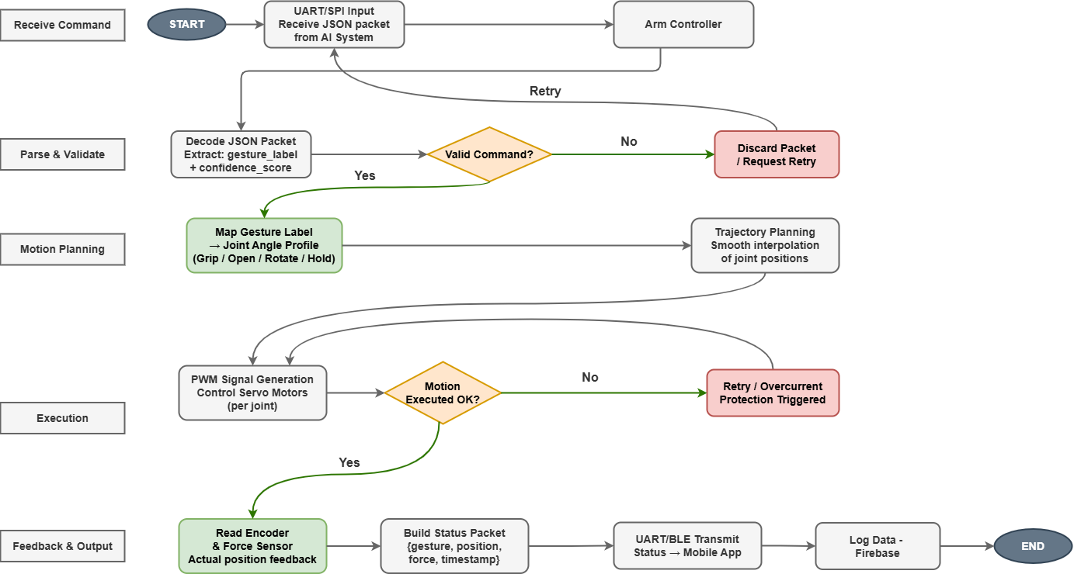
System Diagram
System Diagram
Prosthetics Arm Flow:

Slide 15
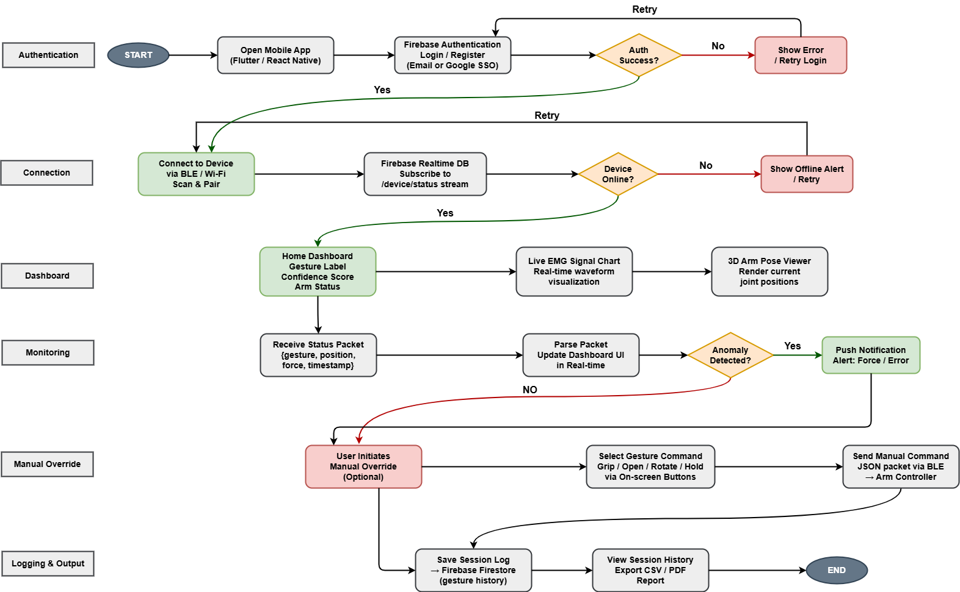
System Diagram
System Diagram
Mobile App Flow:

Slide 16
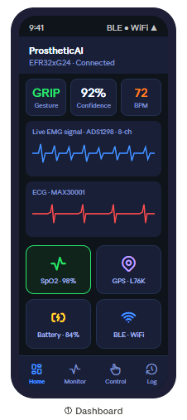
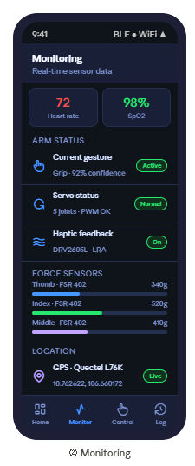
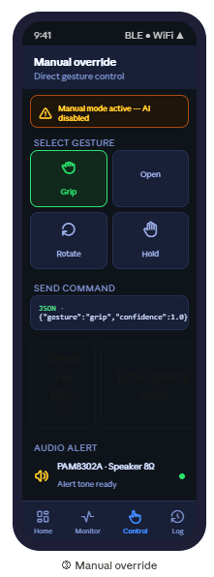
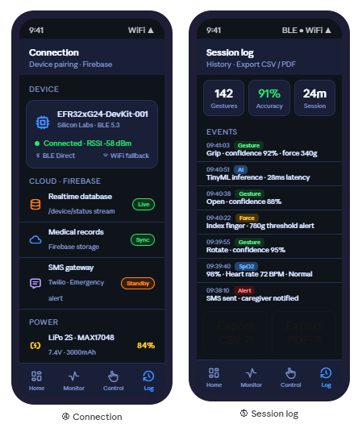
System Diagram
System Diagram
Interface:

Slide 17
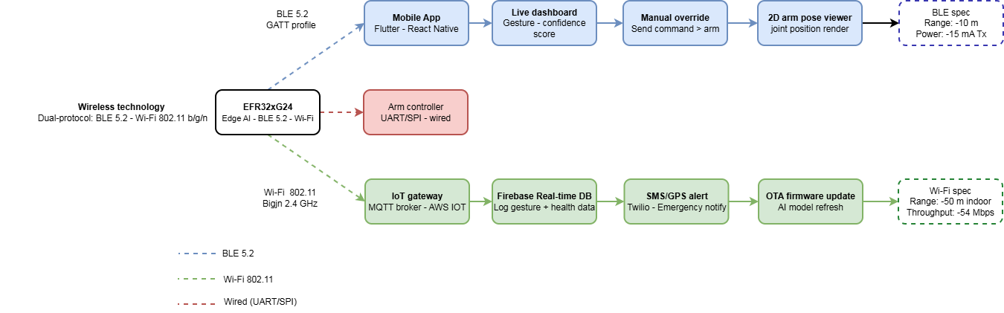
System Diagram
System Diagram
Wireless Technology:

Slide 18
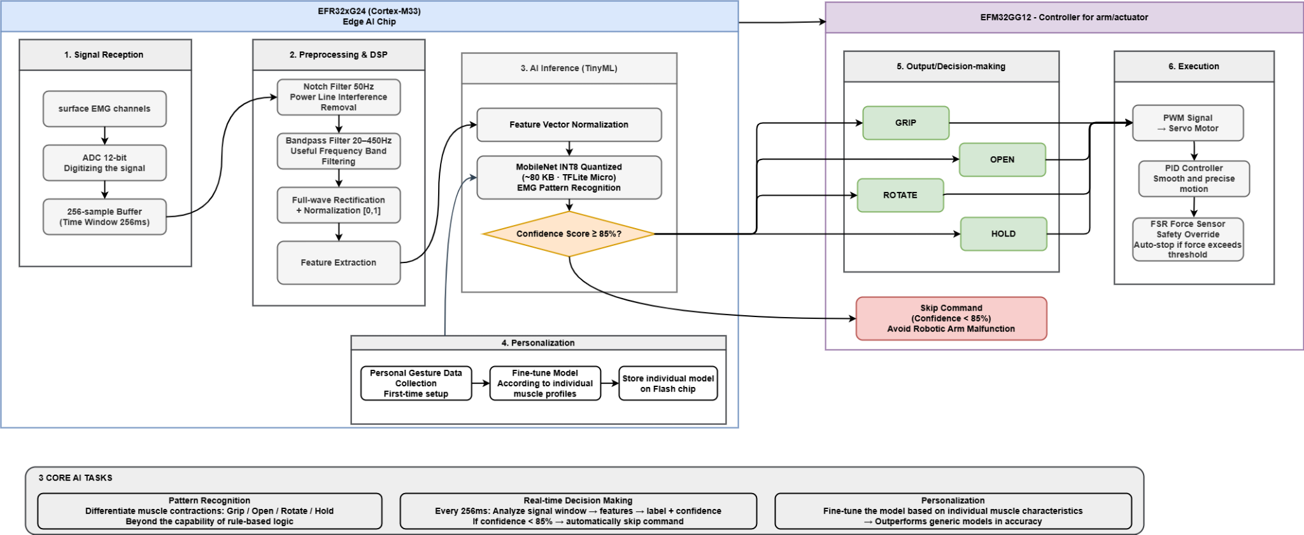
System Diagram
System Diagram
Edge AI solution:

Slide 19
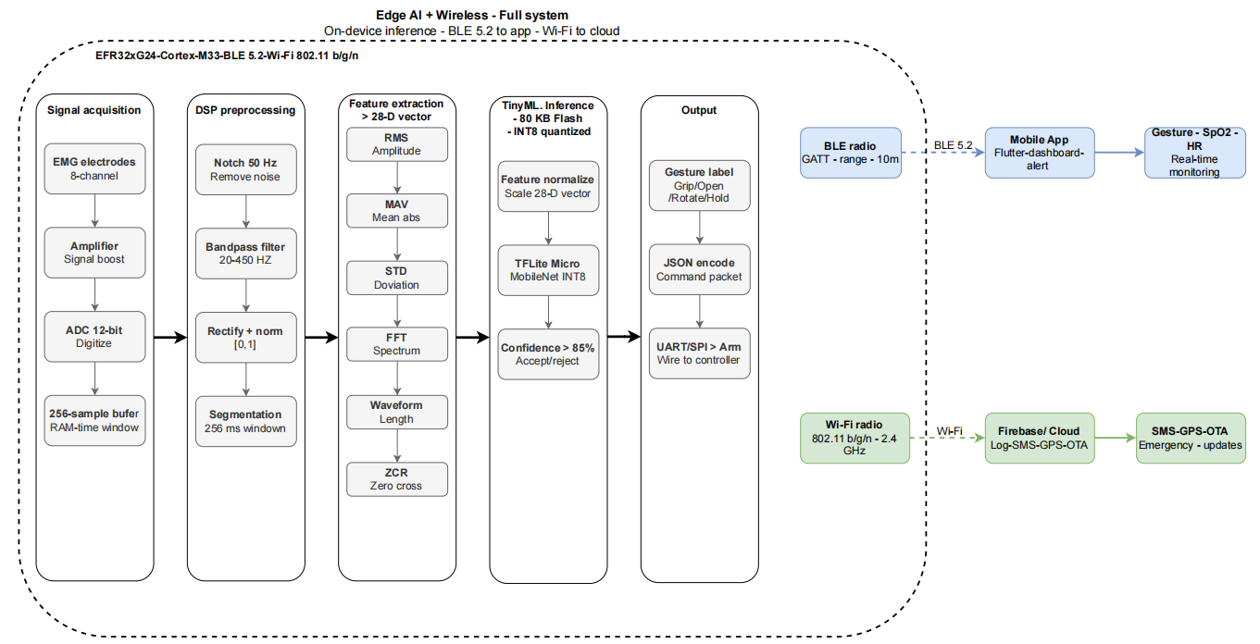
System Diagram
System Diagram
Full System:

Slide 20
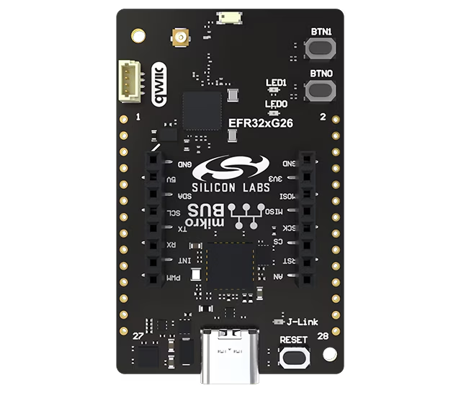
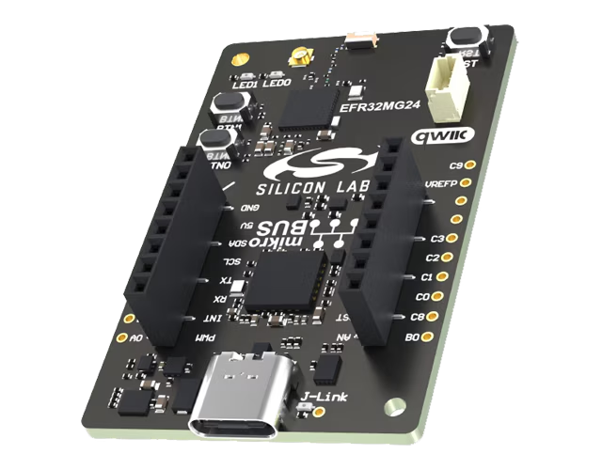
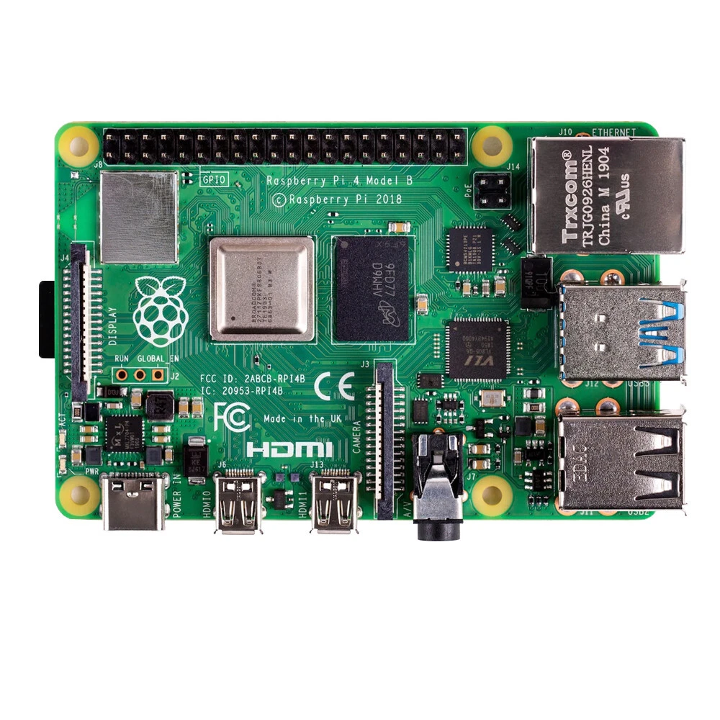
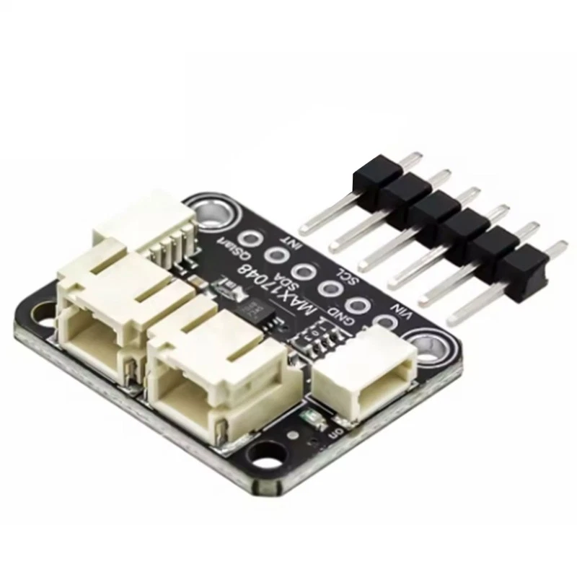
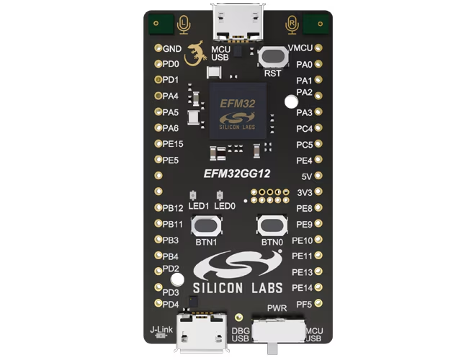
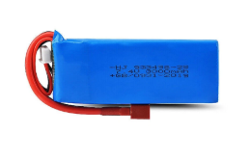
Resource Allocation
Resource Allocation
Equipment :
ERF32xG26 - Dev kit
ERF32xG24 - Explorer kit
Raspberry Pi 4
LiPo 2S
MAX17048 : I2C
EFM32GG12

Slide 21
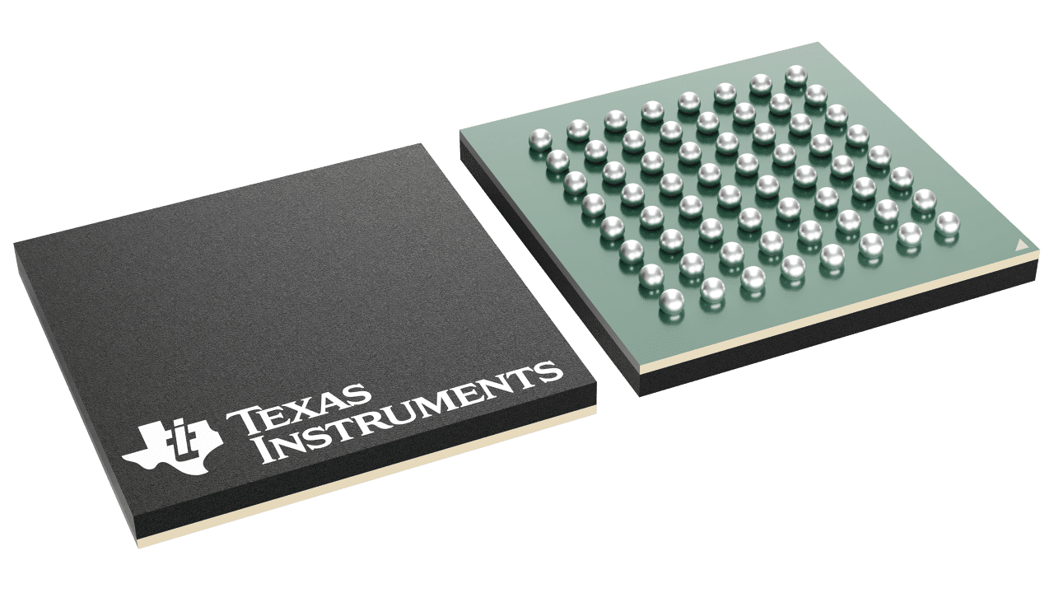
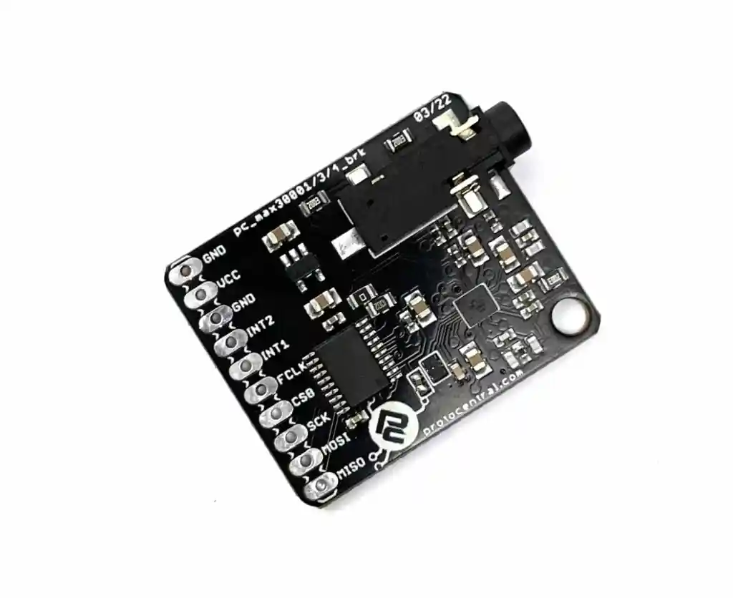
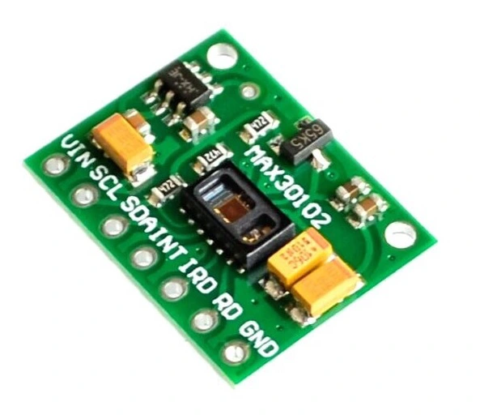
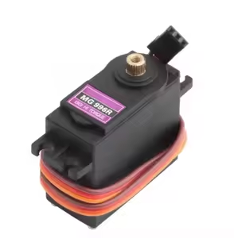
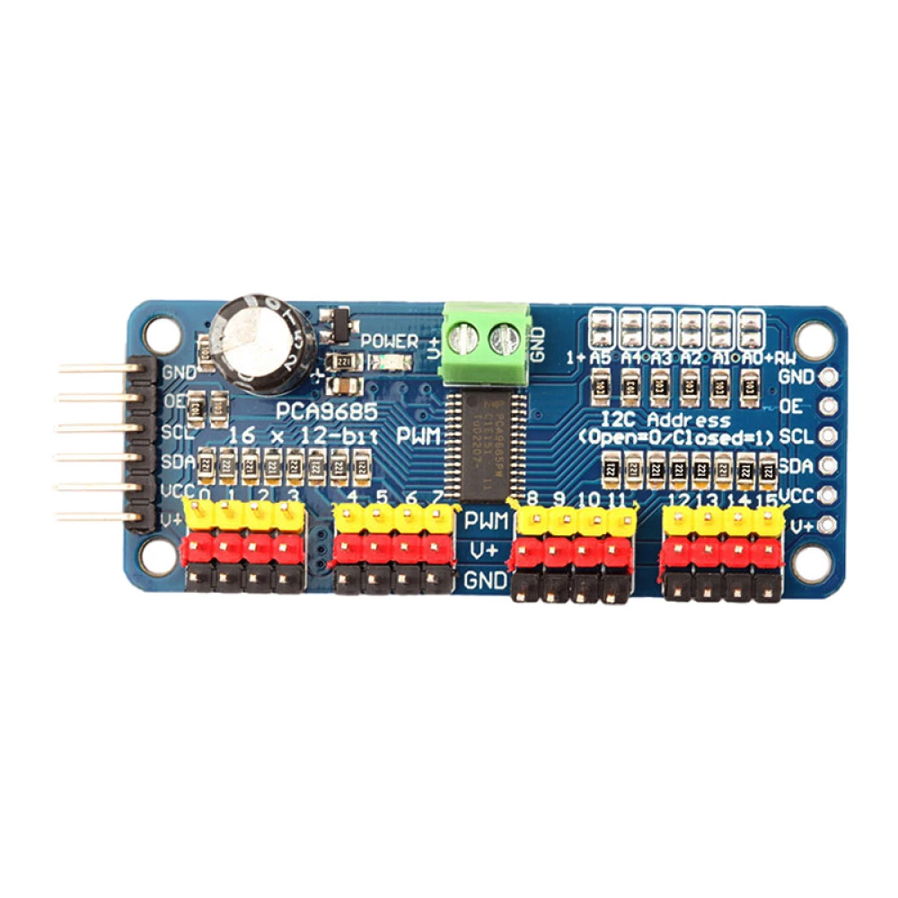
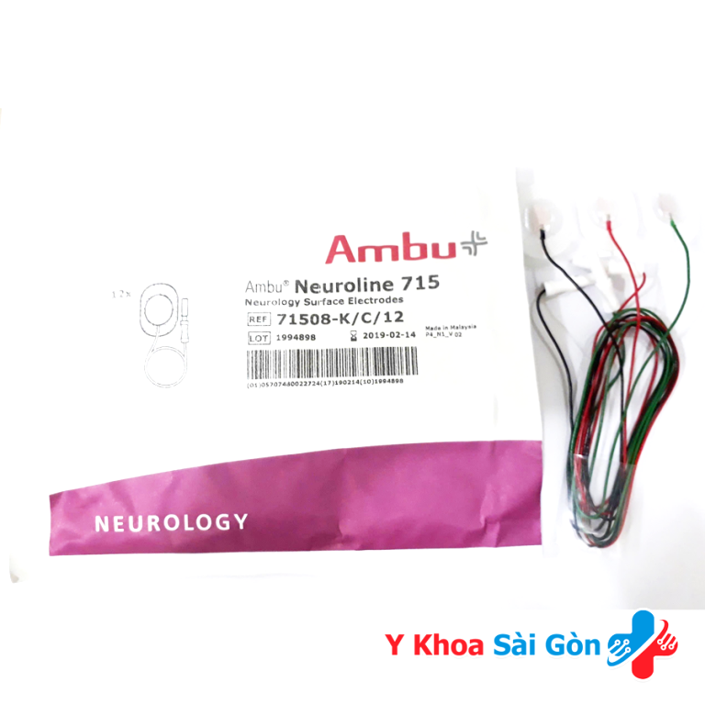
Resource Allocation
Resource Allocation
Equipment :
ADS1294 : SPI
MAX300001 : SPI
MAX30102 : I2C
Surface EMG electrodes
Servo MG996R
PCA 9685 : I2C

Slide 22
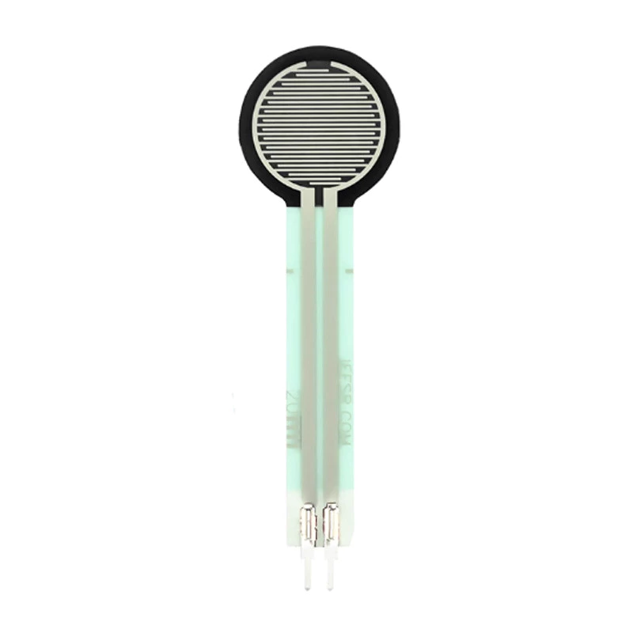
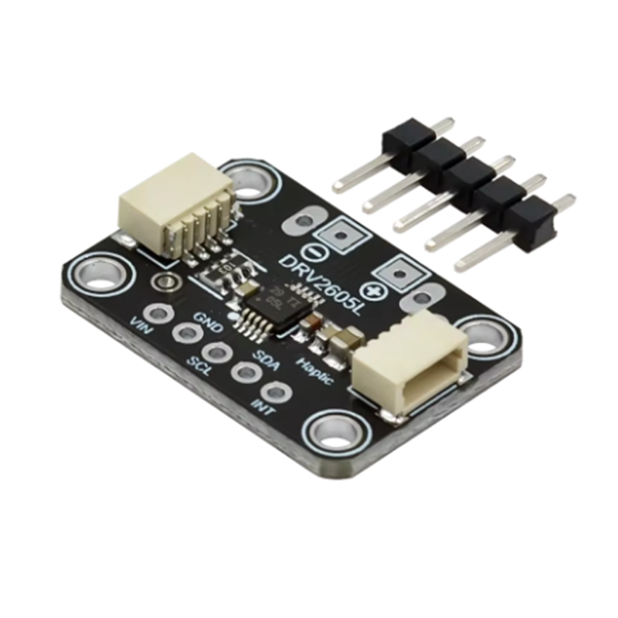
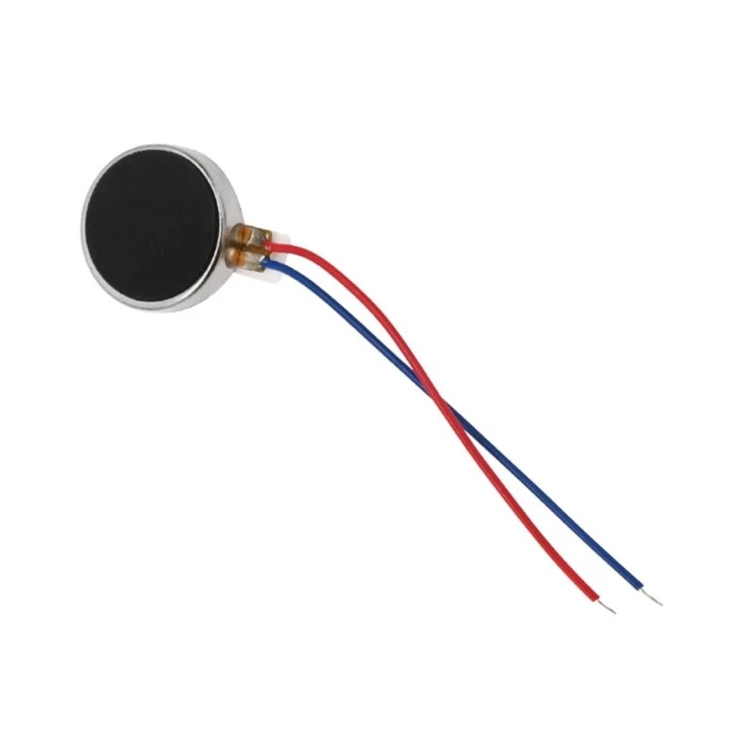
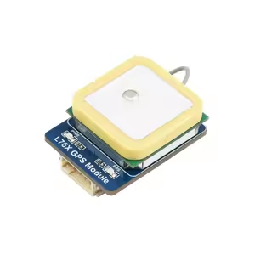
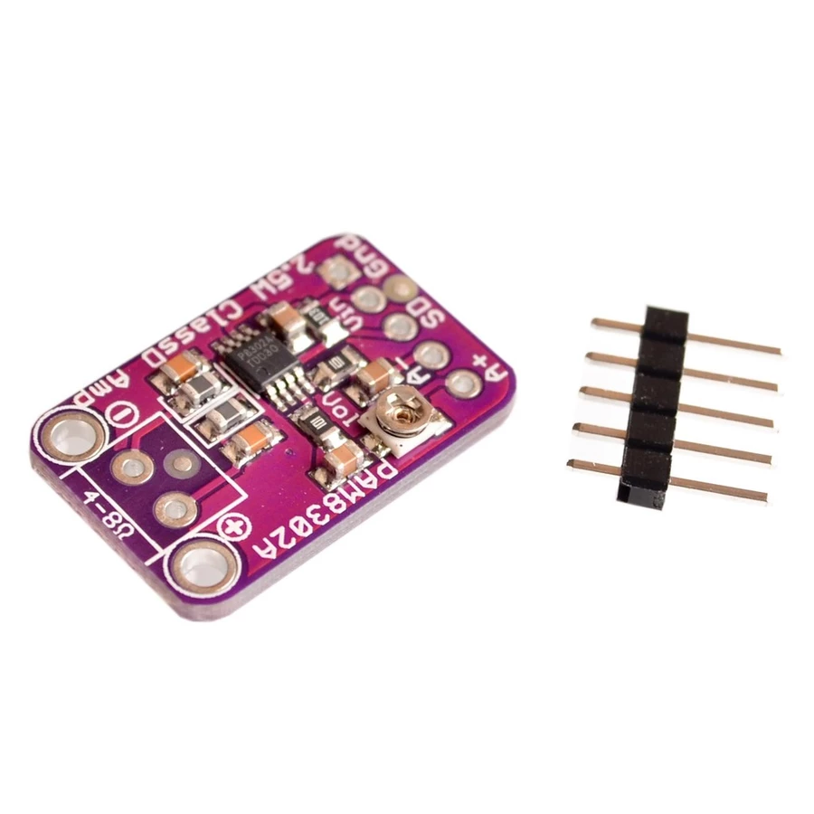
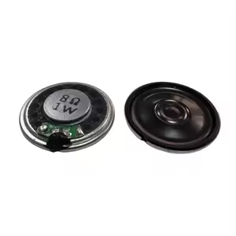
Resource Allocation
Resource Allocation
Equipment :
FSR402
DRV2065L module : I2C
LRA/ERM vibration motor
Quectel L76K : UART
PAM8302A
Speaker

Slide 23




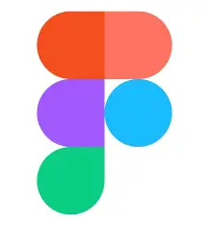
Resource Allocation
Resource Allocation
Tools:
Python
Simplicity Studio
MATLAB
GitHub
Figma

Slide 24





Resource Allocation
Resource Allocation
Tools:
Adruino IDE
VS Code
Flutter
Google scholar
Firebase

Slide 25
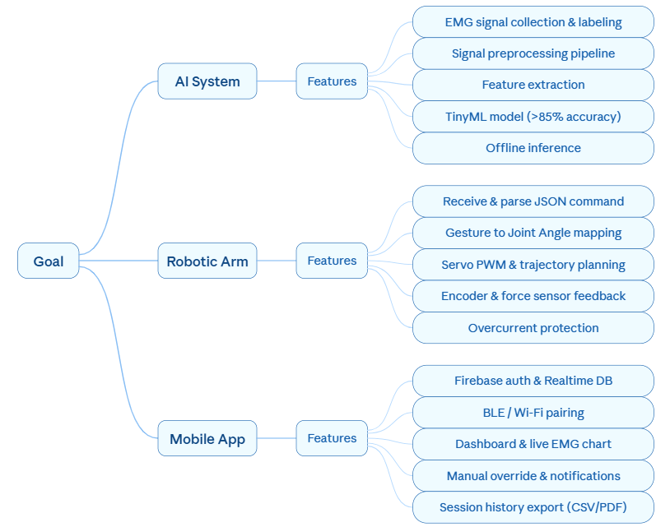
Project Milestones
Project Milestones
Goals:

Slide 26
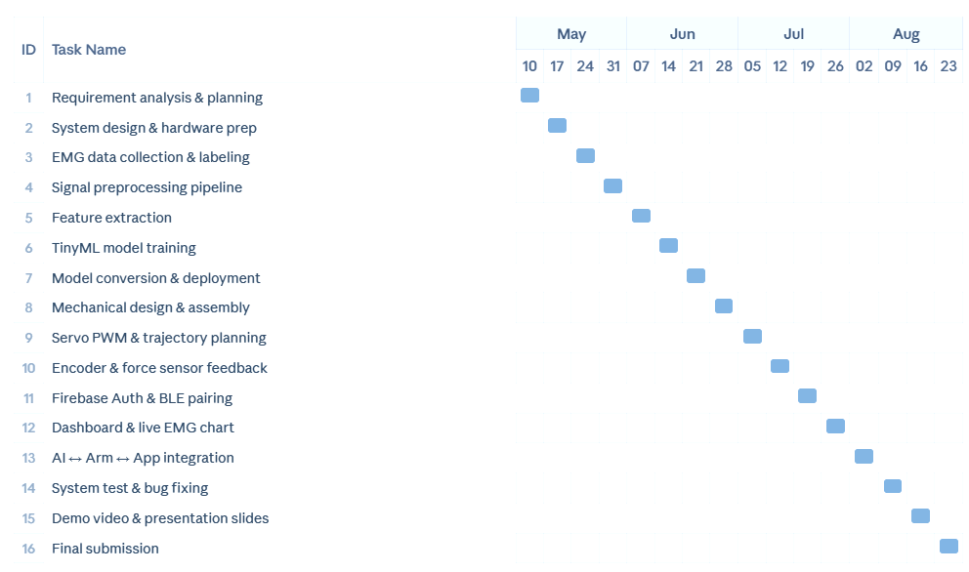
Project Milestones
Project Milestones
Timeline:

Slide 27
Resource Allocation
Resource Allocation
Human Resources :
Tran Minh Triet | Backend & System Architect
Nguyen Tan Hieu | Data Analytics
Nguyen Minh Quan | Hardware & Firmware
Hoang Ba Duy | AI Engineer
Nguyen Duc Trung Kien | Mobile App Developer

Slide 28
Risk Management
Task | Forecast Risk | Action
Requirements Analysis | •Ambiguous project scope leading to feature creep and missed deadlines. • Underestimating hardware limitations. • Misalignment between technical design and actual user/patient needs. | • Define a strict Minimum Viable Product (MVP) and freeze core requirements early. • Conduct early feasibility studies and memory profiling on the selected MCU. • Consult with domain experts or target users to validate functionality expectations.
Hardware Preparation | • Component unavailability or hardware incompatibility . • High vulnerability of micro-volt EMG signals to digital crosstalk. | • Stockpile critical spare modules early . • Implement optocouplers for analog/digital power isolation . • Utilize coaxial shielding for all sensor wiring.
Data Collection & AI | • Flawed datasets leading to poor AI accuracy . • Feature confusion due to a monolithic model architecture. • MCU memory overflow from unoptimized algorithms. | • Enforce strict data validation protocols . • Adopt a Late Fusion architecture with specialized micro-models . • Apply Int8 Quantization to drastically reduce the model footprint .

Slide 29
Risk Management
Task | Forecast Risk | Action
System Integration | • Software-hardware API mismatches . • Thermal hazards (>41°C) from sustained AI computations . • RTOS context-switching overhead causing unacceptable latency. | • Build modular, independently verifiable blocks . • Implement emergency thermal cut-offs (Failsafe mode) . • Deploy asymmetric multiprocessing on Dual-Core MCUs (dedicating Core 1 entirely to AI).
Assembly | • Mechanical instability . • Heat entrapment within the 3D-printed enclosure . • Sweat-induced electrical shorts . • Signal degradation due to high skin resistance in open-fit designs. | • Reinforce structures using advanced CAD libraries . • Integrate breathable waterproof ePTFE membranes for thermal venting . • Isolate EMG sensors using embossed Silicone O-rings .
Edge AI & Model Deployment | • Accuracy degradation across diverse muscle profiles. • Quantization-induced precision loss below 90% threshold. • Flash memory constraints on EFR32xG24 (1.5MB). | • User-specific fine-tuning during onboarding. • Validate INT8 quantized model against FP32 baseline prior to deployment. • Apply model pruning and weight compression to meet flash memory constraints.

Slide 30
Risk Management
Task | Forecast Risk | Action
Mobile App Development | • Lack of domain expertise leading to a highly unpolished, counterintuitive user interface. • Unpredictable cross-version compatibility failures across different Android devices (OS Fragmentation). • Platform limitation: Currently restricted to Android, lacking an iOS version. | • Utilize standardized UI component libraries (e.g., Material 3) to bypass design inexperience. • Implement cloud device-farm testing (e.g., Firebase Test Lab) to ensure stability across diverse Android API levels. • Adopt cross-platform frameworks (e.g., Flutter, React Native) to single-source both Android and iOS codebases.
Testing & Delivery | • Unforeseen hardware-software integration bugs during the final deployment phase. • System failure or signal degradation in real-world environments • Hardware damage or malfunction during the final pitch/demonstration. | • Enforce continuous integration and a strict "code/hardware freeze" at least 2 weeks before the deadline. • Conduct aggressive real-world field testing in diverse conditions (varying EM noise, temperatures). • Prepare a fully assembled, pre-calibrated backup prototype for the final presentation.

Slide 31
Work process
Work Process
Team Woking Methodology:
Team
Meetings
Task & Progress
Management
Source Code
Management
Daily
Communication
Document
Storage
2 times/week. Ad-hoc for issues or member suggestions.
Tool: Discord
Clear task descriptions, accurate time estimates, and daily status updates.
Git (required) and GitHub/GitLab for centralized code storage.
Zalo group chat for quick communication, document sharing & announcements.
Google Drive for centralized storage of important documents.
Combine offline (hardware) and online for planning and reviews.
Follow Agile Scrum: break milestones into tasks with deadlines.
Each task has its own branch. Clear commits & review before merging.
Quick feedback during work hours, focused on tasks.
Everyone updates and secures documents for their tasks.

Slide 32
Work process
Work Process
Work
with
Mentor
Proactive and Timely Communication
1
○ Proactively contact Mentor for technical difficulties or when needing to redefine the project direction.
○ Meetings are scheduled 1–2 times/week depending on the stage, or for important workshops.
Preparation Before Each Meeting
2
○ Prepare a list of questions, provide brief progress updates, and list current challenges.
○ Documents can be sent in advance for the Mentor to review and provide more effective support.
Focused Discussion on Core Issues
3
○ Technical solutions (especially related to the kit), hardware integration, system architecture (Cloud, API...).
○ Clarify product scope, feasible directions, and learn from the Mentor's practical experience.
Maximize Workshop Benefits
4
○ Attend all FPT – Silicon Labs workshops and take detailed notes.
○ Unclear questions will be compiled and asked to the Mentor in the next meeting.
Immediate Action and Regular Updates
5
○ After the meeting, the team discusses and applies feedback to their work.
○ Proactively update progress and provide feedback to the Mentor through agreed-upon channels (email, Zalo...).

Slide 33
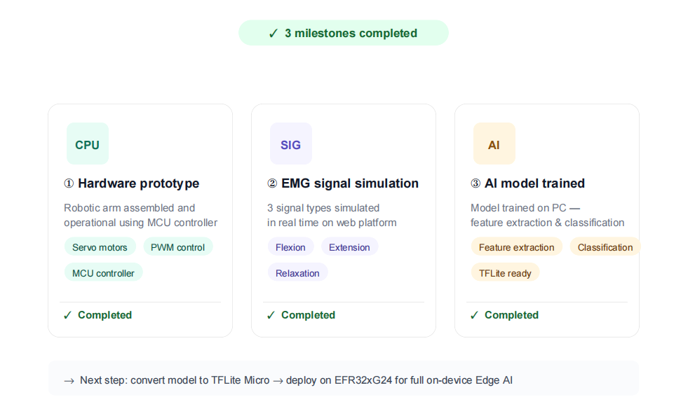
Live Demo
Live Demo
Three milestones achieved:
① hardware prototype assembled
& operational
② real-time simulation of three EMG signal types
③ AI model trained on PC with
high confidence
Note: The current demo focuses on EMG signal simulation and AI training on PC. Hardware integration with Edge AI deployment on EFR32xG24 is the next development phase

Slide 34
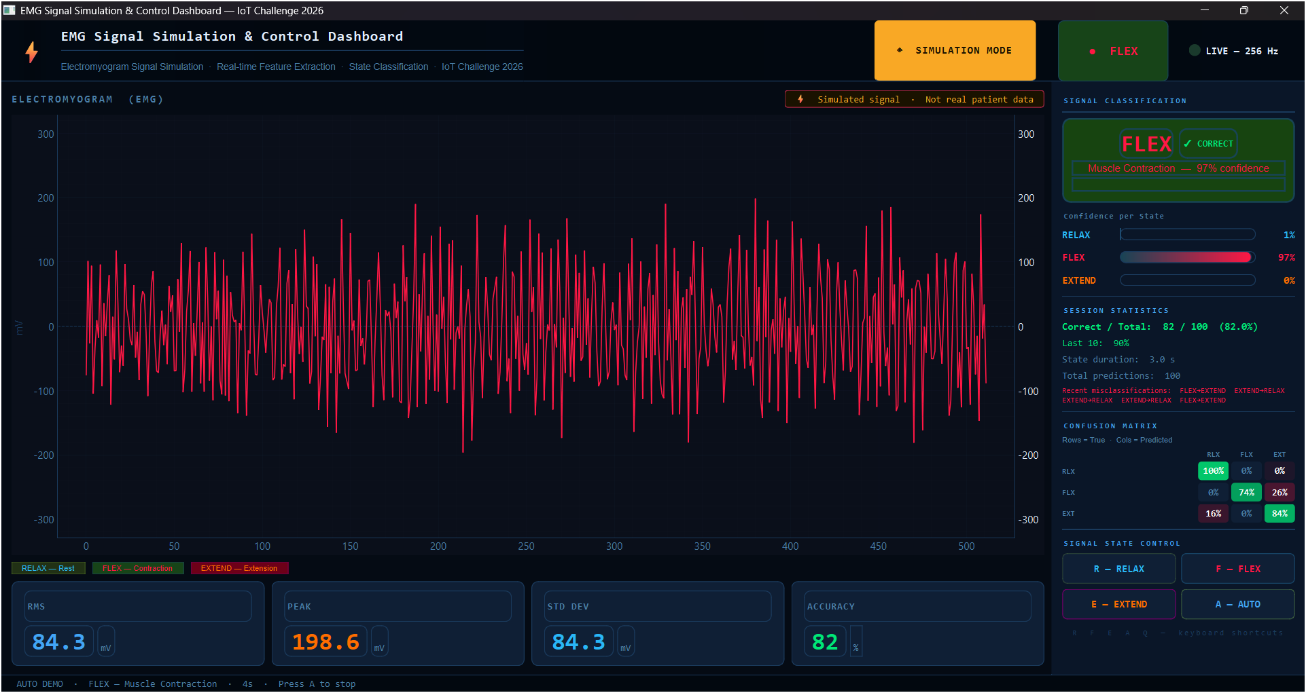
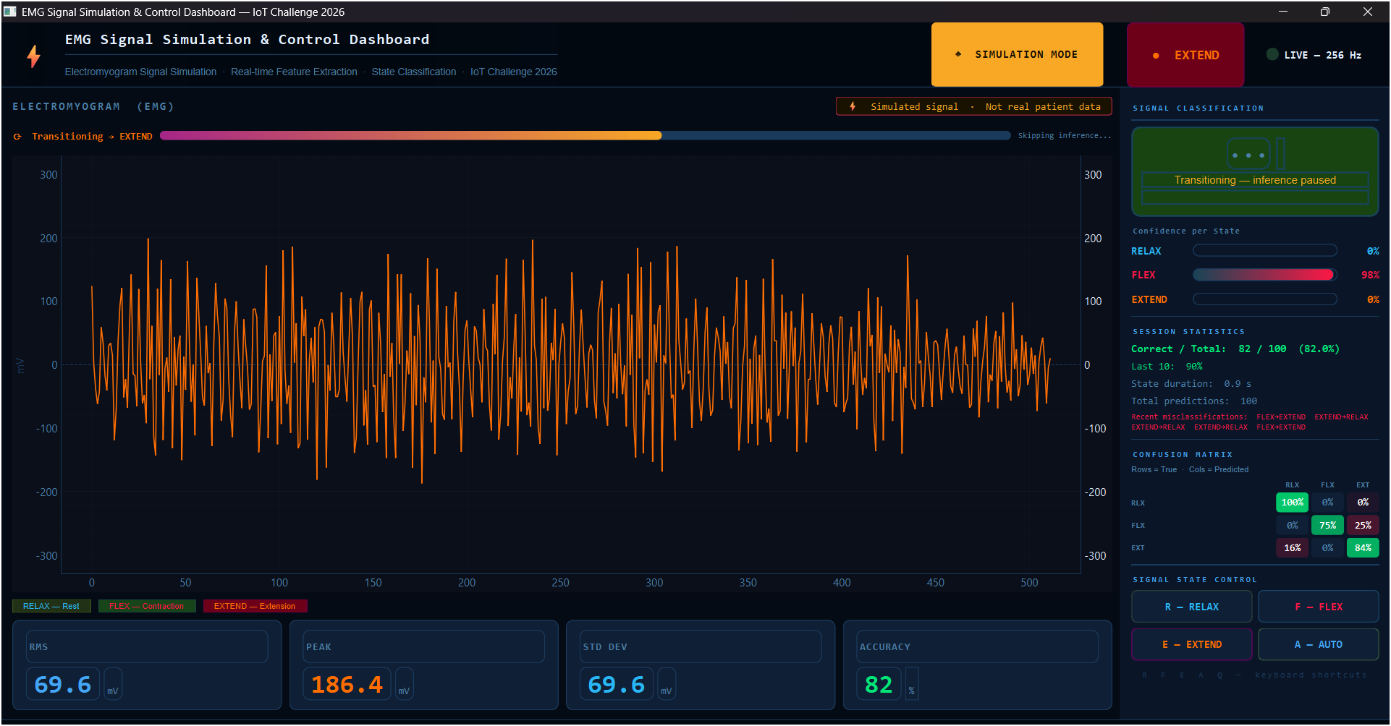
Live Demo
Live Demo
Software:

Slide 35

Live Demo
Live Demo
Software:
Source

Slide 36


Live Demo
Live Demo
Hardware:

Slide 37


