Slide 1


TOURNAMENTS MANAGEMENT
SYSTEM ANALYSIS AND DESIGN
Class: AEP2015
Lecturers: Assoc.Prof Do Phuc & Ms. Nguyen Thi Kim Phung
Group members:
Nguyen Minh Dung 15520137
Truong Hoang Bao 15520046
Tran Hoang Duc 15520128
Nguyen Tran Trong Nhan 15520569

Slide 2

TABLE OF CONTENT
I.Description
II.Task
III.UML Class diagram
IV.ERD
V.UML Usecase diagram
VI. Sequence diagram
VII. Start demo

Slide 3
I.Description:
Manage professional tournaments about sports.
Sign in or sign up a new tournament management.
Choose some optionals about its ID, name and quantity of participant teams.
Create rounds, branches among teams, update match results, display points and the team winning the tournament.
Make tournament reports and schedule matches.
Using Winform on Microsoft Visual Studio 2015.
Database: Microsoft SQL 2014 Framework: .Net v4.5.2

Slide 4
II. Task:
Activity | Progress | Members in charge
Specify and look for information on how to create a match | 100% | Duc And Dung
Sketch and design diagrams (Class, use case, sequence) | 100% | Dung and Nhan
Implement functions in C++ and Design database with SQL server | 100% | Bao, Nhan and Duc
Design GUI in C# and Implement functions in C#(continue) | 100% | All members
Validate and Fix project | 100% | Bao and Duc
Writing report | 100% | Bao,Nhan and Dung

Slide 5
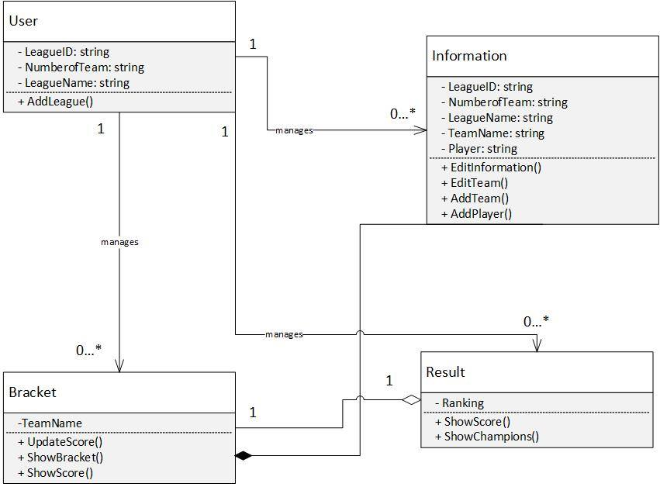
III. Class diagram:

Slide 6
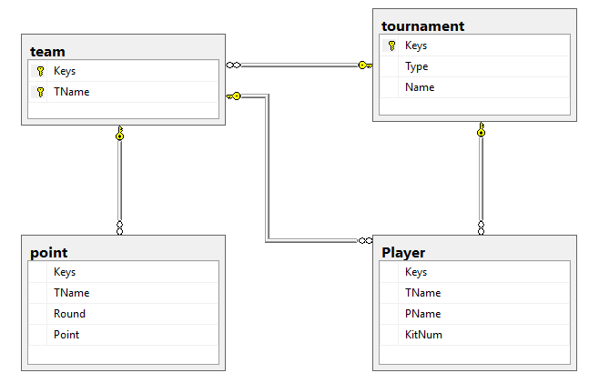
IV. ERD:

Slide 7
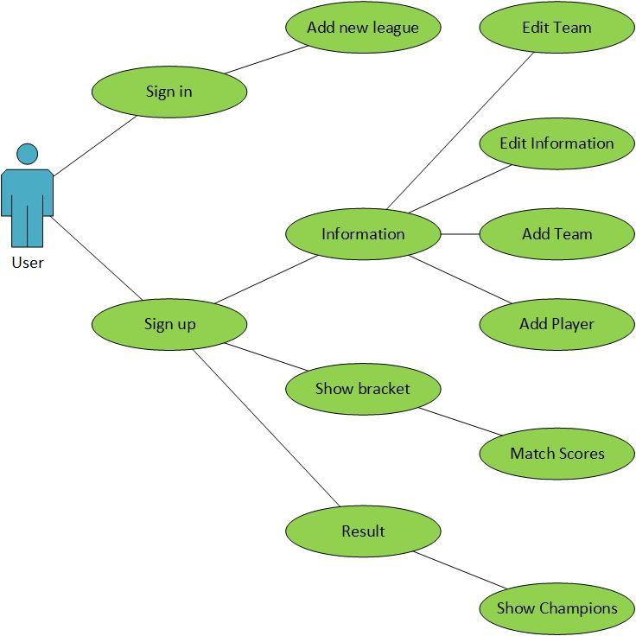
V. Usecase diagram:

Slide 8
VI. Sequence diagram:

Slide 9

VII.Start demo:

Slide 10
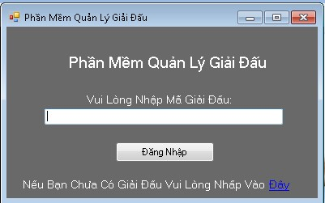

Slide 11
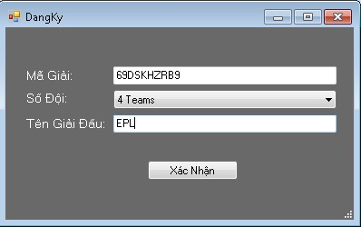

Slide 12
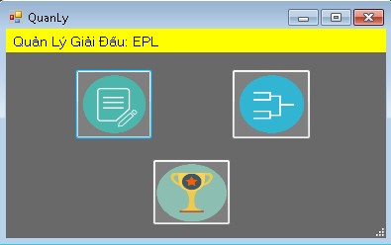

Slide 13
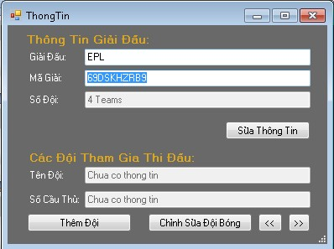

Slide 14
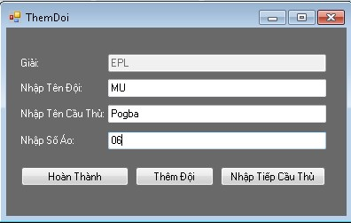

Slide 15
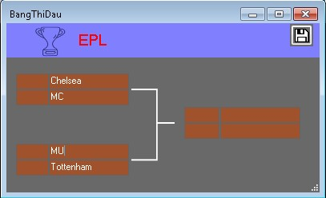

Slide 16
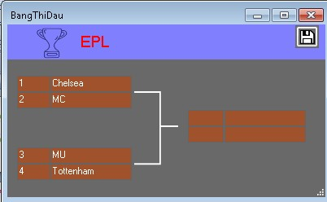

Slide 17
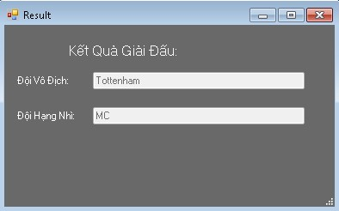

Slide 18
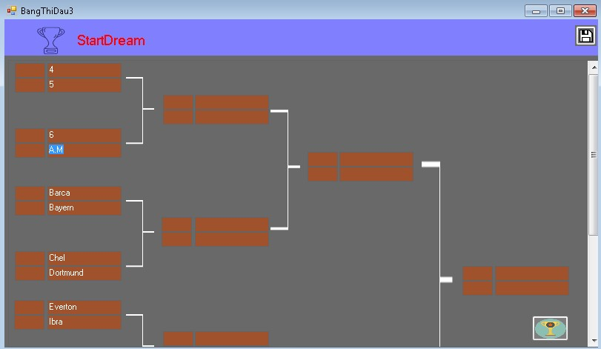

Slide 19


