Slide 1
Test
Notes:
Hello, this is a test powerpoint slide

Slide 2
Slide 1
Absolutely nothing.
Notes:
This is slide number 1, it contains absolutely nothing.

Slide 3
Slide 2
Something
Notes:
This is slide number 2, it’s not much but it at least contains something.

Slide 4
Just kidding
Powerpoint to video! With AI!
Notes:
Just kidding, I hope you found that funny! I would like to introduce a tool that I created that can generate video from powerpoint, using AI text to speech.

Slide 5
https://github.com/hoangbv15/local_ai_ppt_presenter
Python 3.11
Python-pptx https://python-pptx.readthedocs.io/en/latest/index.html
Pdf2image https://pypi.org/project/pdf2image/
CoquiAI xtts2 https://github.com/coqui-ai/TTS
FFMPEG brew install ffmpeg
Poppler brew install poppler
Notes:
it was written in Python.
It uses python P P T X to parse powerpoint files and retrieve speaker notes.
PDF to image to generate images from the PDF exported from the powerpoint slide. Note that this requires the package poppler to be installed via homebrew.
It uses coqui A I X T T S 2 to generate speech.
And finally, F F M Peg to stitch everything together into a video.

Slide 6
How to use it
Step 1 (Optional):
install conda
conda create -n ppt python=3.11
conda activate ppt
Step 2: pip install -r requirements.txt
Step 3: Export your powerpoint slide to pdf, download both
Step 4: Setup voice cloning
Step 5: python main.py --pptx Test.pptx --pdf Test.pdf -o final.mp4
Notes:
Here are the steps on how to use it.
The first step is optional, but I heavily recommend it. Conda is a must have tool when developing in Python. It compartmentalised packages into isolated environments, so your main python environment won’t be polluted.
Step 2 is running pip install, and step 3 is to manually export your powerpoint to P D F. This is needed because the tool cannot convert the powerpoint slide directly to images. There is a way to do it automatically, but you would need libre office installed which I think is overkill. After all, you are already manually creating the powerpoint slide, this is just 1 more manual step.
The next step is to setup the AI voice. I will come back to this in the next slide.
Finally, you use both the powerpoint file and the PDF as inputs of the tool. The output will be a video, with the voice that you set up in the last step.

Slide 7
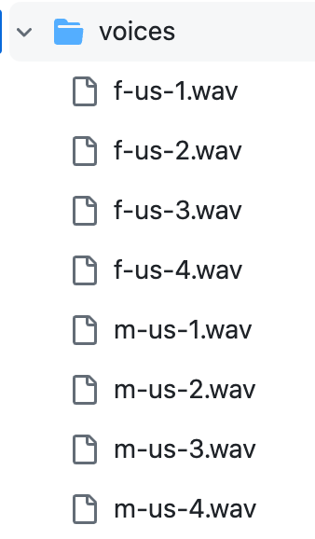
Voice cloning
This is cool! CoquiAI XTTS2!! Totally offline!!!
In the voices folder
Record your own voice and put in here!
Modify line 16 of ttsgenxtts2engine.py
Notes:
Now, let’s get to the best part, voice cloning.
What you are hearing right now is the output of this AI voice cloning.
As I described before, this is using Coqui AI X T T S 2, which is a well known text to speech AI model. And it runs on your computer, no data is sent to Open AI, it’s totally offline.
In the voices folder, there are some sample voices. These are just wave files from 10 to 30 seconds long of someone reading something.
That’s all the AI needs to generate speech!
You can record your own voice reading something for 10 20 seconds, swap your voice file in the python script, and voila!

Slide 8
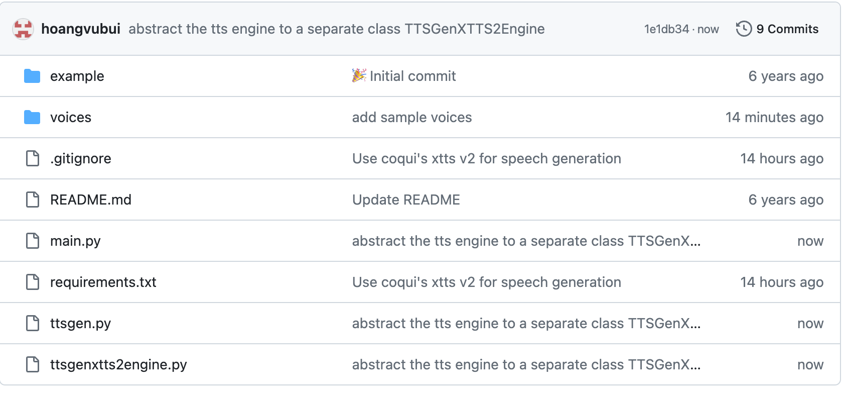
https://github.com/hoangbv15/local_ai_ppt_presenter
Notes:
The code is up on github, you can clone it down and have a play with it.

Slide 9
Thank you!
Notes:
Thank you for listening!

