Slide 1
Linear Regression
Hoang Cao Bao

Slide 2

I. Introduction
Linear Regression is the most straightforward regression algorithm to predict the output of the set of features in which each feature is linearly dependent on the output.
Example:
Predict the price of the house with size x₁ m², has x₂ rooms, and is x₃ m far from the center of the city.
Each features is linearly dependent on the price because price is high when the house is large, has a lot of room, and near the center of the city.
Then we can predict the price of the house based on this formula:
w₁, w₂, w₃, and w₀ are weights we have to find in linear regression problem.

Slide 3
II. Formula
In general, with d features we have features vector x = [1, x₁, x₂, x₃, …, x_{d}] and weights vector w = [w₀, w₁, w₂, w₃, …, w_{d}]. Vector x and w ∈ R^{d+1}.
The formula of linear regression:
f(x) = x^{T}w

Slide 4

III. Prediction Error
Our goal is to find vector w such that the predicted outcome f(x) is near to real output as much as possible.
We have to define the prediction error formula:
With y is the actual output and f(x) is the predicted value.
f(x) can be larger or smaller than y then we take the square of y - f(x) to ensure that the error formula is always positive.
Coefficient ½ is used for eliminating square when we take the derivative of error function.

Slide 5
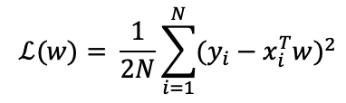

IV. Loss function
With N input and output (x_{i}, y_{i}), i = 1, 2, …, N, loss function is average of prediction error function of these N data.
Finding good weights vector means that loss function is lowest:
We can simplify this function by using matrix instead of N vectors:
X=[x₁, x₂, x₃, …, x_{N}] and y=[y₁, y₂, y₃, …, y_{N}]^{T}
||A||₂ is 2-norm of A.

Slide 6

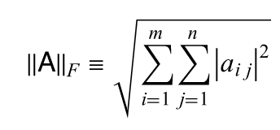
V. Norm
Norm can be easily known as the function from vector space to calculate the distance from the origin to a vector.
The formula for p-norm of a vector x ∈ R^{n} :
The most popular norm is 2-norm or also known as Euclidean norm.
We also consider Frobenius norm for a mxn matrix A:

Slide 7
VI. Weights
To find the best linear regression model, we have to find weights such that the loss function on the data is the smallest.
As we learn in Cal 1, a function is smallest at the point that its derivative equals 0.
Similarly, we have to find vector w such that the gradient of loss function equals 0.
Gradient can be simply known as derivative of a matrix.

Slide 8
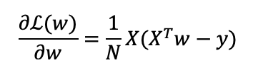

VI. Weights
Gradient of loss function:
Gradient equal 0 when:
Therefore, w = (XX^{T})⁻¹Xy is the unique solution.
However, XX^{T} may be not invertible. Then we will have w = (XX^{T})†XY with † is dagger and A† is pseudo inverse of A.
w = (XX^{T})†XY is the unique solution has smallest 2-norm that minimizes Frobenius norm of X^{T}w-y.
Can be easily understand that w = (XX^{T})†XY to make XX^{T}w near Xy as possible.

Slide 9
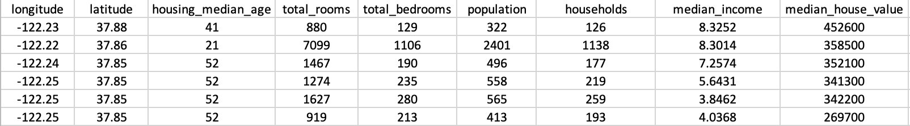
VII. California Housing Dataset
We will apply Linear Regression on California Housing Dataset which can be found at Kaggle.
This dataset has 20000 data with 8 features which are linearly dependent on the median house value.

Slide 10
VII. California Housing Dataset
Features include:
longitude: A measure of how far west a house is; a higher value is farther west
latitude: A measure of how far north a house is; a higher value is farther north
housingMedianAge: Median age of a house within a block; a lower number is a newer building
totalRooms: Total number of rooms within a block
totalBedrooms: Total number of bedrooms within a block
population: Total number of people residing within a block
households: Total number of households, a group of people residing within a home unit, for a block
medianIncome: Median income for households within a block of houses (measured in tens of thousands of US Dollars)

Slide 11
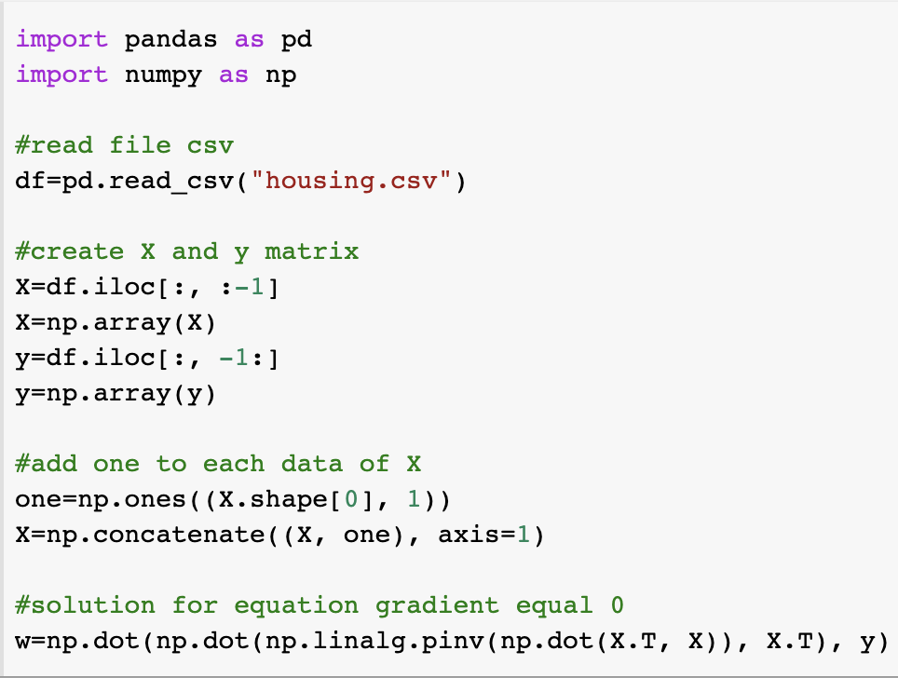
VIII. Python
I use many supportive libraries from Python to find weights for our Linear Regression problem.

Slide 12
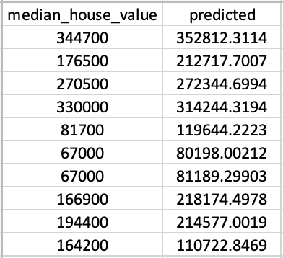
IX. Result
Here is the weights after I run my Python script above:
w = [-3.62060092e+06, -4.31396376e+04, -4.29256734e+04, 1.15069493e+03, -8.37825115e+00, 1.17648543e+02, -3.84887721e+01, 4.54360018e+01, 4.05070683e+04]
Apply weights to predict 10 random data:

Slide 13
X. Comments
The outcome from linear regression algorithm is not really good because it is the simplest regression algorithm.
However, linear regression is easy to learn and implement to produce results in many tasks effectively.
Linear regression is fundamental algorithm to help us know about loss function and gradient.

Slide 14
XI. Code
You can find my code applying linear regression on California Housing Dataset at my github account.

Slide 15
Thank you for listening

