Slide 1


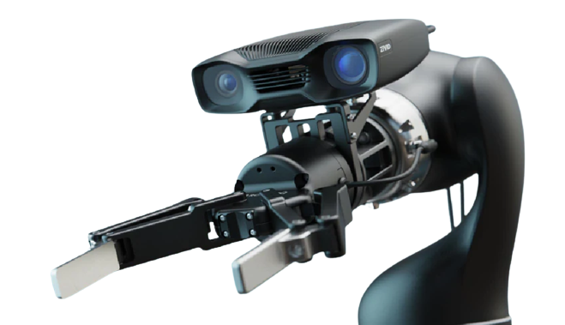
Progress Report
Collision-free grasp detection from color and depth images
Grasp generation with depth estimation from color images
Text-guided RGBD grasp generation
Efficient multimodal fusion for hand pose estimation with hourglass network
A unified framework for depth-assisted monocular object pose estimation
Hand pose estimation from color and depth images
Presenter: Hoàng Đình Cường Email: cuonghd12@.fe.edu.vn Web: hoangcuongbk80.github.io
07/26/2024

Slide 2

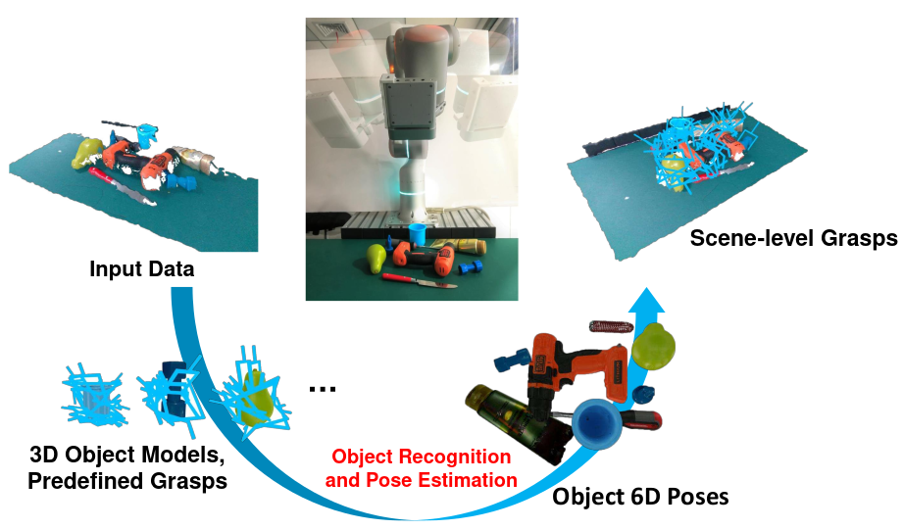
RELATED WORK
Fang, Hao-Shu, et al. "Graspnet-1billion: A large-scale benchmark for general object grasping." Proceedings of the IEEE/CVF conference on computer vision and pattern recognition. 2020.

Slide 3
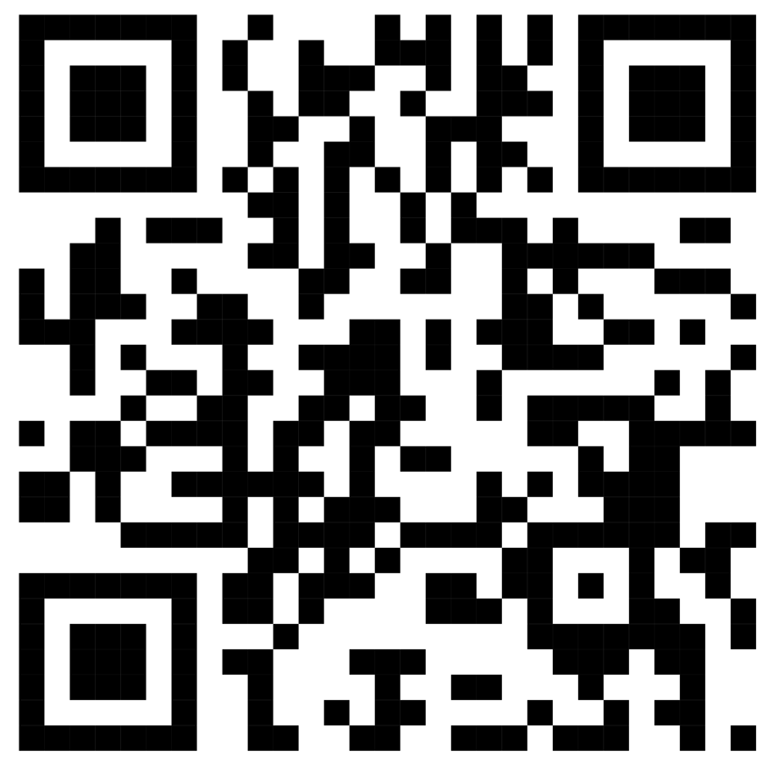
Thank you for your attention!

