Slide 1
DAY 01
C# BASIC

Slide 2
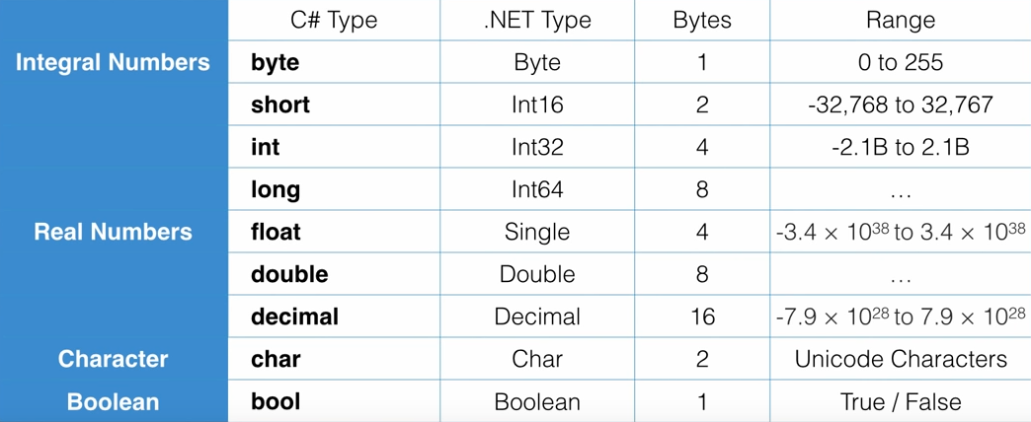
Variables and Constants

Slide 3
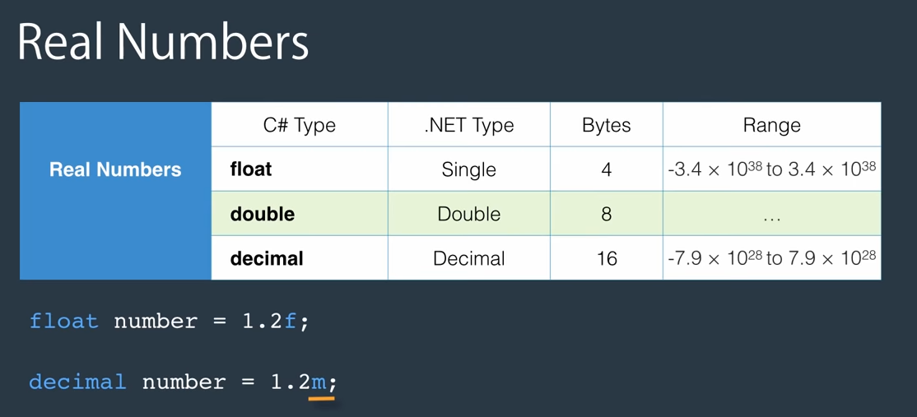
TYPES

Slide 4
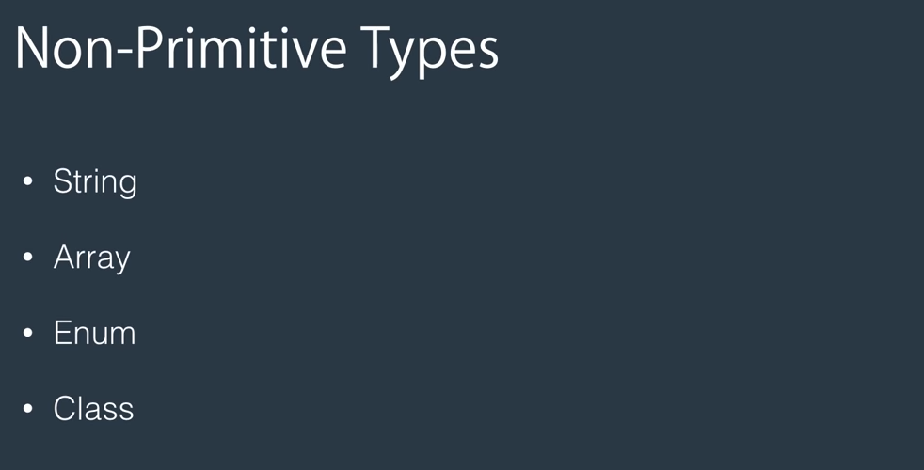
TYPES

Slide 5
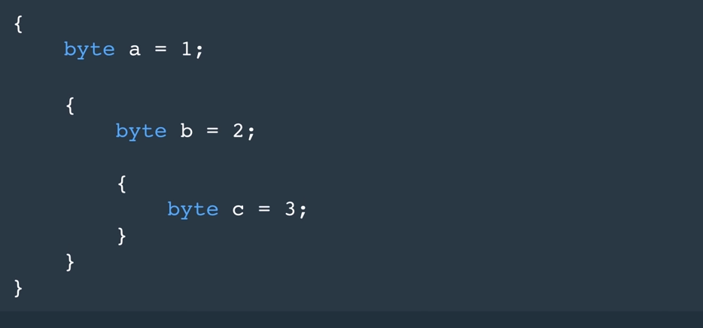
SCOPE

Slide 6
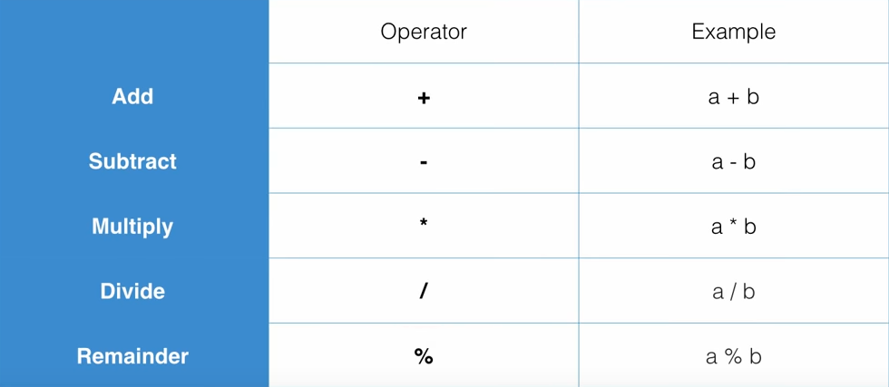
ARITHEMIC Operators

Slide 7
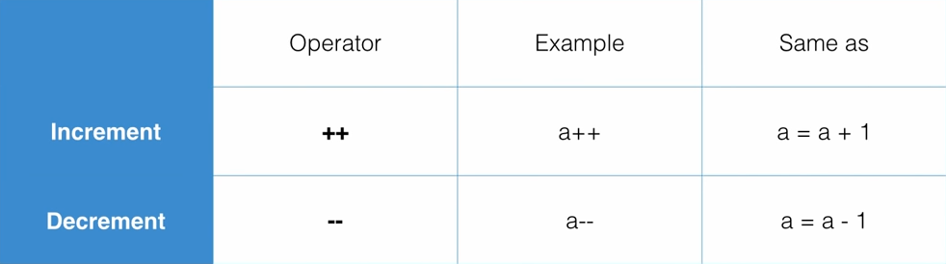
ARITHEMIC Operators

Slide 8
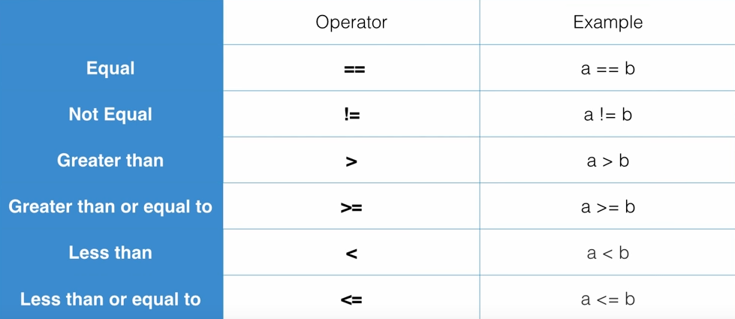
COMPARISON OPERATORS

Slide 9
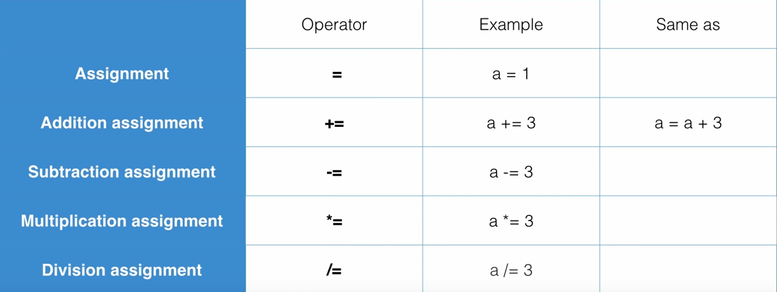
ASSIGNMENT OPERATORS

Slide 10
DECISION MAKING
If-else
Switch-case

Slide 11
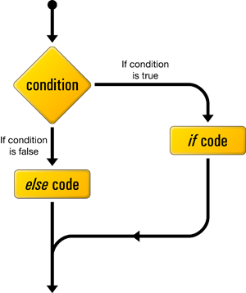
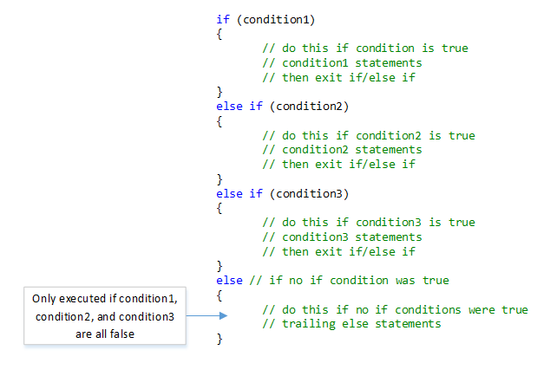
IF Condition

Slide 12
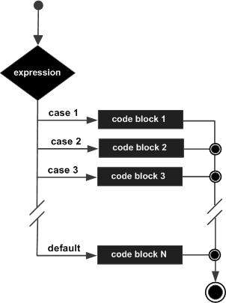
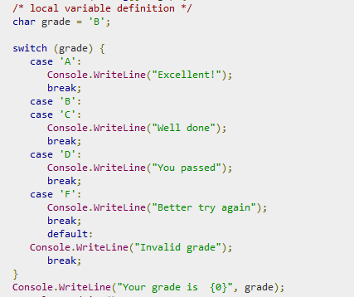
SWITCH - CASE

Slide 13
LOOPS
for
while
do-while

Slide 14

LOOP

Slide 15
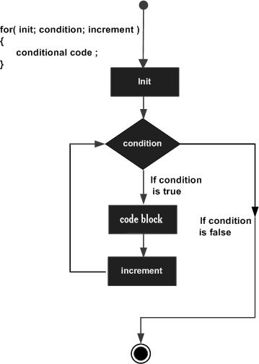
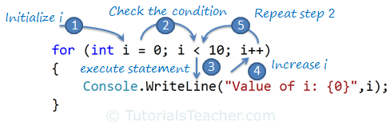
FOR LOOP

Slide 16
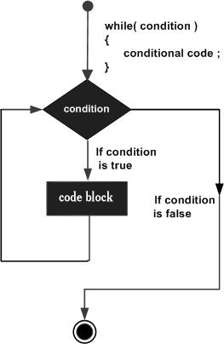
WHILE LOOP

Slide 17
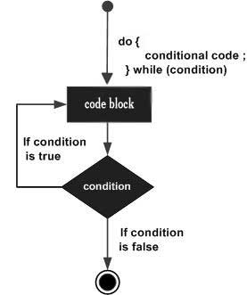
DO - WHILE

Slide 18
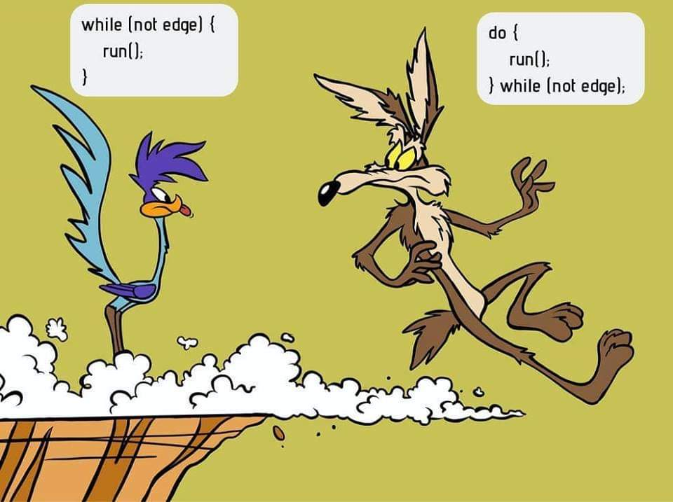
WHILE vs Do-while

