Slide 1
User Trustworthy Score

Slide 2
Outline
Problem definition
Metric / evaluation
Data
Model
Performance tracking

Slide 3



Problem definition
 | Kaggle competition | Real product
Given a list of users, we need to rank those users so that users with lower ranking are more likely to default
The ranking will be represented as score for better UX

Slide 4
Label
Kaggle competition | Real product
All label are provided => only use provided label to train model. | The development process is divided into 2 stages: Stage 1 - No data stage: Use approximate label to train model Use extra rule-based strategies to run the product Plan for label collecting Stage 2 - Data-collected stage: use the collected label (real label) to train model

Slide 5
Stage 1
1a: split data into train/dev (no test) using other Risk's label (promo abuse, fake account, fraud, …)
=> Win backtest (GINI 0.3x when backtest with partner banks)
1b: use all data in 1a for training, dev on collected label after the first month
=> Help the product successfully run in the first stage (NPL reduced 3 times)

Slide 6
Stage 2
Use the collected data after half a year to train/dev/test model
=> Reduced NPL and help business reach target
Handle stability and robustness problems

Slide 7
Metric/Evaluation
 | Kaggle competition | Real product
Metric | Defined by host: (Stable GINI - Home Credit 2024, other competitions: GINI) | Defined by team: GINI
Evaluation | Cross Validation (Group K-folds, Stratified K-folds,…) | Holdout (by time) dev/test dataset
 | Data timeline
 | T1 | T2 | T3 | T4 | T5 | T6 | T7 | T8 | T9 | T10 | T11 | T12 | T13
v1.0 | TRAIN |  |  | DEV
v1.5 | TRAIN |  |  | DEV
v2.0 | TRAIN |  |  |  |  | DEV |  | TEST
v3.0 | TRAIN |  |  |  |  |  | DEV |  | TEST
v3.1 | TRAIN |  |  |  |  |  |  |  | DEV |  | TEST
 | Data timeline
 | T1 | T2 | T3 | T4 | T5 | T6 | T7 | T8 | T9 | T10 | T11 | T12 | T13
v1.0 | TRAIN |  |  | DEV
v1.5 | TRAIN |  |  | DEV
v2.0 | TRAIN |  |  |  |  | DEV |  | TEST
v3.0 | TRAIN |  |  |  |  |  | DEV |  | TEST
v3.1 | TRAIN |  |  |  |  |  |  |  | DEV |  | TEST
 | Data timeline
 | T1 | T2 | T3 | T4 | T5 | T6 | T7 | T8 | T9 | T10 | T11 | T12 | T13
v1.0 | TRAIN |  |  | DEV
v1.5 | TRAIN |  |  | DEV
v2.0 | TRAIN |  |  |  |  | DEV |  | TEST
v3.0 | TRAIN |  |  |  |  |  | DEV |  | TEST
v3.1 | TRAIN |  |  |  |  |  |  |  | DEV |  | TEST

Slide 8
Evaluation
Most important factor
Choose dev and test sets to reflect data you expect to get in the future and want to do well on
Carefully remove leakage information in dev and test sets:
Example: users in test should not exist in train/dev

Slide 9



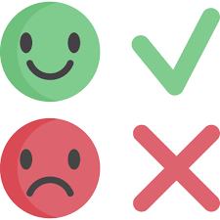
Data
Features
Labels

Slide 10




Data - Features
Transaction history on ZaloPay in last 3 months
Aggregated monthly
Transaction
Device fingerprint (DFP) of users
Use embedding algorithm to convert raw DFP into 32-dimension embedding features
Metadata: number of device, number of malicious device, ...
Device
Information on ID card
KYC

Slide 11
Data - Label
First stage (no data): use risk labels (Fake Account, Promo Abuse, etc.)
From 2nd stage until now: use bnpl label
28th of month M-1
27th of month M
28th of month M
4th of month M+1
4th of month M+2
4th of month M+3
4th of month M+4
4th of month M+5
Label logic:
have success bnpl trans
DPD30 @ MOB2
DPD30
@ MOB4
due date of statement month M
DPD30
@ MOB1
DPD30
@ MOB3
have statement of month M
Score v1.5
Score v2
Score v3.1
Score v3

Slide 12
Model
Catboost
Parameters are optimized by Optuna
Sample weight to balance the fluctuation of number of sample per month
NN
Used on the first version to improve the performance at that time (ensemble with Catboost)
Removed later for maintenance and explained more easier
Adversarial model (written by TuHM2)
Used to detect data drift
https://pypi.org/project/adversarial-test/

Slide 13
Adversarial model for feature selection
In practice, data always change over time, which leads to performance reduction
-> Need an effective way to detect changes
Adversarial test can detect and identify changes in both feature and label
Removing shifted features makes model more robust, however the performance can be reduced
If the shifted features are so important, apply feature engineering steps like binning will help

Slide 14
Adversarial test
User | Feature | Label | Label adversarial
A | … | 0 | 0
B | … | 1 | 0
C | ... | 2 | 0
D | … | 0 | 0
E | … | 1 | 1
F | … | 2 | 1
G | … | 0 | 1
H | … | 1 | 1
Use to quantify the difference between dev and test sets
Steps:
Merge the dev and test sets; label data in dev set as 0, test set as 1 (table 1)
Split 80/20 for adversarial_train/adversarial_test (table 2)
Build a classifier on adversarial_train
Calculate the ROC-AUC score on adversarial_test
If ROC-AUC close to 0.5: no shifted distribution between dev and test sets
If ROC-AUC over 0.7: there is a shift in distribution between dev and test sets
Remove feature with high feature importance to reduce the shift
Dev set
Test set
Random split 80-20
User | Feature | Label adversarial
A | … | 0
B | … | 0
C | … | 0
E | … | 1
F | … | 1
G | … | 1
D | … | 0
H | … | 1
Adversarial train
Adversarial test

Slide 15
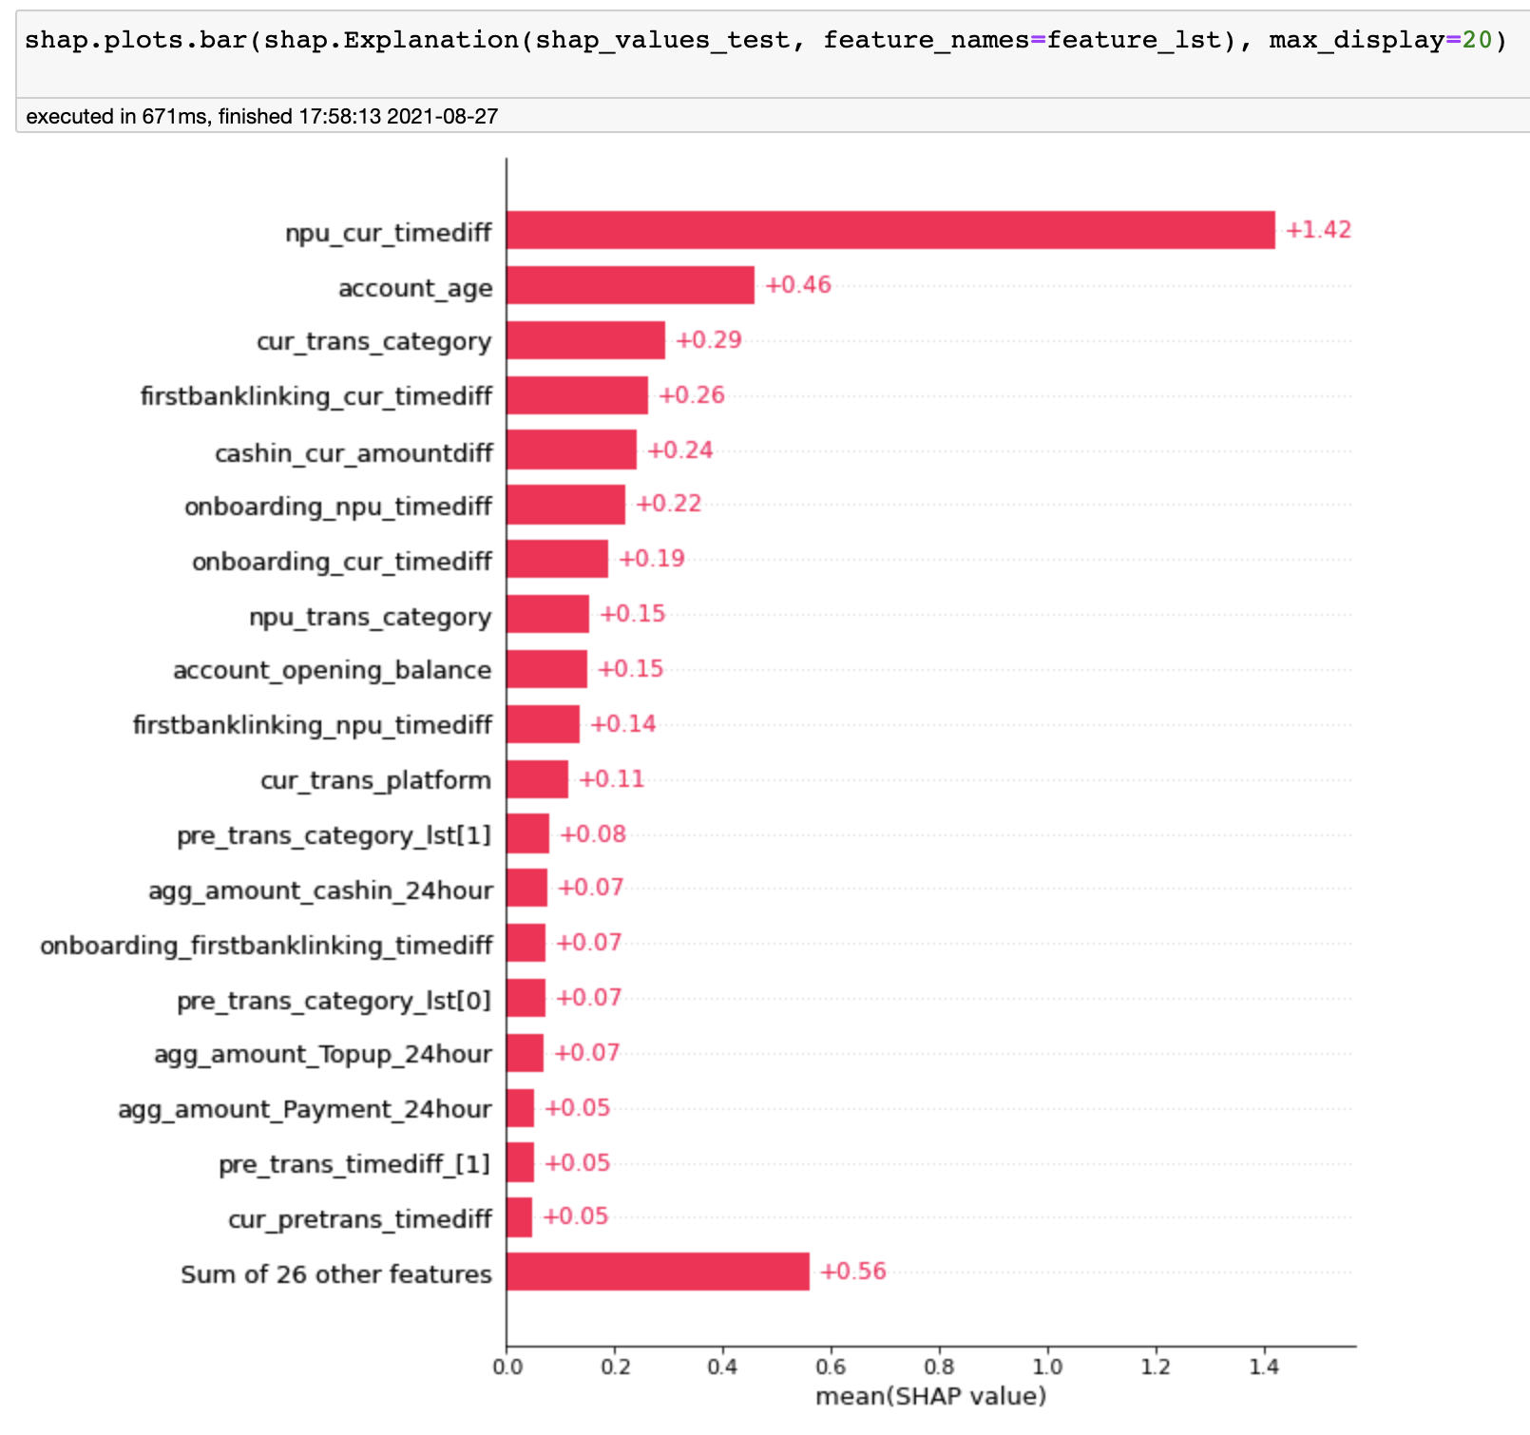
Adversarial test Result
Adversarial test: roc_auc
Random: 0.5 (no shift)
Max: 1
Our data: 0.77
=> Shifted
Remove:
npu_cur_timediff
account_age
Re-do adversarial test:
roc_auc_score = 0.70
data less shifted!
Feature importance in adversarial test using SHAP value method

Slide 16
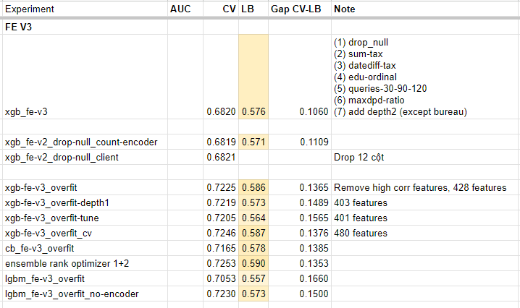
Track performance
Kaggle competition | Real product
Month | v3.1.1 | v3.1.2 | v3.1.3 | v3.1.4 | v3.1.5 | v3.1.6 | v3.1.7
T1 | 0.901 | 0.895 | 0.887 | 0.907 | 0.890 | 0.917 | 0.863
T2 | 0.870 | 0.862 | 0.852 | 0.880 | 0.858 | 0.894 | 0.822
T3 | 0.808 | 0.786 | 0.773 | 0.808 | 0.777 | 0.830 | 0.740
T4 | 0.819 | 0.807 | 0.790 | 0.829 | 0.805 | 0.848 | 0.770
T5 | 0.888 | 0.882 | 0.871 | 0.895 | 0.880 | 0.910 | 0.856
T6 | 0.877 | 0.881 | 0.869 | 0.894 | 0.880 | 0.911 | 0.846
T7 | 0.842 | 0.841 | 0.832 | 0.859 | 0.839 | 0.880 | 0.799
T8 | 0.819 | 0.814 | 0.803 | 0.834 | 0.808 | 0.851 | 0.768
T9 | 0.513 | 0.549 | 0.537 | 0.547 | 0.564 | 0.567 | 0.575
T10 | 0.505 | 0.532 | 0.516 | 0.530 | 0.555 | 0.562 | 0.572
T11 | 0.510 | 0.545 | 0.534 | 0.544 | 0.571 | 0.578 | 0.589

