Slide 1
How to compete in Kaggle
Notes:
Giới thiệu bản thân (tên, from risk zlp),
Section 1: khởi động bằng topic: Kaggle, câu chuyện & bài học sau hơn 2 năm thi
—--- NEXT
Outline của phần này gồm 4 phần …

Slide 2
Outline
What is Kaggle
Kaggle competition
My Kaggle journey
Important things in a competition
Notes:
Outline của phần này gồm 4 phần:
1. Giới thiệu Kaggle cho các bạn mới
2. Focus chính vào các cuộc thi ở Kaggle
3. Hành trình thi kaggle hơn 2 năm
4. Bài học
— NEXT
Đầu tiên giới thiệu về Kaggle

Slide 3






What is Kaggle
“Kaggle is a data science competition platform and online community of data scientists and machine learning practitioners under Google LLC”
Advantages of Kaggle
Learn and practice
Keep in touch with state-of-the-art methods; model tricks
Fame & reputation
5 gold medals
Solo gold medal
1 gold medal
2 silver medals
2 bronze medals
Notes:
Đầu tiên giới thiệu về Kaggle
Competition platform: thử sức với các cuộc thi, giành phần thưởng nếu xếp hạng cao khi cuộc thi kết thúc
Forum: nơi mọi người discuss, thảo luận
Lợi ích của Kaggle: TALK

Slide 4
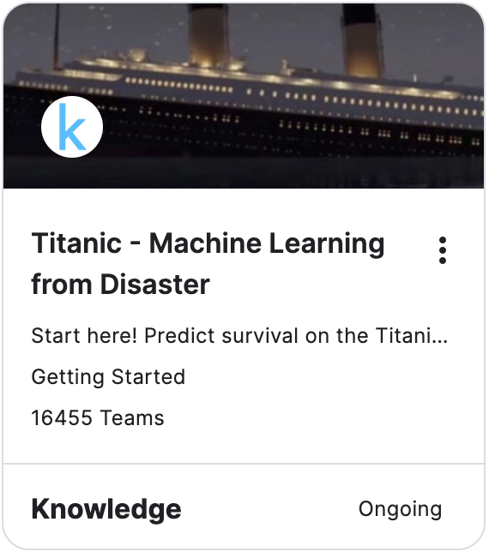

Kaggle competitions
Types of competitions:
Getting started/Playground/Community:
“for fun” competitions, suitable for newcomers
Last about 2 weeks to 1 month
No prize or medal
Featured:
Full-scale machine learning challenges which pose difficult, generally commercially-purposed prediction problems
Last about 3 months
Prize and medal
Advice:
Participate in just 1 playground/community competition
Then go straight to featured competition

Slide 5
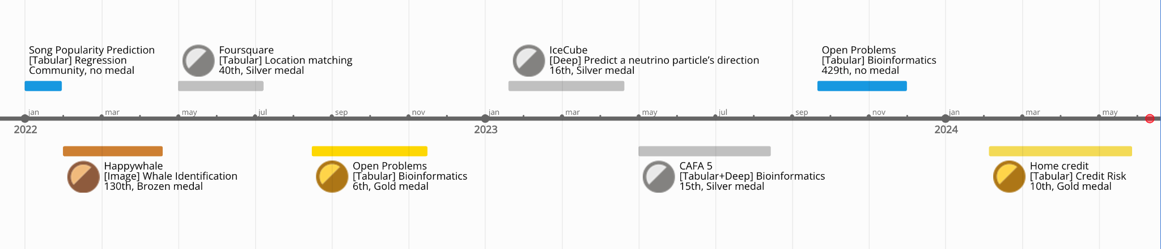
My Kaggle journey

Slide 6
Important things in a competition
Evaluation
Do experiments
Trust CV or LB?
Tryhard

Slide 7
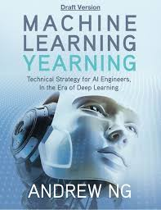
Evaluation
Having a good evaluation == half of your problem is solved
Dev set — which you use to tune parameters, select features, and make other decisions regarding the learning algorithm
Test set — which you use to evaluate the performance of the algorithm, but not to make any decisions regarding what learning algorithm or parameters to use
“Choose dev and test sets to reflect data you expect to get in the future and want to do well on”
Training set — Which you run your learning algorithm on.
TRAIN
DEV
TEST
FUTURE

Slide 8

Evaluation
TRAIN
DEV
TEST
FUTURE
TRAIN
Small or medium data size: OOF
Large datasize: TRAIN + DEV
PUBLIC
TEST
PRIVATE
TEST

Slide 9
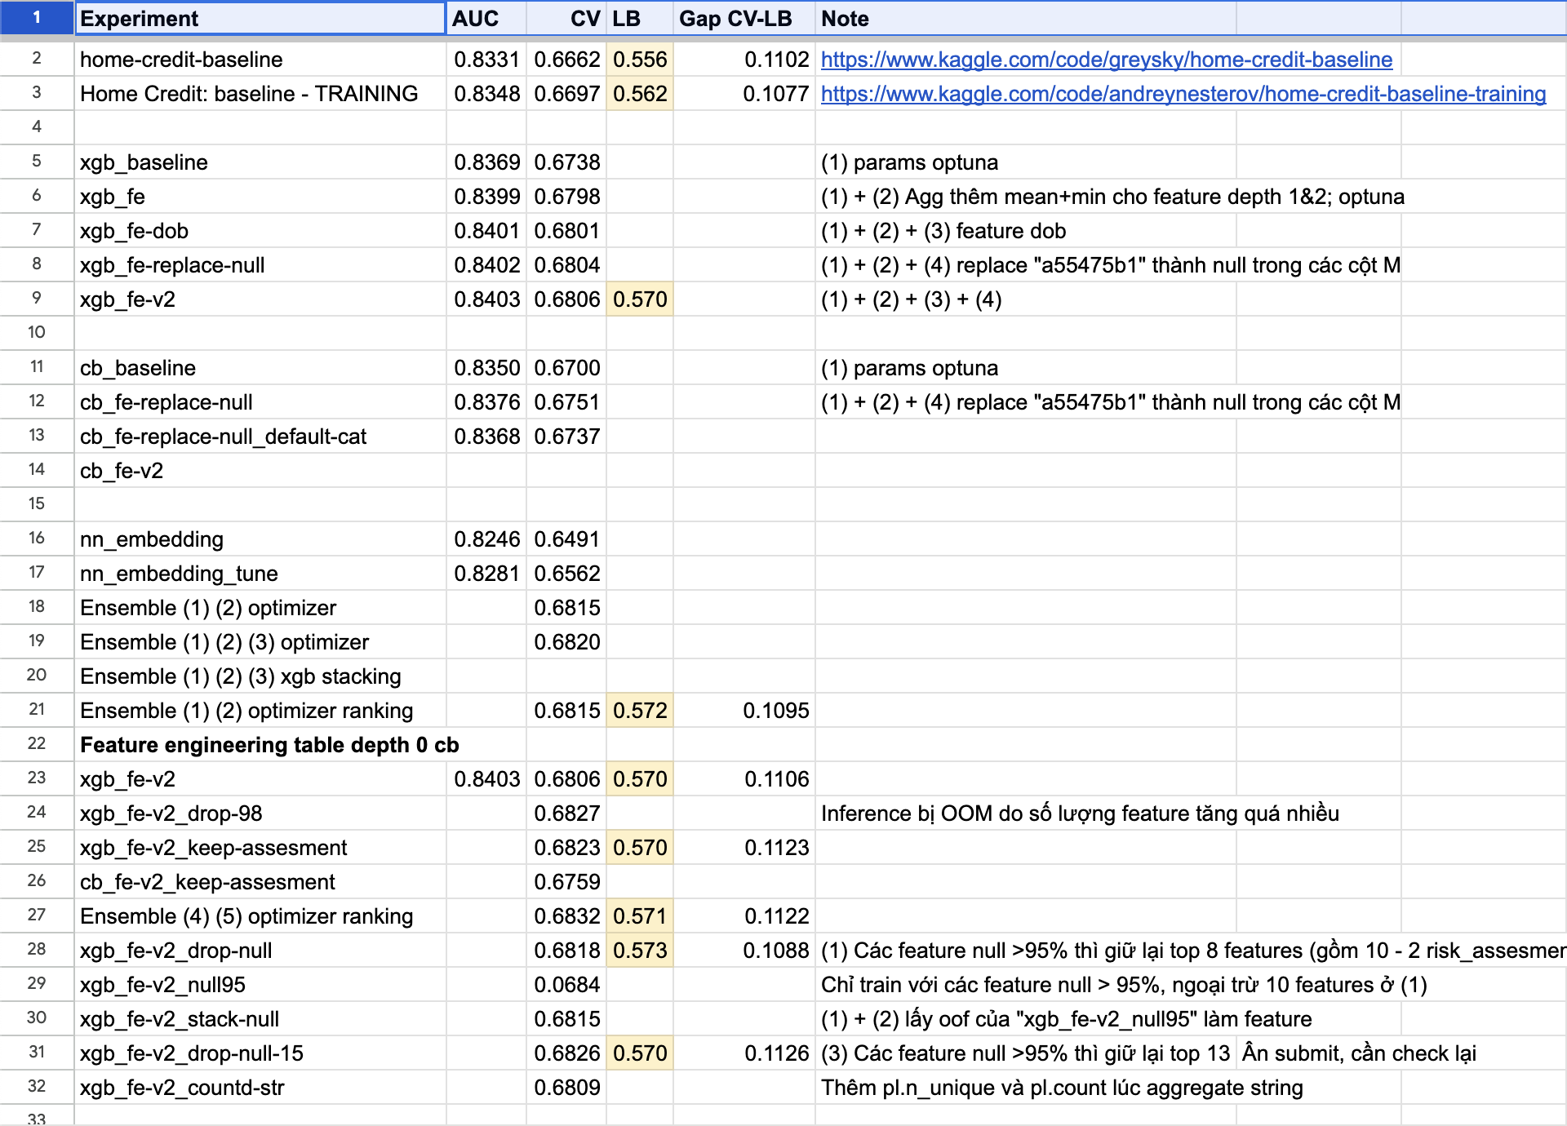
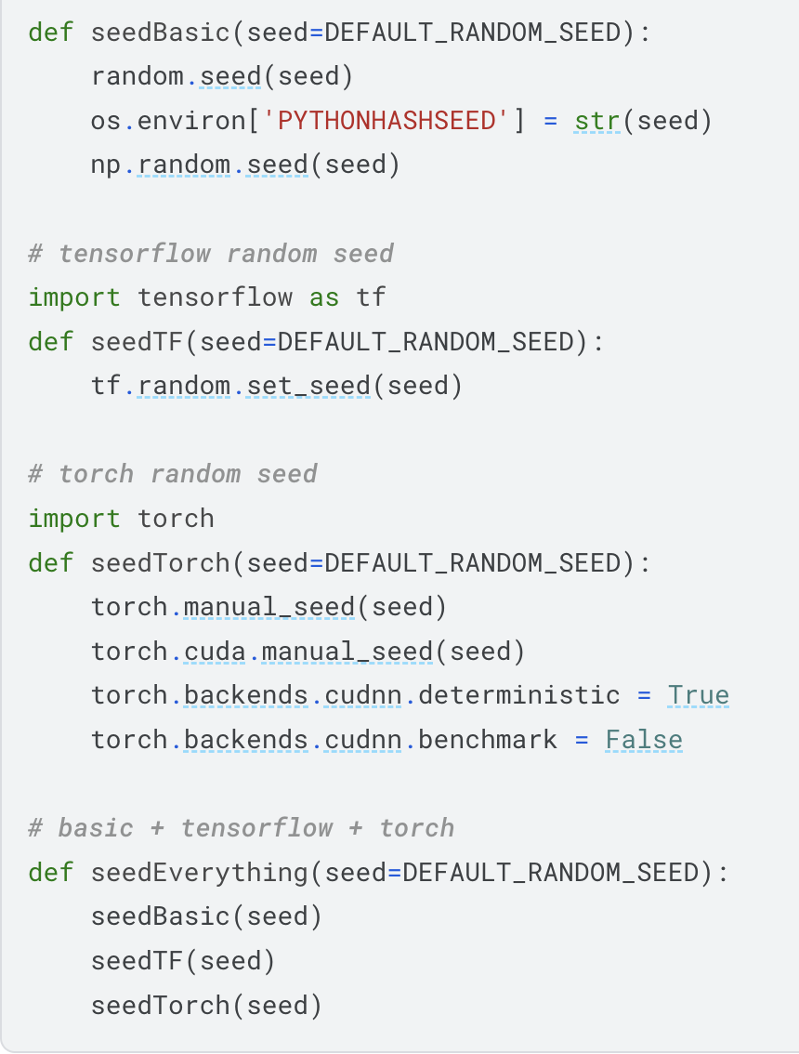
Do experiments
Do experiments to verify everything
Always keep track of your experiments
Make your experiments reproducible
Don’t overwrite your notebooks
Seed random

Slide 10
Trust local CV or public LB?
Normally, public leaderboard is calculated with approximately 30% of the test data. The final results will be based on the other 70%
The local CV contains more data, is controllable and mimics product situation
Advice:
Most of the time (90%) we should trust CV
Exception: leakage or special cases
Foursquare: leakage
2 submissions: best CV & best public LB

Slide 11
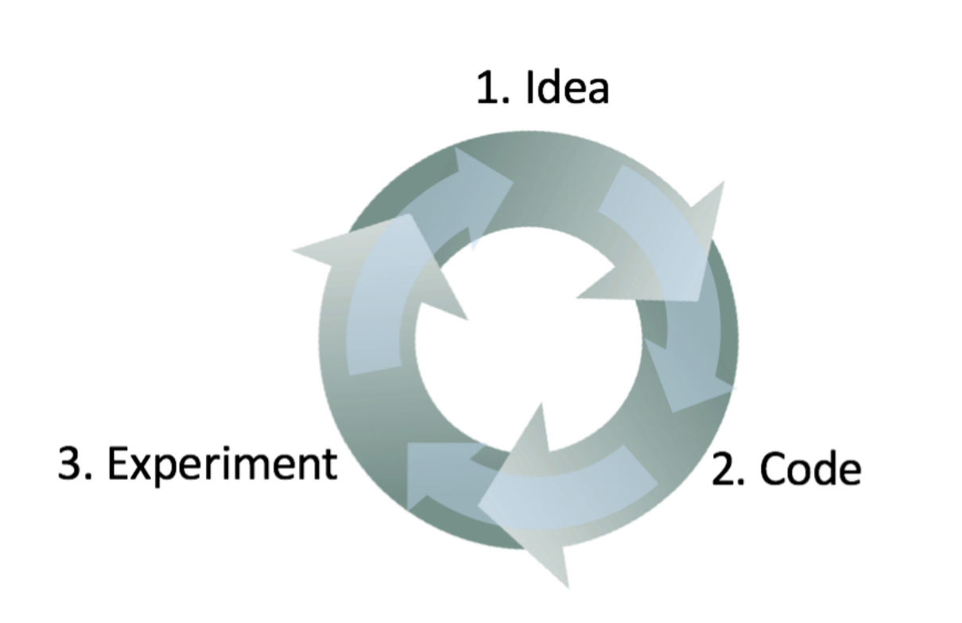
Tryhard
Hard work pay off
The more experiments you did, the deeper your understanding of the data and problems

Slide 12


