Slide 1


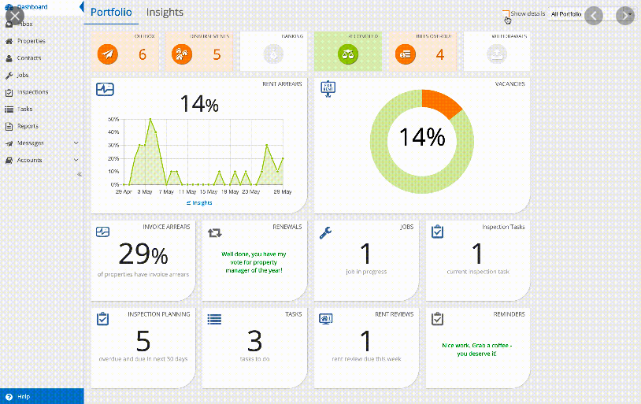
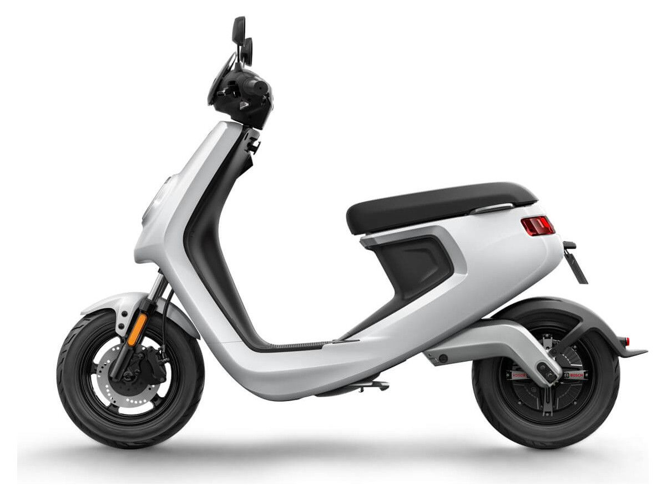

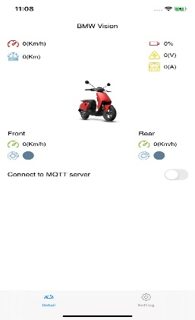
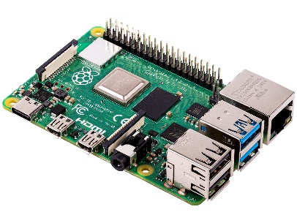
Connectivity
Vehicle Status
Speed Limit
CAN
Kafka
MQTT
Raspberry Pi 3
The Central Gateway

Slide 2
Traffic Sign detection
Gateway: Input - Output
Speed, Odometer, VCU Performance, Status (Brake, Side Stand)…
AI camera
MQTT
/display-topic
Kafka
/display-topic
VCU-S
CAN
CENTRAL GATEWAY
CAN
Publish
CAN
INVERTER
Subcribe
Subcribe
Subcribe
MQTT
/spd-limit-topic
Publish
Mobile App
Web App
(VSK)
Battery voltage,
battery current,…
Set
Speed Limit

Slide 3
Gateway: SW design
Approach 1: When there is new data, Gateway will publish immediately
Main Loop:
WaitForCAN() //WhileLoop
ReadCANMsg()
PublishToServer()
CENTRAL GATEWAY
Vehicle
MQTT/ Kafka
/display-topic

Slide 4
Gateway: SW design
Approach 2: Multi-threading, one thread to read & store data, one thread to publish cyclically
Main Thread: //ReadCAN
While True:
waitForCAN() //WhileLoop
readCANMsg()
updateCentralData()
// As per Message Source
CentralData
{
‘Speed’: 20,
‘Odo’: 100,
‘BattU’: 51,
….
}
Side Thread 1: //PublishToServer
While True:
readCentralData()
publishToServer()
delay(Some delay)
CENTRAL GATEWAY
Vehicle
MQTT/ Kafka
/display-topic

Slide 5
Gateway: SW design
CentralData
{
‘Speed’: 20,
‘Odo’: 100,
‘BattU’: 51,
….,
‘TrafficSign’: 0,
‘SpdLim’: 30,
}
Main Thread: //ReadCAN
While True:
waitForCAN() //WhileLoop
readCANMsg()
updateCentralData()
// As per Message Source
Side Thread 1: //PublishToServer
While True:
readCentralData()
publishToServer()
delay(Some delay)
Side Thread 2: //Read SpeedLimit
While True:
waitForMQTTmsg() //WhileLoop
readMQTTMsg()
updateCentralData() //SpeedLim
Side Thread 3: //Send CAN
While True:
sendCAN()
delay(Some delay)

Slide 6
Gateway: Solved and Unsolved problems
Solved:
- Support for flexible data formats, data sources, transmission protocols.
- Multi-Threading programming.
Unsolved:
- Delay time in transmission.
- Data consistency in Multi-Threading software.
- Still not deeply understand MQTT and Kafka.

