Slide 1
CBA Solutions
Our story with Clean Architecture
April 2018 at Droicoin Vitenam
Speaker: Giang Vo (Mobile Lead)
Mail: giang.vo@hubcba.com

Slide 2
Contents
Our story
Why Clean Architecture?
How did we implement?
Project structure
Layer details
Data flow
Example
Unit test
Conclusion

Slide 3
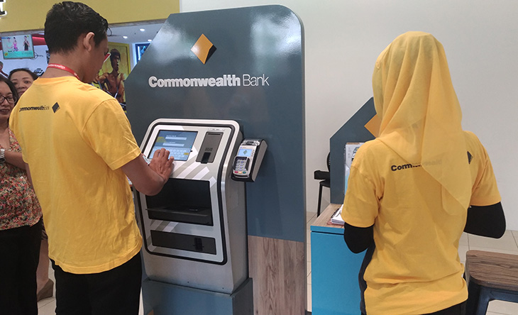
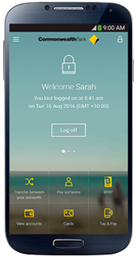
Our story
Our products
KIOSK
SMART-APP

Slide 4
Our story
Some basic features
KIOSK
SMARTAPP
Log In feature
Log In feature
User profile feature
User profile feature
Payment feature
Payment feature

Slide 5
Our story
Some basic features
User profile feature
Business
API
Get user profile
@GET
url.com/profile/
Update user profile
@Update
url.comt/profile/

Slide 6
Our story
Re-use code in short term
SMARTAPP
KIOSK
Future App
Business
Business
Business
API
API
API
User Interface
User Interface
User Interface
Common code
Business
API

Slide 7
Our story
Re-use code in long term
SMARTAPP
Vietnam
User Interface
Business
SMARTAPP
South Africa
SMARTAPP Indonesia
User Interface
User Interface
API

Slide 8
https://github.com/MindorksOpenSource/android-mvp-architecture
public class LoginPresenter<V extends LoginMvpView> extends BasePresenter<V> implements LoginMvpPresenter<V> { @Override public void onServerLoginClick() {} @Override public void onGoogleLoginClick() {} @Override public void onFacebookLoginClick() {} }

Slide 9

Why Clean Architecture?
The clean architecture was introduced by Uncle Bob
A Clean approach (by Yossi Segev):
The application code is separated into layers.
The layers follow a strict dependency rule.
As we move toward the bottom layer — the code becomes generic

Slide 10
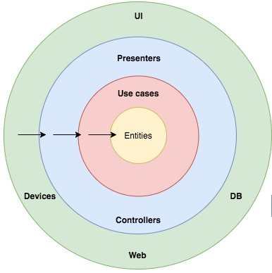
Why Clean Architecture?
Dependency rules
Presentation layer
(UI)
Data layer
(API, DB)
Dependences flow
Domain layer
(Business)

Slide 11
How did we implement?
Project structure
SMARTAPP
(Android Project
GIT Module)
SMARTAPP
Business
(Domain layer)
Business
(Android Module
GIT Submodule)
Repository
(Data layer)
Repository
(Android Module
GIT Submodule)
Application
(Presenter layer)
KIOSK
(Android Project
GIT Module)
Logical structure
Physical structure

Slide 12
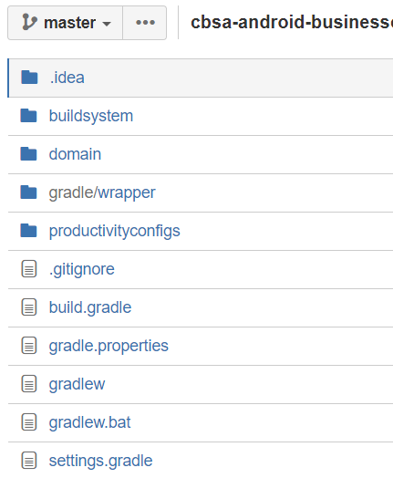
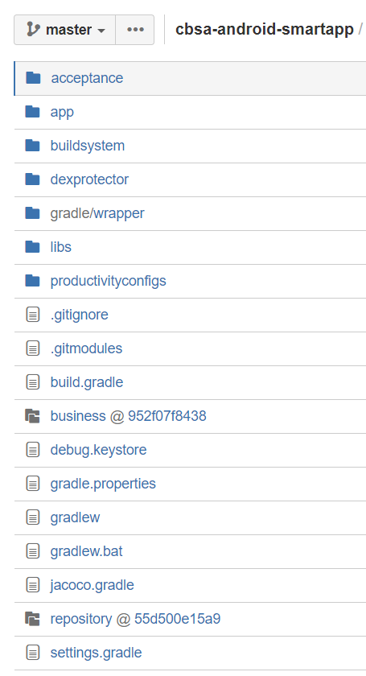
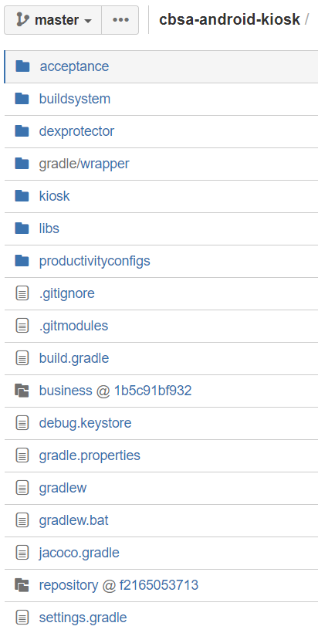
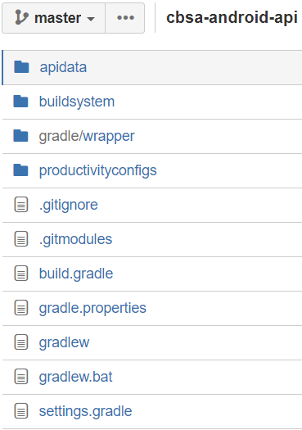
How did we implement?
Project structure
Notes:
A example ve project kiOSka nd smart-app

Slide 13
How did we implement?
Terminology
Use-case - a simple business
Repository - an interface where the use-case can access data
RepositoryImpl - an implementation of repository
CallBack - an interface where the use-case can notify data
CallBackIpml - an implementation of CallBack.

Slide 14
How did we implement?
Layers detail (relationship)
Application Layer
Business
Layer
Repository
Layer
Views
Repository
Repository
Imp
ViewModel
Use-cases
API Mappers
CallBack Impl
CallBack
API models
UI Mappers
Business entities
Retrofit + OKHTTP

Slide 15
How did we implement?
Data flow
Server
Views
Repository
Repository
Imp
ViewModel
Use-cases
Mappers
CallBack Impl
CallBack

Slide 16
Talk is cheap! Show me the code
Business requirement:
After user logins, customer want to see their profile.
If the profile is active, application shows it.
If the customer profile is blocked by system, application shows “profile is blocked ”message to customer.
If the customer profile is closed, application shows “profile is closed ”message to customer
GitHub: https://github.com/hoanggiang063/anddroid-clean-architecture-structure

Slide 17
How did we implement?
Unit test
SMARTAPP
Business
(Domain layer)
Use-cases test
Repository
(Data layer)
Repository test
Application
(Presenter layer)
ViewModel test
Notes:
A example ve project kiOSka nd smart-app

Slide 18
Conclusion
Following the Clean Architecture, we built a good architecture for:
Testable for each of modules
Easy to scalable
Reduce change
In terms of the same business among applications (common business), we can apply Clean Architecture for:
Sharable among applications
Reduce effort

Slide 19
Giang Vo (Mobile Lead)
Mail: giang.vo@hubcba.com

