Slide 1
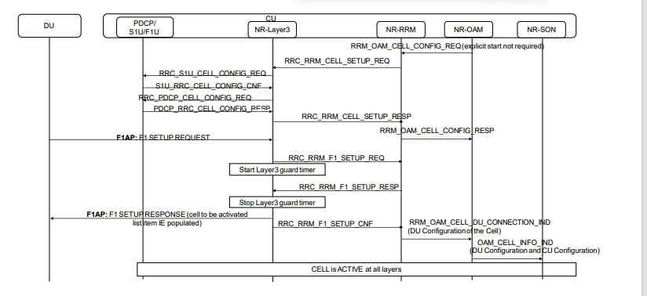

Slide 2
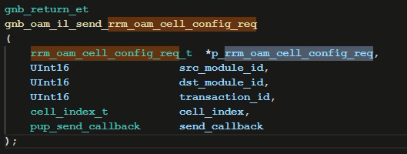


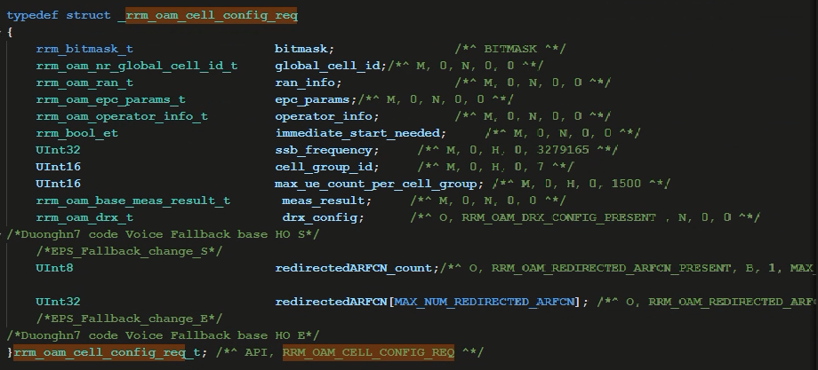

Slide 3

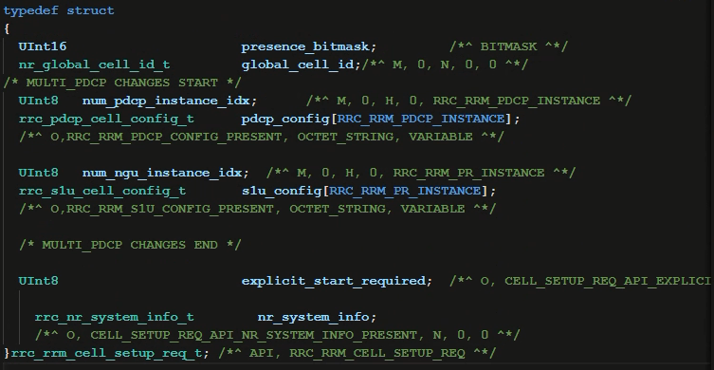

Slide 4



Slide 5


Slide 6


Slide 7


Slide 8
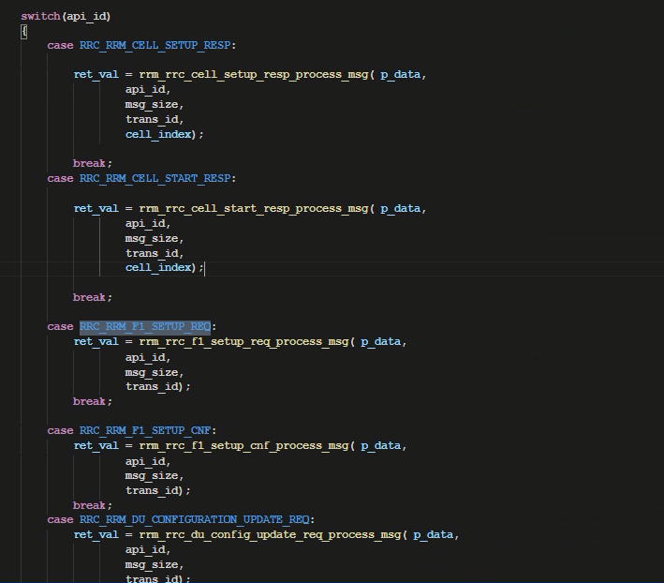
Rrm_rrc_msg_handler

Slide 9
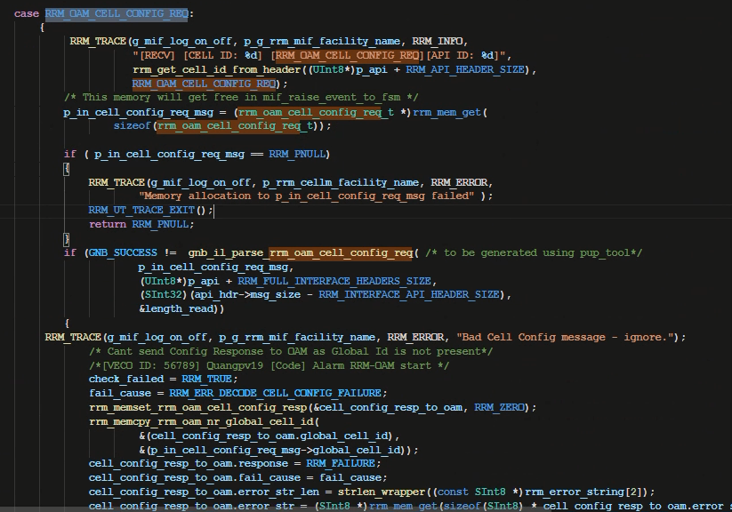
Rrm_mif_msg_handler

Slide 10
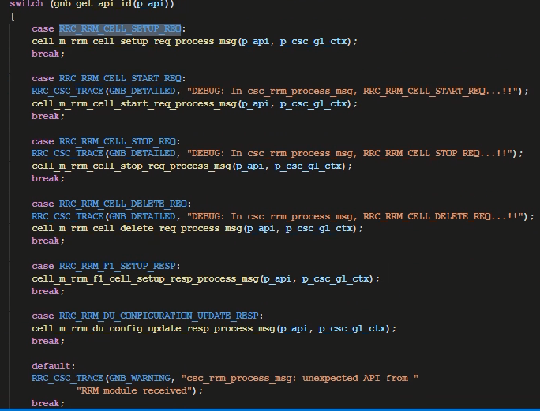
Csc_md

Slide 11


Slide 12
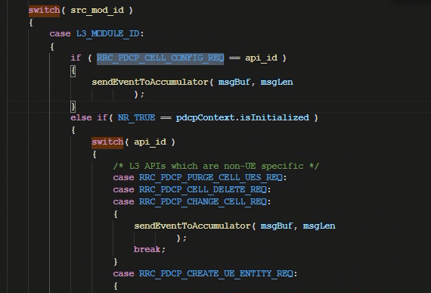
Pdcp_master_thread.c

Slide 13
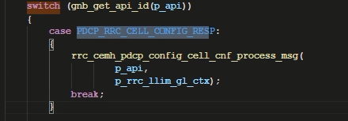
Rrc_llmd.c

Slide 14
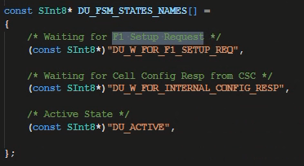

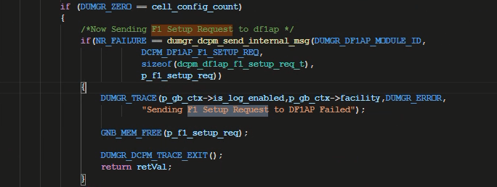
F1ap_du_fsm.c
Dcpm_dcelllm_fsm.c

Slide 15


Slide 16
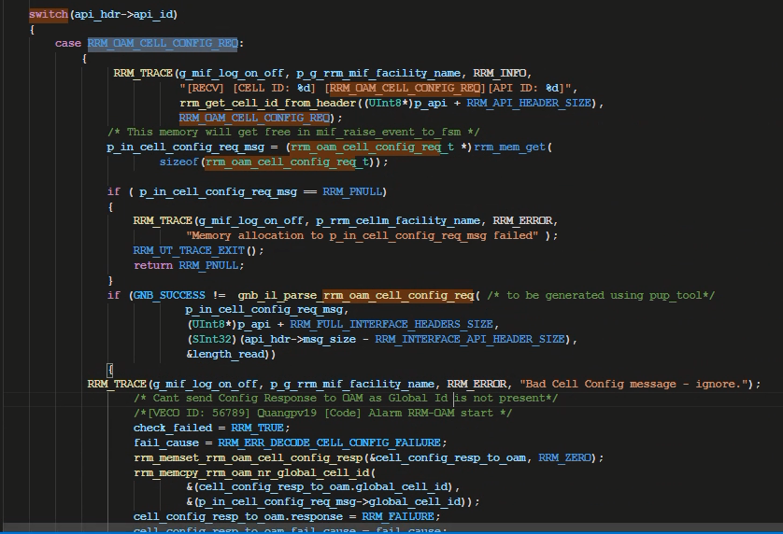
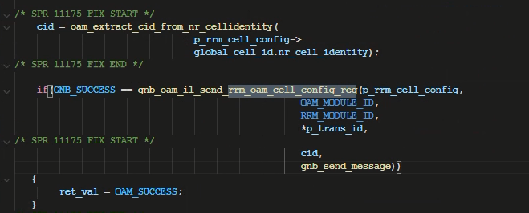
Oam_config_mgm_fsm
Rrm_mil_msg_handler

Slide 17
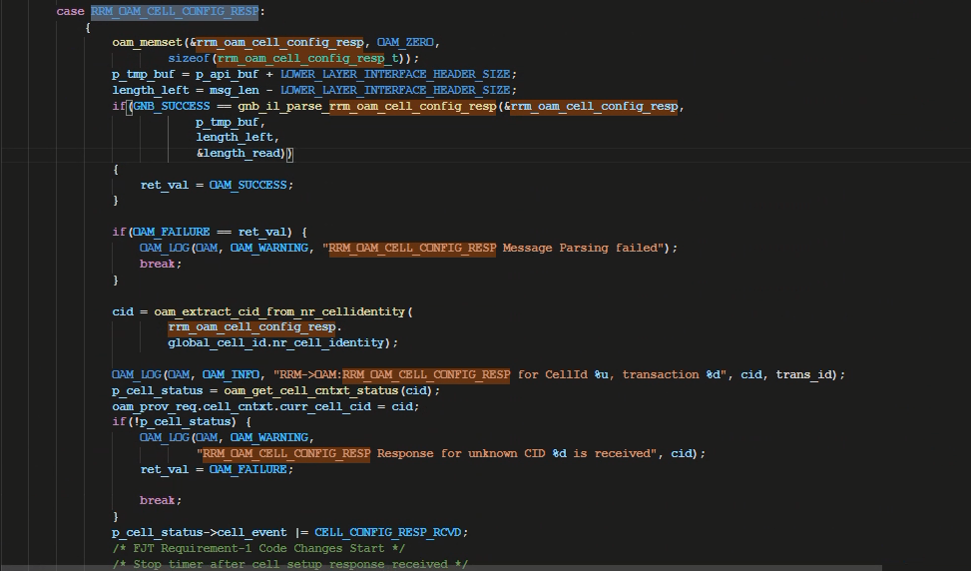
Oam_sim_proc_msg

Slide 18
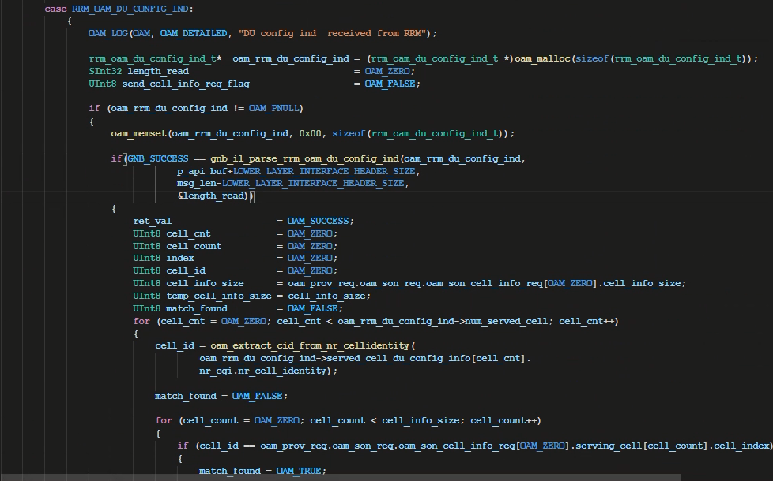
Oam_sim_proc_msg.c

Slide 19


