Slide 1
E-commerce Website
--------------------------------------------------------------------------------------------
Member: HOANG HONG DANG
NGUYEN HUU HOANG
HA SY THIEN
LE HOANG PHUC BAO
HO NGOC DUC
instruction: PHAN HUU TRI

Slide 2
Project Summary
Creation, maintenance and updating user, which contains
Find products to buy
View product information
Details of the products
Product payment
Buy product
Open shop to sell
Creation, maintenance and updating store, which contains
Manage store invoices
Store product management
Creation, maintenance and updating super admin, which contains
Manage all information

Slide 3
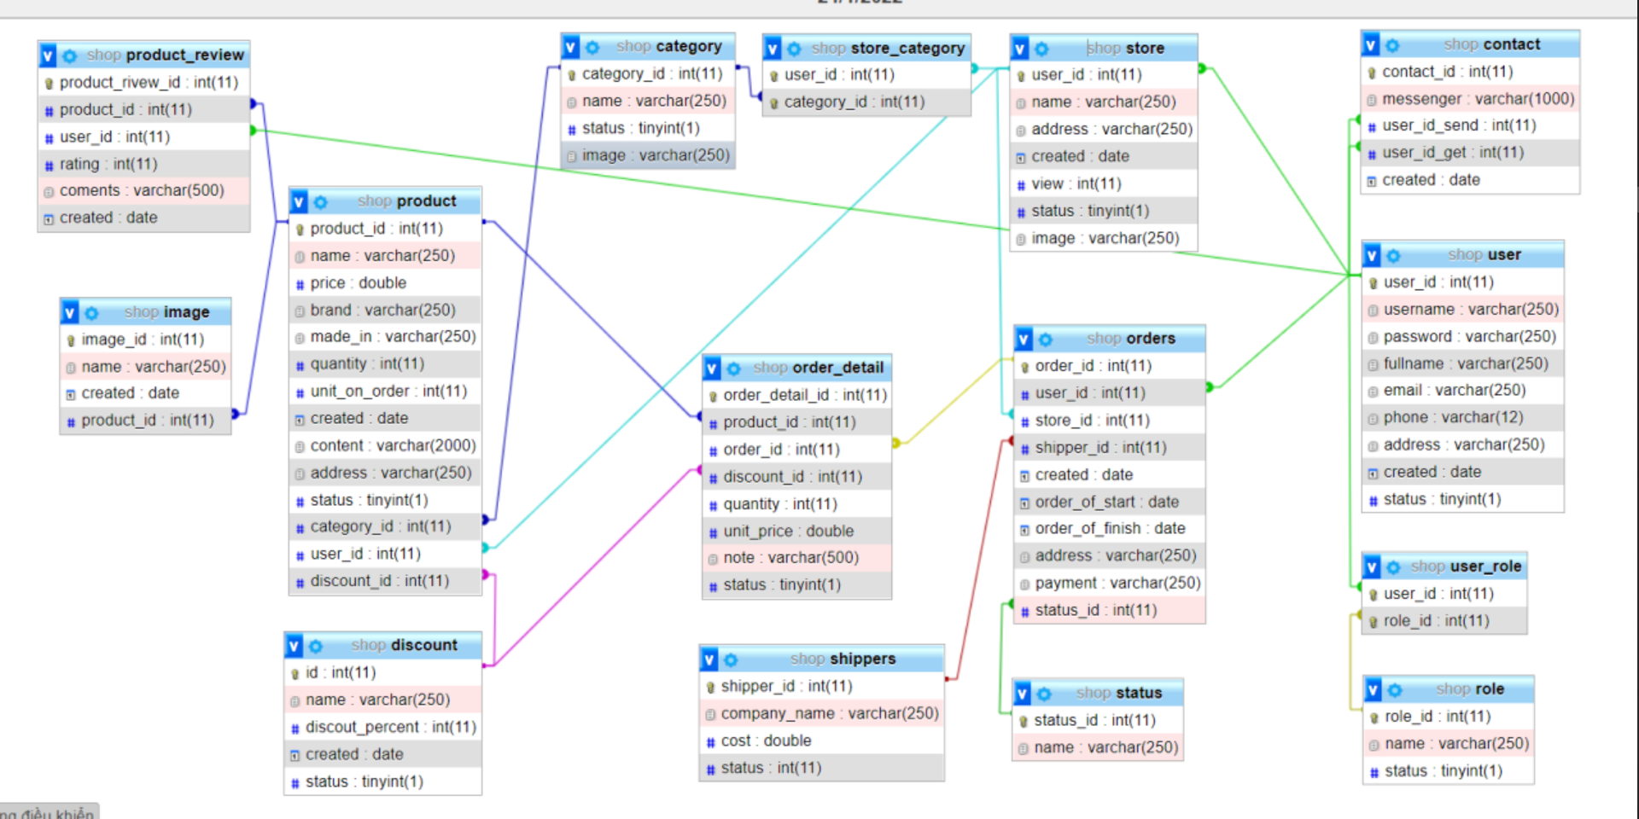

Slide 4
Thanks For Watching

