Slide 1



The Importance of Sleep
Sleep is essential for our physical and mental well-being. It allows our bodies and minds to rest and repair.
by Hung Nguyen Hoang

Slide 2

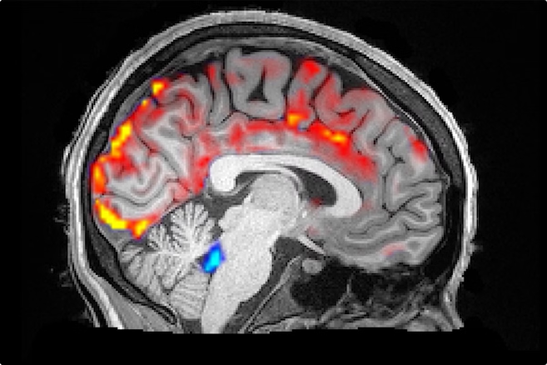
The Stages of Sleep
1
Stage 1
Light sleep, when you're drifting off and waking up. Your brain waves slow down and your muscles relax.
2
Stage 2
Your brain waves slow down even more, and your heart rate and breathing slow down. Your body temperature drops.
3
Stage 3
Deep sleep, when your brain waves are slow and regular. Your muscles are relaxed and it's hard to wake up.
4
REM Sleep
REM sleep is an active stage of sleep where your eyes move rapidly behind your eyelids. Your brain is active and you can have dreams.

Slide 3




What Happens When You Don't Sleep Enough
Harder to Think Clearly
It's tough to focus, make decisions, and remember things.
More Accidents and Mistakes
Being tired can slow your reactions and make accidents more likely, especially while driving.
Weaker Immune System
Not getting enough sleep can make you more likely to get sick.
Mood Swings and Irritability
You may feel more easily upset or have a hard time controlling your emotions.

Slide 4

The Benefits of Quality Sleep
1
Improved Mood
2
Enhanced Memory
Reduces stress and anxiety
Improves learning and cognitive function
3
Stronger Immune System
4
Increased Energy Levels
Fights off infections and diseases
Boosts alertness and productivity

Slide 5


Tips for Improving Sleep Quality
Establish a Regular Sleep Schedule
Create a Relaxing Bedtime Routine
Go to bed and wake up around the same time every day
Warm bath, reading, listening to calming music
Optimize Your Sleep Environment
Limit Caffeine and Alcohol
Avoid caffeine and alcohol in the hours before bedtime, as they can interfere with your sleep quality.
Make sure your bedroom is dark, quiet,cool and comfortable .

Slide 6

Getting the Best Sleep
Over the past 5 slides, we've explored:
The importance of sleep
The stages of the sleep cycle
The consequences of not getting enough sleep
The Benefits of Quality Sleep
Tips for improving sleep quality
In summary, taking care of our sleep is important for our health and productivity. Let's apply the strategies we've shared to get deeper, higher-quality sleep.

