Slide 1

Introdution about Jazz Change & Configuration Management
HCMC, Jun 2016

Slide 2
Agenda
Overview
Dashboard and Widget
Work Items
Query
Profile & Configurations
Demo & Practice
Q & A

Slide 3
Dashboard and Widget

Slide 4
Dashboard
Dashboard
Summary information for end-user
Project dashboard
Public information for everyone
Keeps all summary reports
Only Project Administrator can update and modify
Personal dashboard
Specific for every End-User
With different way access
Customizable, it ups to you
Widget

Slide 5
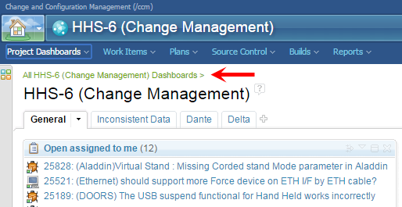
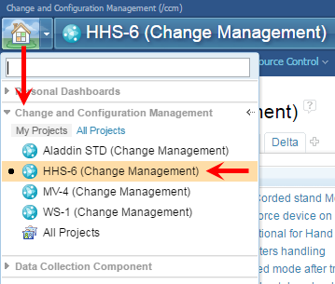
Project Dashboard
Shows after login to system
Or access from Home menu to specific project selected

Slide 6
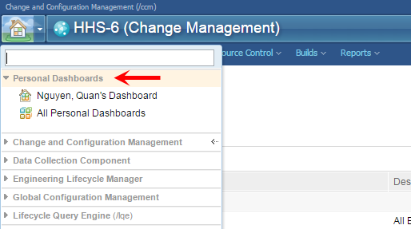
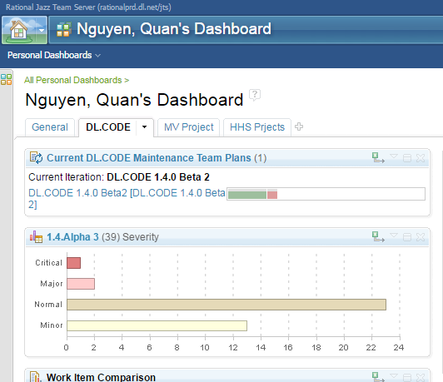
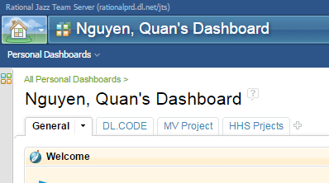
Personal Dashboard
Home menu → Personal Dashboard

Slide 7
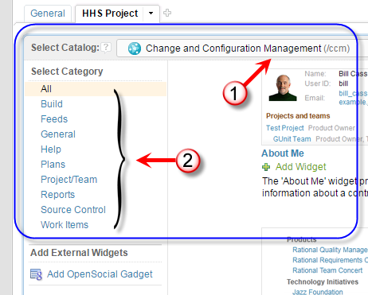
Widget
Build-in report template supports
Distinguish Catalog with applications
Select Catalog → Category
Drag and Drop supports

Slide 8
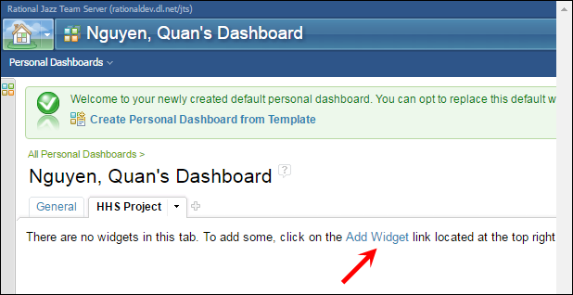
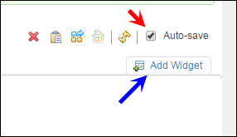
Widget – Add new Widget

Slide 9
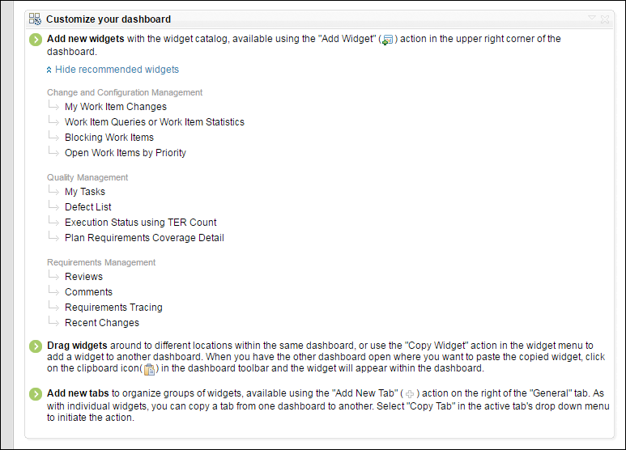
Widget – System recommended

Slide 10
Work Items

Slide 11
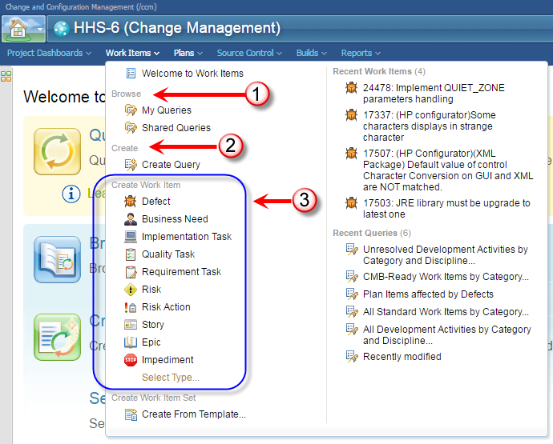
Overview about Work Items

Slide 12
Work Items
Dashboard of Work Items
Query of Work Items
Brower
Create
Export
Create Work Item
Defect
Business Need
Implementation Task
Quality Task
Requirement Task

Slide 13
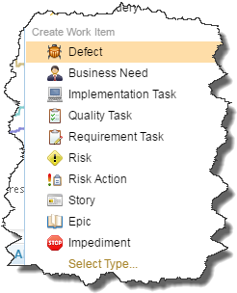
Type of Work Items
Defect
Business Need
Implementation Task
Quality Task
Requirement Task

Slide 14
Work Items – Overview (1/2)
Summary
Overview
Links
Attachments
Relationships
Approvals
History
Time Tracking

Slide 15
Work Items – Overview (2/2)
Summary
Overview
Details
Field and Attributes
Description
Discussion
External link
User / Work Items
Attachment – for defect’s evidences
Status
Subscribes

Slide 16
Work Items – Attachments
Policy and Rule
Link Attachments
Defect report and evidences of failure
Discussion Attachments
Arguments of appeal
Research and Study

Slide 17
Work Items - Relationships
Relationships
Relation
Blocks / Depends On
Resolves / Resolved By
Parent / Children
Duplicated By / Duplicate Of
Related Artifacts

Slide 18
Work Items
Query
Data filtering
Can be static or dynamic
Jazz CCM
Advantage points
Disadvantage points

Slide 19
Profile and Configurations

Slide 20
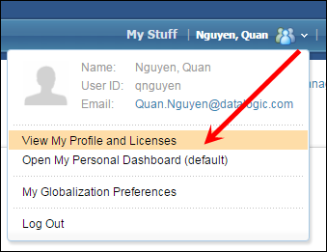
Profile and Configurations
Overview
Profile photo
Repository Permissions
Client Access Licenses
Work Environment
Location
Days
Allocations
Mail Configuration
Notifications when needed

Slide 21
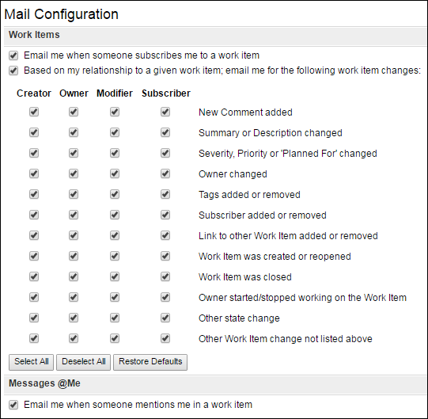
Mail Configuration

Slide 22
Demo and Practice

Slide 23
Demo and Practice
Personal dashboard
Work Items
Query and Widget

Slide 24
Introduction about Jazz CCM
Q
A
&

Slide 25
Thank You!
Datalogic S.p.A.
Via Candini, 2
40012 Lippo di Calderara di Reno
Bologna – Italy
Tel. +39 051 3147011
Fax +39 051 3147205
E-mail corporate@datalogic.com

