Slide 1
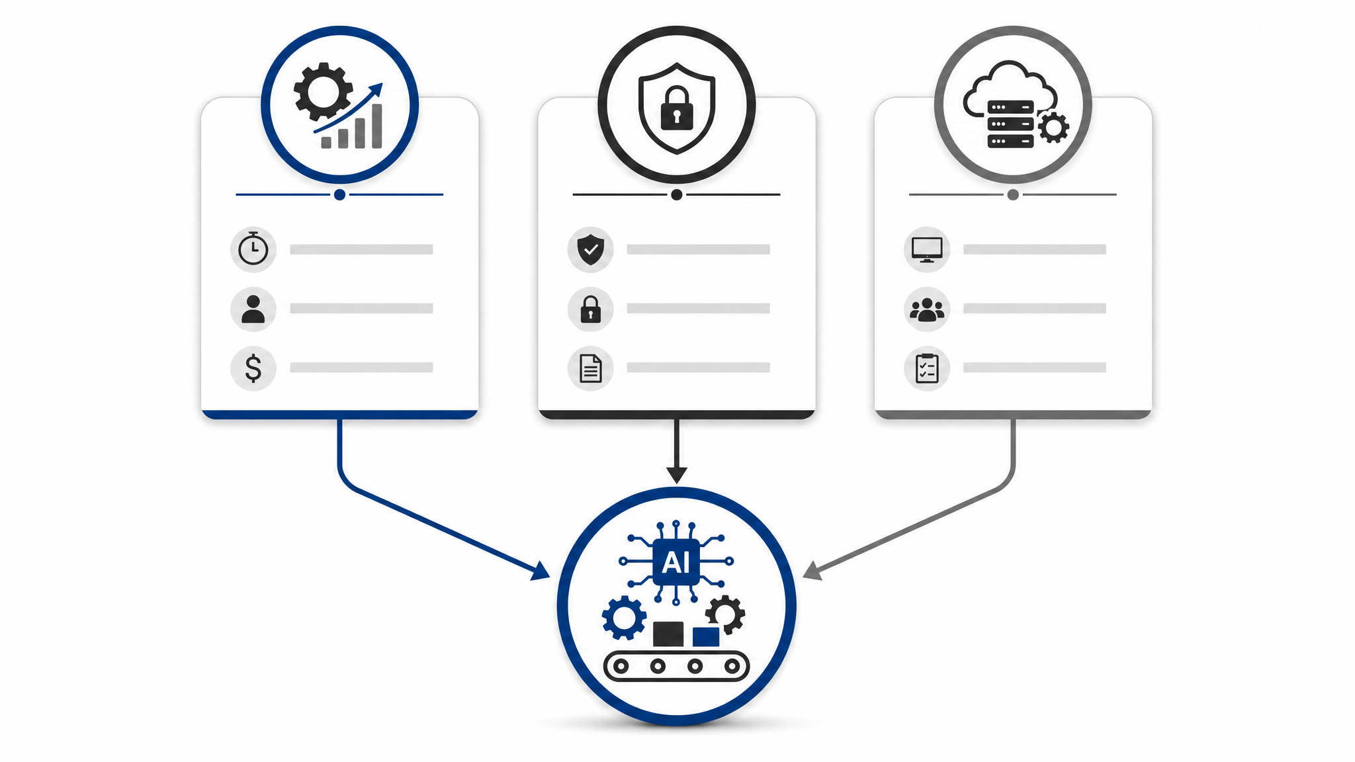
FINAL VALIDATION DECK
AI 流程自动化采纳机制：最终核验结果已经闭环。
基于中小企业 AI 流程自动化采纳机制研究
从“待核验训练路线”升级为“数据、模型、Agent 已验证”的课堂答辩版本。
544
5,814
0.7137
0.0
Stage 1 可建模样本
Stage 2 可建模样本
Stage 2 GroupKFold R²
Agent hallucination rate
口径锁定：Stage 1 = SME 机制解释；Stage 2 = GE10 行业/区域外部验证。
Final validation sources: 10_Agent系统/reports/final_research_registry_summary.json
01

Slide 2
STAGE 1 / STAGE 2
两阶段设计把中小企业机制解释和外部泛化验证分开。
Stage 1
Stage 2
SME mechanism interpretation layer
GE10 industry and region external validation layer
553
544
36
5,814
5,814
36
面板行数
可建模样本
geo 分组
面板行数
可建模样本
geo 分组
年份范围：2021 - 2025
研究用途：中小企业规模层机制分析
年份范围：2021 - 2025
行业分组：50 个 NACE
`data/processed/eurostat_ai_panel.csv`
`data/processed/stage2_industry_panel.csv`
What the chart shows
Stage 1 answers the original SME mechanism question; Stage 2 checks whether the pattern remains stable in broader official statistics.
Why it matters
This prevents overstating Stage 2 as SME-only while still using its scale for external validation.
Decision it supports
PPT narration should always say: Stage 1 for mechanism, Stage 2 for validation.
02
Source: final research validation pack, e789173.

Slide 3
MODEL VALIDATION
最终模型页只展示已核验指标，不再混用历史调参分数。
Layer
Champion
GroupKFold R²
Time holdout R²
Industry holdout R²
Stage 1
ridge
0.8680
0.9312
N/A
Stage 2
extra_trees
0.7137
0.7019
0.9521
0.8680
0.7137
0.9521
Stage 1 Ridge GroupKFold R²
Stage 2 ExtraTrees GroupKFold R²
Stage 2 industry holdout R²
What the chart shows
Ridge is retained for Stage 1 mechanism explanation; ExtraTrees is the Stage 2 champion.
Why it matters
GroupKFold by geo is more convincing than random splits because it tests cross-region transfer.
Decision it supports
Use these values as final PPT facts; keep 0.916679 as training-process history only.
03
Source: final research validation pack, e789173.

Slide 4
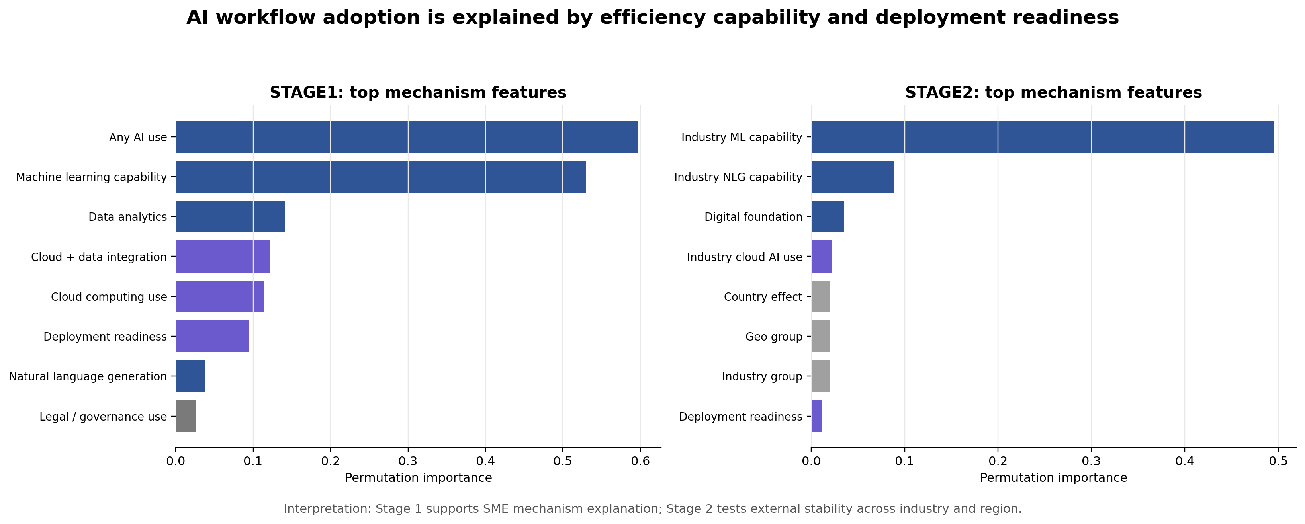
FEATURE EXPLANATION
双阶段特征重要性把模型结果重新解释回研究机制。
What the chart shows
Stage 1 is driven by AI use, ML capability and deployment readiness.
Why it matters
Stage 2 repeats the ML capability signal while adding industry and region controls.
Decision it supports
This supports the claim that adoption depends on capability and readiness, not generic AI enthusiasm.
Source: final research validation pack, e789173.
04

Slide 5
AGENT VALIDATION
研究 Agent 的价值是证据优先，而不是凭空生成答案。
6
1.0
1.0
0.0
0.0436s
evaluation cases
tool success rate
citation accuracy proxy
hallucination rate
average latency
Guardrail
Tool stack
数值型回答必须来自工具、模型 API 或 evidence files。
query_indicator / predict_adoption / cite_source / recommend_deployment
超范围问题返回“无法确认”，不向中国所有中小企业做无证据外推。
RAG 只索引经过验证的报告、模型结果和来源说明。
What the chart shows
The Agent is tested with metric lookup, prediction, citation, deployment and unknown-claim cases.
Why it matters
The zero hallucination proxy comes from the explicit refusal behavior on unsupported claims.
Decision it supports
This makes ai.zhjjq.tech a research-backed operating layer, not only a demo website.
05
Source: final research validation pack, e789173.

Slide 6
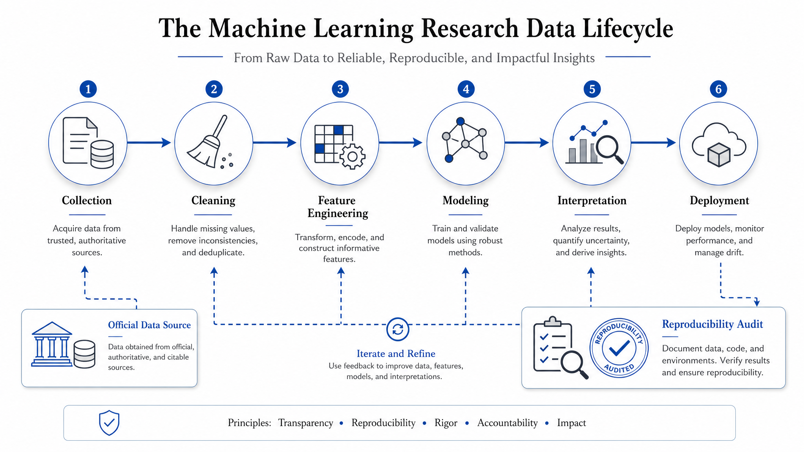
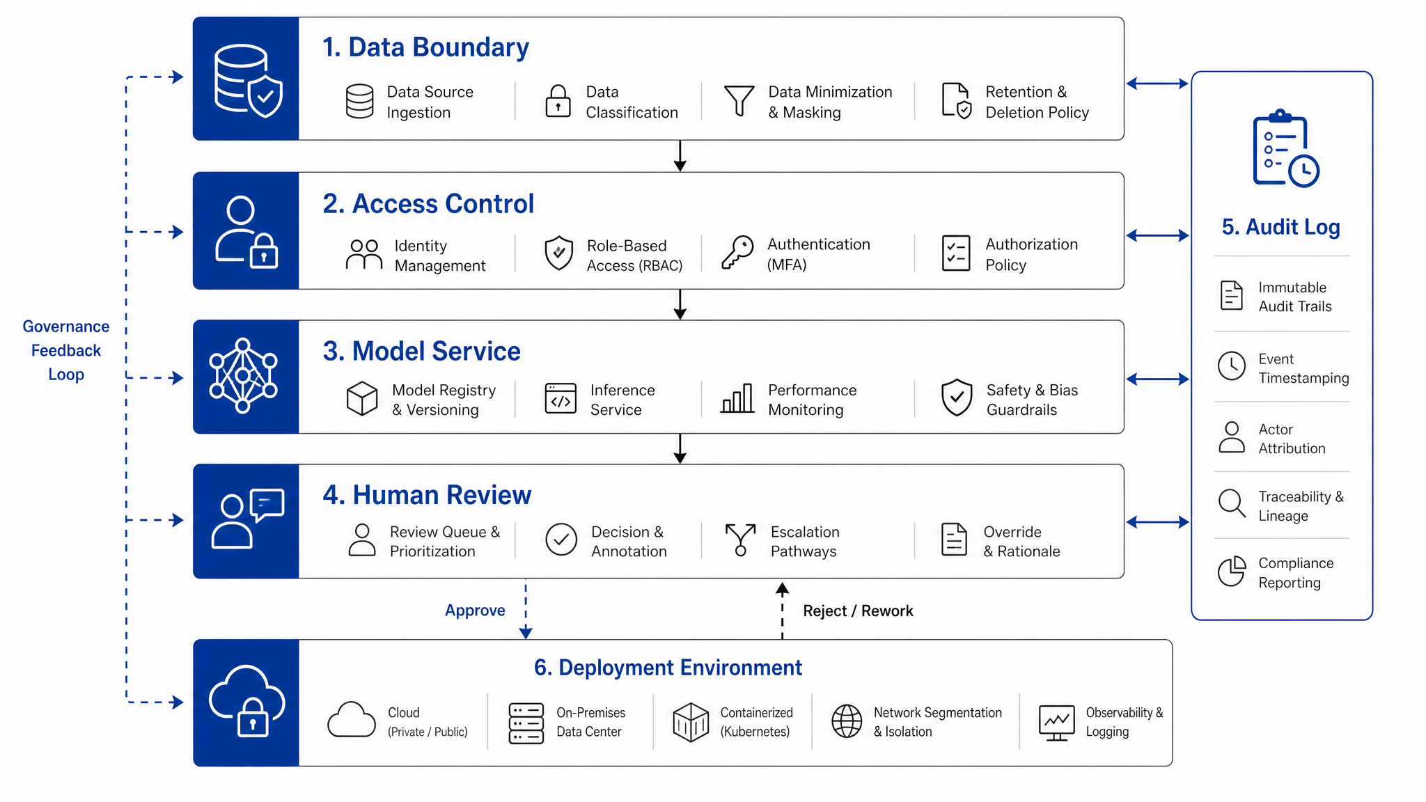
DIGITAL LIFECYCLE
最终版本把数据生命周期、安全边界和复现证据放在同一条链路里。
Collection
Cleaning
Feature engineering
Modeling
Interpretation
Deployment
What the chart shows
The digital lifecycle is visible from official acquisition to deployment recommendation.
Why it matters
Security is not a side issue; it changes which deployment mode is appropriate.
Decision it supports
Source: final research validation pack, e789173.
06
The final deck should present lifecycle and governance as part of machine-learning rigor.

Slide 7
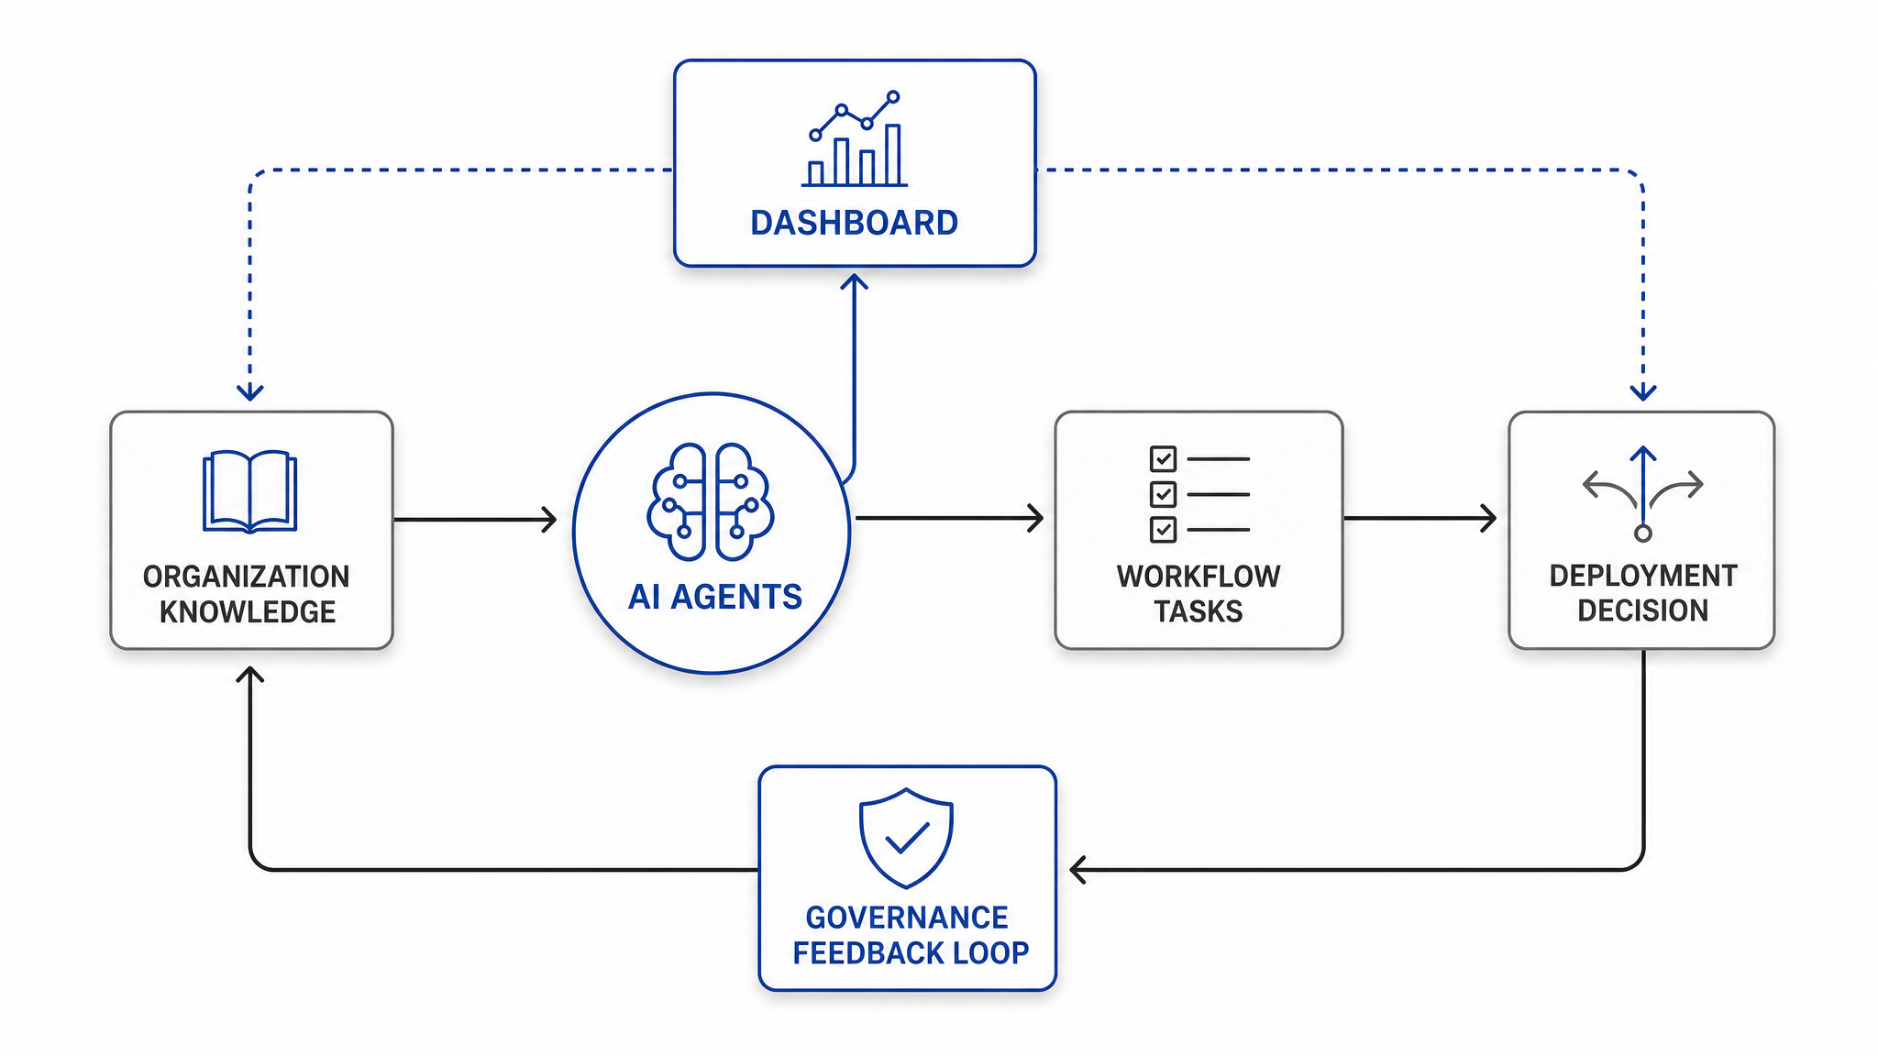
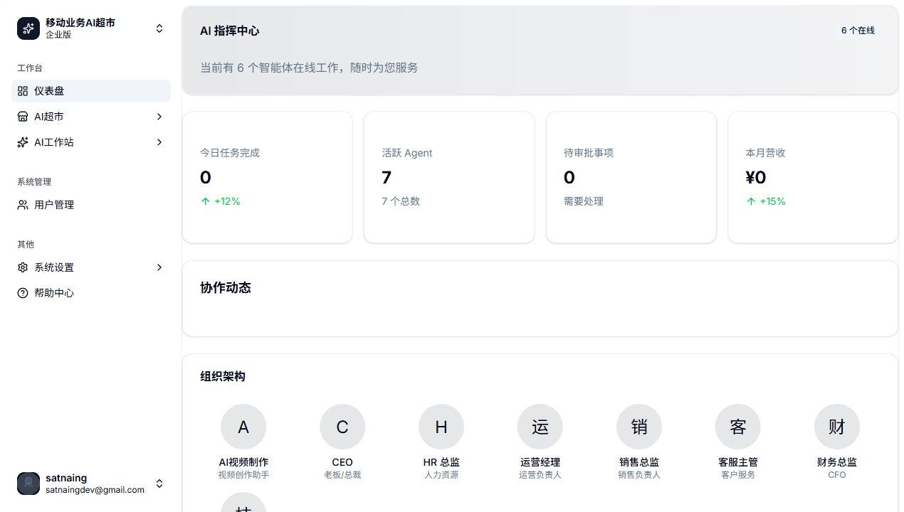
PRODUCT LANDING
ai.zhjjq.tech 把模型结论落到真实 AI 办公流程中。
Research model → enterprise profile → deployment recommendation → AI workstation workflow
What the chart shows
The website is not just a screen; it is the operating surface for workflow agents and governance feedback.
Why it matters
The model helps decide whether an enterprise should use SaaS, API, local or hybrid deployment.
Decision it supports
Source: final research validation pack, e789173.
07
This links the machine-learning case to a practical SME AI automation product scenario.

Slide 8
FINAL CONTRIBUTION
这份结题案例已经形成“数据真实、模型严谨、Agent 可落地”的闭环。
01
Official data
Eurostat source files, manifest hash audit and reproducible panels.
02
Machine learning
Ridge, ExtraTrees, GroupKFold, time holdout and industry holdout.
03
Explainable mechanism
Efficiency demand × security concern × deployment readiness.
04
Agent deployment
Tool-based answers, evidence files and unable-to-confirm guardrail.
下一步只需要把国内问卷和真实工作流日志接入，就能继续增强中国中小企业场景解释力。
Source: final research validation pack, e789173.
08

