Slide 1

OPENING
企业 AI 部署偏好与治理机制：完整机器学习案例
用官方数据、机器学习验证和证据约束 Agent，形成明天可展示的完整课程案例。
12.77M official source rows
5,814 Stage 2 modeling rows
0.7245 Stage 2 R2
12.77M
5,814
0.7245
official source rows
modeling panel rows
Stage 2 long-run R2
Source: public repository data, result tables, imagegen manifest, and QA reports.
01

Slide 2

DATA UPGRADE
主证据从问卷/Kaggle 升级为官方数据
问卷和访谈解释机制，公开主模型必须依赖可追溯官方数据。
Eurostat source manifests
SHA256 and download records
Questionnaire only as auxiliary evidence
Source: public repository data, result tables, imagegen manifest, and QA reports.
02

Slide 3

LIFECYCLE
数据生命周期每一步都有仓库证据
从 source manifest 到 processed panel，再到 outputs 和 PPT，路径可复查。
data/raw/manifest*.jsonl
data/processed/*.csv
outputs/tables and reports
Source: public repository data, result tables, imagegen manifest, and QA reports.
03

Slide 4
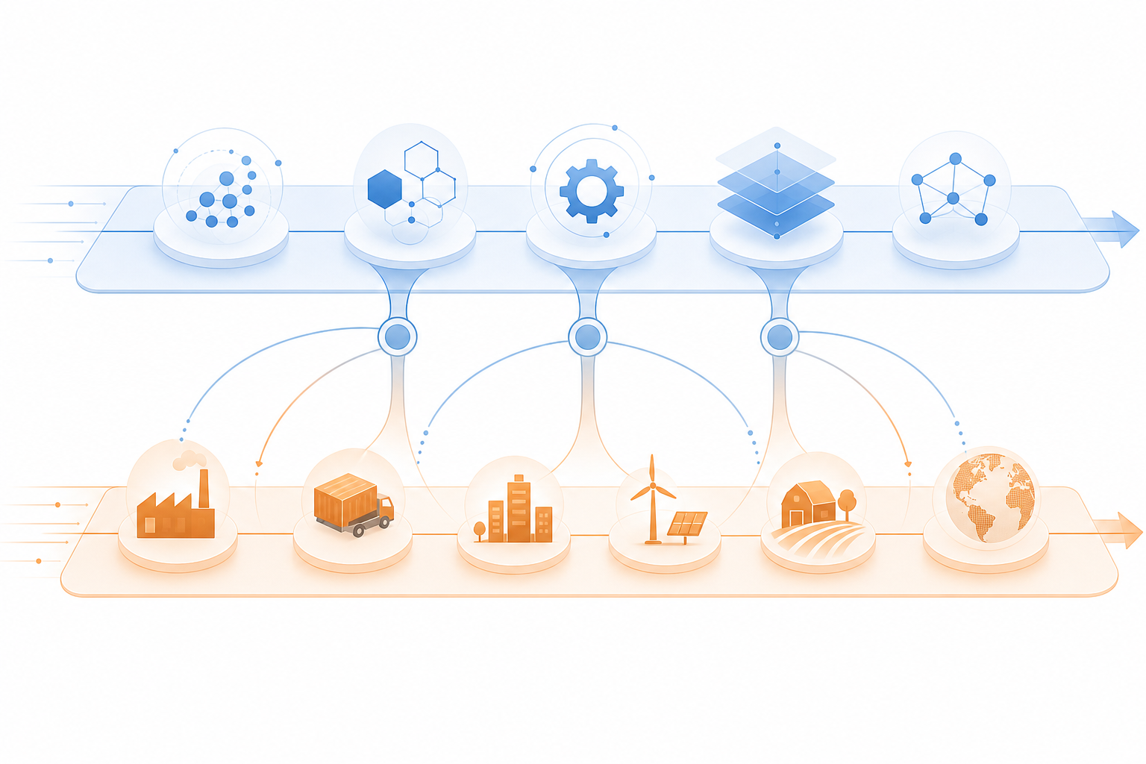
BOUNDARY
Stage 1 解释 SME 机制，Stage 2 验证行业/区域泛化
两层数据边界分开讲，避免把 Stage 2 误说成 SME-only。
Stage 1: 553 / 544 / 36
Stage 2: 5,814 / 36 / 50
2021, 2023-2025
Source: public repository data, result tables, imagegen manifest, and QA reports.
04

Slide 5
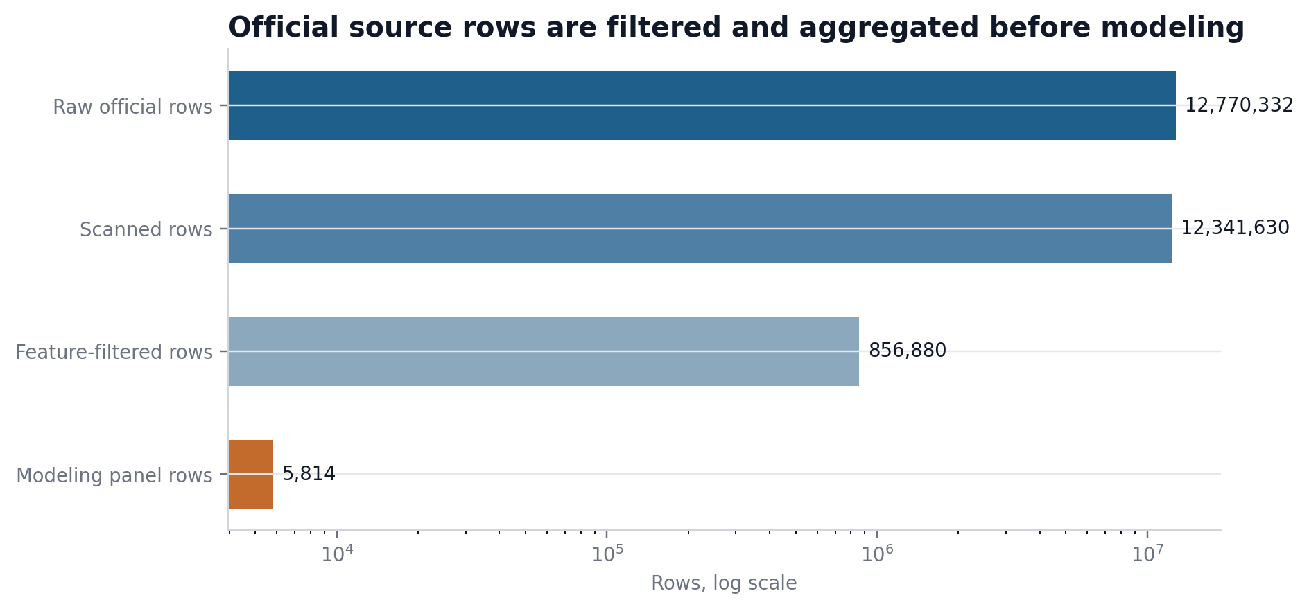
SCALE AUDIT
1277 万源数据行不是直接训练样本
官方源数据经过扫描、筛选和聚合，形成 5,814 行建模面板。
12,770,332 raw rows
856,880 feature-filtered rows
5,814 modeling rows
Source: public repository data, result tables, imagegen manifest, and QA reports.
05

Slide 6
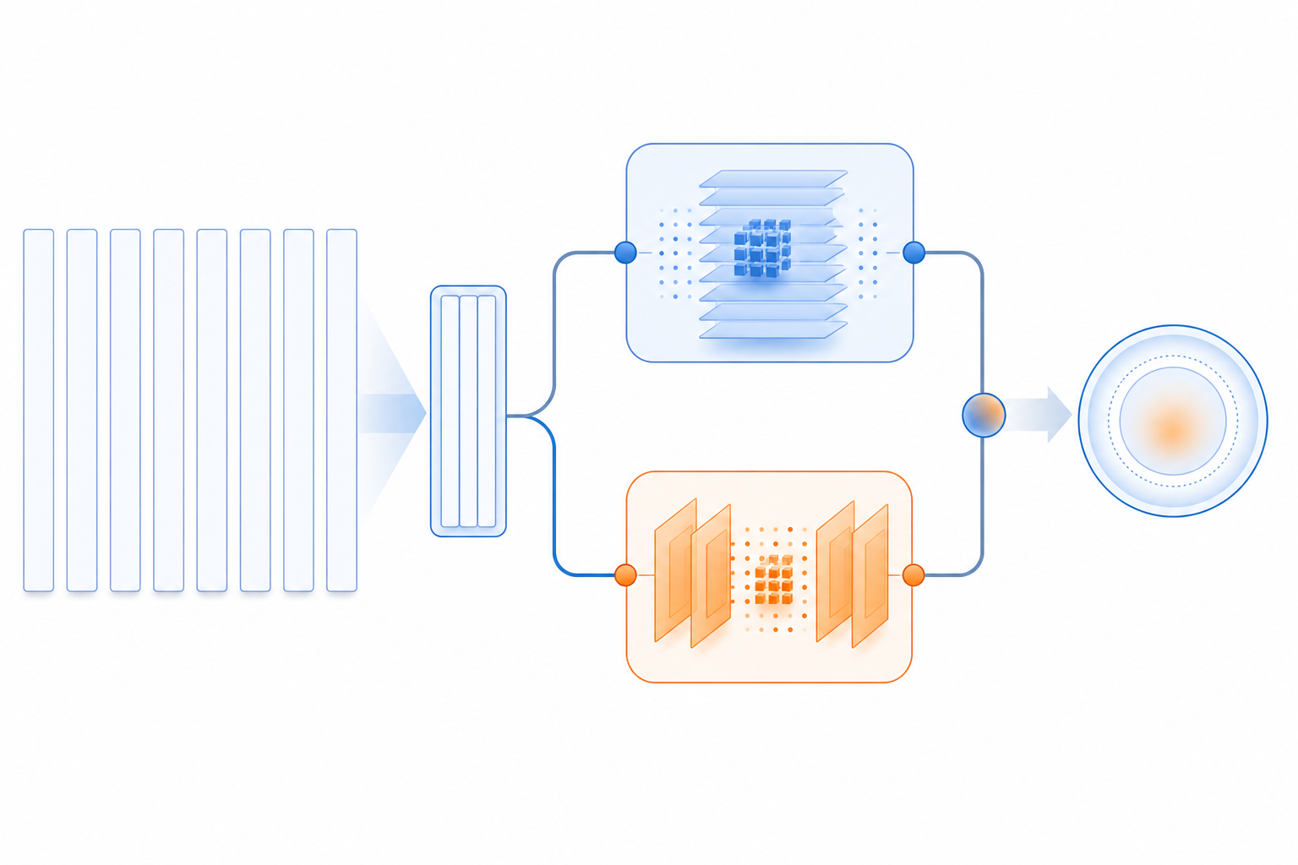
ML TASK
监督学习任务围绕官方 AI 工作流指标展开
目标变量来自企业使用 AI 自动化工作流或辅助决策的官方指标。
Target: workflow automation
Ridge and ExtraTrees
Leakage-controlled features
Source: public repository data, result tables, imagegen manifest, and QA reports.
06

Slide 7
VALIDATION
GroupKFold 按国家分组降低泄漏
公开展示使用保守的分组验证，不用随机切分夸大结果。
Stage 1 R2=0.8680
Stage 2 R2=0.7245
Time holdout as boundary check
Source: public repository data, result tables, imagegen manifest, and QA reports.
07

Slide 8
STAGE 1
Stage 1 Ridge 支撑 SME 机制解释
553 行面板、544 行可建模样本、36 个 geo，主指标 R2=0.8680。
Ridge
MAE=1.8342
SME mechanism layer
Source: public repository data, result tables, imagegen manifest, and QA reports.
08

Slide 9
STAGE 2
Stage 2 ExtraTrees 支撑行业/区域外部验证
5,814 行、36 个 geo、50 个行业，长跑复算 R2=0.7245。
ExtraTrees
MAE=1.9646
External validation layer
Source: public repository data, result tables, imagegen manifest, and QA reports.
09

Slide 10
MECHANISM
特征重要性服务机制解释，不写成因果证明
数字基础、部署准备度和治理相关变量进入解释链。
Feature importance
Deployment readiness
No causal proof claim
Source: public repository data, result tables, imagegen manifest, and QA reports.
10

Slide 11
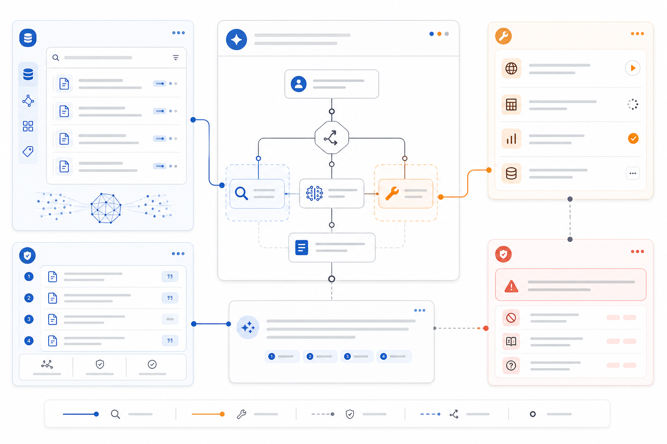
AGENT
Agent 原型把证据约束转成可演示工具
无模型二进制时返回 unavailable 和复现路径，不伪造预测。
Evidence-bound answers
Safe unavailable fallback
8 unit tests pass
Source: public repository data, result tables, imagegen manifest, and QA reports.
11

Slide 12

GITHUB
公开仓库只保留课程复现材料
论文、问卷/访谈隐私、模型二进制和认证信息不进入公开仓库。
Public: data/code/outputs/PPT
Private: manuscript/questionnaire
No joblib / pkl / env
Source: public repository data, result tables, imagegen manifest, and QA reports.
12

Slide 13
LIMITS
边界说清楚，比把结论写满更专业
不写千万样本直接训练、不写机器学习证明因果、不写 Stage 2 SME-only。
Correct source-chain wording
No causal overclaim
Questionnaire is aggregate only
Source: public repository data, result tables, imagegen manifest, and QA reports.
13

Slide 14

CLOSE
真实数据、严格验证、可复现展示
这套案例能体现机器学习课程的数据治理、模型训练、解释和工程复现。
Final PPTX and PDF
14 previews + contact sheet
Evidence map and QA
Source: public repository data, result tables, imagegen manifest, and QA reports.
14

