Slide 1
1. Bài báo NCKH
RMPE: Regional Multi-Person Pose Estimation
(Nhận dạng tư thế của nhiều người theo vùng)
Published in: 2017 IEEE International Conference on Computer Vision (ICCV)
Date of Conference: 22-29 Oct. 2017
Location: Venice, Italy
Citation: 636
https://openaccess.thecvf.com/content_ICCV_2017/papers/Fang_RMPE_Regional_Multi-Person_ICCV_2017_paper.pdf

Slide 2
2. Bài toán là gì
Multi-person pose estimation in the wild is challenging. Although state-of-the-art human detectors have demon- strated good performance, small errors in localization and recognition are inevitable. These errors can cause failures for a single-person pose estimator (SPPE), especially for methods that solely depend on human detection results. In this paper, we propose a novel regional multi-person pose estimation (RMPE) framework to facilitate pose estimation in the presence of inaccurate human bounding boxes
To illustrate the problems of previous approaches, we applied the state-of-the-art object detector Faster-RCNN [29] and the SPPE Stacked Hourglass mod- el [23]. Figure 1 and Figure 2 show two major problems: the localization error problem and the redundant detection problem.

Slide 3
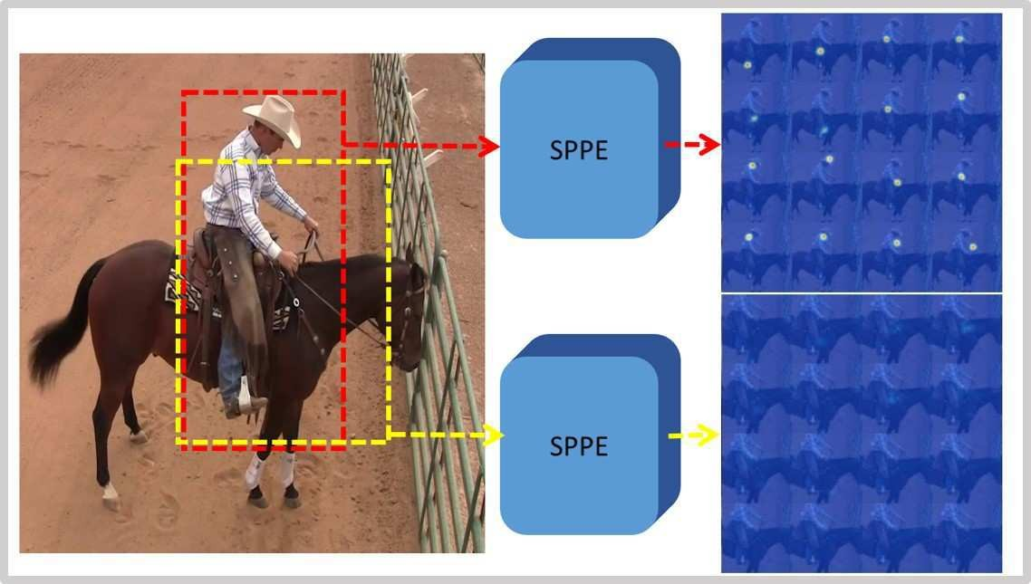
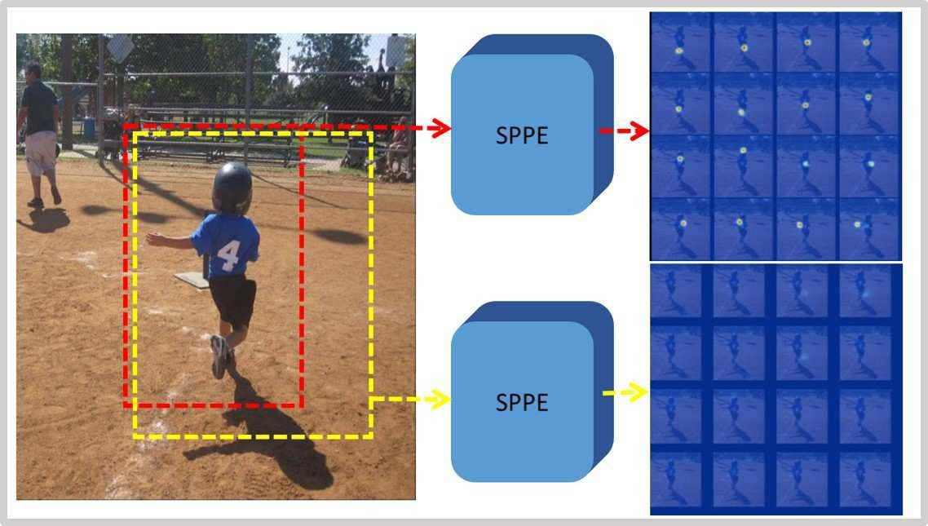
3. Vấn đề 1
Figure 1. Problem of bounding box localization errors. The red boxes are the ground truth bounding boxes, and the yellow boxes are detected bounding boxes with IoU > 0.5. The heatmaps are the outputs of SPPE [23] corresponding to the two types of boxes. The corresponding body parts are not detected in the heatmaps of the yellow boxes. Note that with IoU > 0.5, the yellow boxes are considered as “correct” detections. However, human poses are not detected even with the “correct” bounding boxes.

Slide 4
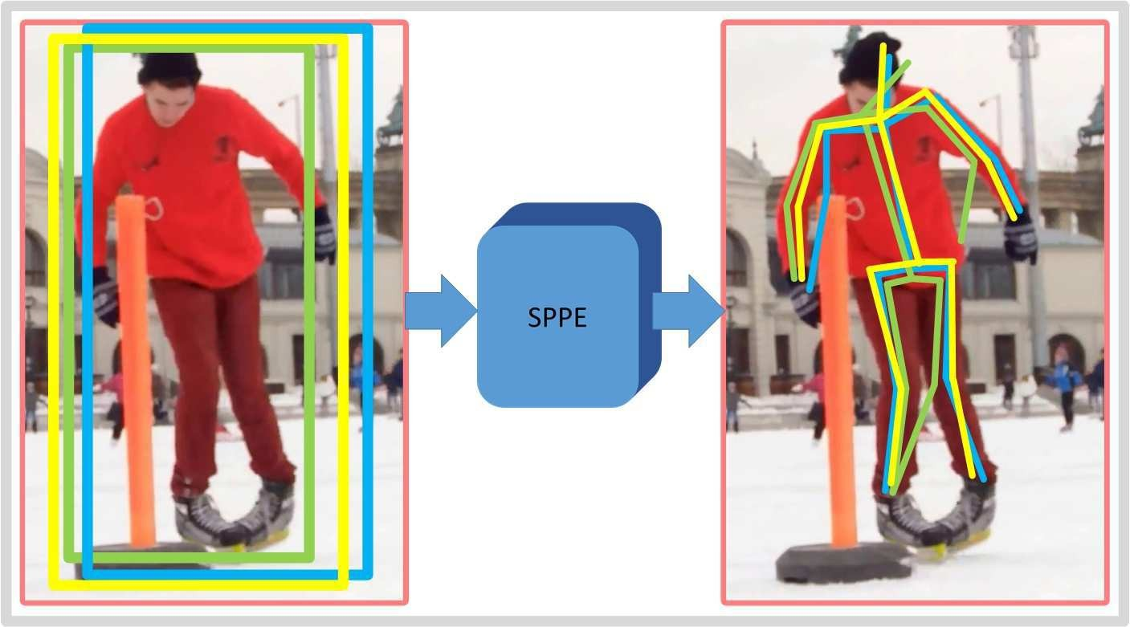
3. Vấn đề 2
Figure 2. Problem of redundant human detections. The left image shows the detected bounding boxes; the right image shows the es- timated human poses. Because each bounding box is operated on independently, multiple poses are detected for a single person.

Slide 5
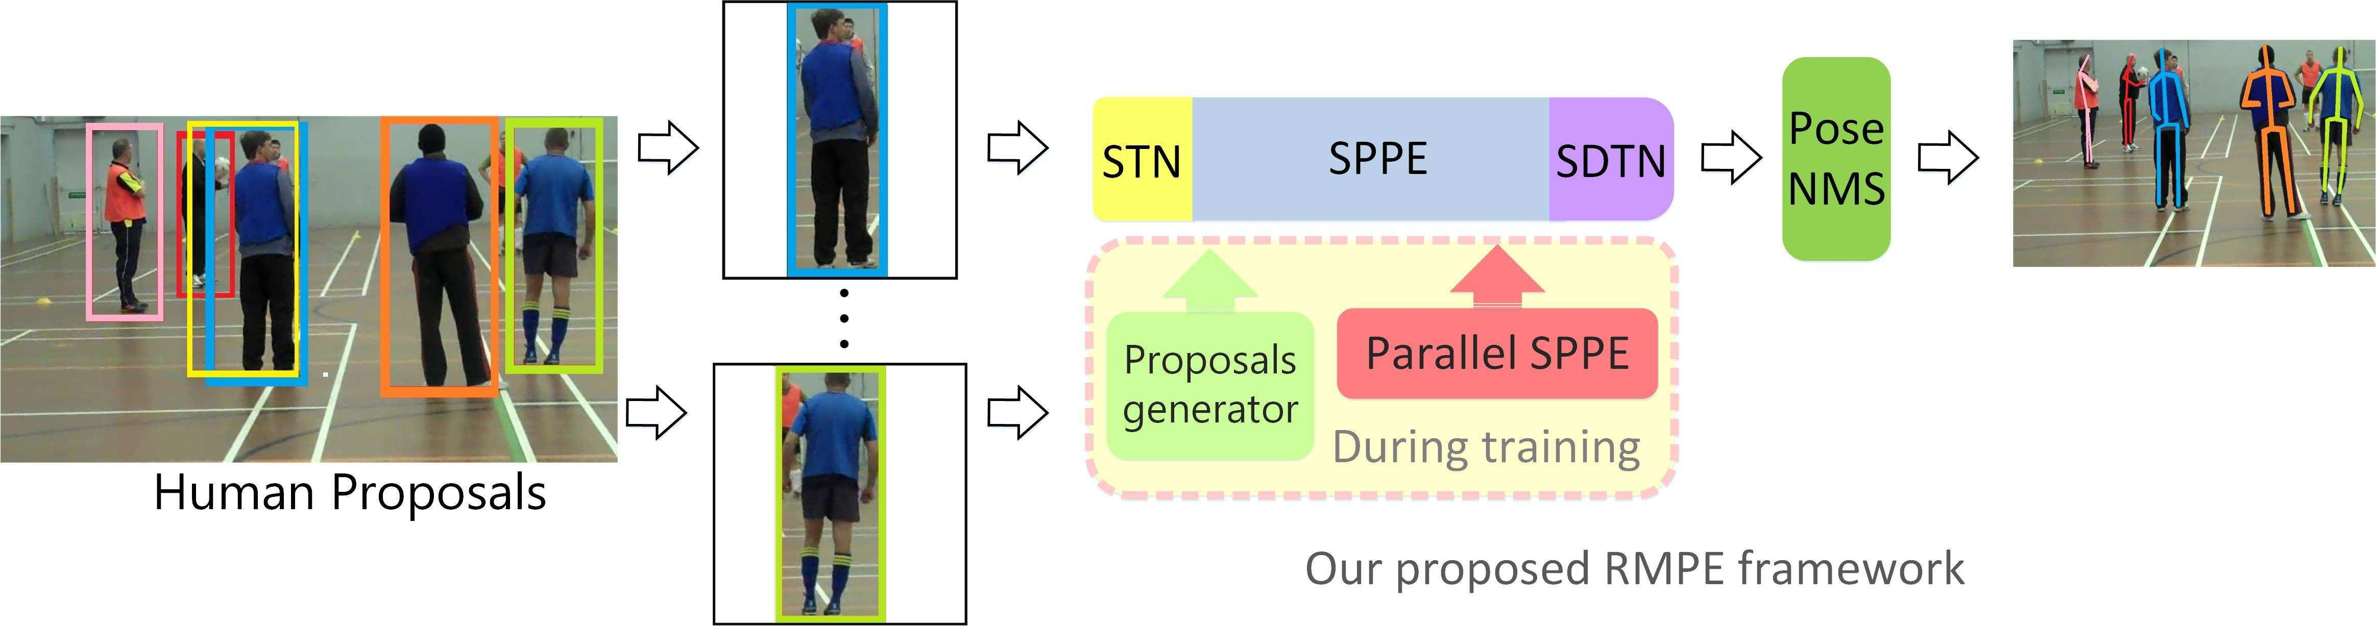
4. Ý tưởng giải quyết
To address the problem of bounding box localization error, We have designed a new symmetric spatial transformer network (SSTN) which is at tached to the SPPE to extract a high-quality single person region from an inaccurate bounding box. (Figure 1)
To address the problem of redundant detection, a parametric pose NMS is introduced. Our parametric pose NMS eliminates redundant poses by using a novel pose distance metric to compare pose similarity. A data-driven approach is applied to optimize the pose distance parameters.

Slide 6
The End.

