Slide 1
NEURON GRID IN SPIKING NEURON NETWORK
Group 03: Nguyen Le Trung – Pham Huy Hoang – Vu Hoang Long

Slide 2
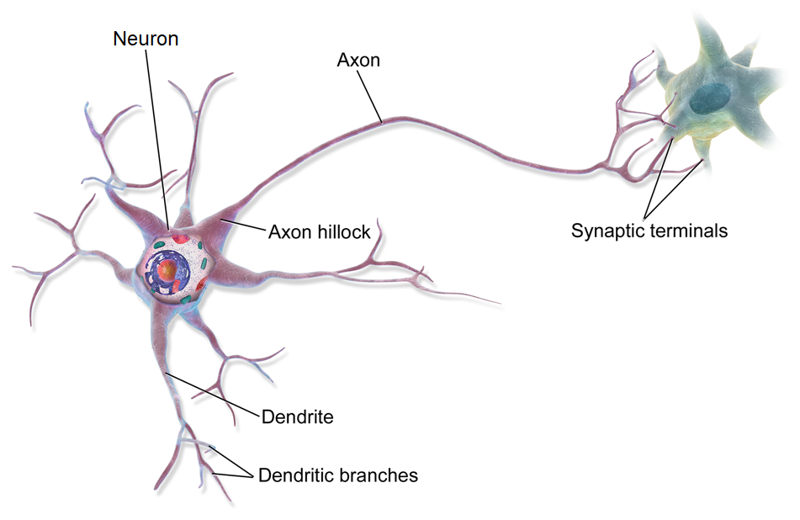
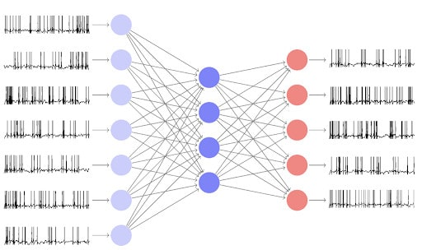
GENERAL IDEA
NEURON
NETWORK

Slide 3
TABLE OF CONTENTS
Neuron Structure
Spiking Neuron Network (SNN)
Specifications
Neuron Grid
TOP Module
4. Architecture
5. Simulation

Slide 4
NEURON STRUCTURE
y₁
y₂
.
.
.
y_{n}
Input
x₁
x₂
.
.
.
x_{n}
Output

Slide 5
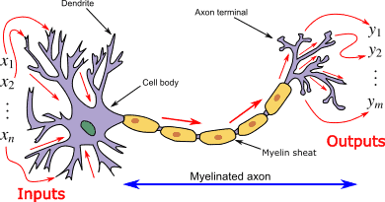
SPIKING NEURON NETWORK (SNN)^{[0]}
SNN try to mimic the natural behaviors of human’ brain.
Each neuron has a value analogous to the electrical potential of biological neurons at every certain time.
This value can be increased or decreased based on the spikes stream.
If it exceeds some threshold, the neuron will send out an impulse, then the value will instantly drop below its average.
In a SNN, neurons contact with each other by sending and sensing spikes.

Slide 6
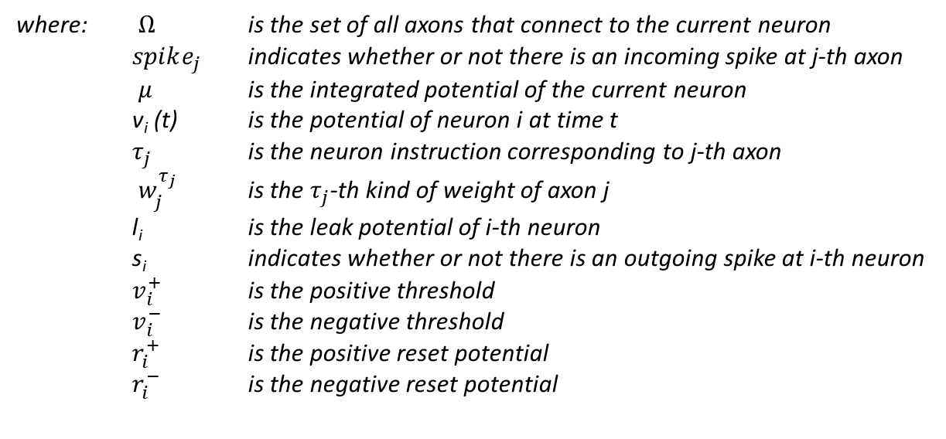
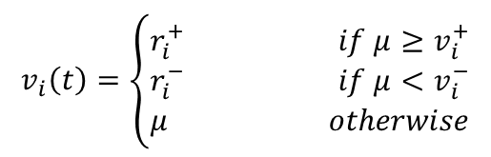
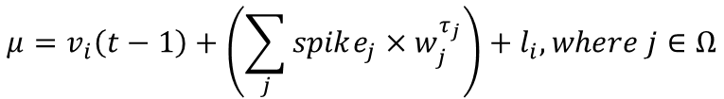

SPECIFICATIONS
$$v_{i}\left(t\right)=\left\{\begin{aligned}r_{i}^{+} if μ≥v_{i}^{+} \\ r_{i}^{−} if μ<v_{i}^{−} \\ μ otherwise\end{aligned}\right.$$
$$μ=v_{i}\left(t−1\right)+\left(\sum_{j}{{spike_{j}×w}_{j}^{τ_{j}}}\right)+l_{i}, where j∈Ω$$
$$s_{i}\left(t\right)= \left\{\begin{aligned}1 if v_{i}≥v_{i}^{+} \\ 0 otherwise\end{aligned}\right.$$
where: $Ω$ is the set of all axons that connect to the current neuron
$spike_{j}$ indicates whether or not there is an incoming spike at j-th axon
$μ$ is the integrated potential of the current neuron
v_{i} (t) is the potential of neuron i at time t
$τ_{j}$ is the neuron instruction corresponding to j-th axon
$w_{j}^{τ_{j}}$ is the $τ_{j}$-th kind of weight of axon j
l_{i} is the leak potential of i-th neuron
s_{i} indicates whether or not there is an outgoing spike at i-th neuron
$v_{i}^{+}$ is the positive threshold
$v_{i}^{−}$ is the negative threshold
$r_{i}^{+}$ is the positive reset potential
$r_{i}^{−}$ is the negative reset potential

Slide 7
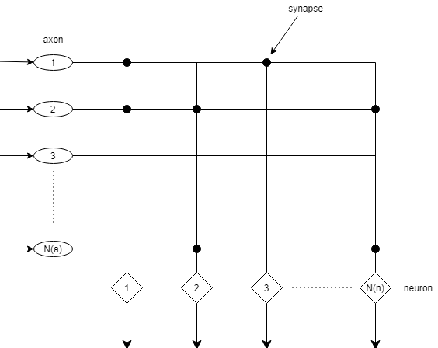
NEURON GRID
SPECIFICATIONS
Based on RANC^{[1]}
Representation: Matrix: N(a) x N(n)
N(a) = 256 axons
N(n) = 256 neurons
Iterate through N(a) axons
Iterate through N(n) neurons

Slide 8
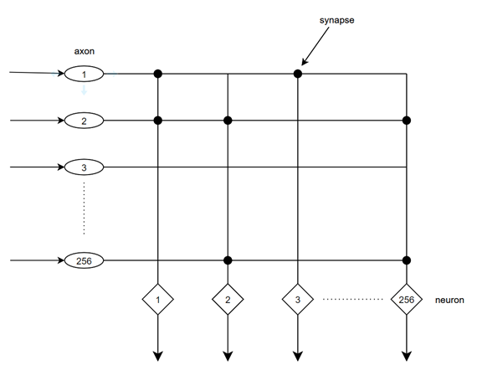
SPECIFICATIONS
axon_spikes
256
NEURON GRID
scheduler_set
synapse connections: of considered neuron with 256 axons in core. bit 1 is connected.
scheduler_clear
256
neuron_parameter
368
8
neuron_num
neuron_instruction
2
9
current potential: accumulated potential value of neuron
8
axon_num
9
reset potential: the reset value of neuron after releasing a spike
spike_out
9x4
weights 0 to 3: Value of synapse connection’s weight corresponding to considered neuron
update_potential
9
9
leak value: leak potential
tick
potential_out
neuron_parameter
clk
9
positive threshold
done
reset_n
9
negative threshold
error
1
reset mode: 2 reset modes of neuron: absoluted and linear
TOP MODULE
9
dx value
9
dy value
scheduler_set: request axon_spikes from the storage
scheduler_clear: clear the information after collected
update_potential: indicate the RAM to update potential_out into neuron_parameter
potential_out: the neuron potential after processed
8
axon destination (due to 256 axons)
spike_out: indicate the moment that there is a spike
neuron_instruction: refer to the weight types of each axon
neuron_num: address where to collect neuron_parameter from RAM
axon_num: address where to collect neuron_instruction from the storage
axon_spikes: spikes information of the entire network
4
deliver tick offset

Slide 9
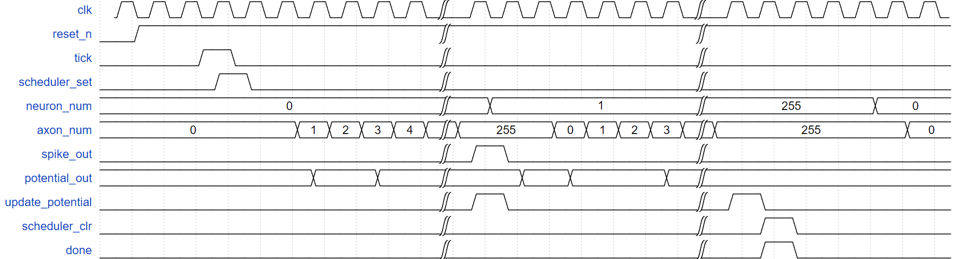
SPECIFICATIONS
Waveform

Slide 10
ARCHITECTURE
Section | Combination of RANC Token Controller and Neuron Block | Neuron Grid
Target Chip Technology | Zynq UltraScale+ MPSoC ZCU106 Evaluation | Zynq UltraScale+ MPSoC ZCU106 Evaluation
Maximum Frequency | 278.86 MHz | 331.90 MHz
Hardware Usage | 235 LUTs, 37 FFs | 277 LUTs, 30 FFs
Detecting Throughput | 676.6 Mbps | 805.3 Mbps
Latency | 66050 clocks | 66048 clocks

Slide 11
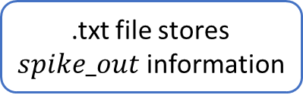
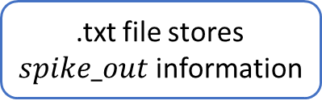
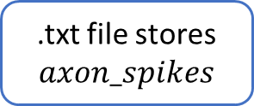
SIMULATION
.txt file stores $spike_out$ information
Verilog simulation
C++ Code
generate
.txt file stores $axon_spikes$
compare
.txt file stores $spike_out$ information
C++ simulation

Slide 12
REFERENCES
[0] "Basic Guide to Spiking Neural Networks for Deep Learning", [Online]. Available: https://cnvrg.io/spiking-neural-networks/
[1] "Spiking neural network", [Online]. Available: https://en.wikipedia.org/wiki/Spiking_neural_network.
[2] Valancius, et al., "FPGA Based Emulation Environment for Neuromorphic Architectures", 2020 IEEE International Parallel and Distributed Processing Symposium Workshops (IPDPSW), New Orleans, LA, USA, pp. 90-97, 2020.
[3] Valancius, et al., "RANC: Reconfigurable Architecture for Neuromorphic Computing", 2020.

Slide 13
THANK YOU!

