Slide 1
GROUP 08 ZF DETECTOR FOR 2x2MIMO
Nguyen Le Trung – Pham Huy Hoang – Vu Hoang Long

Slide 2
Table of contents
Theoretical Concepts and Related Works
Architecture
Verification and Synthesis Result

Slide 3
Table of contents
Theoretical Concepts and Related Works
Architecture
Verification and Synthesis Result

Slide 4
1. Theoretical Concepts and Related Works
1.1. Theoretical Concepts
1.2. Related Works

Slide 5
1.1 Theoretical Concepts
1.1.1 ZF detecting technique and 2x2MIMO
1.1.2 Data Format
1.1.3 QR Decomposition

Slide 6
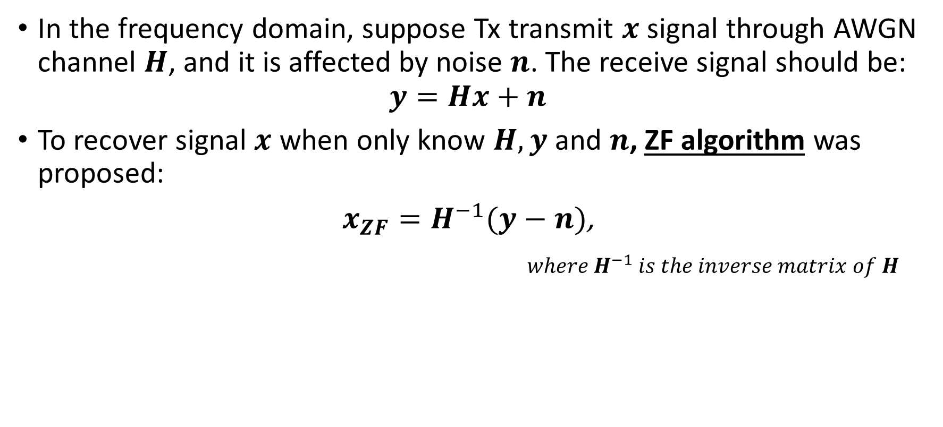
1.1.1. ZF detecting technique and 2x2MIMO
In the frequency domain, suppose Tx transmit $x$ signal through AWGN channel $H$, and it is affected by noise $n$. The receive signal should be:
$$y=Hx+n$$
To recover signal $x$ when only know $H,y$ and $n$, ZF algorithm was proposed:
$x_{ZF}=H^{−1}(y−n)$,
$where H^{−1} is the inverse matrix of H$

Slide 7
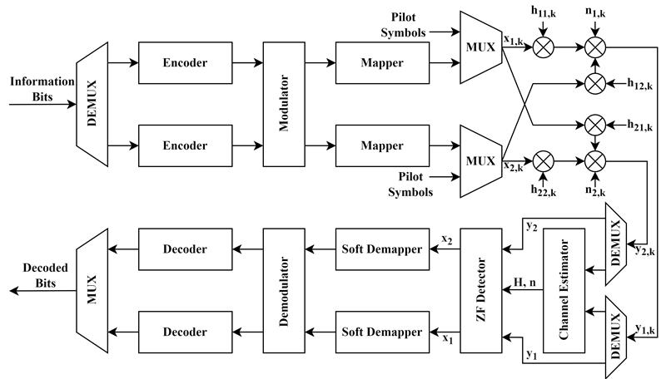
1.1.1. ZF detecting technique and 2x2MIMO
Transmission model of a 2×2MIMO with ZF detection

Slide 8
1.1.2. Data format
Each matrix component is a real number, use signed fixed point 16-bit binary to represent each real number.
1 bit
3 bits
12 bits
Sign bit
characteristic (integer part)
Mantissa (fractional part)
-0.5₁₀ = 1000100000000000

Slide 9
1.1.2. Data format
How do we represent complex number?
a | -b
b | a
0.5 | 0.2
-0.2 | 0.5
a + jb
0.5 – j0.2

Slide 10
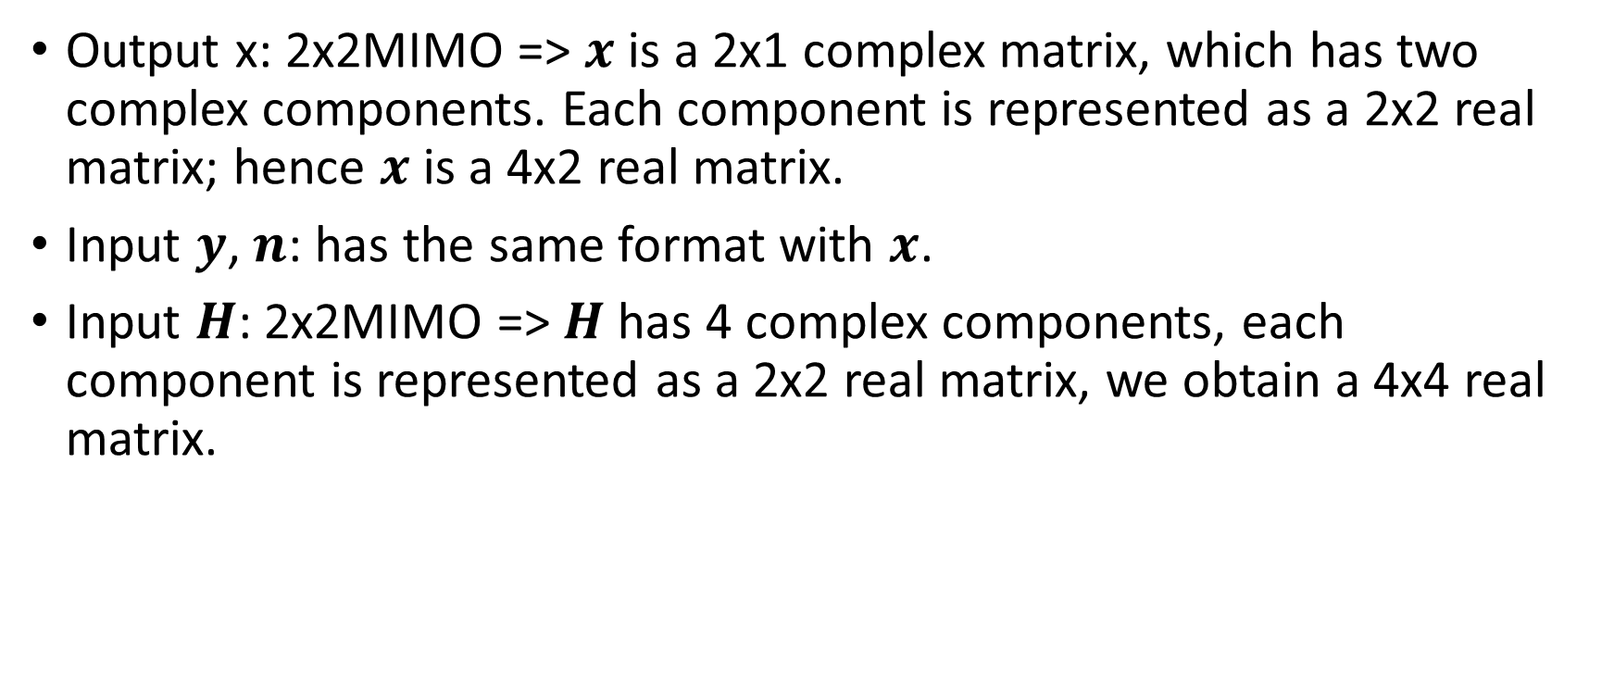
1.1.2. Data format
Output x: 2x2MIMO => $x$ is a 2x1 complex matrix, which has two complex components. Each component is represented as a 2x2 real matrix; hence $x$ is a 4x2 real matrix.
Input $y$, $n$: has the same format with $x$.
Input $H$: 2x2MIMO => $H$ has 4 complex components, each component is represented as a 2x2 real matrix, we obtain a 4x4 real matrix.

Slide 11
1.1.2. Data format
a₁ | -b₁
b₁ | a₁
a₂ | -b₂
b₂ | a₂
a₁ | -b₁ | a₂ | -b₂
b₁ | a₁ | b₂ | a₂
a₃ | -b₃ | a₄ | -b₄
b₃ | a₃ | b₄ | a₄
a₁ + jb₁
a₂ +jb₂
a₁ + jb₁ | a₂ + jb₂
a₃ +jb₃ | a₄ + jb₄
2x1 complex matrix to 4x2 real matrix
2x2 complex matrix to 4x4 real matrix

Slide 12
1.1.2. Data format
Bit stream index for matrices (from MSB to LSB)
127:112 | 111:96
95:80 | 79:64
63:48 | 47:32
31:16 | 15:0
255:240 | 239:224 | 223:208 | 207:192
191:176 | 175:160 | 159:144 | 143:128
127:112 | 111:96 | 95:80 | 79:64
63:48 | 47:32 | 31:16 | 15:0
4x2 matrix
4x4 matrix

Slide 13
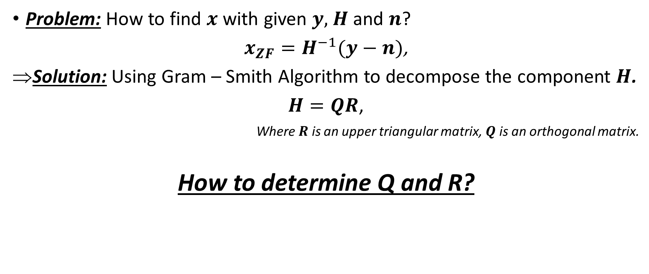
1.1.3. QR-decomposition
Problem: How to find $x$ with given $y,$ $H$ and $n$?
$x_{ZF}=H^{−1}(y−n)$,
Solution: Using Gram – Smith Algorithm to decompose the component $H$.
$H=QR$,
Where $R$ is an upper triangular matrix, $Q$ is an orthogonal matrix.
How to determine Q and R?

Slide 14
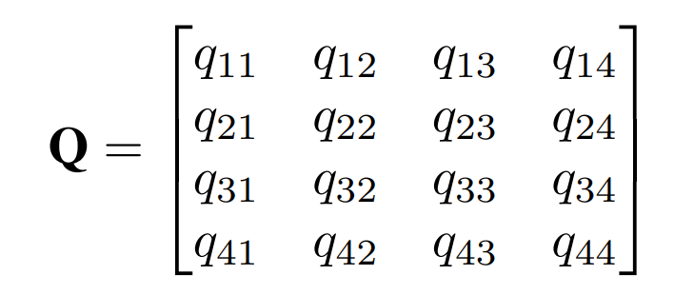
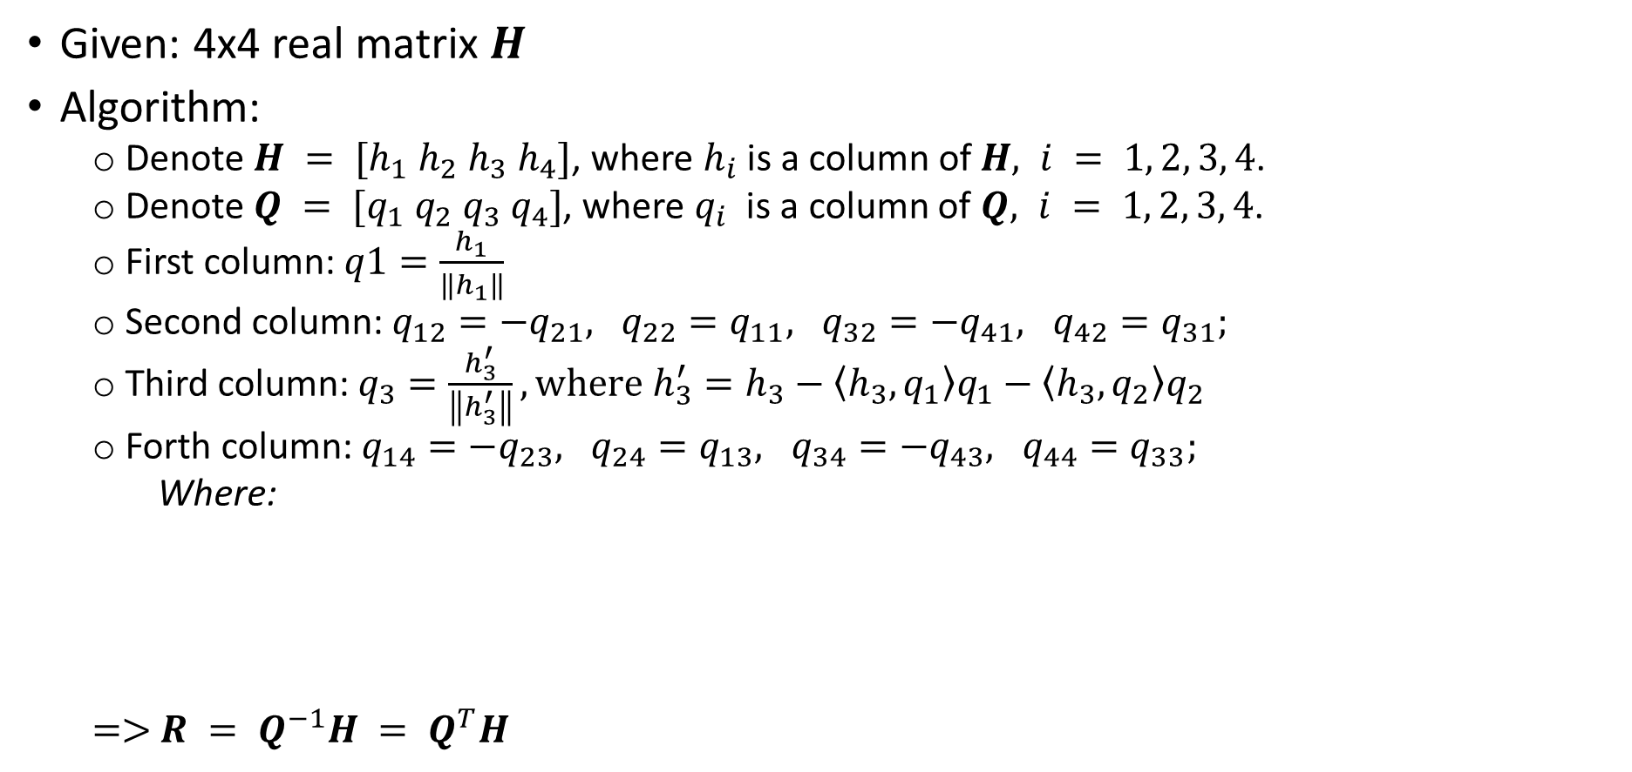
1.1.3. QR-decomposition
Given: 4x4 real matrix $H$
Algorithm:
Denote $H = [h_{1} h_{2} h_{3} h_{4}]$, where $h_{i}$ is a column of $H, i = 1, 2, 3, 4$.
Denote $Q = [q_{1} q_{2} q_{3} q_{4}]$, where $q_{i}$ is a column of $Q, i = 1, 2, 3, 4$.
First column: $q1=\frac{h_{1}}{\left\|h_{1}\right\|}$
Second column: $q_{12}=−q_{21}, q_{22}=q_{11}, q_{32}=−q_{41}, q_{42}=q_{31};$
Third column: $q_{3}=\frac{h_{3}^{′}}{\left\|h_{3}^{′}\right\|}, where h_{3}^{′}=h_{3}−〈h_{3},q_{1}〉q_{1}−〈h_{3},q_{2}〉q_{2}$
Forth column: $q_{14}=−q_{23}, q_{24}=q_{13}, q_{34}=−q_{43}, q_{44}=q_{33};$
Where:
$=>$ $R = Q^{−1}H = Q^{T}H$

Slide 15
1. Theoretical Concepts and Related Works
1.1. Theoretical Concepts
1.2. Related Works

Slide 16
1.2 Related Works
In [3], P. Luethi et al. : a VLSI implementation of High-Speed Iterative Sorted MMSE QR Decomposition which leads out the throughput.
In [4], P. Luethi et al. : design of Gram-Schmidt-based QR Decomposition for MIMO Detection.
In [5], W. Zhao et al.: a new scalable QRD structure based on the master-slave-pair element leading to improvement of throughput/area efficency.
In [6], V.S Trinh et al.: the implementation of low-complexity detector for high-rate spatial modulation, which results very high throughput, compared to the three mentions before.

Slide 17
1.2 Related Works
However, beside the very efficient algorithm, their implementation of hardware on FPGA seems not to be the most optimized one.
Our work:
Re-design the hardware architecture
Optimize the resource
Achieve higher throughput

Slide 18
Table of contents
Theoretical Concepts and Related Works
Architecture
Verification and Synthesis Result

Slide 19
2. Architecture
2.1. General Architecture
2.2. Sub-modules

Slide 20




2.1 General Architecture
Given:
$$y=Hx+n$$
To recover $x$:
Because $R$ is an upper triangular matrix, we can easily find $x$.
$$y=QRx+n$$
$$⇒Q^{T}y=Rx+Q^{T}n$$
$$⇒Rx=Q^{T}\left(y−n\right)$$

Slide 21
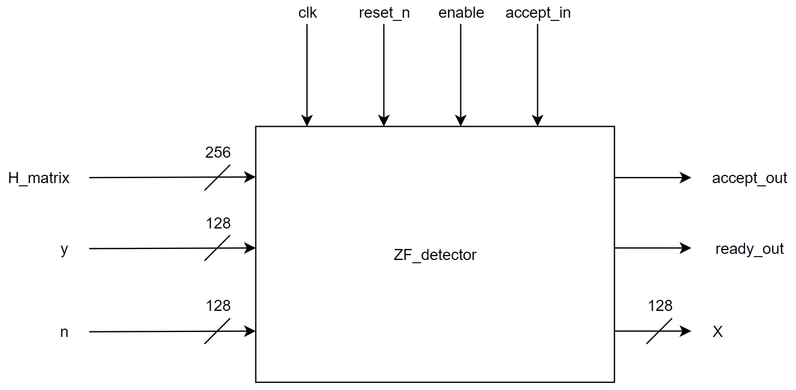
2.1 General Architecture
TOP module

Slide 22
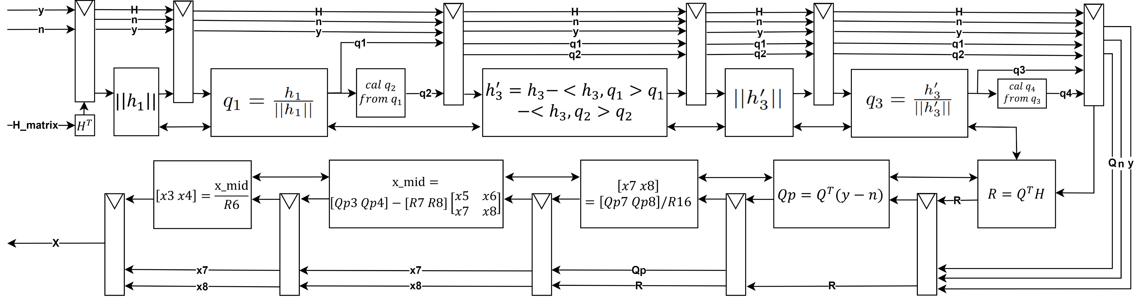
2.1 General Architecture

Slide 23
2. Architecture
2.1. General Architecture
2.2. Sub-modules

Slide 24
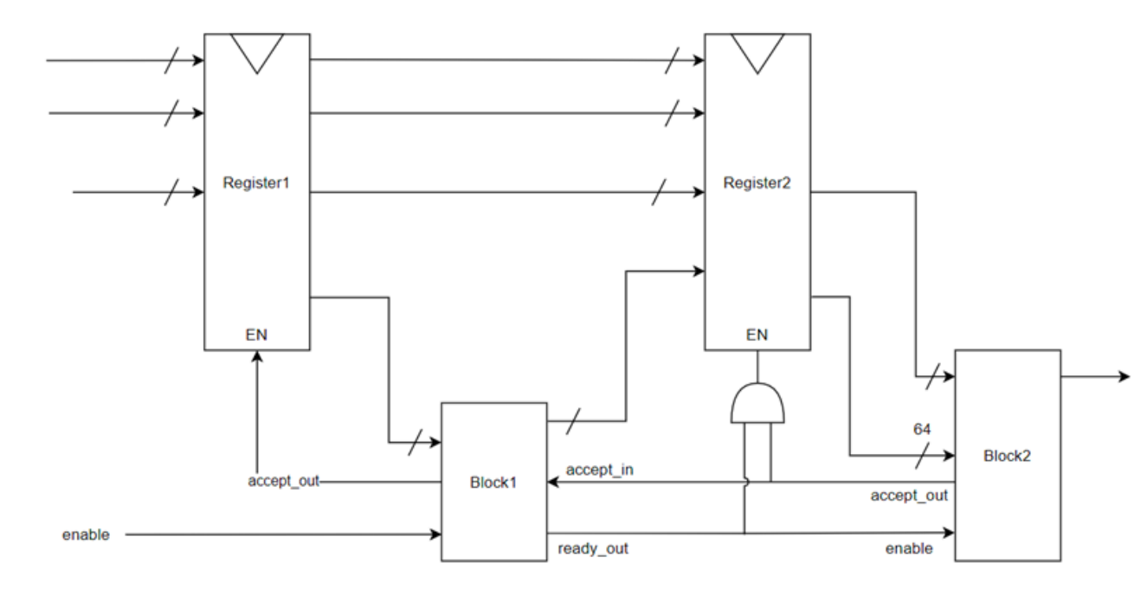
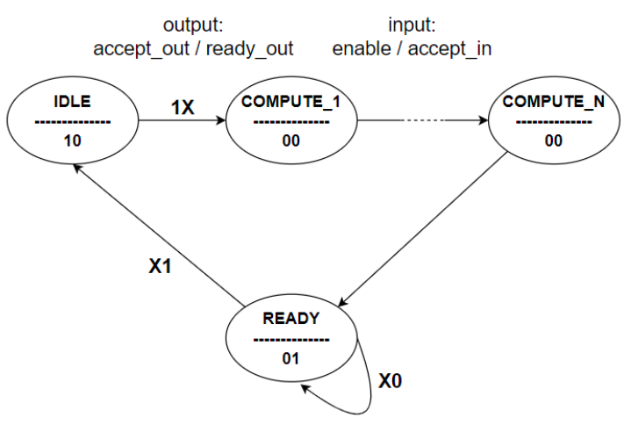
2.2 Sub-modules
All sub-modules in our pipeline architecture have the same concept of finite state machine
FSM of a sub-module
Connection between sub-blocks inside pipeline architecture

Slide 25
Table of contents
Theoretical Concepts and Related Works
Architecture
Verification and Synthesis Result

Slide 26
3. Verification and Synthesis Result
3.1. Verification
3.2. Synthesis Result

Slide 27
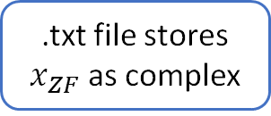
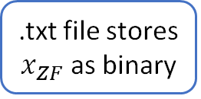
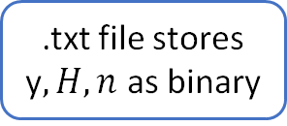
3.1 Verification
execute
.txt file stores $x_{ZF}$as binary
convert()
.txt file stores $x_{ZF}$as complex
Verilog Code
C++ Code
check_result()
accuracy
.txt file stores y$, H, n$ as binary
ZF_DETECTOR()
.txt file stores $x_{ZF}$as complex
C++ Code
generate
C++ Code

Slide 28
3. Verification and Synthesis Result
3.1. Verification
3.2. Synthesis Result

Slide 29
3.2 Synthesis Result
This work
Section | [3] | [4] | [5] | [6] | QR decomposition |  | ZF – Detector (Base on QRD)
Algorithm | GR-SQRD | MGS-SQRD | GR | ISQRD Sorted MGS | GS – QRD
Target Chip Technology | 0.25um IP/5M CMOS | UMC 0.18um IP/6M CMOS | Xilinx Virtex-6 | Xilinx Virtex-5 | Zynq UltraScale+ ZCU106 Evaluation Platform
Element bit-width | 13-bit | 20-bit | 12-bit | 12-bit | 16-bit | 32-bit | 16-bit | 32-bit
MaxFreq. | 166 MHz | 162 MHz | 128 MHz | 365 MHz | 467 MHz | 293 MHz | 467 MHz | 293 MHz
Hardware Usage | 54k gates | 61.8k gates | 1851 Slices | 26128 FFs 17197 LUTs 260 DSPs | 4,843 FFs 6684 LUTs 80 DSPs | 11535 FFs 14092 LUTs 320 DSPs | 6933 FFs 6564 LUTs 66 DSPs | 15266 FFs 13640 LUTs 264 DSPs
Detect Throughput | 432.6 Mbps | 499.2 Mbps | 179.3 Mbps | 2.9 Gbps | 4.1 Gbps | 2.6 Gbps | 8.2 Gbps | 5.3 Gbps
Latency | 80 clocks | 104 clocks | 137 clocks | 165 clocks | 114 clocks | 198 clocks | 184 clocks | 324 clocks

Slide 30
REFERENCES
[1] T.-B. Nguyen, T.-D. Nguyen, M.-T. Le, and V.-D. Ngo, “Efficiency zero-forcing detectors based on group detection for massive mimo systems,” in 2017 International Conference on Advanced Technologies for Communications (ATC), 2017, pp. 48–53.
[2] I.-W. Lai, S. Godtmann, T.-D. Chiueh, G. Ascheid, and H. Meyr, “Asymptotic ber analysis for mimo-bicm with zero-forcing detectors assuming imperfect csi,” in 2008 IEEE International Conference on Communications, 2008, pp. 1238–1242.
[3] P. Luethi, A. Burg, S. Haene, D. Perels, N. Felber, and W. Fichtner, “Vlsi implementation of a high-speed iterative sorted mmse qr decomposition,” in 2007 IEEE International Symposium on Circuits and Systems, 2007, pp. 1421–1424.
[4] P. Luethi, C. Studer, S. Duetsch, E. Zgraggen, H. Kaeslin, N. Felber, and W. Fichtner, “Gram-schmidt-based qr decomposition for mimo detection: Vlsi implementation and comparison,” in APCCAS 2008 - 2008 IEEE Asia Pacific Conference on Circuits and Systems, 2008, pp. 830–833.
[5] W. Zhao, J. Lin, and S.-C. Chan, “Throughput/area efficient fpga implementation of qr decomposition for mimo systems,” in 2016 IEEE International Conference on Digital Signal Processing (DSP), 2016, pp. 522–526.
[6] V.-D. N. Van-Son Trinh, Thuong-Duc Duong, “High throughput fpga implementation of low-complexity detector for high-rate spatial modulation,” 2020.
[7] M. Viswanathan, Wireless Communication Systems in Matlab, 2nd ed., 2020.
[8] 2x2 mimo. [Online]. Available: https://halberdbastion.com/resources/ wireless/mimo/2x2-mimo
[9] (2022) Qr decomposition. [Online]. Available: https://en.wikipedia.org/ wiki/QR decomposition
[10] R. V. W. Putra, “A novel fixed-point square root algorithm and its digital hardware design,” in International Conference on ICT for Smart Society, 2013, pp. 1–4.
[11] H. Thapliyal, T. S. S. Varun, E. Munoz-Coreas, K. A. Britt, and T. S. Humble, “Quantum circuit designs of integer division optimizing t-count and t-depth,” in 2017 IEEE International Symposium on Nanoelectronic and Information Systems (iNIS), 2017, pp. 123–128.
[12] P. Desai, S. Aslan, and J. Saniie, “Fpga implementation of gram-schmidt qr decomposition using high level synthesis,” in 2017 IEEE International Conference on Electro Information Technology (EIT), 2017, pp. 482– 487

Slide 31
Thank you!

