Slide 1
Ryana Calendars

Slide 2
Group 1
Members list :
Le Nguyen Kha ( Leader )
Le Nguyen Toan
Vuong Hoang Long
Instructors:
Nguyen Van Trong
Let’s Go !!!

Slide 3
Contents
First
Research Purpose
Introduce Website
Second
Website Interface & Functionality
Third
Advantage & Disadvantage
Fourth
Fifth
Development

Slide 4
RESEARCH
PURPOSES
Our team was assigned to the project to design a sales website that includes products: calendars, journals, diaries and folders. We decided to design the website with the following criteria:
Create a simple interface, easy to use, easy access for new people or have used the internet for a long time.
Help people save time and solve problems when choosing product.

Slide 5
INTRODUCE
We built Ryana Calendars in learned languages like HTML, CSS, and some basic JavaScript. Ryana Calendars has basic functions such as being able to select the item to search, categorize the item according to its function, view product details, search for it on Google Map, send feedback to the admin. In the languages mentioned above we have been trying for the past 1 month to do the best we can for ourselves, now I invite teachers and everyone to see the results of our group.
Please

Slide 6
Add And Remove Products
Update And Maintenance
Admin
Provide User Account

Slide 7
Buy Products
Feedback
Customer
Message For Admin

Slide 8
WEBSITE INTERFACE AND FUNCTIONALITY

Slide 9

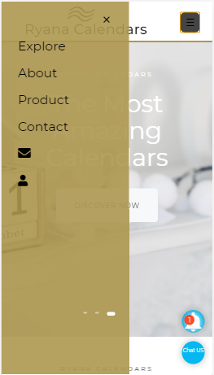
Home Page

Slide 10
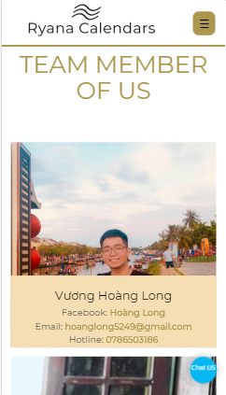
Contact

Slide 11
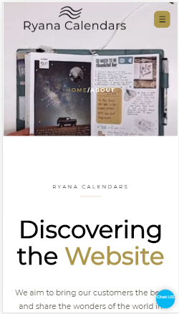
About Us

Slide 12
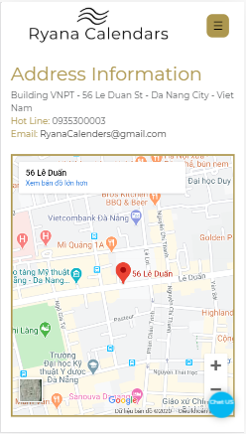
Map

Slide 13
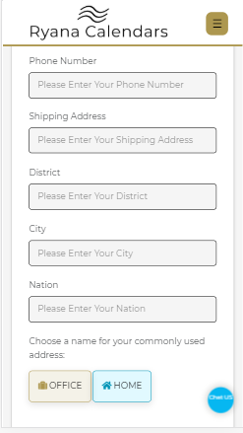
Information Customer

Slide 14
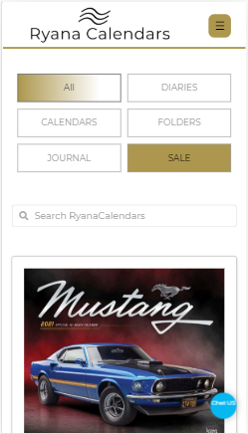
ALL Products

Slide 15

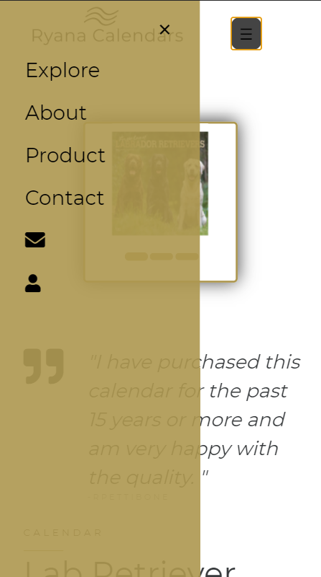
Demo Product 1

Slide 16

Product description and reviews

Slide 17
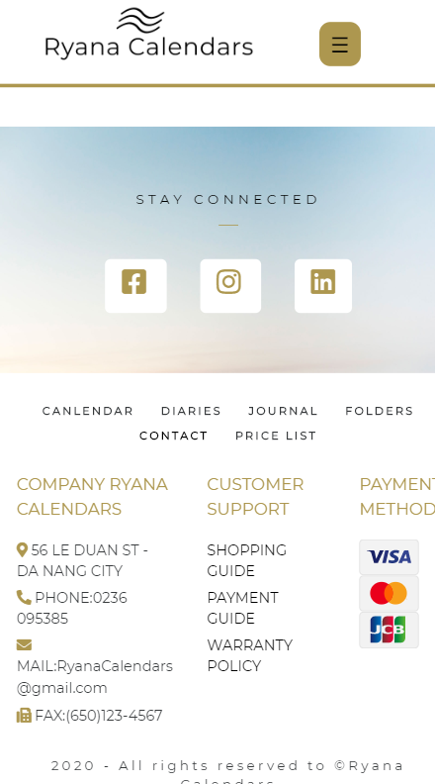
Footer

Slide 18
ADVANTAGE AND DISVANTAGE

Slide 19
Advantage
The dedicated guidance of the instructor
Learn a lot about HTML and CSS
Know how to use Github in teamwork
Solidarity of team members
Planning carefully before implementing the project

Slide 20
Disvantage
Not fluent in Javascript
No experience in designing websites
The code is not optimized
Some functions have not been perfected
Restriction about English

Slide 21
DEVELOPMENT

Slide 22
Database development
Code optimization
More funcitons for the website
Developed on the mobile platform
Online marketing on social networking

Slide 23

I would like to thank Mr. Nguyen Dinh Trong for creating favorable conditions and helping our team in the process of making a project. Thank you, everyone in the group, for always trusting and promoting each other to come today.
However, due to limited time and many other reasons, although our team has tried our best, our project still has many shortcomings and limitations.
We look forward to the sympathy and advice of the board teachers and friends.

Slide 24
Thank You For Watching

