Slide 1
GrabCut 算法的实现、分析与改进
枚辉煌 1800094810：算法实现与改进
李佩轩 1800012994：算法分析与对比

Slide 2
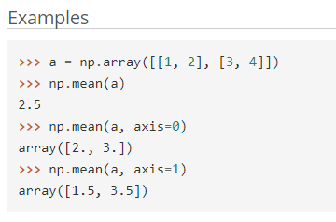
GrabCut 算法实现
两个版本：Python vs C++
Python
调包一时爽，一直调包一直爽：numpy, sklearn.mixture.GaussianMixture, opencv
Easy to write, hard to debug: np.mean(a)
Slow performance! 30s/iteration
C++
只用 opencv 来处理图像与计算矩阵的特征值
写起来比较麻烦，但是能掌握自己的代码运行过程，便于debug
比 python 版本快 10 倍！

Slide 3
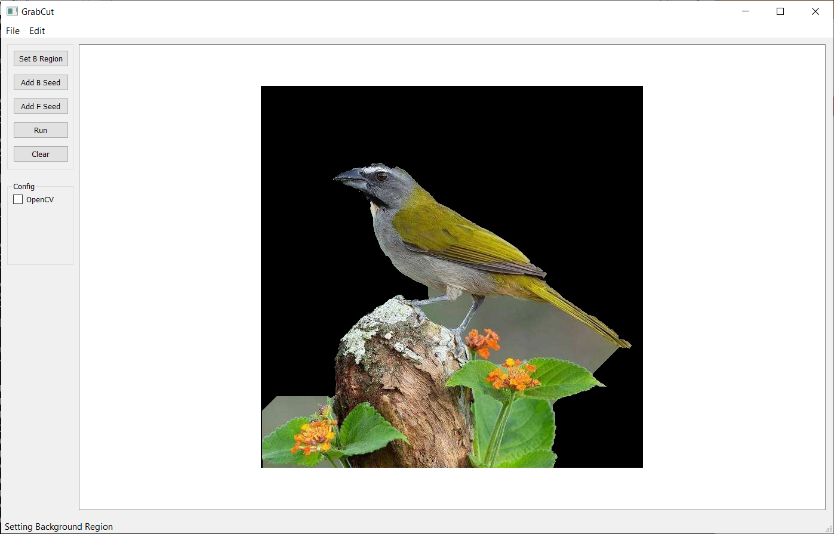
Python 版本

Slide 4
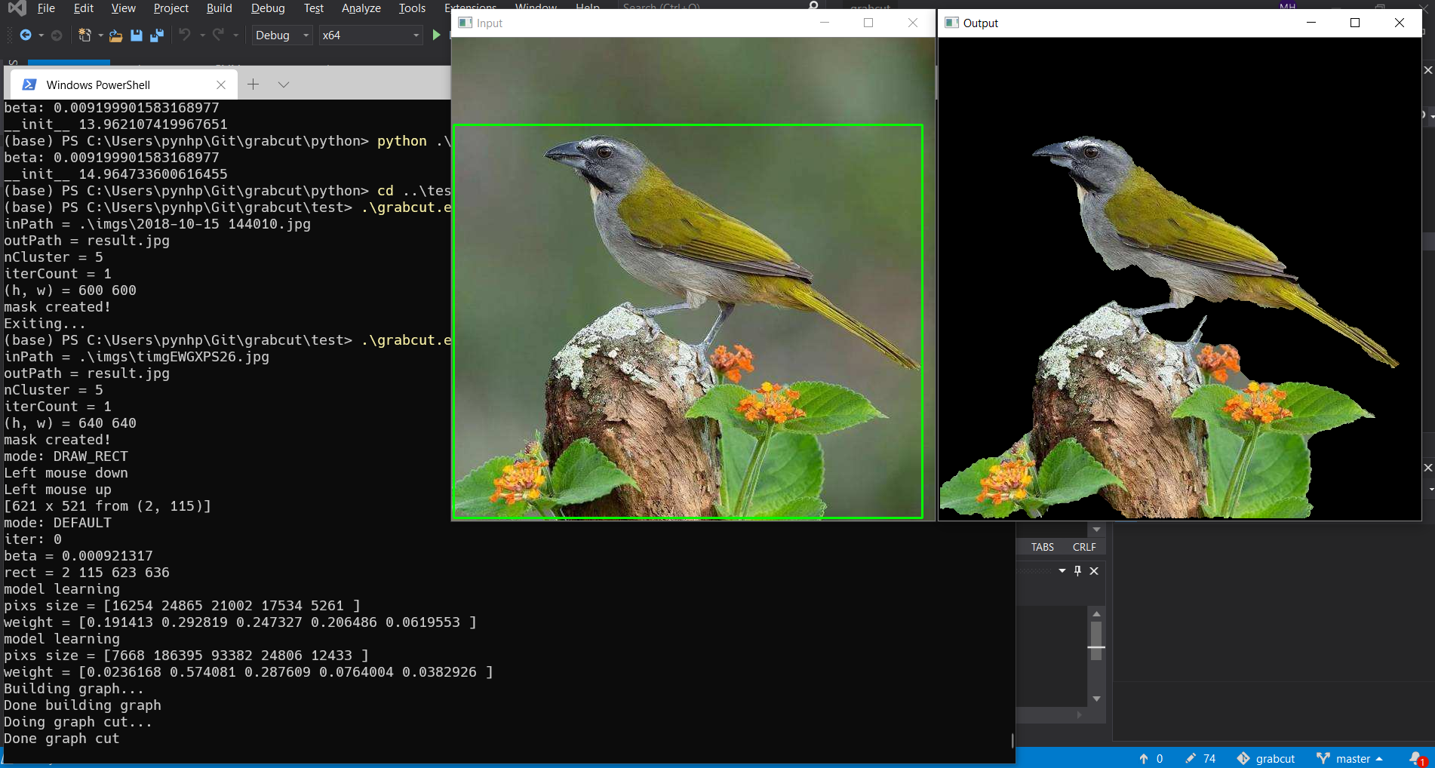
C++ 版本

Slide 5
GrabCut 算法回顾
User draws a rectangle, pixels outside rectangle are set as background, pixels inside rectangle are temporarily set as foreground
Use clustering algorithms to initialize FGD/BGD GMMs.
Assign pixels to the most likely component in GMMs.
Learn GMM parameters
Use Graph Cut algorithm to classify pixels to FGD/BGD model.
Repeat step 3-5 until the classification converges.

Slide 6
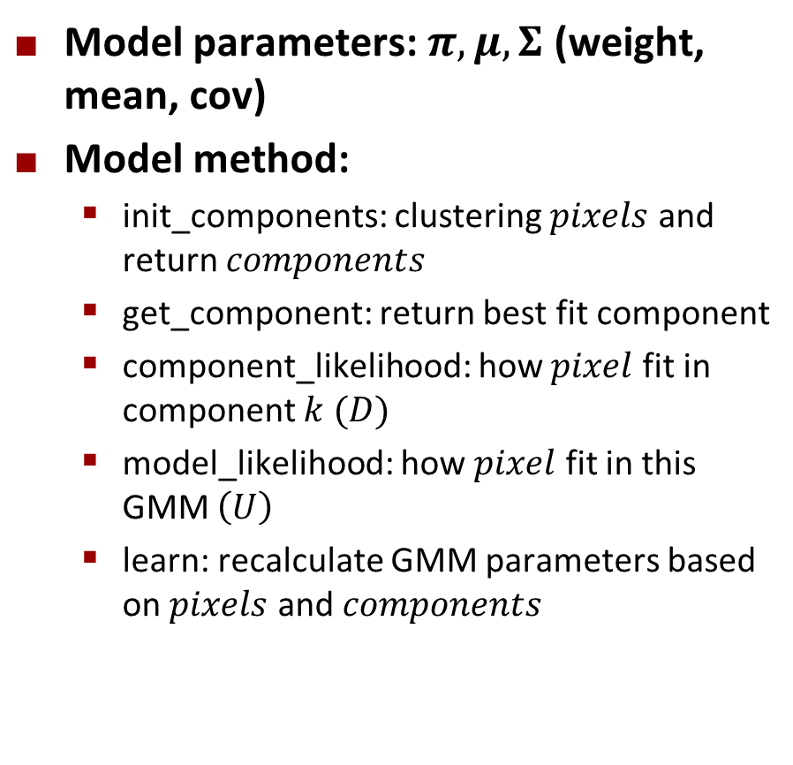
Gaussian Mixture Model
class GMM
{
public:
const static int K = 5;
double weight[K];
double mean[K][3];
double cov[K][3][3];
double det_cov[K];
double inv_cov[K][3][3];
void init_components(const vector<Vec3b>& pixels, VecIndex &components);
Index get_component(const Vec3b &pixel);
double component_likelihood(const Vec3b &pixel, int k);
double model_likelihood(const Vec3b &pixel);
void learn(const vector<Vec3b>& pixels, const VecIndex& components);
};
Model parameters: $π,μ,Σ$ (weight, mean, cov)
Model method:
init_components: clustering $pixels$ and return $components$
get_component: return best fit component
component_likelihood: how $pixel$ fit in component $k$ $(D)$
model_likelihood: how $pixel$ fit in this GMM $\left(U\right)$
learn: recalculate GMM parameters based on $pixels$ and $components$

Slide 7
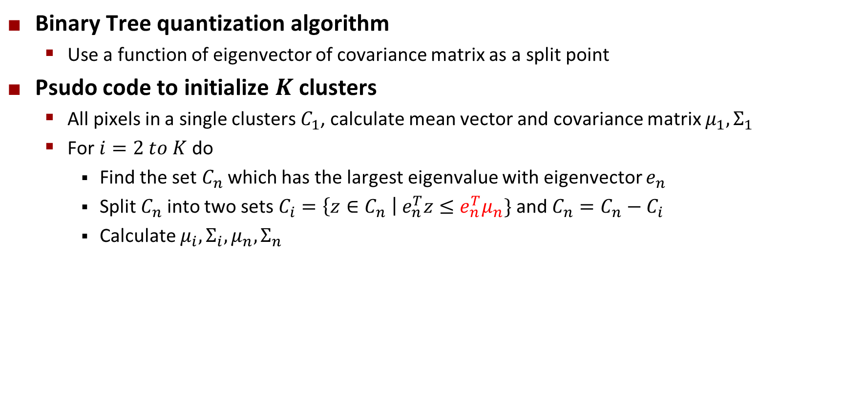
init_components
Binary Tree quantization algorithm
Use a function of eigenvector of covariance matrix as a split point
Psudo code to initialize $K$ clusters
All pixels in a single clusters $C_{1}$, calculate mean vector and covariance matrix $μ_{1}, Σ_{1}$
For $i=2 to K$ do
Find the set $C_{n}$ which has the largest eigenvalue with eigenvector $e_{n}$
Split $C_{n}$ into two sets $C_{i}=\left\{z∈C_{n} \right| e_{n}^{T}z≤e_{n}^{T}μ_{n}\}$ and $C_{n}=C_{n}−C_{i}$
Calculate $μ_{i},Σ_{i}, μ_{n}, Σ_{n}$

Slide 8
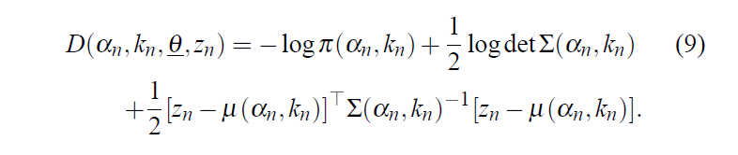
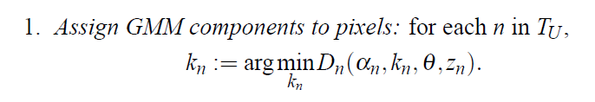
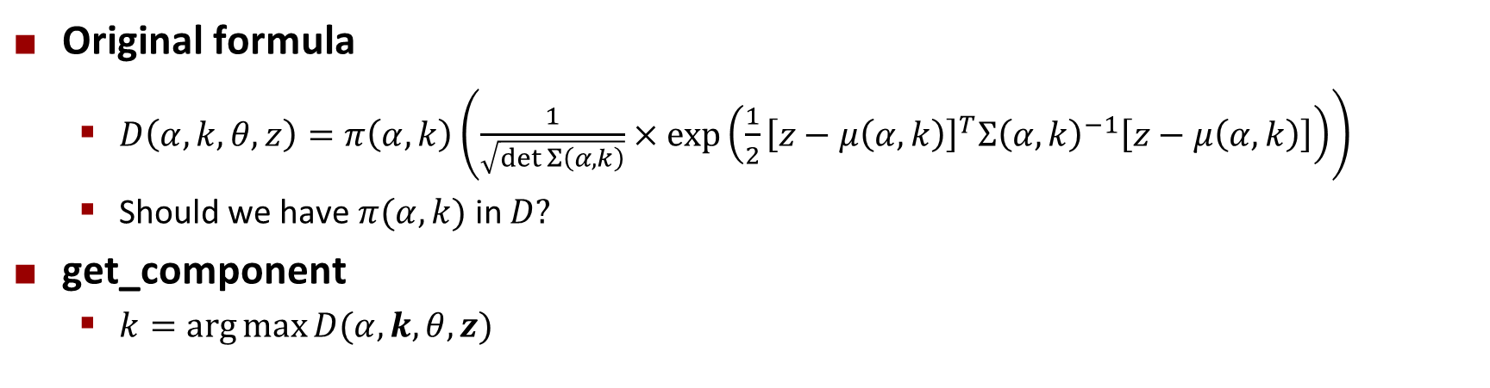
component_likelihood and get_component
Original formula
$D\left(α,k, θ, z\right)=π\left(α, k\right)\left(\frac{1}{\sqrt{\det{Σ\left(α,k\right)}}}×exp⁡\left(\frac{1}{2}{\left[z−μ\left(α,k\right)\right]}^{T}Σ{\left(α,k\right)}^{−1}\left[z−μ\left(α,k\right)\right]\right)\right)$
Should we have $π(α,k)$ in $D?$
get_component
$k=\arg{\max{D(α,k, θ,z)}}$

Slide 9

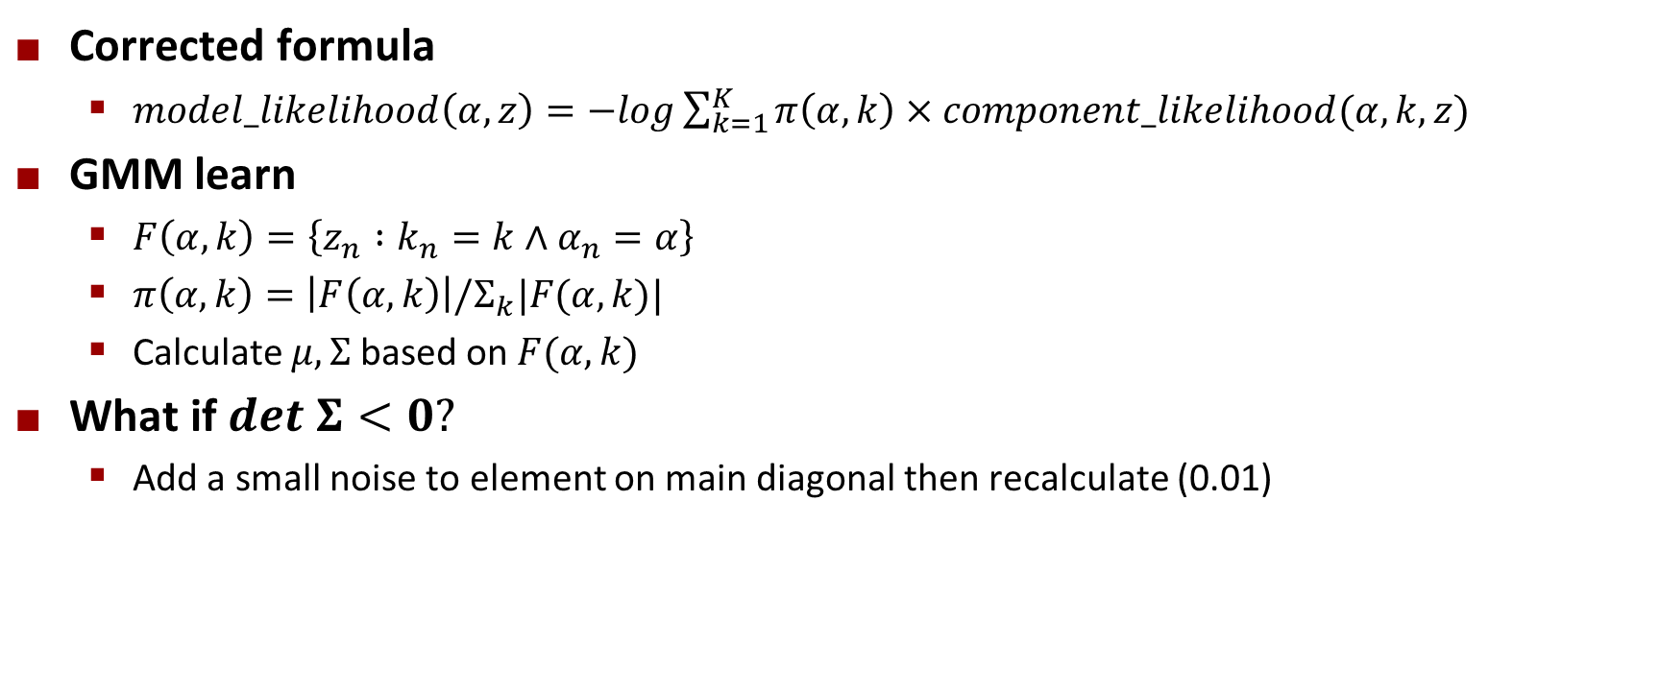
model_likelihood and learn
Corrected formula
$model_likelihood\left(α,z\right)=−log\sum_{k=1}^{K}{π\left(α,k\right)×component_likelihood(α,k,z)}$
GMM learn
$F\left(α,k\right)=\left\{z_{n} :k_{n}=k∧α_{n}=α\right\}$
$π\left(α,k\right)=\left|F\left(α,k\right)\right|/Σ_{k}|F(α,k)|$
Calculate $μ,Σ$ based on $F(α,k)$
What if $det Σ<0?$
Add a small noise to element on main diagonal then recalculate (0.01)

Slide 10



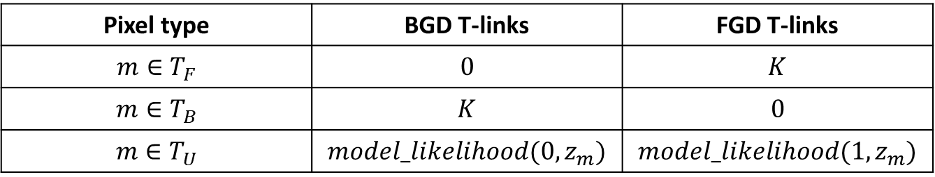
Graph Cut
N-links: 8 neighboring edges for each pixel, define smoothness term $V$
$N\left(m,n\right)=\frac{γ}{dist(m,n)}×\exp{(−β{\left\|z_{m}−z_{n}\right\|}^{2})}$
$γ=50, β={\left(2\left\langle {\left\|z_{m}−z_{n}\right\|}^{2}\right\rangle \right)}^{−1}$
T-links: edges connect from BGD source to pixels and from pixels to FGD source, define color fit term $U$
$K$ is the greatest $N$-links weight in graph
Pixel type | BGD T-links | FGD T-links
$$m∈T_{F}$$ | $$0$$ | $$K$$
$$m∈T_{B}$$ | $$K$$ | $$0$$
$$m∈T_{U}$$ | $$model_likelihood(0, z_{m})$$ | $$model_likelihood(1, z_{m})$$

Slide 11
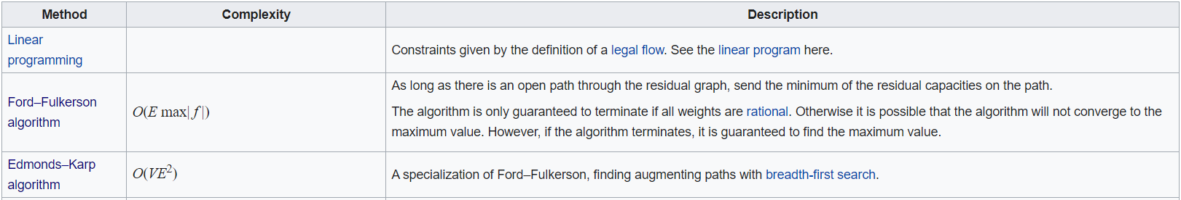
Maximum Flow
Cannot use Ford-Fulkerson or Edmond-Karp algorithm because of real capacity
Boykov-Kolmogorov Maximum Flow
An efficient way to compute the max-flow for computer vision related graph
Source code: https://pub.ist.ac.at/~vnk/software.html

