Slide 1

SBS

Slide 2
Overview
Introduction
Class Diagram
Demo
Conclusion

Slide 3

Introduction

Slide 4

Introduction

Slide 5
Class Diagram

Slide 6

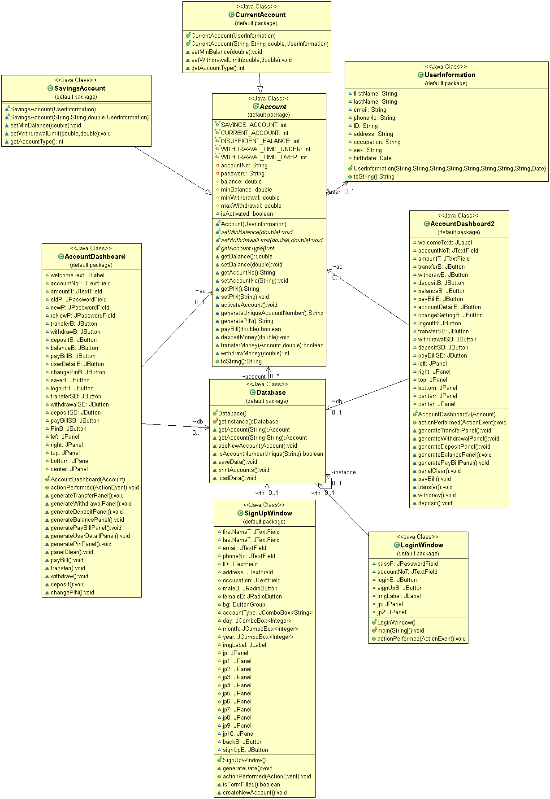





Slide 7
Demo

Slide 8
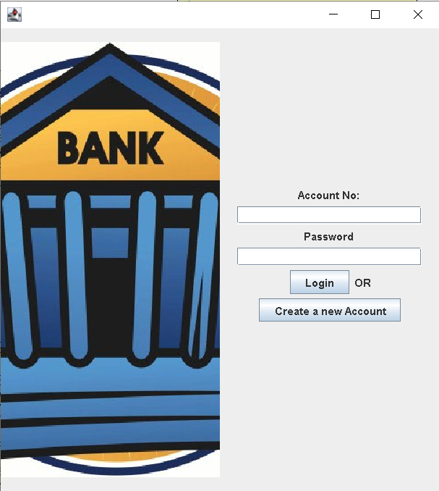

Slide 9
Conclusion
Simple
Confidentiality

Slide 10

Thank you for listening.
Is there any question?

