Slide 1
JOURNEY TO YOUR BEST PROGRAM

Slide 2

Topic 1.
What’s Top-Down approach and how to apply it?
Agenda
What’s Top-Down approach
When to use Top-Down approach
How to apply Top-Down approach
Advantages and Disadvantages
Top-Down approach or Bottom-Up approach
Example

Slide 3
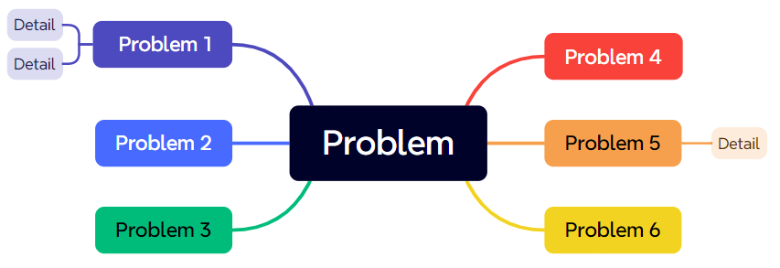
What’s Top-Down approach
Top-down approach: Starts with a high-level overview of the problem and then breaks it down into smaller, more manageable pieces
The goal is to create an organizational structure that is easy to manage and deploy.

Slide 4
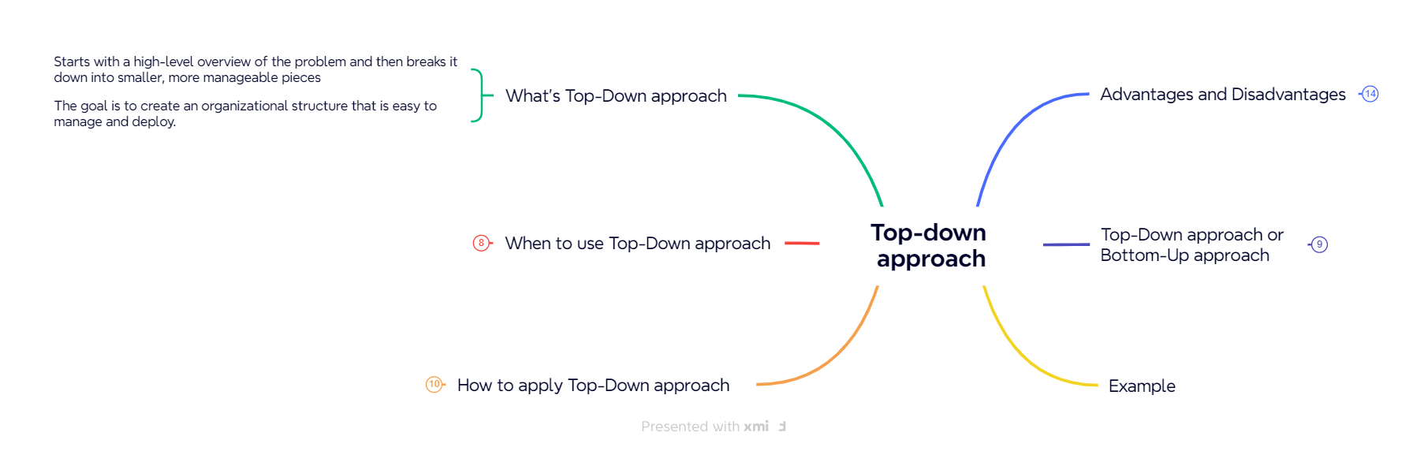
What’s Top-Down approach

Slide 5
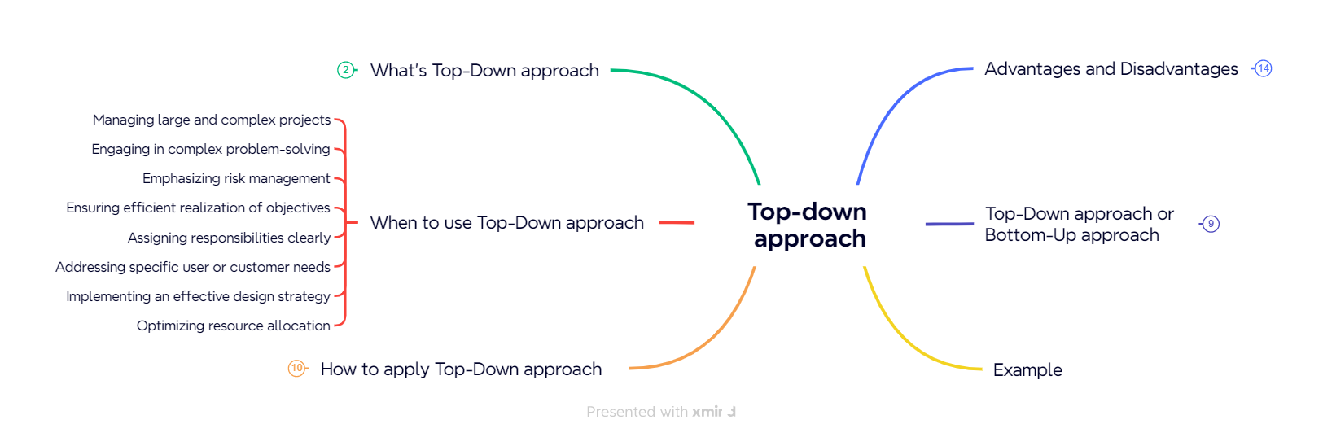
When to use Top-Down approach

Slide 6
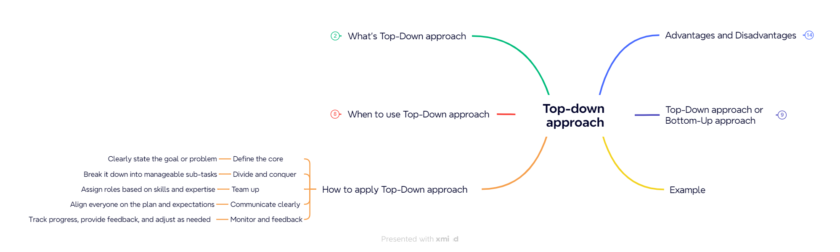
How to apply Top-Down approach

Slide 7
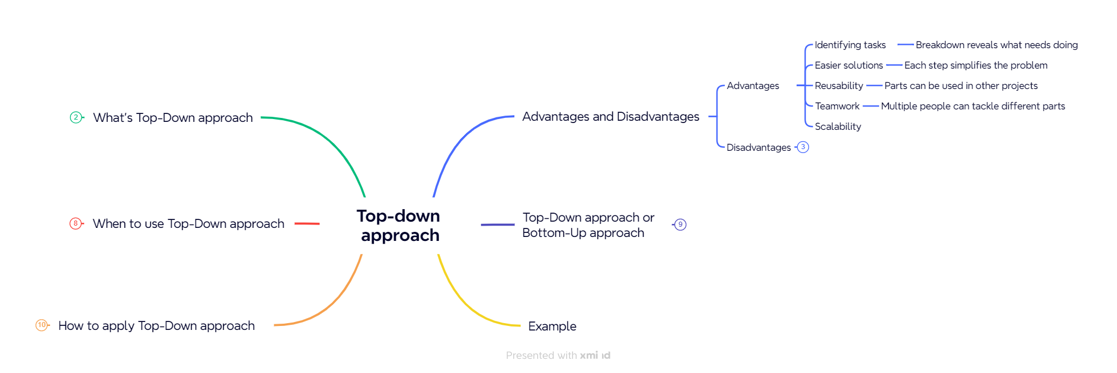
Advantages and Disadvantages

Slide 8
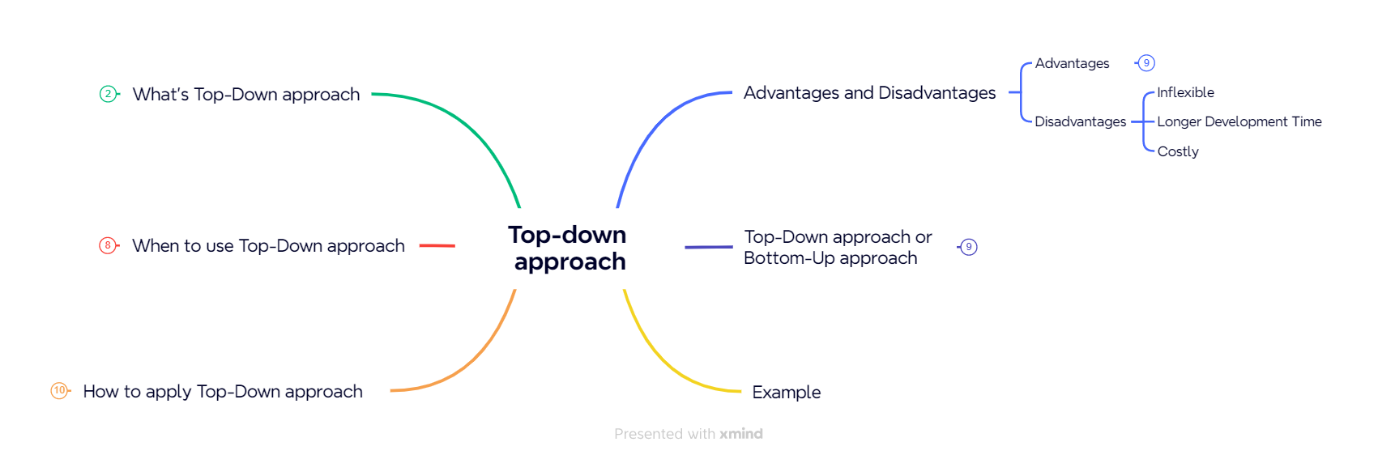
Advantages and Disadvantages

Slide 9
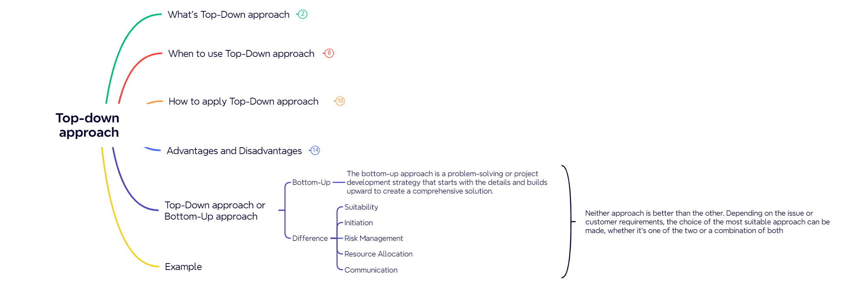
Top-Down approach or Bottom-Up approach

Slide 10
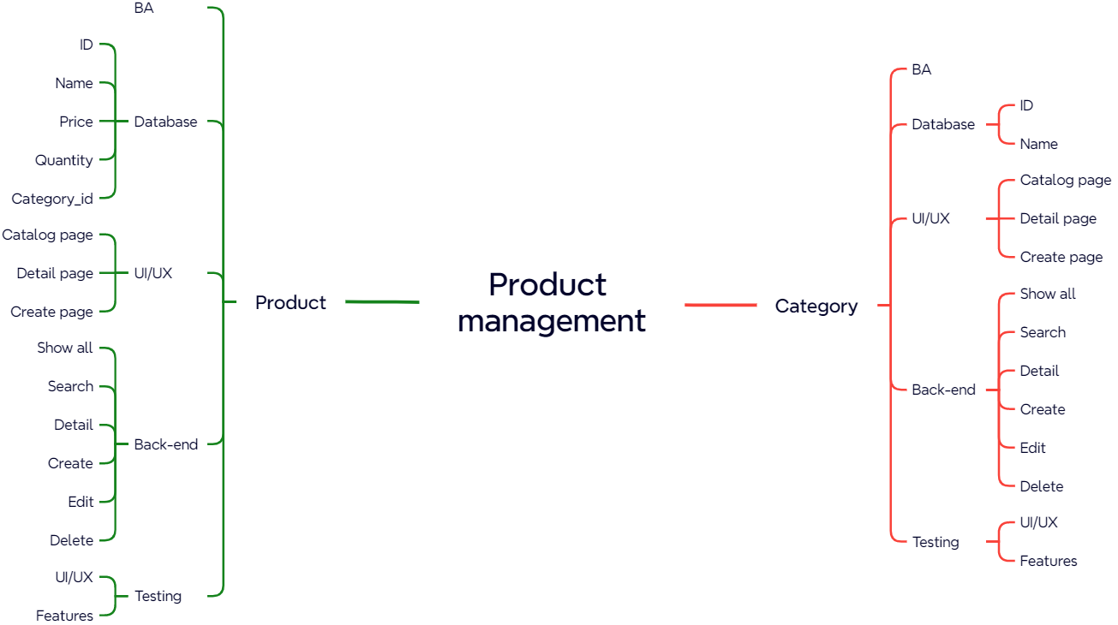
Example

Slide 11
THANKS!

