Slide 1
WELCOME
Phạm Hà Hoàng Nam
Nguyễn Song Toàn
Nguyễn Anh Quân
Tạ Việt Hùng
Bùi Anh Huy

Slide 2
Agenda
What is asynchronous communication?
asynchronous in B-Bay

Slide 3

What is asynchronous communication?

Slide 4
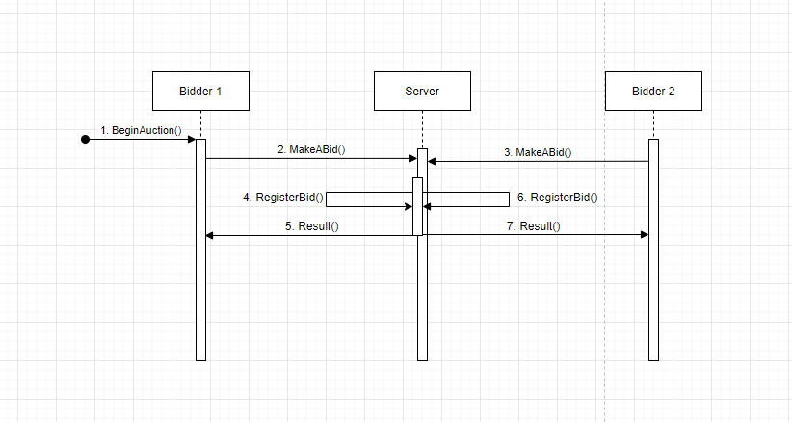
asynchronous in B-Bay

Slide 5
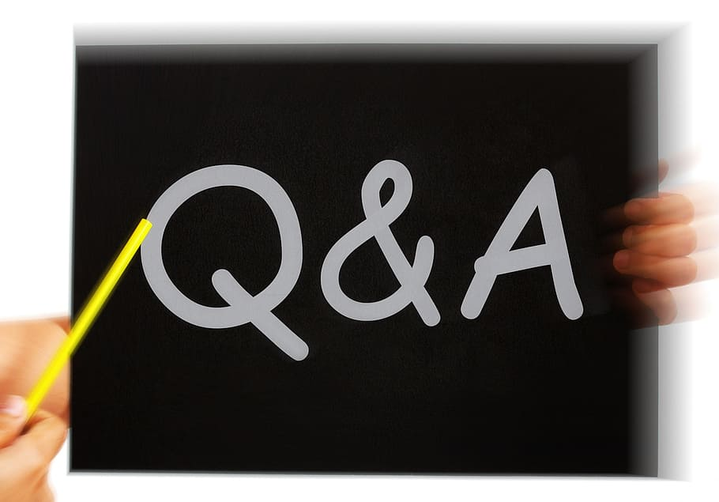

Slide 6
Thanks For Listening.

