Slide 1
Git
2016.08.22

Slide 2
Learning about git
https://www.atlassian.com/git/tutorials/learn-git-with-bitbucket-cloud
Note:
Git is a version control system
Bitbucket or Github is a cloud service that using git system

Slide 3
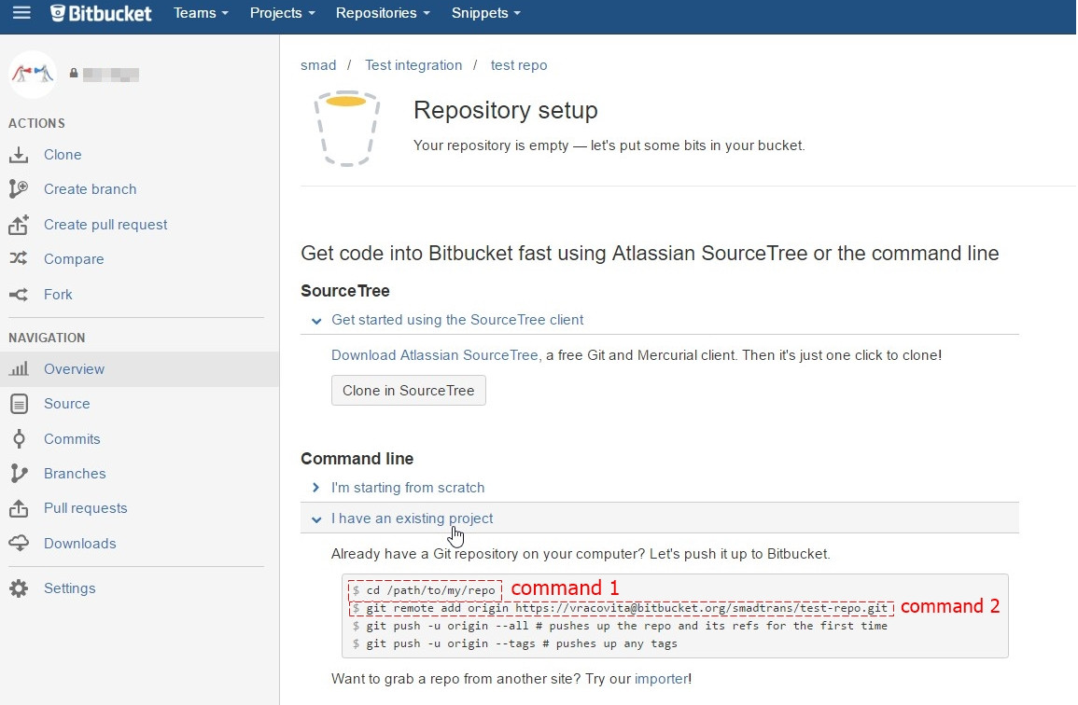
Commands to create new repo
Git global setup for the first use
git config --global user.name "Hoang-Mai Dinh"
git config --global user.email "maidinh@postech.ac.kr"
git config --system core.editor “vim”
For Mac’s users:
git credential-osxkeychain
curl -O http://github-media-downloads.s3.amazonaws.com/osx/git-credential-osxkeychain
sudo mv git-credential-osxkeychain /usr/local/bin/
Clone repo from the Bitbucket server or Github server
git clone <git link>
Create new repo for existing project on laptop:
Sign in Bitbucket or Github
Create new repo with the same name of existing folder (prefer lower-case name)
Choose “I have an existing project”
cd to project dir on laptop
git init
git add --all
git remote add origin <git link can be found on command 2>
git commit -m “Initial commit”
“-m” option using for one line comment
if need to comment more lines, just use commit without option, it will enter into a “vim” environment
press Shift+g → press ‘o’ at the end of file (become INSERT mode) → type comments
press ‘:wq’ → save and quit vim environment
git push origin master

Slide 4
Commands to commit
Check changes before making commit
git status
git diff
Choose files to commit
git add -u → choose all modified files
git add [new-file] → add new files
Commit to local
git commit
git commit -m
git commit -a -m (commit without add, -a option mean ‘add’ first and then ‘commit’)
Commit to server
git push origin master

Slide 5
git log
git log
git log --oneline
git log --name-status
git log --stat
git log -p

