Slide 1
Autoencoder process imputation

Slide 2
Induce missing data
For full dataset:
median_duration_activity
mean_duration_activity
min_duration_activity
max_duration_activity
median_duration_activity
mean_duration_activity
min_duration_activity
max_duration_activity
most_frequent_activity
missing_median_duration_activity
missing_mean_duration_activity
missing_min_duration_activity
missing_max_duration_activity
avai_instance
nan_instance
train_size
val_size
test_size
train_row_num
val_row_num
test_row_num
For missing dataset:
Most_frequent_activity
missing_median_duration_activity
missing_mean_duration_activity
missing_min_duration_activity
missing_max_duration_activity
train_size: number of cases
val_size
test_size
train_row_num: number of rows
val_row_num
Test_row_num
avai_instance: number of instances that have no nan in test set
nan_instance: number of instances that have nan in test set

Slide 3
Induce missing data
'complete_df_full.csv’
'missing_df_full.csv’
'complete_df_train.csv’
'complete_df_val.csv’
'complete_df_test.csv’
'missing_df_train.csv’
‘missing_df_val.csv’
'missing_df_test.csv'

Slide 4
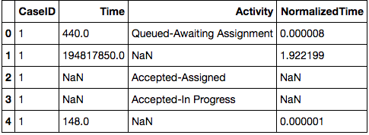
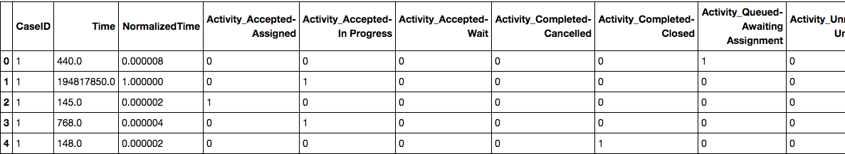
Preprocess data
Normalize data
normalized_complete_df
normalized_missing_df
normalized_complete_df.csv
normalized_missing_df.csv
enc_complete_df_w_normalized_time
enc_missing_df_w_normalized_time
enc_complete_df
enc_missing_df
enc_complete_df_w_time
enc_missing_df_w_time
One hot encode data

Slide 5
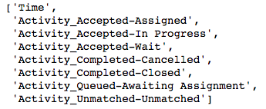
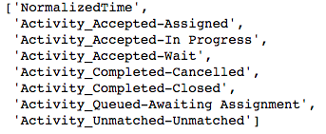
Preprocess data
Get nan and avai masking matrix
Get masking for Time
Get masking for Activity
nan_index_df: 1 for nan elements
avai_index_df: 1 for available elements
pad_index_df: 1 for all elements
Replace nan with 0: to get full data
cols_w_time
cols_w_normalized_tim
Pad with 0
enc_complete_df_w_normalized_time
enc_missing_df_w_normalized_time
vectorized_complete_df_w_normalized_time
vectorized_missing_df_w_normalized_time
enc_complete_df_w_time
enc_missing_df_w_time
vectorized_complete_df_w_time
vectorized_missing_df_w_time
nan_index_df
avai_index_df
pad_index_df
vectorized_avai_index_df
vectorized_nan_index_df
vectorized_pad_index_df

Slide 6
Split and save data
complete_matrix_w_normalized_time_train
missing_matrix_w_normalized_time_train
avai_matrix_train
nan_matrix_train
complete_matrix_w_normalized_time_val
missing_matrix_w_normalized_time_val
avai_matrix_val
nan_matrix_val
pad_matrix_val
complete_matrix_w_normalized_time_test
missing_matrix_w_normalized_time_test
avai_matrix_test
nan_matrix_test
pad_matrix_test
cols_w_time
cols_w_normalized_time

Slide 7
Train model
Load data
Training
VAE
missing_matrix_w_normalized_time_train
recon_data
loss
complete_matrix_w_normalized_time
Validate and Test
VAE
convert2df
missing_matrix_w_normalized_time_val
recon_val
recon_df_w_normalized_time
getActivityforTimeInverseTransform
recon_df_w_time
recon_df_w_activity_for_inverse
modifiedInversedMinMaxScaler
missing_true_df

