Slide 1
Neural computing for event log quality improvement

Slide 2
Framework
Raw event log
Multivariate Anomaly Detection
Event Log Reconstruction
Improved event log

Slide 3
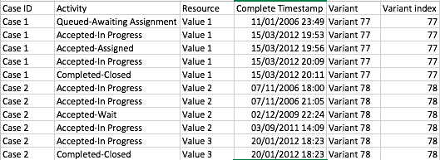
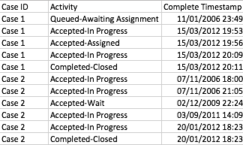
Dataset
Approach
Autoencoder and its variants

Slide 4



Multivariate anomaly detection
How to introduce anomalous data?
Activity
Timestamp
= RANDOM(1, 2) * MEAN + STANDARD DEVIATION

Slide 5
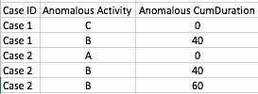



Multivariate anomaly detection
Input treatment
One hot encode
Standardization
Zero padding
Case 1
Case 2

Slide 6
Multivariate anomaly detection
Anomalous Activity Detector
Input
Reconstructed input
Normal
MAE
(reconstruction error)
Threshold
Abnormal
Anomalous Time Detector
Input
Reconstructed input
Normal
AE
(reconstruction error)
Threshold
Abnormal

Slide 7
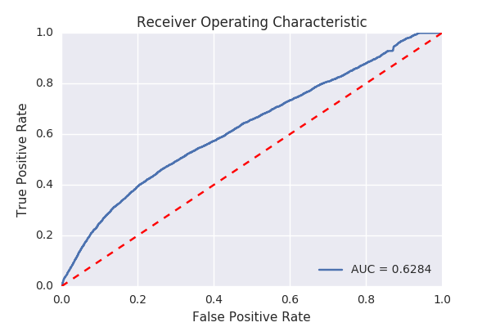
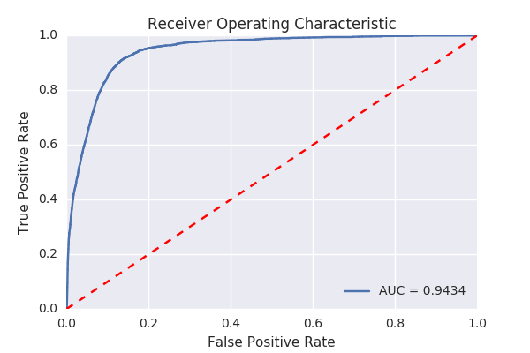
Multivariate anomaly detection
Results

Slide 8
Event log reconstruction
How to introduce missing data?
Randomly delete data points with the missingness ratio = 30%/35%/40%/50%

Slide 9
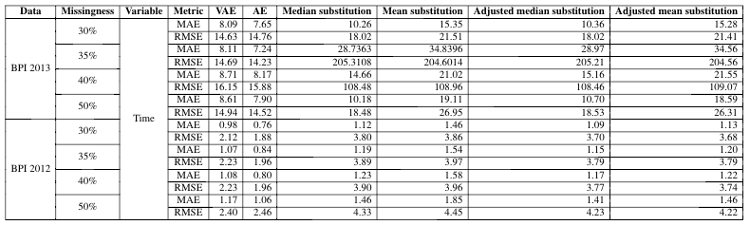
Event log reconstruction
Results

Slide 10
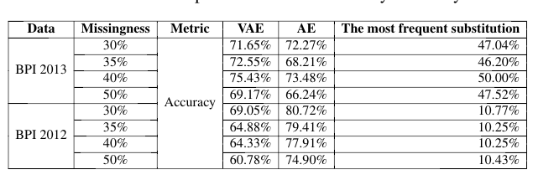
Event log reconstruction
Results

