Slide 1
CoAP Talk
Basuke Suzuki - @basuke
Kinoma
IoT Fest January 29, 2015 at MIT

Slide 2
Agenda
What is CoAP?
DEMO with KinomaJS on Create
Behind the scene
Dive into CoAP internals
Possibility, Deficiency, Other Protocols, etc.

Slide 3
What is CoAP?
Constraint Application Protocol
Protocol for embedded devices, IoT, M2M.
Defined in RFC 7252
CoAP = Lightweight Fast HTTP

Slide 4
CoAP is Lightweight
Message is simple binary format. Easy to parse. Space efficient.
Client and server share the internal structures, so easy to implement both client and server compare to HTTP.
RFC Document is just 112 pages. Seriously it’s short. With the full example use case and the default values for timeout or retry count, which is very valuable.
Notes:
CoAPの軽量さをアピール。
パースのしやすさではHTTPとの対比を。数値も文字列、改行で区切り。CoAPでは長さは別にあり、数値もバイナリで納めるので、スペースの効率の面でもパース

Slide 5
CoAP is Fast
Implemented on top of UDP
Stateless. No connection. Less overhead.
Faster by omitting the protocol level reliability.
Choices are yours
Notes:
UDPについては後で話します。
reliabilityに関しても後で話します。

Slide 6
CoAP is HTTP (almost)
Request and Response model
RESTful design, GET/PUT/POST/DELETE
Addressable by URL with query string
Content-Type can be specified, but limited to pre-defined types, text, json, xml, etc…

Slide 7
HTTP is Great, but…
Reliability is based on the TCP.
HTTP Headers are just text with structure, so easy to read for human, but not for machine.
20+ years history and so many extensions to take care of. Headers are always huge. 700-800 bytes average today (Google SPDY report)
Not the best choice for IoT world.
Notes:
TCP packet overhead = 20 bytes

Slide 8
CoAP is NOT HTTP
UDP instead of TCP
No overhead of headers
Limited Content-Types
Headers are limited to pre-defined one
Content size is limited to packet size. Depend on the lower level stack. On UNIX, about 1K.

Slide 9
UDP is fast, simple
Connection less, no handshake
Used for Video-streaming, DNS, DHCP, RIP
1:N communication - Broadcast and Multicast
Small overhead of packet
UDP: 8 bytes < TCP: 20+ bytes
Notes:
TCP must connect to the endpoint at first, every packet need 3 way communication

Slide 10
but UDP is Unreliable!
Packet may deliver to the destination more than once, or may not deliver at all
Packets may not arrive in order of delivery
Sender does not know if or when the packet is delivered
Application-layer must implement these features if they need those reliabilities.

Slide 11
TCP is Reliable
Sender knows the result of the delivery. If not delivered, retransmit until it fails by timeout.
If sender send A then B, receiver receive A and B in that order.
TCP is streaming transmission so that there are no limit of data size.
With its congestion control, bandwidth won’t filled by the re-transmitted packets.

Slide 12
CoAP is reliable by itself
Duplicate detection by 16bit Message ID
Acknowledgement response with data
Each request contains a token. The token is binary data defined by the application. That same token must be included in the response. The token is what allows the requestor to match a response to a request.

Slide 13
CoAP is reliable by itself
(cont.)
Retransmission of message with exponentially incrementing interval, to prevent congestion of the network by transmission.
These features are optional. If you really need speed, you can choose to disable them.

Slide 14
HTTP is Infrastructure
HTTP freed up developers from application
For many years, protocols are only for specific purpose. (SMTP, FTP, DNS, etc)
HTTP was originally for delivery of information to human, but now it is basic infrastructure of the conversation of programs.
So does CoAP, in IoT field.

Slide 15
“CoAP is the first UDP protocol which has the freedom of application level usage.”
– Basuke Suzuki (2015)

Slide 16

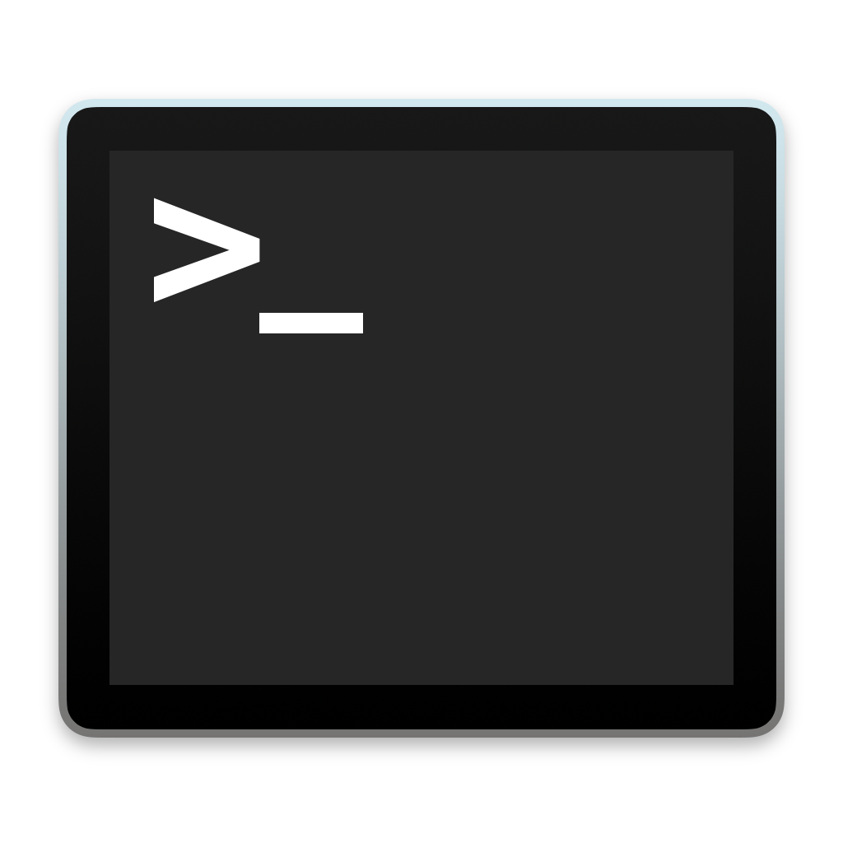

DEMO
CoAP Server and Client
Share color information
{“red”:255,”green”:135,”blue”:0}

Slide 17
Kinoma Create
Kinoma Create is the JavaScript-powered construction kit for Internet of Things devices and other connected electronics.

Slide 18
A lot of Pins

Slide 19
KinomaJS
Support

Slide 20
CoAP on KinomaJS
var client = new CoAP.Client();
client.onResponse = function(response) {
// success
};
client.onError(err) {
// failure
};
client.request(“coap://10.0.1.109/color”, ’GET’);

Slide 21
CoAP on KinomaJS
var client = new CoAP.Client();
client.request({
uri: “coap://10.0.1.109/color”,
method: ’GET’,
}).then(function(response) {
// success
}, function(err) {
// failure
});

Slide 22
CoAP in Depth

Slide 23
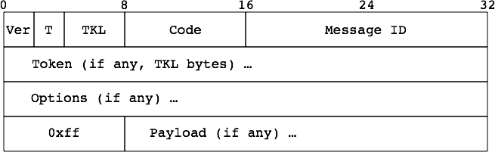
CoAP Message Format
Minimum bytes are 4 bytes. (Empty Message)
Must be fit inside UDP packet

Slide 24
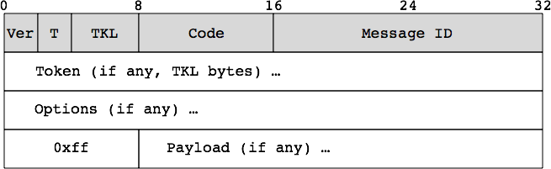



Fixed Header
Token Length
Message Type. 2 bits.
Version. Always 01.

Slide 25
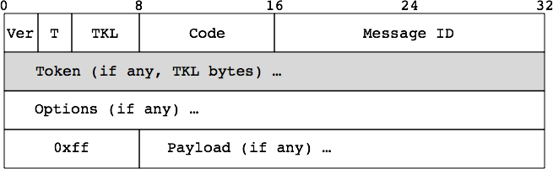
Token
0 to 8 bytes binary
length is specified in the header
Response must have same token value with request.
The value of the token is defined by the application layer. Protocol doesn’t care about the contents.
Use case: request kind, sequence number, etc.

Slide 26
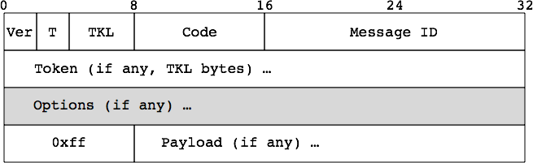

Options
Option types are defined as integer index.
Option format is defined for each Option type.
Empty, Unsigned Integer, String, Binary

Slide 27
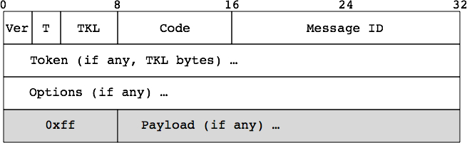
Payload
Payload is optional. If it exists, Payload Marker (0xff) must be exist to indicate the beginning of payload.
Format is specified by Content-Format option.
Available formats are: Text, JSON, XML, EXI, Binary

Slide 28
Message Code
3 bits Class and 5 bits Detail
Formatted to display like this: 2.05
Method for Request
Class = 0
Result for Response
Class = 2, 4, 5
Class | Usage
0 | Request
2 | Success Response
4 | Client Error Response
5 | Server Error Response

Slide 29
Message ID
Each Endpoint has its own IDs space
16 bit Unsigned Integer
Sender endpoint assign new Message ID and recipient respond with same Message ID
Only for the retransmission management

Slide 30
Message Types
Confirmable = 0x0
Non-Confirmable = 0x1
Acknowledgement = 0x2
Reset = 0x3

Slide 31
Confirmable
Client
Server
Client
Server
CON [0x1235]
CON [0x1234]
ACK [0x1235]
ACK [0x1234]
2.05 “Hello”
CON [0x8765]
2.05 “Hello”
ACK [0x8765]
Piggybacked
Separate

Slide 32
Non-Confirmable
Client
Server
Client
Server
NON [0x1235]
NON [0x1234]
NON [0x9854]
CON [0x8765]
2.05 “Hello”
2.05 “Hello”
ACK [0x8765]

Slide 33
Retransmission
4 retransmissions.
Interval is increase on every re-transmit.
Max time is 247 secs
Client
Server
CON [0x1235]
x
TIMEOUT!
CON [0x1235]
ACK [0x1235]

Slide 34
Retransmission (cont.)
Client doesn’t know if request reached to server.
Server logic will be executed more than once for same request. It should be cached.
Client
Server
CON [0x1235]
ACK [0x1235]
x
TIMEOUT!
CON [0x1235]
ACK [0x1235]

Slide 35
Retransmission (cont.)
ACK may be delivered after invocation of timeout.
Server must send same response, including Piggybacked or not.
Client
Server
CON [0x1235]
ACK [0x1235]
TIMEOUT!
CON [0x1235]
ACK [0x1235]

Slide 36
What is Reset?
Endpoint has no context for the request.
CON [0x1235]
Client
ACK [0x1235]
Crash!
x
Server
CON [0x8765]
2.05 “Hello”
RST [0x8765]

Slide 37
or CoAP Ping
Detecting the aliveness of the other endpoint
Minimum packet is used. 4 bytes each.
Make up for the unreliability of the Non-Confirmable request
Client
Server
CON [0x1234]
- empty -
RST [0x1234]

Slide 38
CoAP URI
coap://example.com/hello?a=b&c=d
“coap” for non-secure CoAP
“coaps” for secure CoAP
Encoded into several Options

Slide 39
Observe
Client
Server
Registration
Response
Initial request is called Registration.
Following responses are called Notification
Has sequence number
Notification can be Confirmable or Non-Confirmable
Draft extension
Notification
Notification
Notification

Slide 40
Block-wise Transfer
Big response can be sent as a small blocks with sequence number.
Client who receive blocks will regenerate the original response.
Preferred size will be sent from the client.
Draft extension

Slide 41
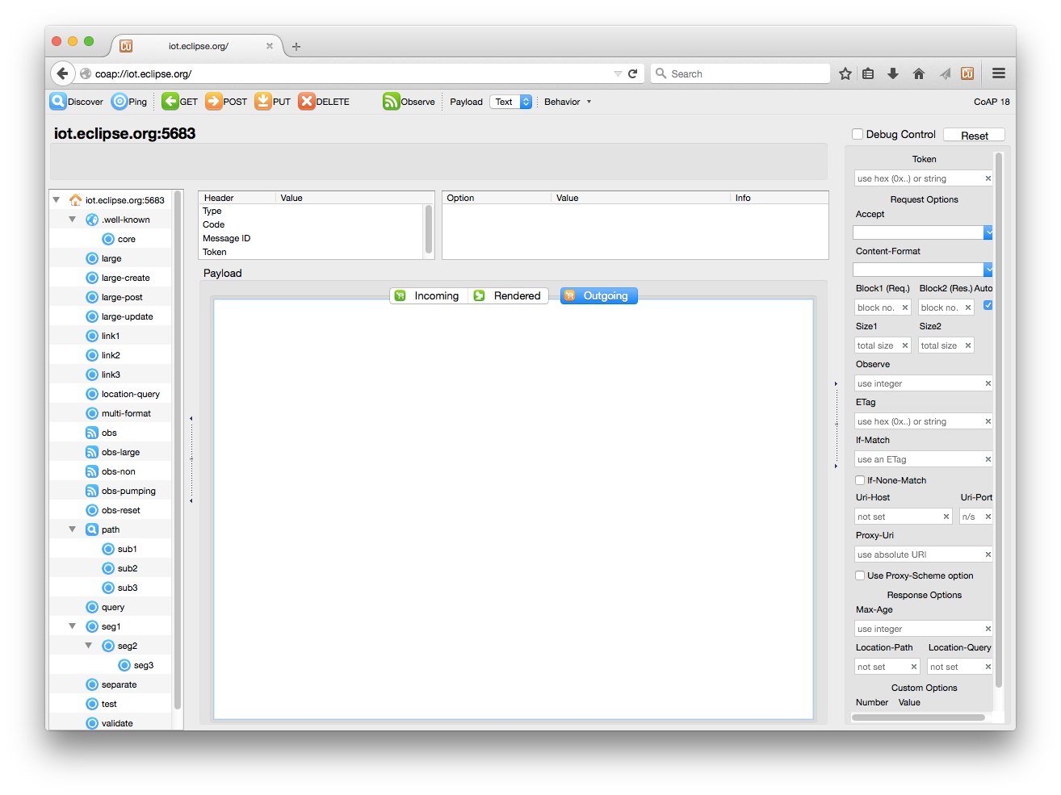
Resource Discovery
/.well-known/core
CoRE Link Format
Copper(Cu) Firefox Add-on
http://mzl.la/1JNaB7v

Slide 42
Service Discovery
UDP support Multicast.
The multicast address for “All-CoAP-Server” is defined.
Request must be Non-Confirmable
Server must not send Rest as error response.

Slide 43
Network Errors
HTTP: Errors are handled in TCP layer. If error happen, you can gave up very soon.
CoAP Confirmable: Errors are handled in CoAP protocol layer, usually library takes care of them. Ordering problem may exist though.
CoAP Non-Confiramable: Errors happens and ignored. You just cannot get response.

Slide 44
6LoWPANs
IPv6 over Low-Power Wireless Personal Area Networks
Slow, high error rate, small packet size
less than 80 bytes

Slide 45
HTTP and CoAP Proxy
Route the HTTP request to CoAP Server and send back the CoAP response to HTTP Client
Or vice versa
Because of the similarity with HTTP
Cache
Well defined in RFC

Slide 46
Security
DTLS = Datagram TLS
Shared Key
Public Key and Private Key pair
Supported by major library: OpenSSL, NSS, …
Both for encryption and authentication

Slide 47
Other IoT(?) protocols
MQTT
WebSocket

Slide 48
MQTT
Publish/Subscribe model
Broker is required on Internet
Require long-living TCP connection.

Slide 49
WebSocket
Connection phase is on HTTP protocol
Once it accepted, the socket is took over by WebSocket client and server and both endpoint are free to send packets.
Disconnect detection,
Protocol is defined in RFC.
JavaScript APIs are well defined by W3C.
Only for client side.

Slide 50
Summary
Good: CoAP is fast, lightweight HTTP.
Bad: Small data size, unreliability, less information.
Apps take care of errors more than http.
Limited implementations. Not enough use cases for actual field.
Extensions are still draft

