Slide 1
The Constrained Application Protocol (CoAP)-Part 2
Khamdamboy Urunov, a Ph.D. student.,
hamdamboy.urunov@gmail.com

Slide 2
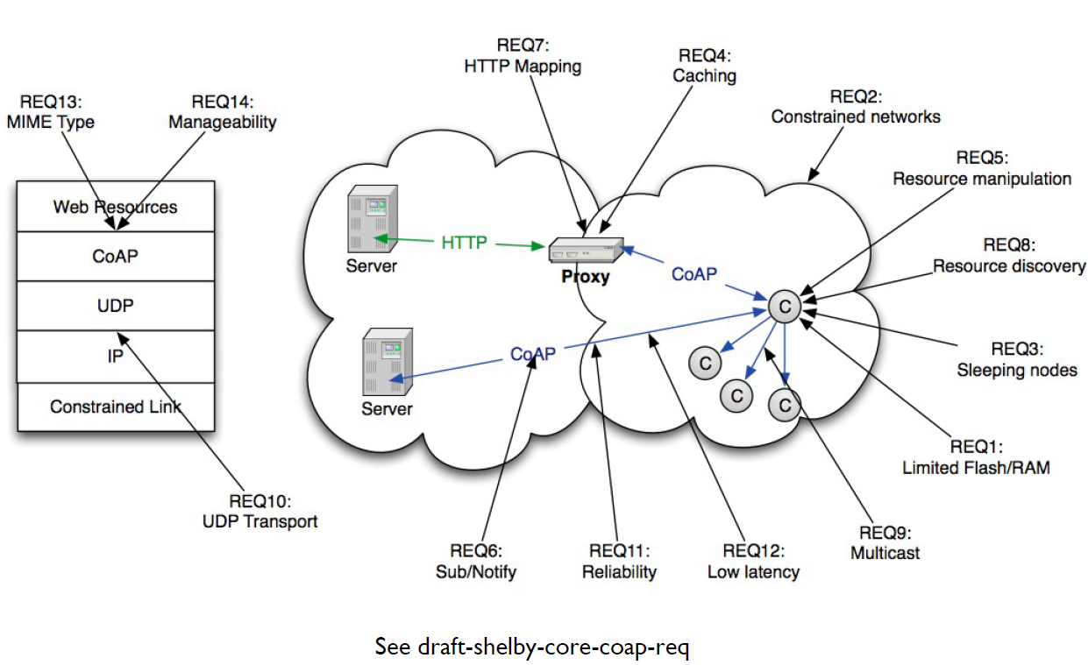
CoAP Design Requirements

Slide 3
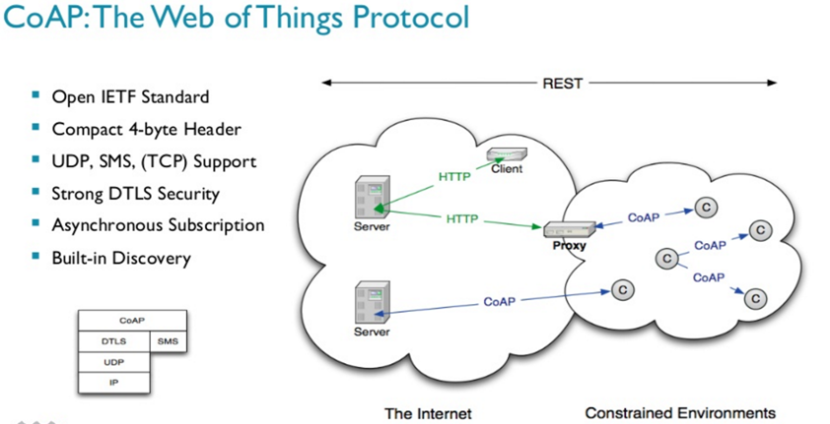
The CoAP Architecture
http://www.slideshare.net/zdshelby/coap-tutorial

Slide 4
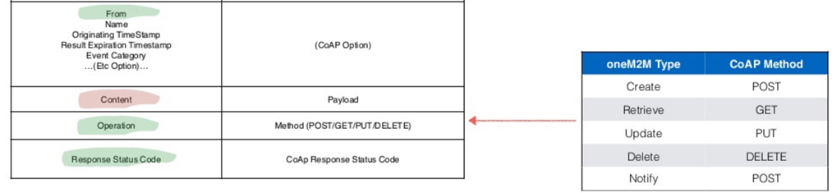
CoAP methods
CoAP feature uses:
GET, POST, PUT, DELETE methods
GET Method
The GET method retrieves a representation for the information that currently corresponds to the resource identified by the request URI.
If the request includes an Accept Option, that indicates the preferred content-format of a response.
OneM2M protocol Binding: binding with CoAP
http://www.test.com/index.htm?name1=value1&name2=value2
We can only send limited data with GET method and it’s sent in the header request URL whereas
We can send large amount of data with POST because it’s part of the request body.
Different point
one
draft-ietf-core-coap-18., June 2013 : https://tools.ietf.org/pdf/draft-ietf-core-coap-18.pdf

Slide 5
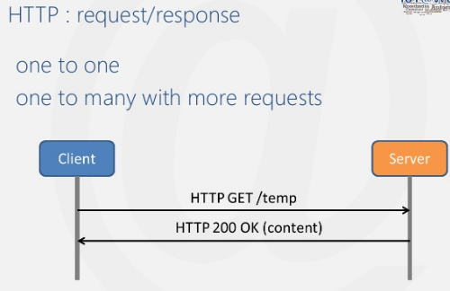
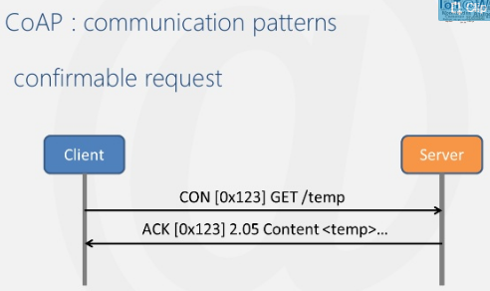
CoAP methods (cont…)
GET Method
Confirmable Message
Some messages require an acknowledgement. These messages are called “Confirmable“;
When no packets are lost, each Confirmable message elicits exactly one return message of type Acknowledgement or type Reset.
http://www.slideshare.net/paolopat/io-t-protocols-landscape

Slide 6
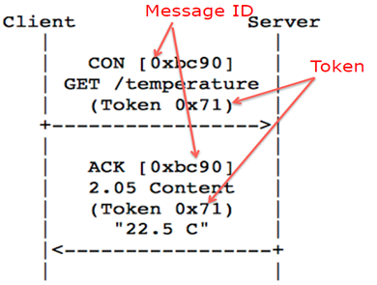
CoAP methods (cont…)
The Token Option
  is an opaque sequence of 1-2 bytes
  which is used to match a request with a response
  is meant for use with asynchronous responses by this specification.
  the Token is generated by a client and included in a way that Token values currently in use are unique.
GET Method
Tokens have the following rules:
If a Token Option is included in a request, the response (and any subsequent delayed responses) MUST include the same value in a Token Option.
If a Token Option is included in a request, any resulting delayed response SHOULD NOT include the URI option (for sake of efficiency) as the Token is sufficient for matching it with the request.
If a request does not include a Token option, the server MUST provide its ReST response within the transaction response. If it cannot do so (i.e., can only satisfy the request through an asynchronous response), it MUST respond with error "Token Option required by server (CoAP 240)". This option MUST NOT occur ore than once in a header.
https://tools.ietf.org/html/draft-ietf-core-coap-03#page-17

Slide 7
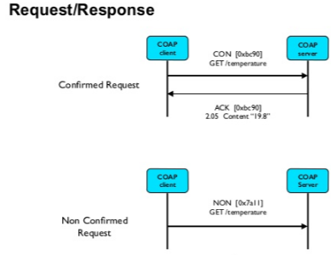
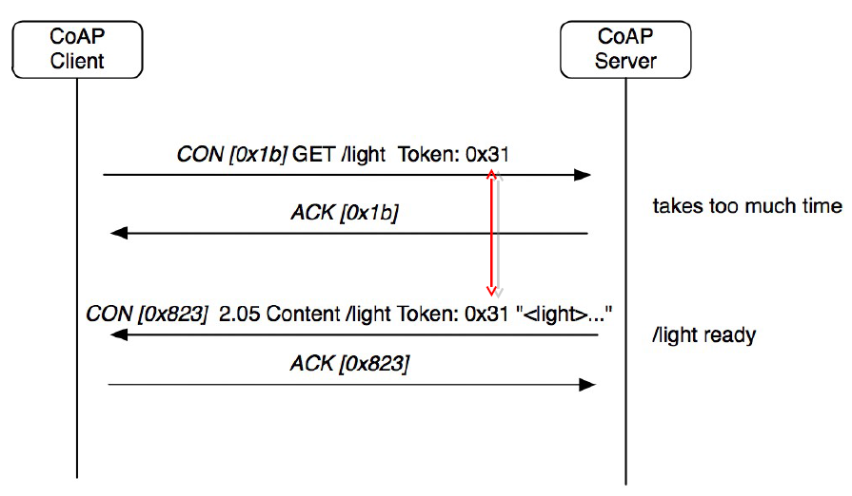
CoAP methods (cont…)
GET Method
Acknowledgement Message
An Acknowledgement message acknowledges that a specific Confirmable message arrived.
By itself, an Acknowledgement message does not indicate success or failure of any request encapsulated in the Confirmable message, but the Acknowledgement message may also carry a Piggybacked Response.
Non-confirmable Message
Some other messages do not require an acknowledgement.
This is particularly true for messages that are repeated regularly for application requirements, such as repeated readings from a sensor.

Slide 8
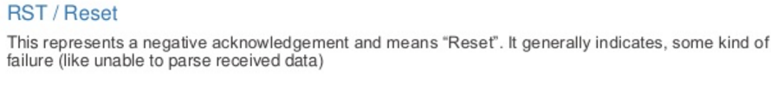
CoAP methods (cont…)
GET Method
Pros and Cons Point
The GET method is restricted to send upto 1024 characters only
Never use GET method if you have password or other sensitive information to be sent to the server.
GET can't be used to send binary data, like images or word documents, to the server.
The data sent by GET method can be accessed using QUERY_STRING environment variable.
The PHP provides $_GET associative array to access all the sent information using GET method.
Reset Message
A Reset message indicates that a specific message (Confirmable or Non-confirmable) was received,
but some context is missing to properly process it.
This condition is usually caused when the receiving node has rebooted and has forgotten some state that would be required to interpret the message.
Provoking a Reset message (e.g., by sending an Empty Confirmable message) is also useful as an inexpensive check of the liveness of an endpoint ("CoAP ping").

Slide 9


CoAP methods (cont…)
POST Method
The POST method is used to request the server to create a new subordinate resource under the requested parent URI.
If a resource has been created on the server, the response SHOULD be 201 (Created) including the URI of the new resource in a Location Option with any possible status in the message body.
If the POST succeeds but does not result in a new resource being created on the server, a 200 (OK) response code SHOULD be returned.
Client
Server
CON [ox1c] POST/ light Token: 0x33
ACK [ox1c] POST/ 201 Create
58.2; Token: 0x33
POST can transfer data securely to server, it can transfer large data and should be used to send data to server;

Slide 10
GET
POST
History | Parameters remain in browser history because they are part of the URL | Parameters are not saved in browser history.
Bookmarked | Can be bookmarked. | Cannot be bookmarked.
BACK button/re-submit behaviour | GET requests are re-executed but may not be re-submitted to server if the HTML is stored in the browser cache. | The browser usually alerts the user that data will need to be re-submitted.
Encoding type (ectype attribute) | application/x-www-form-urlencoded | multipart/form-data or application/x-www-form-urlencoded Use multipart encoding for binary data.
Parameters | can send but the parameter data is limited to what we can stuff into the request line (URL). Safest to use less than 2K of parameters, some servers handle up to 64K | Can send parameters, including uploading files, to the server.
Hacked | Easier to hack for script kiddies | More difficult to hack
Restrictions on form data type | Yes, only ASCII characters allowed. | No restrictions. Binary data is also allowed.
Security | GET is less secure compared to POST because data sent is part of the URL. So it's saved in browser history and server logs in plaintext. | POST is a little safer than GET because the parameters are not stored in browser history or in web server logs.
Restrictions on form data length | Yes, since form data is in the URL and URL length is restricted. A safe URL length limit is often 2048 characters but varies by browser and web server. | No restrictions
Usability | GET method should not be used when sending passwords or other sensitive information. | POST method used when sending passwords or other sensitive information.
Visibility | GET method is visible to everyone (it will be displayed in the browser's address bar) and has limits on the amount of information to send. | POST method variables are not displayed in the URL.
Cached | Can be cached | Not cached

Slide 11
PUT
CoAP methods (cont…)
The PUT method requests that the resource identified by the request URI be updated or created with the enclosed message body.
If a resource exists at that URI the message body SHOULD be considered a modified version of that resource, and a 200 (OK) response SHOULD be returned.
If no resource exists then the server MAY create a new resource with that URI, resulting in a 201 (Created) response.
If the resource could not be created or modified, then an appropriate error response code SHOULD be sent. Responses to this method are not cacheable.
PUT:- Used when the client is sending a replacement document or uploading a new document to the Web server under the request URL

Slide 12
CoAP methods (cont…)
DELETE
The DELETE method requests that the resource identified by the request URI be deleted.
The response 200 (OK) SHOULD be sent on success.
Responses to this method are not cacheable.
DELETE:- Used when the client is trying to delete a document from the Web server, identified by the request URL.

Slide 13
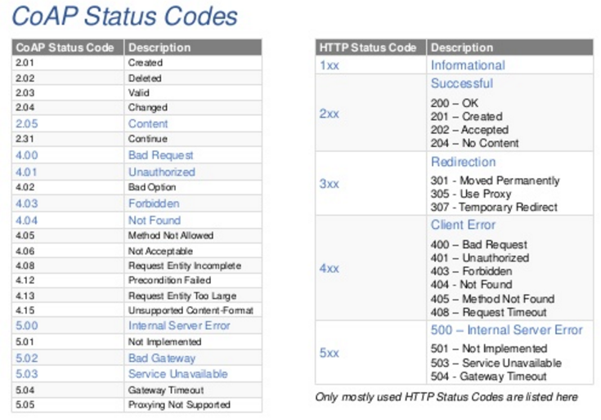
Code status

Slide 14
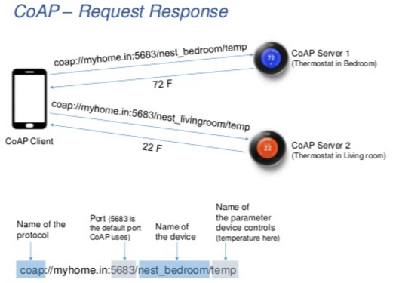
Example

Slide 15
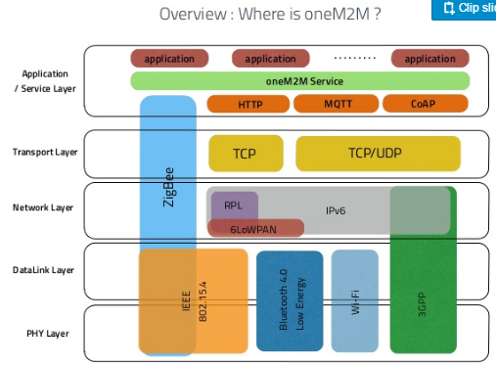
CoAP & OneM2M

Slide 16
CoAP Feature
CoAP Feature | Elements
Embedded web transfer protocol | (coap://)
Asynchronous transaction model
UDP binding with reliability and multicast support
methods | GET, POST, PUT, DELETE
support | URI
header | Small, simple 4 byte
DTLS based | PSK, RPK and Certificate security
Subset of MIME types and HTTP response codes
Built-in discovery
Optional observation and block transfer

Slide 17
What CoAP is (and is not)
CoAP is | CoAP is not
✓A very efficient RESTful protocol | A general replacement for HTTP
Ideal for constrained devices and networks | HTTP compression
Specialized for M2M applications | Restricted to isolated “automation” networks
Easy to proxy to/from HTTP

Slide 18
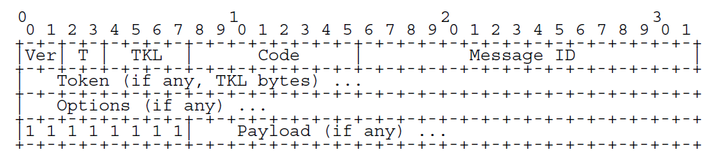
CoAP messages are encoded in a simple binary format.
The Message Header (4 bytes).
The variable-length token value 0 and 8 bytes long.
Message Format
Ver - Version (1) → 2 bit unsigned integer . Implementations of this field to 1 (01 binary).
T – Message Type → 2- bit unsigned integer. (Confirmable, Non-Confirmable, Acknowledgement, Reset).
TKL- Token Length → 4-bit unsigned integer. Indicates the length of the variable-length Token field (0-8 bytes).
Code – 8-bit unsighted integer. 3 bit class(most signification bits). 5 bits detail (least significant bits).
Request Method (1-10) or Response Code (40-255)
Message ID – 16-bit identifier for matching responses
Token – Optional response matching token
Standards Track RFC 7252 June, 2014

Slide 19
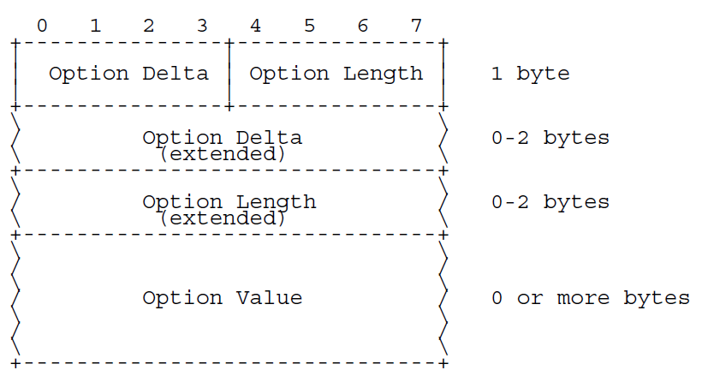
Option Format
CoAP defined a number of options that can be included in a message.
Option Delta - Difference between this option type and the previous.
4 bit unsigned integer. A value between 0 and 12 indicates the Optional Delta.
Length - Length of the option value
4 bit unsigned integer. A value between 0 and 12 indicates the length of the Optional Value, in bytes.
Value - The value of Length bytes immediately follows Length

Slide 20
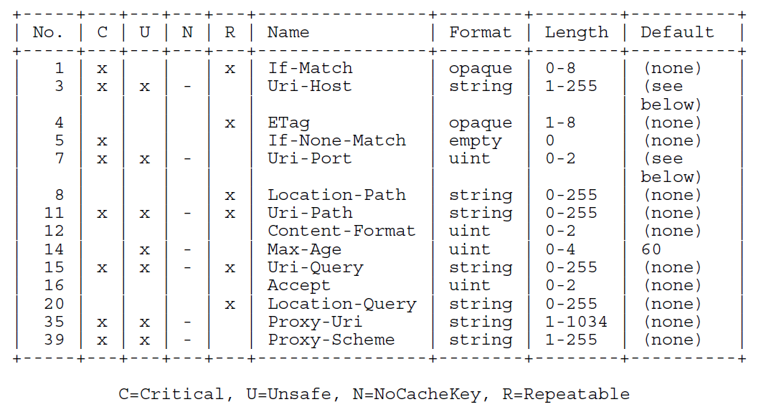
Base Specification Options
The Uri-Host Option specifies the Internet host of the resource being requested.
The Uri-Post Option specifies the transport-layer port number of the resource
The Uri-Path Option specifies one segment of the absolute path to the resource
The Uri-Query Option specifies one argument parameterizing the resource

Slide 21
Caching
• CoAP includes a simple caching model
✓Cache ability determined by response code
✓An option number mask determines if it is a cache key
• Freshness model
✓Max-Age option indicates cache lifetime
• Validation model
✓Validity checked using the Etag Option
• A proxy often supports caching
✓Usually on behalf of a constrained node,
✓a sleeping node,
✓or to reduce network load

Slide 22
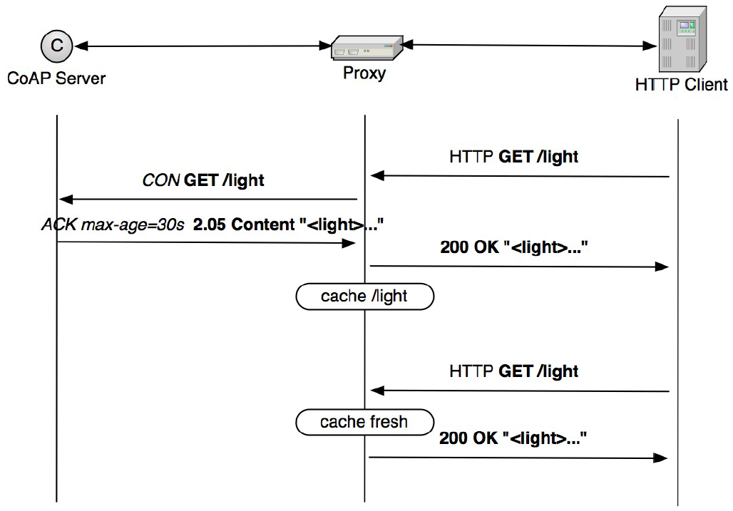
Proxying and caching

Slide 23
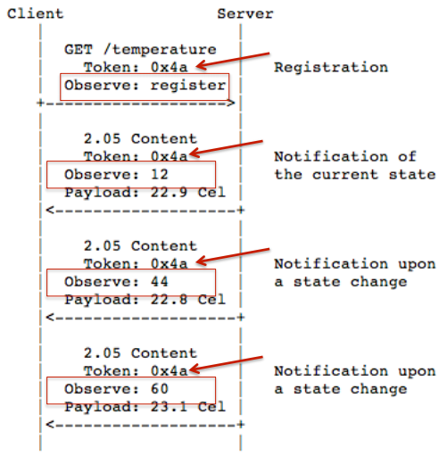
Observation
COAP Observation
PROBLEM:
REST paradigm is often “PULL” type, that is, data is obtained by issuing an explicit request
Information/data in WSN is often periodic/ triggered (e.g., get me a temperature sample every 2 seconds or get me a warning if temperature goes below 5°C)
SOLUTION:
use Observation on COAP resources

Slide 24
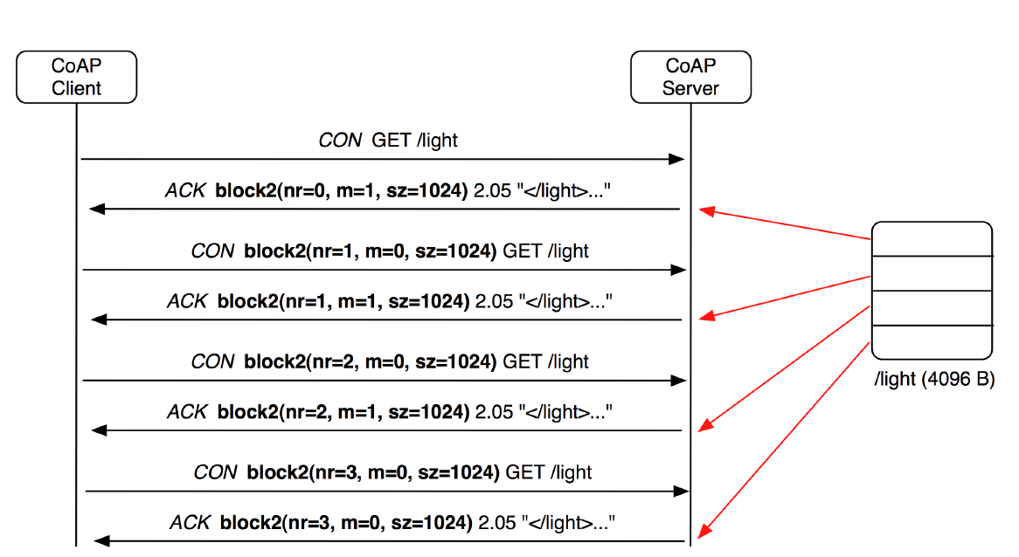
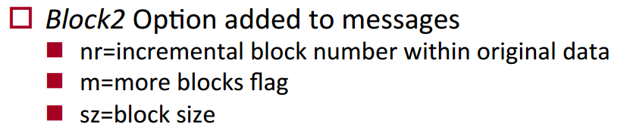
Block transfer
COAP Block Transfer
PROBLEM:
avoid segmentation in the lower layers (IPv6)
SOLUTION:
COAP Block Transfer Mode n brings up fragmentation at the application layer

Slide 25
Getting Started with CoAP
• There are many open source implementations available
✓Java CoAP Library Californium
✓C CoAP Library Erbium
✓libCoAP C Library
✓jCoAP Java Library
✓OpenCoAP C Library
✓TinyOS and Contiki include CoAP support
• CoAP is already part of many commercial products/systems
✓ Sensinode NanoService
✓ RTX 4100 WiFi Module
• Firefox has a CoAP plugin called Copper
• Wireshark has CoAP dissector support
• Implement CoAP yourself, it is not that hard!

Slide 26
Resource Discovery
GOAL:
Discovering the links hosted by CoAP (or HTTP) servers
GET /.well-known/core?optional_query_string
• Service Discovery
✓What services are available in the first place?
✓Goal of finding the IP address, port and protocol
✓Usually performed by e.g. DNS-SD when DNS is available
• Resource Discovery
✓What are the Web resources I am interested in?
✓Goal of finding URIs
✓Performed using Web Linking or some REST interface
  ✓CoRE Link Format is designed to enable resource discovery

Slide 27
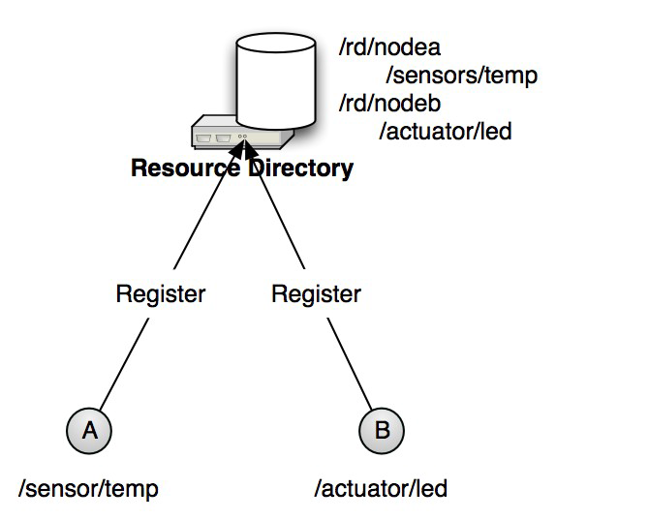
Resource Directory
• CoRE Link Format only defines
✓ The link format
✓ Peer-to-peer discovery
• A directory approach is also useful
✓ Supports sleeping nodes
✓ No multicast traffic, longer battery life
✓ Remote lookup, hierarchical and federated distribution
• The CoRE Link Format can be used to build Resource Directories
✓ Nodes POST (register) their link-format to an RD
✓ Nodes PUT (refresh) to the RD periodically
✓ Nodes may DELETE (remove) their RD entry
✓ Nodes may GET (lookup) the RD or resource of other nodes

Slide 28
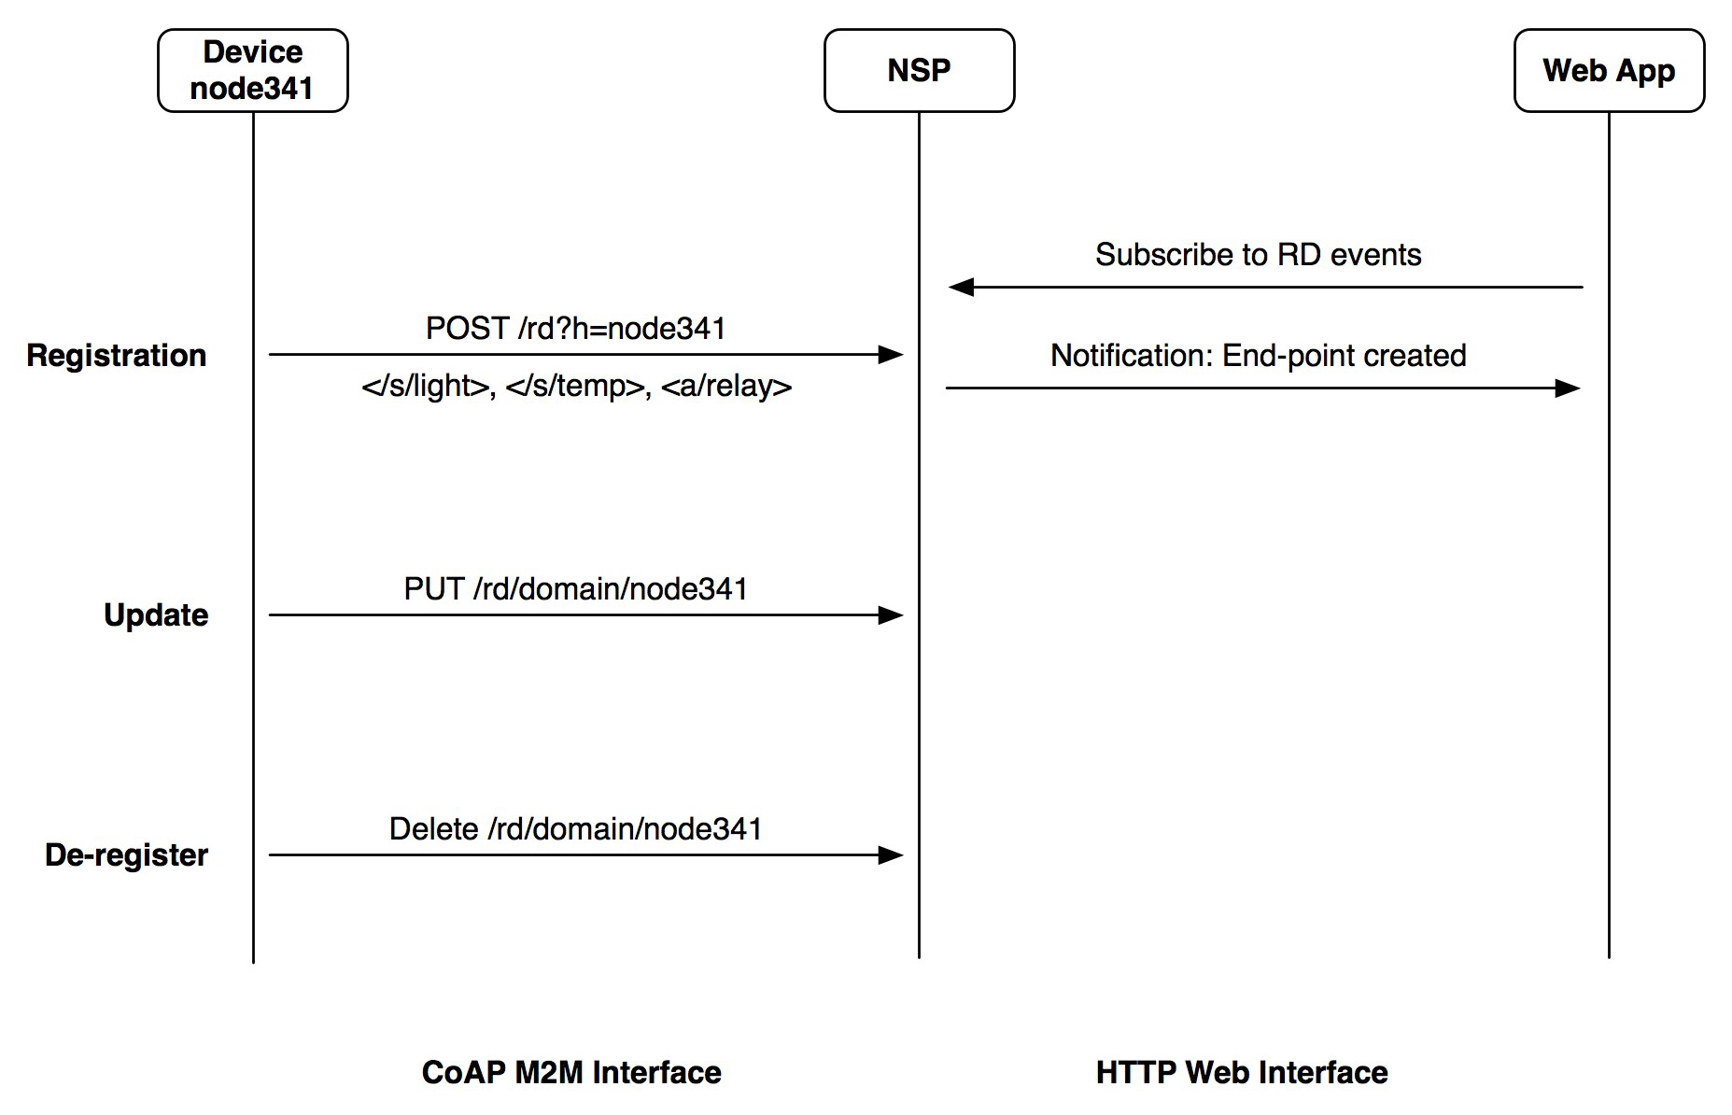
Resource Directory

Slide 29
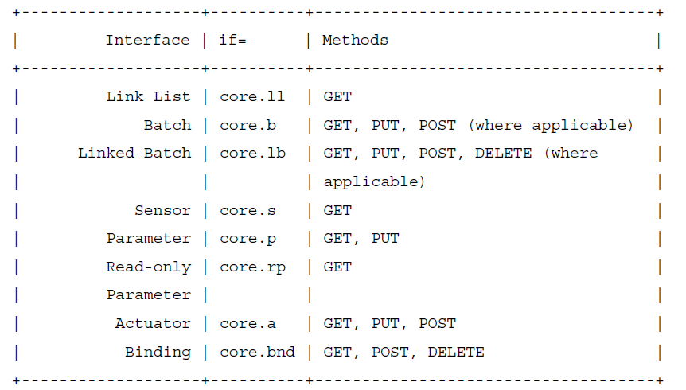
CoRE Interfaces
• CoRE Interfaces [draft-shelby-core-interfaces]
✓A paradigm for REST profiles made up of function sets
✓Simple interface types

Slide 30
Thank you !

