Slide 1





Constrained of Application Protocol

Slide 2
CoAP Content
CoAP Overview
CoAP Methods
CoAP Message format
CoAP Workflow
Implementation

Slide 3
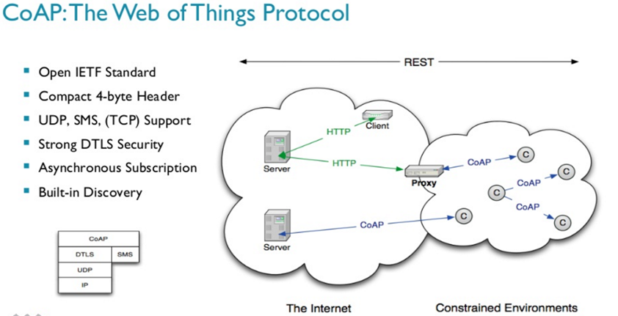
CoAP Overview
What is CoAP?
Internet Application Protocol for constrained devices
Work on Constrained RESTful Environments
Protocol for Embedded devices, IoT, M2M
Easily translates to HTTP for intergration

Slide 4
CoAP Overview
CoAP features
Web protocol fulfilling M2M requirements in constrained environments
UDP binding with optional reliability supporting unicast and multicast requests.
Asynchronous message exchanges.
Low header overhead and parsing complexity.
URI and Content-type support.
Simple proxy and caching capabilities.
A stateless HTTP mapping, allowing proxies to be built providing access to CoAP resources via HTTP in a uniform way or for HTTP simple interfaces to be realized alternatively over CoAP.
Security binding to Datagram Transport Layer Security (DTLS)

Slide 5
CoAP Overview
CoAP advantages
CoAP is Lightweight:
- Message is simple binary format (4 bytes header) -> easy to parse, space efficient.
- Client and server share the internal structures, so easy to implement both client and server compare to HTTP.
CoAP is faster than HTTP
- Implement on top of UDP (Broadcast and Multicast), fast but unreliable.
- Stateless, no connection, less overhead.
- Omite the protocol level reliability.
CoAP is almost like HTTP
- Request and Response model.
- RESTfull design, GET/PUT/POST/DELETE method.
- Addressable by URL with query string
- Content-Type can be specified, but limited to pre-defined types, text, json, xml, etc…

Slide 6
CoAP Methods
GET Method
The GET method retrieves a representation for the information that currently corresponds to the resource identified by the request URI.
If the request includes an Accept Option, that indicates the preferred content-format of a response.
We can only send limited data with GET method and it’s sent in the header request URL whereas
We can send large amount of data with POST because it’s part of the request body.

Slide 7
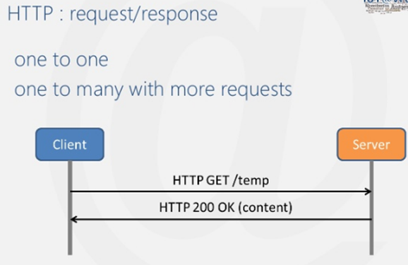
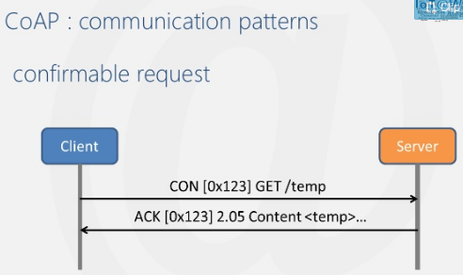
CoAP Methods
GET Method
Confirmable Message
Some messages require an acknowledgement. These messages are called “Confirmable“;
When no packets are lost, each Confirmable message elicits exactly one return message of type Acknowledgement or type Reset.

Slide 8
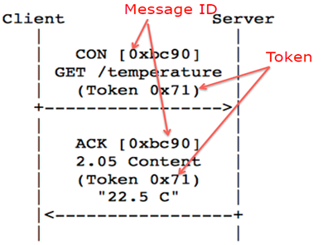
CoAP Methods
GET Method
The Token Option
is an opaque sequence of 1-2 bytes
which is used to match a request with a response
is meant for use with asynchronous responses by this specification.
the Token is generated by a client and included in a way that Token values currently in use are unique.

Slide 9
CoAP Methods
POST Method
The POST method is used to request the server to create a new subordinate resource under the requested parent URI.
If a resource has been created on the server, the response SHOULD be 201 (Created) including the URI of the new resource in a Location Option with any possible status in the message body.
If the POST succeeds but does not result in a new resource being created on the server, a 200 (OK) response code SHOULD be returned.
Client
Server
CON [ox1c] POST/ light Token: 0x33
ACK [ox1c] POST/ 201 Create
58.2; Token: 0x33
POST can transfer data securely to server, it can transfer large data and should be used to send data to server;

Slide 10
CoAP Methods
GET
POST
History | Parameters remain in browser history because they are part of the URL | Parameters are not saved in browser history.
Bookmarked | Can be bookmarked. | Cannot be bookmarked.
BACK button/re-submit behaviour | GET requests are re-executed but may not be re-submitted to server if the HTML is stored in the browser cache. | The browser usually alerts the user that data will need to be re-submitted.
Encoding type (ectype attribute) | application/x-www-form-urlencoded | multipart/form-data or application/x-www-form-urlencoded Use multipart encoding for binary data.
Parameters | can send but the parameter data is limited to what we can stuff into the request line (URL). Safest to use less than 2K of parameters, some servers handle up to 64K | Can send parameters, including uploading files, to the server.
Hacked | Easier to hack for script kiddies | More difficult to hack
Restrictions on form data type | Yes, only ASCII characters allowed. | No restrictions. Binary data is also allowed.
Security | GET is less secure compared to POST because data sent is part of the URL. So it's saved in browser history and server logs in plaintext. | POST is a little safer than GET because the parameters are not stored in browser history or in web server logs.
Restrictions on form data length | Yes, since form data is in the URL and URL length is restricted. A safe URL length limit is often 2048 characters but varies by browser and web server. | No restrictions
Usability | GET method should not be used when sending passwords or other sensitive information. | POST method used when sending passwords or other sensitive information.
Visibility | GET method is visible to everyone (it will be displayed in the browser's address bar) and has limits on the amount of information to send. | POST method variables are not displayed in the URL.
Cached | Can be cached | Not cached

Slide 11
CoAP Methods
PUT Method
The PUT method requests that the resource identified by the request URI be updated or created with the enclosed message body.
If a resource exists at that URI the message body SHOULD be considered a modified version of that resource, and a 200 (OK) response SHOULD be returned.
If no resource exists then the server MAY create a new resource with that URI, resulting in a 201 (Created) response.
If the resource could not be created or modified, then an appropriate error response code SHOULD be sent. Responses to this method are not cacheable.
PUT:- Used when the client is sending a replacement document or uploading a new document to the Web server under the request URL

Slide 12
CoAP Methods
DELETE Method
The DELETE method requests that the resource identified by the request URI be deleted.
The response 200 (OK) SHOULD be sent on success.
Responses to this method are not cacheable.
DELETE: - Used when the client is trying to delete a document from the Web server, identified by the request URL.

Slide 13
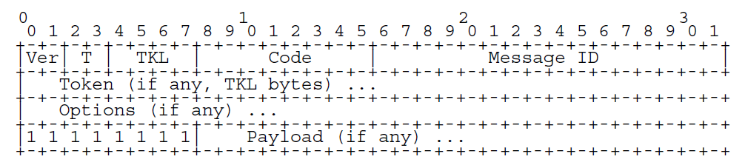
CoAP Message Format
CoAP messages are encoded in a simple binary format.
The Message Header (4 bytes).
The variable-length token value 0 and 8 bytes long.
Ver - Version (1) → 2 bit unsigned integer . Implementations of this field to 1 (01 binary).
T – Message Type → 2- bit unsigned integer. (Confirmable, Non-Confirmable, Acknowledgement, Reset).
TKL- Token Length → 4-bit unsigned integer. Indicates the length of the variable-length Token field (0-8 bytes).
Code – 8-bit unsighted integer. 3 bit class(most signification bits). 5 bits detail (least significant bits).
Request Method (1-10) or Response Code (40-255)
Message ID – 16-bit identifier for matching responses
Token – Optional response matching token

Slide 14
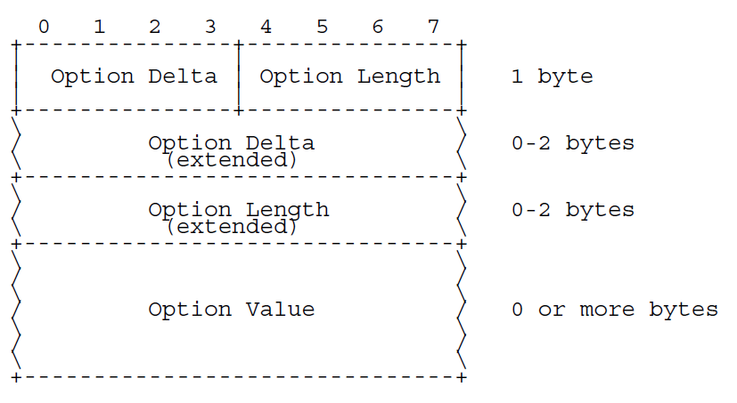
CoAP Message Format
CoAP defined a number of options that can be included in a message.
Option Delta - Difference between this option type and the previous.
4 bit unsigned integer. A value between 0 and 12 indicates the Optional Delta.
Length - Length of the option value
4 bit unsigned integer. A value between 0 and 12 indicates the length of the Optional Value, in bytes.
Value - The value of Length bytes immediately follows Length

Slide 15
CoAP Workflow
CoAPSever.h
ID | Syntax | Description
1 | Void bufferToPacket(uint8_t buffer[],int32_t packetlen) | Convert data from received buffer to packet data
2 | Int parseOption(coapOption *option, uint16_t *running_delta, uint8_t **buf, size_t buflen) | Parse the option in request message if any.
3 | Void add(callback call, String url,resource_dis resource[]) | Add resource for server
4 | Callback find(String url) | Find out callback function of current resource defined by url
5 | Bool start(int port) | Start UDP connection (server) listen to message sent to “port”
6 | Void server(callback c, String url) | Call add() function to create Resource name url, with callback
7 | Uint16_t sendPacket(coapPacket *packet, IPAddress ip, int port) | Create binary message packet and send it through UDP connection
8 | bool loop() | Function run in loop to receive, parse, handle and response request from client

Slide 16
CoAP Workflow
Server

Slide 17
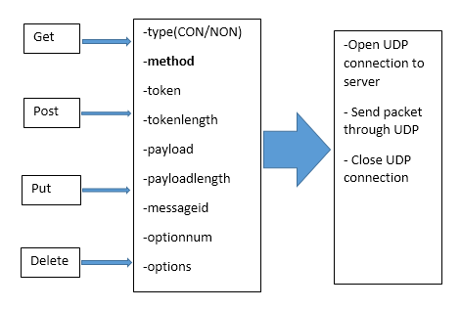
CoAP Workflow
Client

Slide 18
CoAP
Implementation
Target
Build CoAP server with sensor on Arduino Uno board, connect network via ESP8266 board.
Arduino control ESP8266 using AT command to connect wifi, send and receive message.
Run CoAP client on PC (connect to same wifi station with server) send command to server
and get sensor data from Arduino.

Slide 19
CoAP
Implementation
Implementation
To implement server on Arduino Uno, we use CoAP library for ESP8266 at https://github.com/automote/ESP-CoAP . This library provide two headers file coap_client.h and coap_server that can be use to build both our CoAP server and clienton ESP8266 board. But instead of building CoAP server on ESP8266, we build it on Arduino Uno, so we just use ESP8266 for wifi connection and data transfer.
To use ESP8266 for wifi connection and data transfer, we use ESP library that provide athttps://github.com/itead/ITEADLIB_Arduino_WeeESP8266. This library have almost functions to help us work with ESP8266

Slide 20
CoAP
Implementation
Implementation

Slide 21
CoAP Implementation
CoAPSever.h
ID | Syntax | Description
9 | Void resourceDiscovery(coapPacket *packet,IPAddress ip, int port,resource_dis resource[]); | Discover resource by url receive from request packet, used in handling function
10 | Void sendResponse(IPAddress ip, int port, char *payload); | Used in callback function, call sendPacket() to send response message to client via UDP connection
11 | Void addObserver(String url,coapPacket *request,IPAddress ip,int port); | Used in loop() to add observed resource, requested by client
12 | Void notification(char *payload); | Proccess observe function and send response payload to client

Slide 22
CoAP Implementation
CoAPClient.h
ID | Syntax | Description
1 | Bool start(int port) | Start client,UDP connection listen to message from port
2 | Bool loop() | Run in loop to handle response message
3 | Uint16_t get(IPAddress ip, int port, char *url) | CoAP get method
4 | Uint16_t put(IPAddress ip, int port, char *url, char *payload,int payloadlen) | CoAP put method
5 | Uint16_t post(IPAddress ip, int port, char *url, char *payload,int payloadlen) | CoAP post method
6 | Uint16_t ping(IPAddress ip, int port) | CoAP delete method
7 | Uint16_t observe(IPAddress ip,int port,char *url,uint8_t observe) | Make observation a server resource defined by url
8 | Uint16_t send(IPAddress ip, int port, char *url, COAP_TYPE type, COAP_METHOD method, uint8_t *token, uint8_t tokenlen, uint8_t *payload, uint32_t payloadlen,uint8_t number,uint8_t buffer) | Proccess data and call function sendPacket()

Slide 23
CoAP Implementation
CoAPClient.h
ID | Syntax | Description
9 | Uint16_t sendPacket(coapPacket &packet, IPAddress ip, int port); | Create binary message packet and send it to server via UDP
10 | Uint16_t observeCancel(IPAddress ip,int port,char *url); | Cancel observation created by url
11 | Int parseOption(coapOption *option, uint16_t *running_delta, uint8_t **buf, size_t buflen); | Parse option in server response message

Slide 24
CoAP Implementation
ESP8266.h
ID | Syntax | Description
1 | Bool restart(void) | Restart ESP8266 module
2 | Bool setOprToStation(void) | Set wifi mode for ESP as station
3 | Bool setOprToSoftAP(void) | Set wifi mode for ESP as access point
4 | Bool setOprToStationSoftAP(void) | Set wifi mode for ESP as both type above
5 | String getAPList(void) | Show available Access point
6 | Bool joinAP(String ssid, String pwd) | Connect to wifi with ssid and password
7 | Bool enableClientDHCP(uint8_t mode, enabled) | Enable DHCP client
8 | Bool leaveAP(void) | Disconnect wifi
9 | String getJoinedDeviceIP(void) | Show joined device IP
10 | String getIPStatus(void) | Get information about connection (id,type,addr,port)

Slide 25
CoAP Implementation
ESP8266.h
ID | Syntax | Description
11 | bool enableMUX(void) | Set multi conection mode
12 | bool disableMUX(void) | Set single connection mode
13 | bool registerUDP(String addr, uint32_t port) | Start single UDP connection address addr and listen at port
14 | bool unregisterUDP(void) | Close single UDP connection
15 | bool registerUDP(uint8_t mux_id, String addr, uint32_t port) | Start multi UDP connection
16 | bool unregisterUDP(uint8_t mux_id) | Close UDP connection with id in multi connection
17 | bool startServer(uint32_t port = 333) | Configure ESP as server
18 | bool stopServer(void) | Delete ESP server
19 | bool send(uint8_t mux_id, const uint8_t *buffer, uint32_t len) | Send data by UDP multi connection
20 | uint32_t recv(uint8_t *coming_mux_id, uint8_t *buffer, uint32_t buffer_size, uint32_t timeout = 1000) | Receive data from UDP multi connection

Slide 26
Thank You !

