Slide 1





OMA Lightweight M2M

Slide 2
OMA Lightweight M2M Content
Why Lightweight Device Management
OMA Lightweight M2M Standard
Bootstrapping Interface
Object Model
Access Control Model
Application Server Interaction
Example Flows

Slide 3
OMA Lightweight M2M Why Lightweight Device Management
Traditional Device Management (DM) is widely used in mobile devices
Used by operators and enterprises for managing smart phones, tablets and laptops
Some M2M DM use today with cellular devices, mostly proprietary
OMA DM was one of the first standards for device management in the mobile handset sector.
In the meanwhile various standards exist that provide similar functionality, such as TR 69, or IEEE 802.1AR.
OMA Lightweight M2M (LWM2M) created to serve the IoT market with a focus on lightweight nature:
Applicable to various radio technologies (devices just need IP connectivity)
Extensible object model and registry open to the whole industry
Enables both management and application data handling with the same solution
Addresses security need for software updates and device re-configuration.
Re-uses IETF specifications.

Slide 4
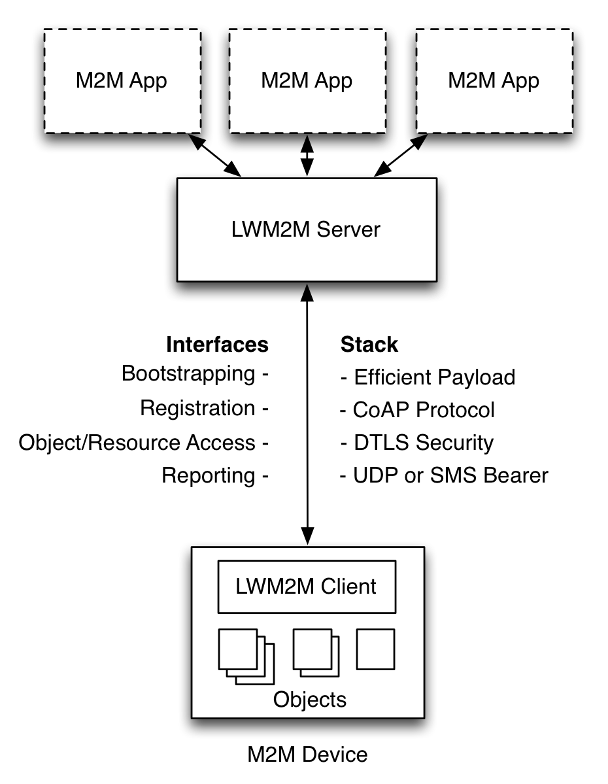
OMA Lightweight M2M OMA LWM2M Architecture
M2M Applications
Application abstraction through REST API
Resource Discovery and Linking
LWM2M Server
Reuses IETF technologies, such as the CoAP protocol, DTLS, Resource Directory.
Deployable on gateways and in the cloud
LWM2M Clients are Devices
Device abstraction through CoAP
LWM2M Clients are CoAP Servers
Any IP network connection

Slide 5
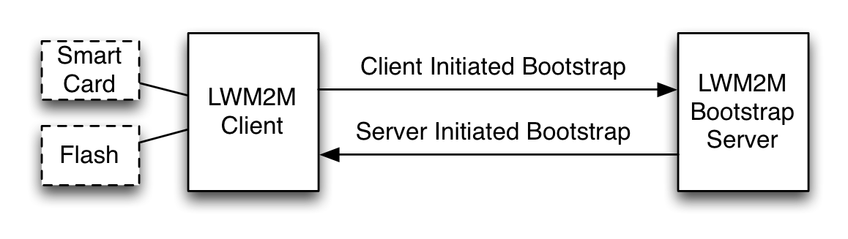
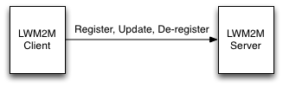
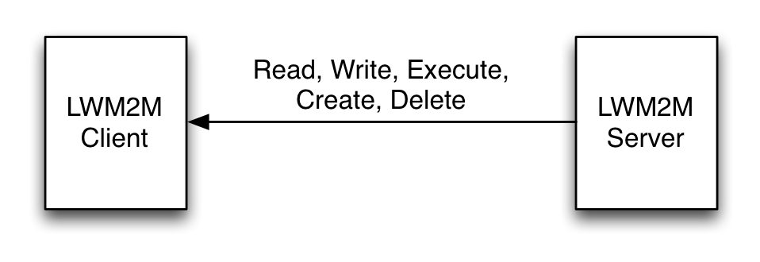
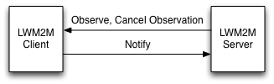
OMA Lightweight M2M LWM2M Interfaces
Bootstrap Interface
Configure Servers & Keys & ACLs
Pre-Configured, Smart Card, or Server Initiated Bootstrap
CoAP REST API
Registration Interface
RFC 6690 and Resource Directory
Management Interface Using Objects
Management Objects and Resources
CoAP REST API
Reporting Interface
Object Instances and Resources Report
Asynchronous notification using CoAP Observe

Slide 6
OMA Lightweight M2M Bootstrap Interfaces

Slide 7
OMA Lightweight M2M Bootstrapping Features
OMA LWM2M supports different credential provisioning procedures:
Pre-shared Secrets
Raw Public Keys
Certificates
These credentials are provisioned by the Bootstrap Server for use with LWM2M servers.
It is possible to mix credentials for use with different servers and even to use different credentials in a single client/server interaction.
The LWM2M client is assumed to possess credentials for authentication to the Bootstrap Server. These credentials are typically pre-provisioned during manufacturing time.

Slide 8
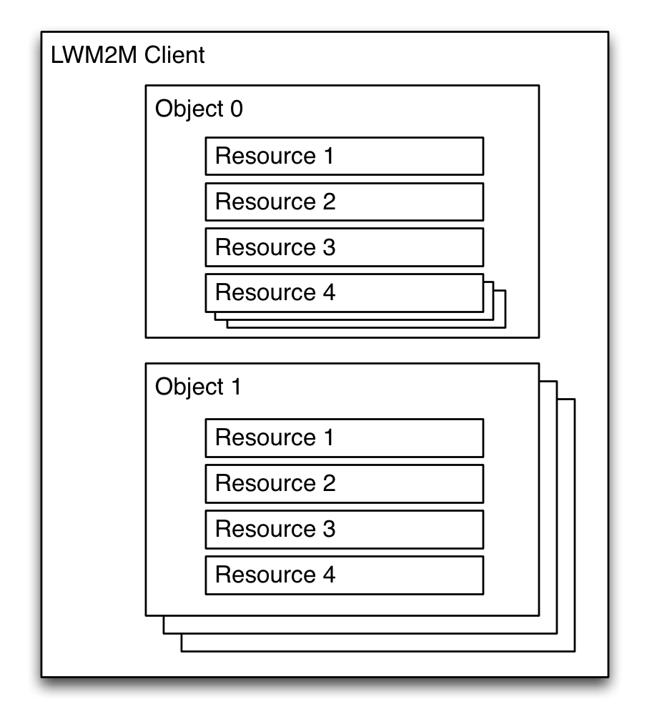
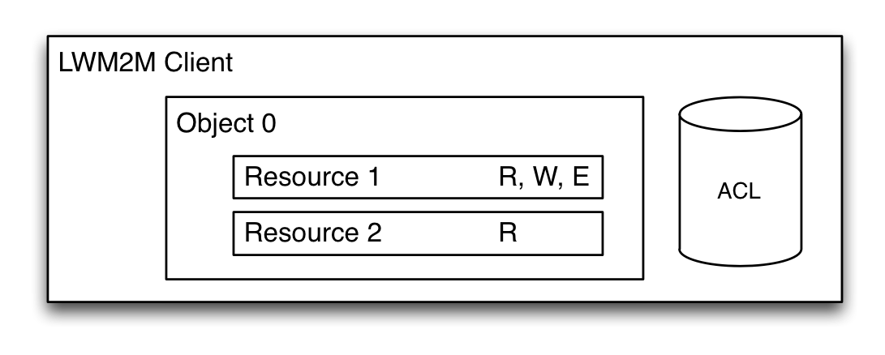
OMA Lightweight M2M Object Model
A LWM2M Client has one or more Object Instances
An Object is a collection of Resources
A Resource is an atomic piece of information that can be
Read, Written or Executed
Resources can have multiple instances
Access control list (ACL) objects control access to objects accessed by LWM2M Servers
Objects and Resources are identified by a 16-bit Integer, Instances by an 8-bit Integer
Objects/Resources are accessed with simple URIs:
/{Object ID}/{Object Instance}/{Resource ID}
Example: /3/0/1 = 3 = Device Object, 0 = Object Instance #0, 1 = Manufacturer Resource

Slide 9
OMA Lightweight M2M Standard Device Management Objects
The LWM2M Technical Specification defines eight normative Objects
Object Name | ID | Multiple Instances? | Description
LWM2M Security | 0 | Yes | This LWM2M Object provides the keying material of a LWM2M Client appropriate to access a specified LWM2M Server.
LWM2M Server | 1 | Yes | This LWM2M objects provides the data related to a LWM2M server.
Access Control | 2 | Yes | Access Control Object is used to check whether the LWM2M Server has access right for performing an operation.
Device | 3 | No | This LWM2M Object provides a range of device related information which can be queried by the LWM2M Server, and a device reboot and factory reset function.
Connectivity Monitoring | 4 | No | This LWM2M objects enables monitoring of parameters related to network connectivity.
Firmware | 5 | No | This Object includes installing firmware package, updating firmware, and performing actions after updating firmware.
Location | 6 | No | The GPS location of the device.
Connectivity Statistics | 7 | No | This LWM2M Objects enables client to collect statistical information and enables the LWM2M Server to retrieve these information, set the collection duration and reset the statistical parameters.

Slide 10
OMA Lightweight M2M

Slide 11
OMA Lightweight M2M

Slide 12
OMA Lightweight M2M

Slide 13
OMA Lightweight M2M

Slide 14
Thank You !

