Slide 1

Device Management with OMA Lightweight M2M
Simon Lemay and Hannes Tschofenig

Slide 2
Overview
Why Lightweight Device Management
OMA Lightweight M2M Standard
Bootstrapping Interface
Object Model
Access Control Model
Application Server Interaction
Example Flows
©Sensinode 2013

Slide 3
Why Lightweight Device Management

Slide 4
Why Lightweight Device Management?
Traditional Device Management (DM) is widely used in mobile devices
Used by operators and enterprises for managing smart phones, tablets and laptops
Some M2M DM use today with cellular devices, mostly proprietary
OMA DM was one of the first standards for device management in the mobile handset sector.
In the meanwhile various standards exist that provide similar functionality, such as TR 69, or IEEE 802.1AR.
OMA Lightweight M2M (LWM2M) created to serve the IoT market with a focus on lightweight nature:
Applicable to various radio technologies (devices just need IP connectivity)
Extensible object model and registry open to the whole industry
Enables both management and application data handling with the same solution
Addresses security need for software updates and device re-configuration.
Re-uses IETF specifications.

Slide 5
Features
Key management
Service provisioning
Access Control
Bootstrapping
Device Management
Device Configuration
Changes to settings
Changes to parameters of the device
Mobile Device Management
Firmware Update
Update application and system software
Bug fixes
Fault Management
Report Errors from devices
Query about status of devices
Application
Configuration & Control
Configure settings of the application
Send control commands
Reporting
Notify changes in sensor values
Notify alarms and events

Slide 6
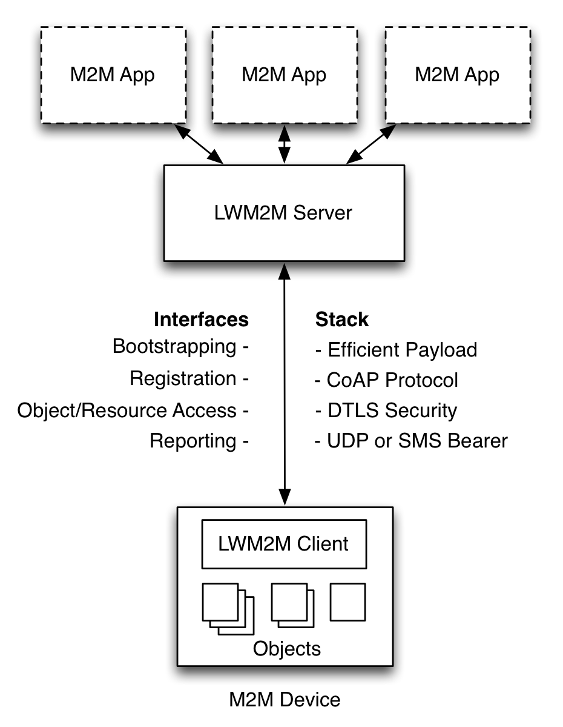
OMA LWM2M Architecture
M2M Applications
Application abstraction through REST API
Resource Discovery and Linking
LWM2M Server
Reuses IETF technologies, such as the CoAP protocol, DTLS, Resource Directory.
Deployable on gateways and in the cloud
LWM2M Clients are Devices
Device abstraction through CoAP
LWM2M Clients are CoAP Servers
Any IP network connection

Slide 7
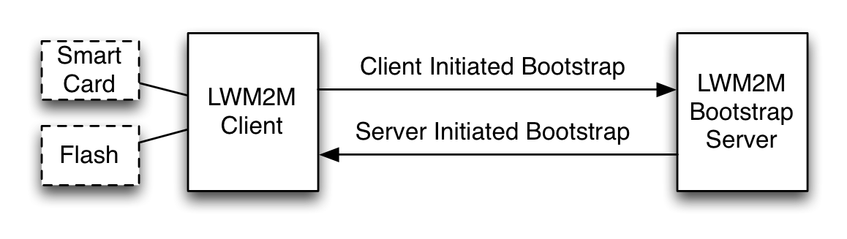
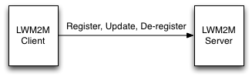
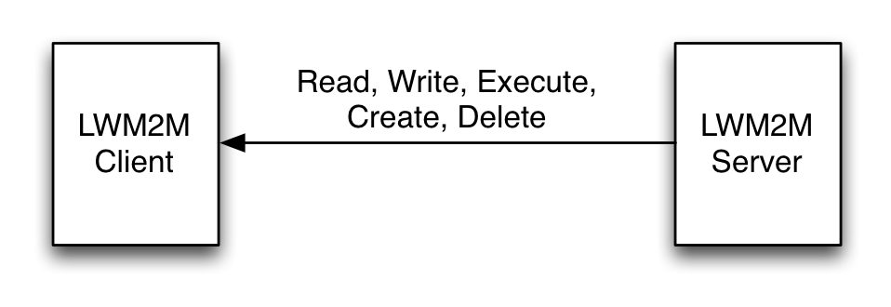
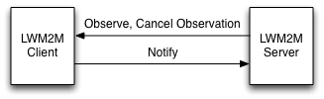
LWM2M Interfaces
Bootstrap Interface
Configure Servers & Keys & ACLs
Pre-Configured, Smart Card, or Server Initiated Bootstrap
CoAP REST API
Registration Interface
RFC 6690 and Resource Directory
Management Interface Using Objects
Management Objects and Resources
CoAP REST API
Reporting Interface
Object Instances and Resources Report
Asynchronous notification using CoAP Observe

Slide 8
Bootstrap Interface

Slide 9
Bootstrapping Architecture

Slide 10
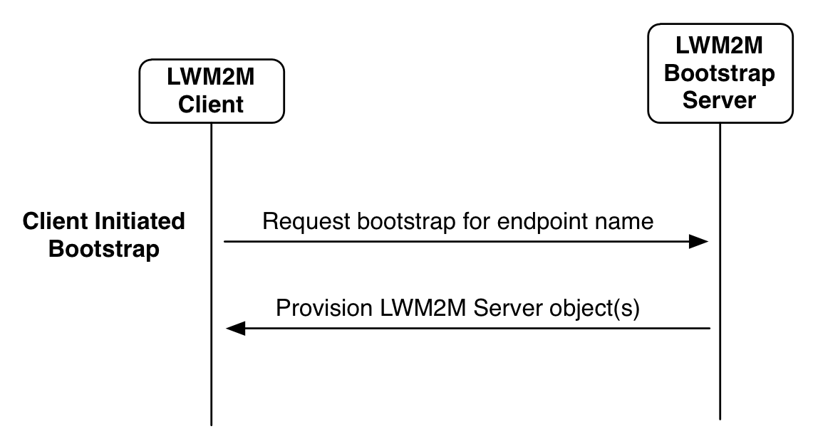
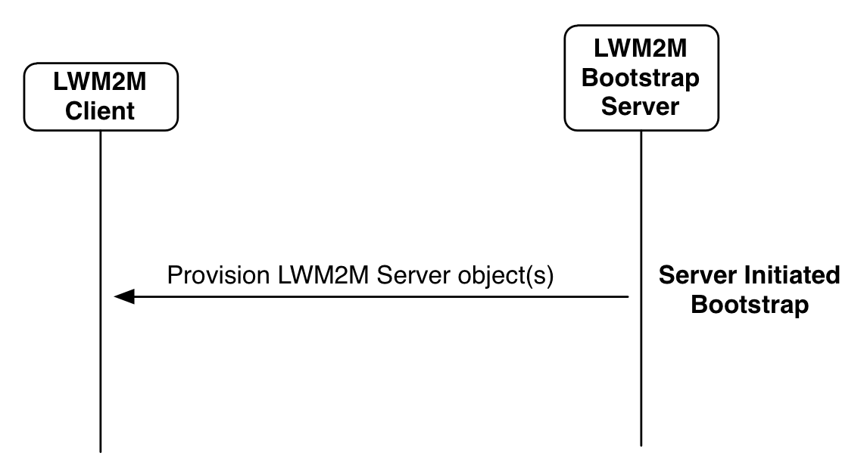
Bootstrapping
©Sensinode 2013

Slide 11
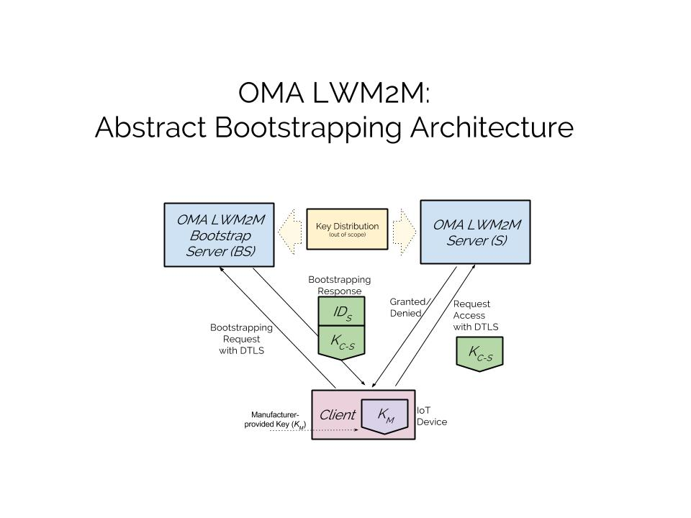

Slide 12
Bootstrapping Features
OMA LWM2M supports different credential provisioning procedures:
Pre-shared Secrets
Raw Public Keys
Certificates
These credentials are provisioned by the Bootstrap Server for use with LWM2M servers.
It is possible to mix credentials for use with different servers and even to use different credentials in a single client/server interaction.
The LWM2M client is assumed to possess credentials for authentication to the Bootstrap Server. These credentials are typically pre-provisioned during manufacturing time.

Slide 13
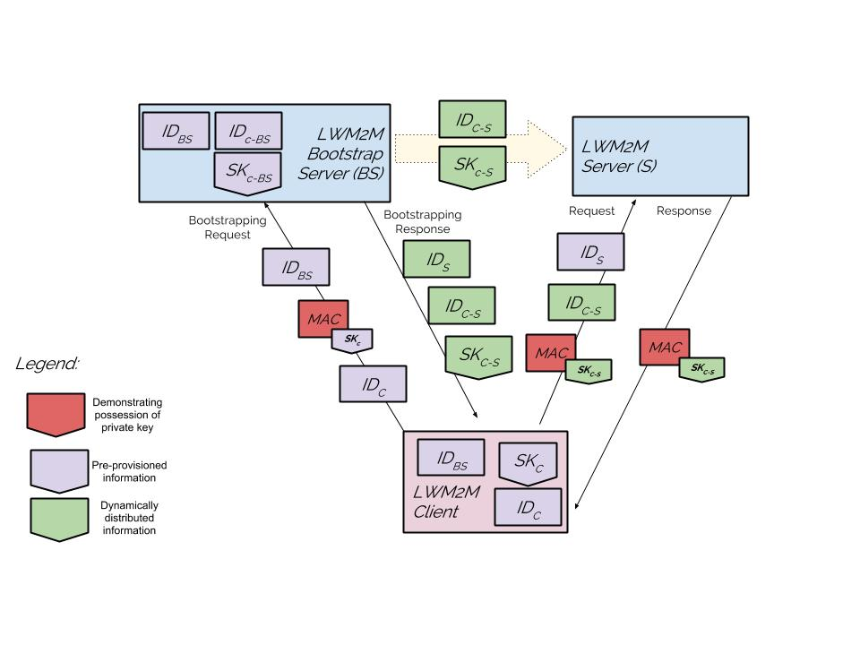
Pre-Shared Key Mode

Slide 14
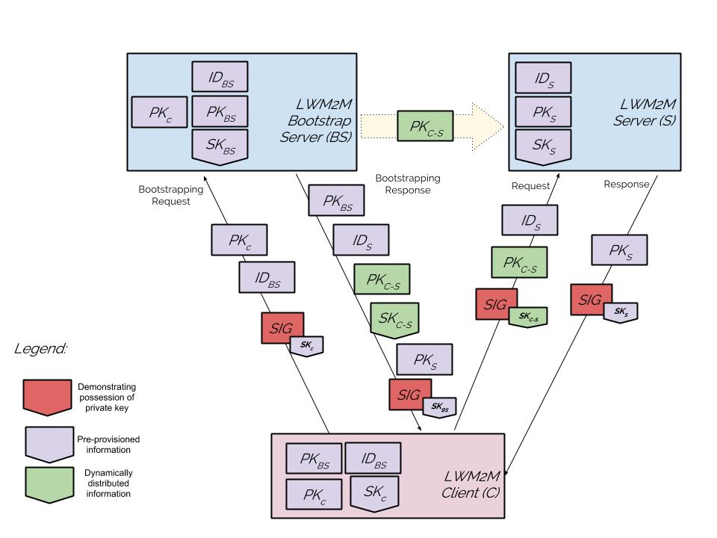
Raw Public Key Mode

Slide 15
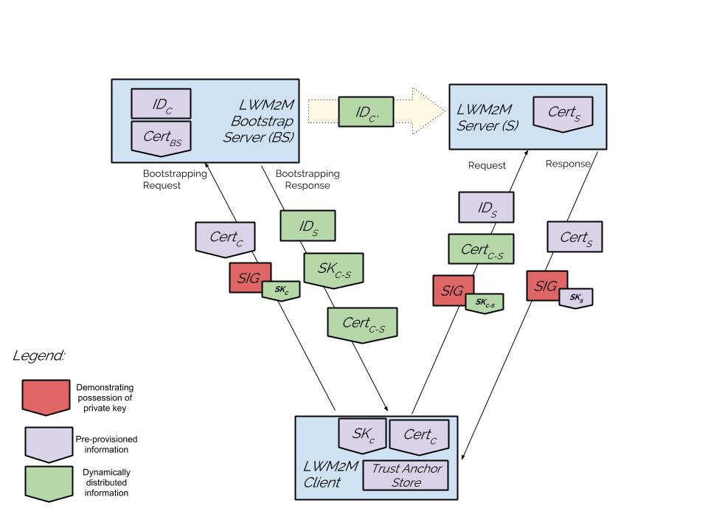
Certificate Mode

Slide 16
A few more details
LWM2M Client may be pre-provisioned with information about the LWM2M Server (rather than distributing credentials with the bootstrapping protocol)
LWM2M Client MUST have a LWM2M Bootstrap Server Account (+Bootstrap Server URI, Endpoint Client Name)
LWM2M Security Object
Security Mode (PSK, raw public key, certificate, no-sec)
Public Key or Identity (certificate, public key, or PSK identity)
Server Public Key or Identity (LWM2M server or bootstrap server certificate, public key or PSK identity)
Secret Key (secret key or private key)
LWM2M Server URI (bootstrap server or LWM2M server)
Bootstrap Server (true – false)

Slide 17
Object Model

Slide 18
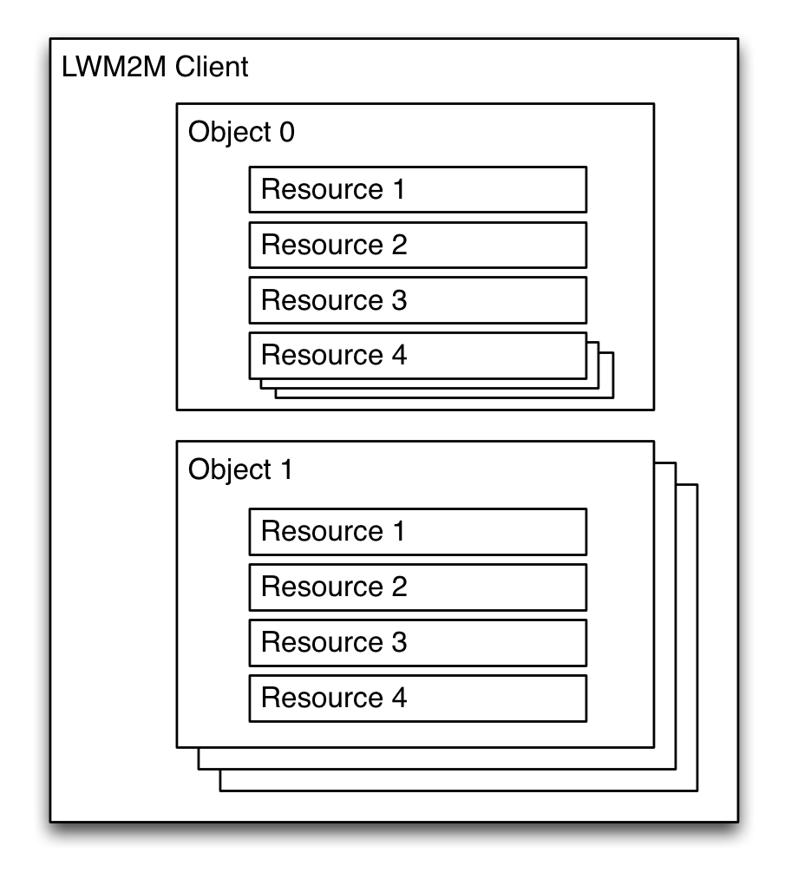
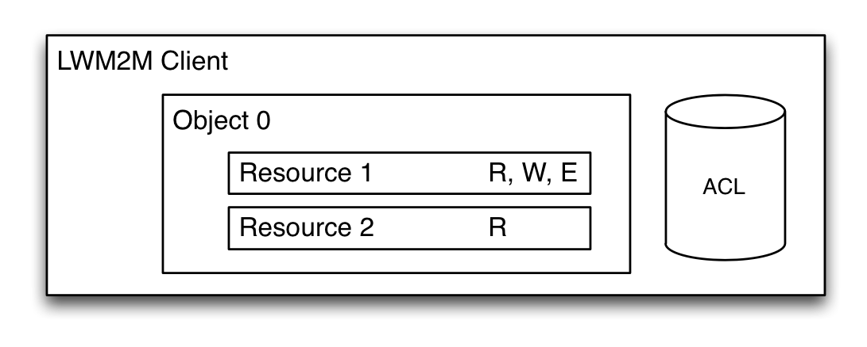
Object Model
A LWM2M Client has one or more Object Instances
An Object is a collection of Resources
A Resource is an atomic piece of information that can be
Read, Written or Executed
Resources can have multiple instances
Access control list (ACL) objects control access to objects accessed by LWM2M Servers
Objects and Resources are identified by a 16-bit Integer, Instances by an 8-bit Integer
Objects/Resources are accessed with simple URIs:
/{Object ID}/{Object Instance}/{Resource ID}
Example: /3/0/1 = 3 = Device Object, 0 = Object Instance #0, 1 = Manufacturer Resource
©Sensinode 2013

Slide 19
Standard Device Management Objects
The LWM2M Technical Specification defines eight normative Objects
Object Name | ID | Multiple Instances? | Description
LWM2M Security | 0 | Yes | This LWM2M Object provides the keying material of a LWM2M Client appropriate to access a specified LWM2M Server.
LWM2M Server | 1 | Yes | This LWM2M objects provides the data related to a LWM2M server.
Access Control | 2 | Yes | Access Control Object is used to check whether the LWM2M Server has access right for performing an operation.
Device | 3 | No | This LWM2M Object provides a range of device related information which can be queried by the LWM2M Server, and a device reboot and factory reset function.
Connectivity Monitoring | 4 | No | This LWM2M objects enables monitoring of parameters related to network connectivity.
Firmware | 5 | No | This Object includes installing firmware package, updating firmware, and performing actions after updating firmware.
Location | 6 | No | The GPS location of the device.
Connectivity Statistics | 7 | No | This LWM2M Objects enables client to collect statistical information and enables the LWM2M Server to retrieve these information, set the collection duration and reset the statistical parameters.

Slide 20
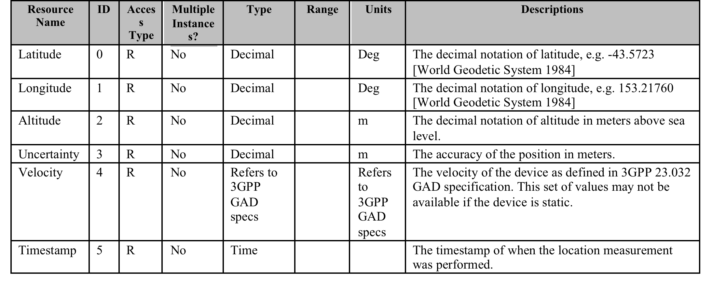
Object Example
Example of the LWM2M Location Object, which has 6 Resources

Slide 21
Defining new Objects
Defining a new Object is straightforward
Object IDs are registered with the OMA Naming Authority (OMNA)
Who can register an Object?
OMA working groups
3rd party organizations
Enterprises
How to register an Object?
Write a specification filling out the Object template tables:
Object Name, Description and if it can have Multiple Instances
The list of resources the Object defines
Fill out the Lightweight Object form on-line.
IPSO Alliance has created additional objects, which are documented here (Starter Pack) and here (Expansion Pack).

Slide 22
Access Control Model

Slide 23
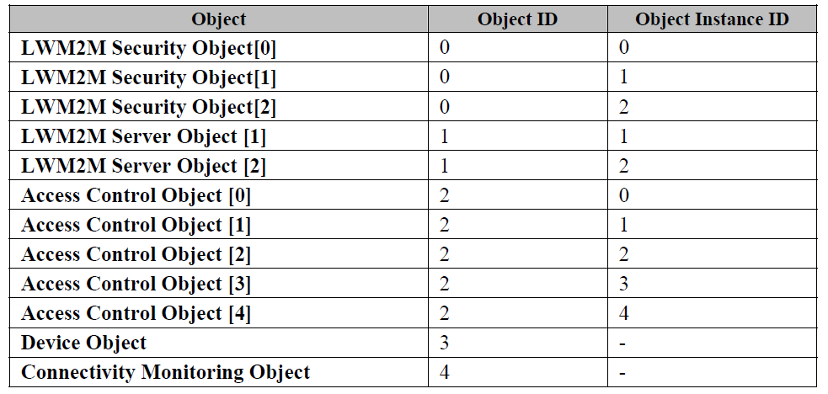
Overview
Bootstrap servers distribute access control lists to LWM2M clients.
Example from Appendix F of the OMA LWM2M technical specification: (Table shows example objects provisioned at a LWM2M client by the Bootstrap server.)

Slide 24
Overview, cont.
Luminaire
LWM2M
Client
Registration and resource access
LWM2M
Server 1
ACL: <Server 1, RW>
Light Switch
Application
LWM2M
Bootstrap Server
Registration and resource access
LWM2M
Client 3
LWM2M
Server 2
ACL: <Server 2, RW>

Slide 25
Discussion
ACLs work well when a Bootstrap Server is aware of the future interactions between LWM2M servers and LWM2M clients.
Real-time provisioning of ACLs by the Bootstrap Server is also possible.
During registration a LWM2M client is a CoAP client; afterwards it becomes a CoAP server waiting for incoming CoAP requests.
Notes:
LWM2M clients can become LWM2M servers in another communication setup and may therefore also receive ACLs from the Bootstrap Server. In our example light switches and luminaires are LWM2M clients in different communication scenarios.
Different LWM2M clients may also use different Bootstrap Servers.
A single LWM2M client may also have more than one Bootstrap Server (e.g., for redundancy/ purpose)

Slide 26
Application Server Interaction

Slide 27
LWM2M Application Server
Web Server App
Soft Endpoints
DISCOVER
/domain/endpoints/3303/0/5700
LWM2M Server
/3303/0/5700
REGISTER
IP Device
IP Device
LWM2M Clients

Slide 28
LWM2M Application Server
Web Server App
/domain/endpoints/3303/0/5700
1. GET
4. REPLY
LWM2M Server
/3303/0/5700
3. REPLY
2. GET
IP Device
IP Device
LWM2M Clients

Slide 29
LWM2M Application Server
Web Server App
2. NOTIFY
LWM2M Server
1. NOTIFY
IP Device
IP Device
LWM2M Clients

Slide 30
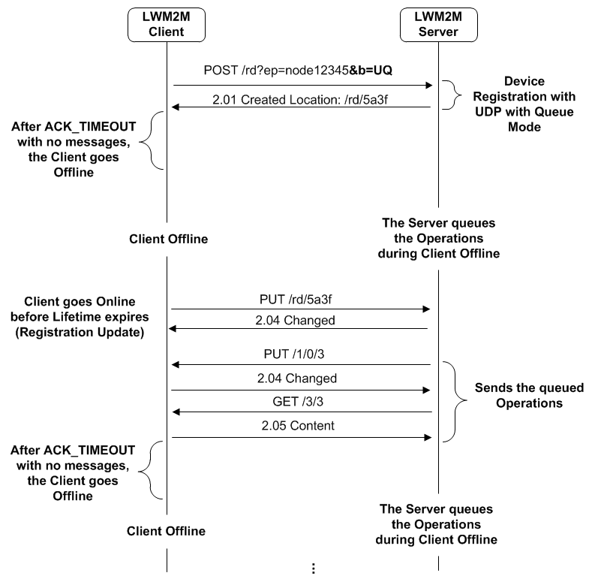
LWM2M Supports Sleeping Endpoints “b=uq”
Client uses the registration refresh to inform LWM2M server that it is awake, and listens for any queued operations

Slide 31
Observe Parameters
LWM2M provides a mechanism to control Observation
“Write Attributes” Interface using query parameters to set observe attributes:
Pmin – minimum observation quiet period, to limit notification frequency
Pmax – maximum observation quiet period, to guarantee notifications
Lt – low limit measurement notification, like low alarm, in engineering units
Gt – high limit measurement notification, like a high alarm, in engineering units
Step – Minimum delta change required to notify, in engineering units

Slide 32
LWM2M Bulk Read
{“e”:[
{"n":"0","sv":"Open Mobile Alliance"},
{"n":"1","sv":"Lightweight M2M Client"},
{"n":"2","sv":"345000123"},
{"n":"3","sv":"1.0"},
{"n":"6/0","v":"1"},
{"n":"6/1","v":"5"},
{"n":"7/0","v":"3800"},
{"n":"7/1","v":"5000"},
{"n":"8/0","v":"125"},
{"n":"8/1","v":"900"},
{"n":"9","v":"100"},
{"n":"10","v":"15"},
{"n":"11/0","v":"0"},
{"n":"13","v":"1367491215"},
{"n":"14","sv":"+02:00"},
{"n":"15","sv":"U"}]
}
Returns TLV or JSON based on requested content-format
CBOR needs to be added
Linked Objects are supported

Slide 33
LWM2M Uses CoRE RD Resource Links (RFC 6690)
<4001/0/9002>;rt=“oma.lwm2m”;ct=50;obs=1
Resource Type
Content Type
Observable
Links are uploaded during registration to inform the LWM2M server about resources on the endpoint
Links are discovered using GET with content type “application/link-format”
JSON representation using content type “application/link-format+json”

Slide 34
Example Flows

Slide 35
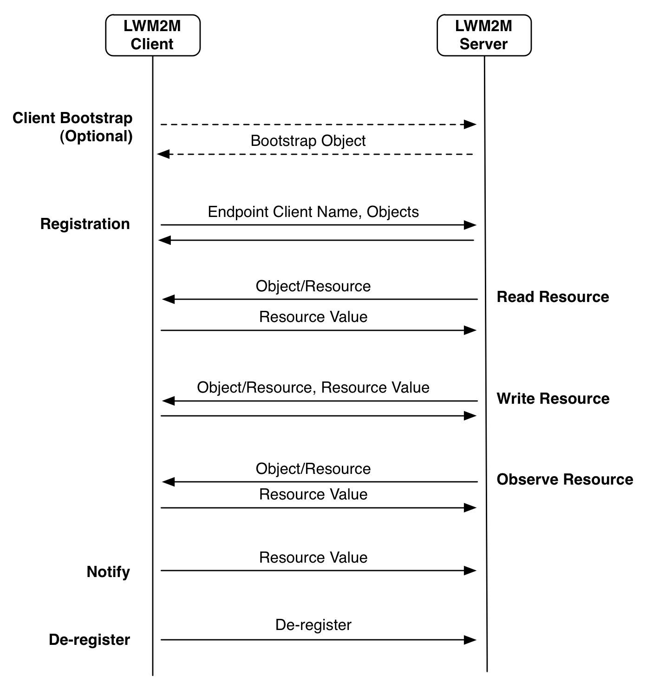
Interface Flows
©Sensinode 2013

Slide 36
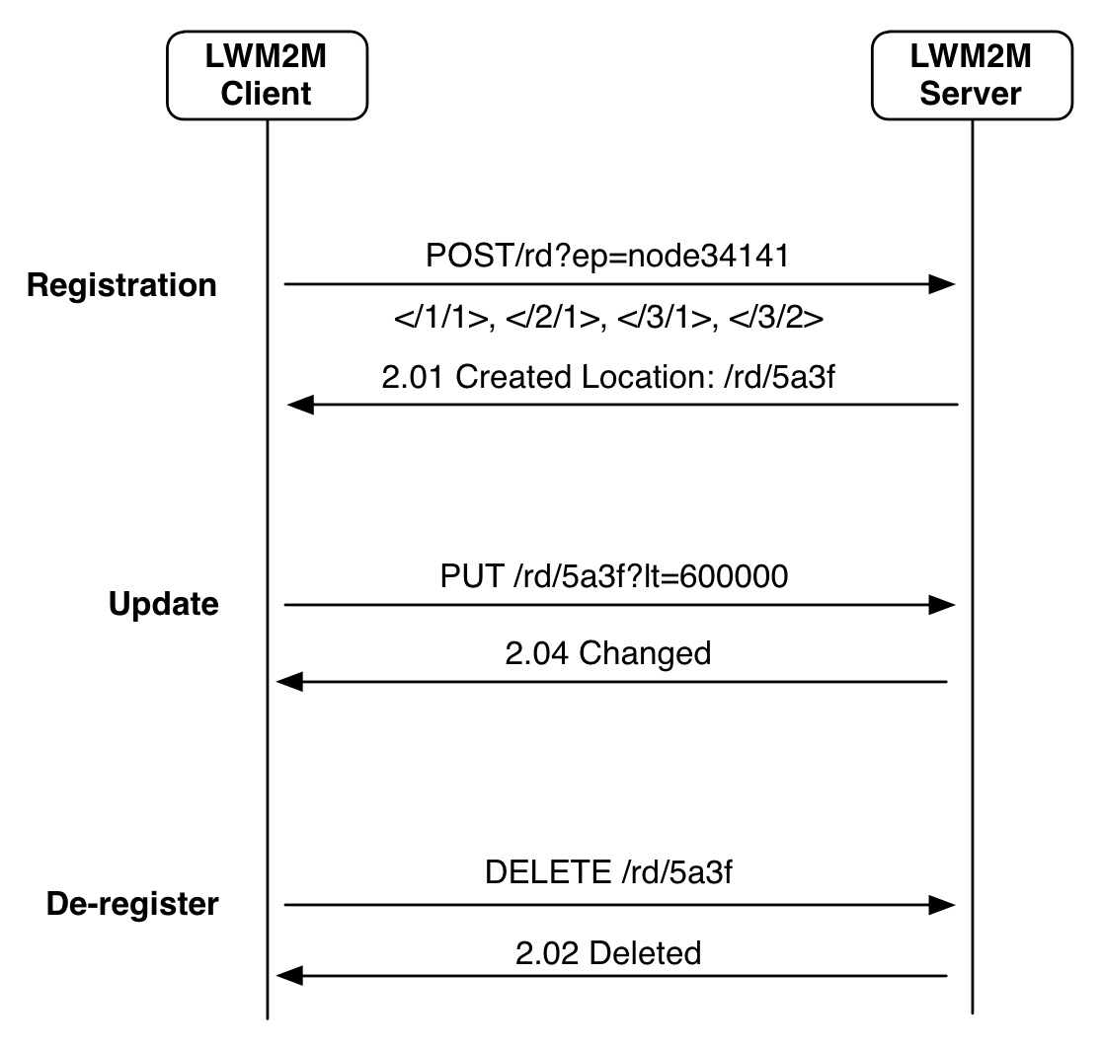
Registration
©Sensinode 2013

Slide 37
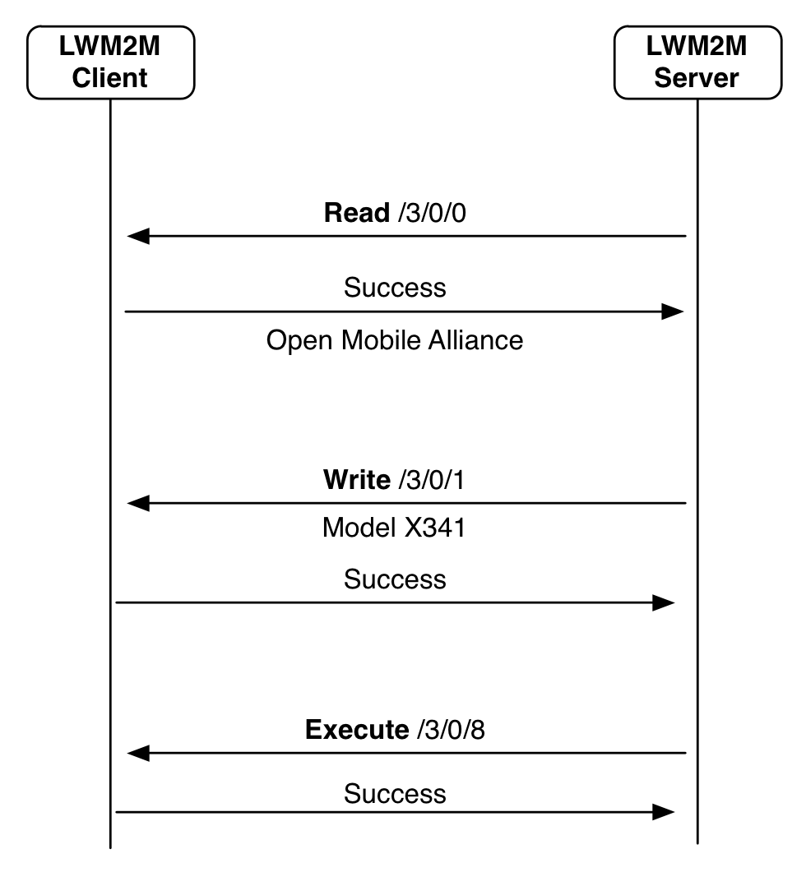
Object Access
©Sensinode 2013

Slide 38
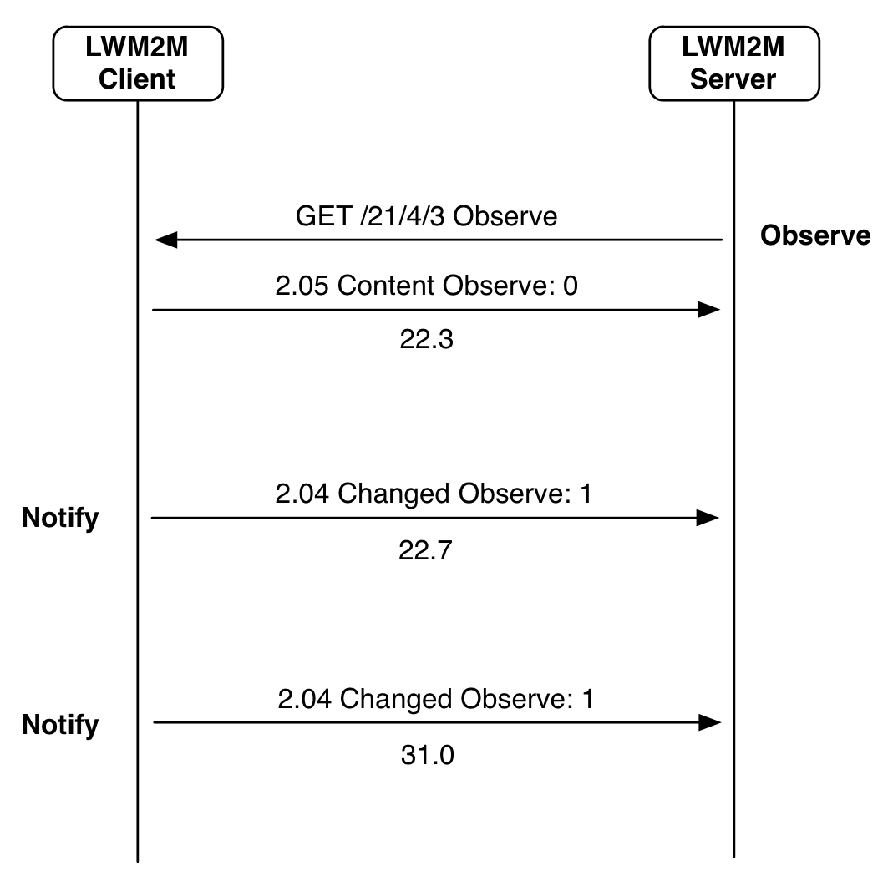
Notification
©Sensinode 2013

Slide 39
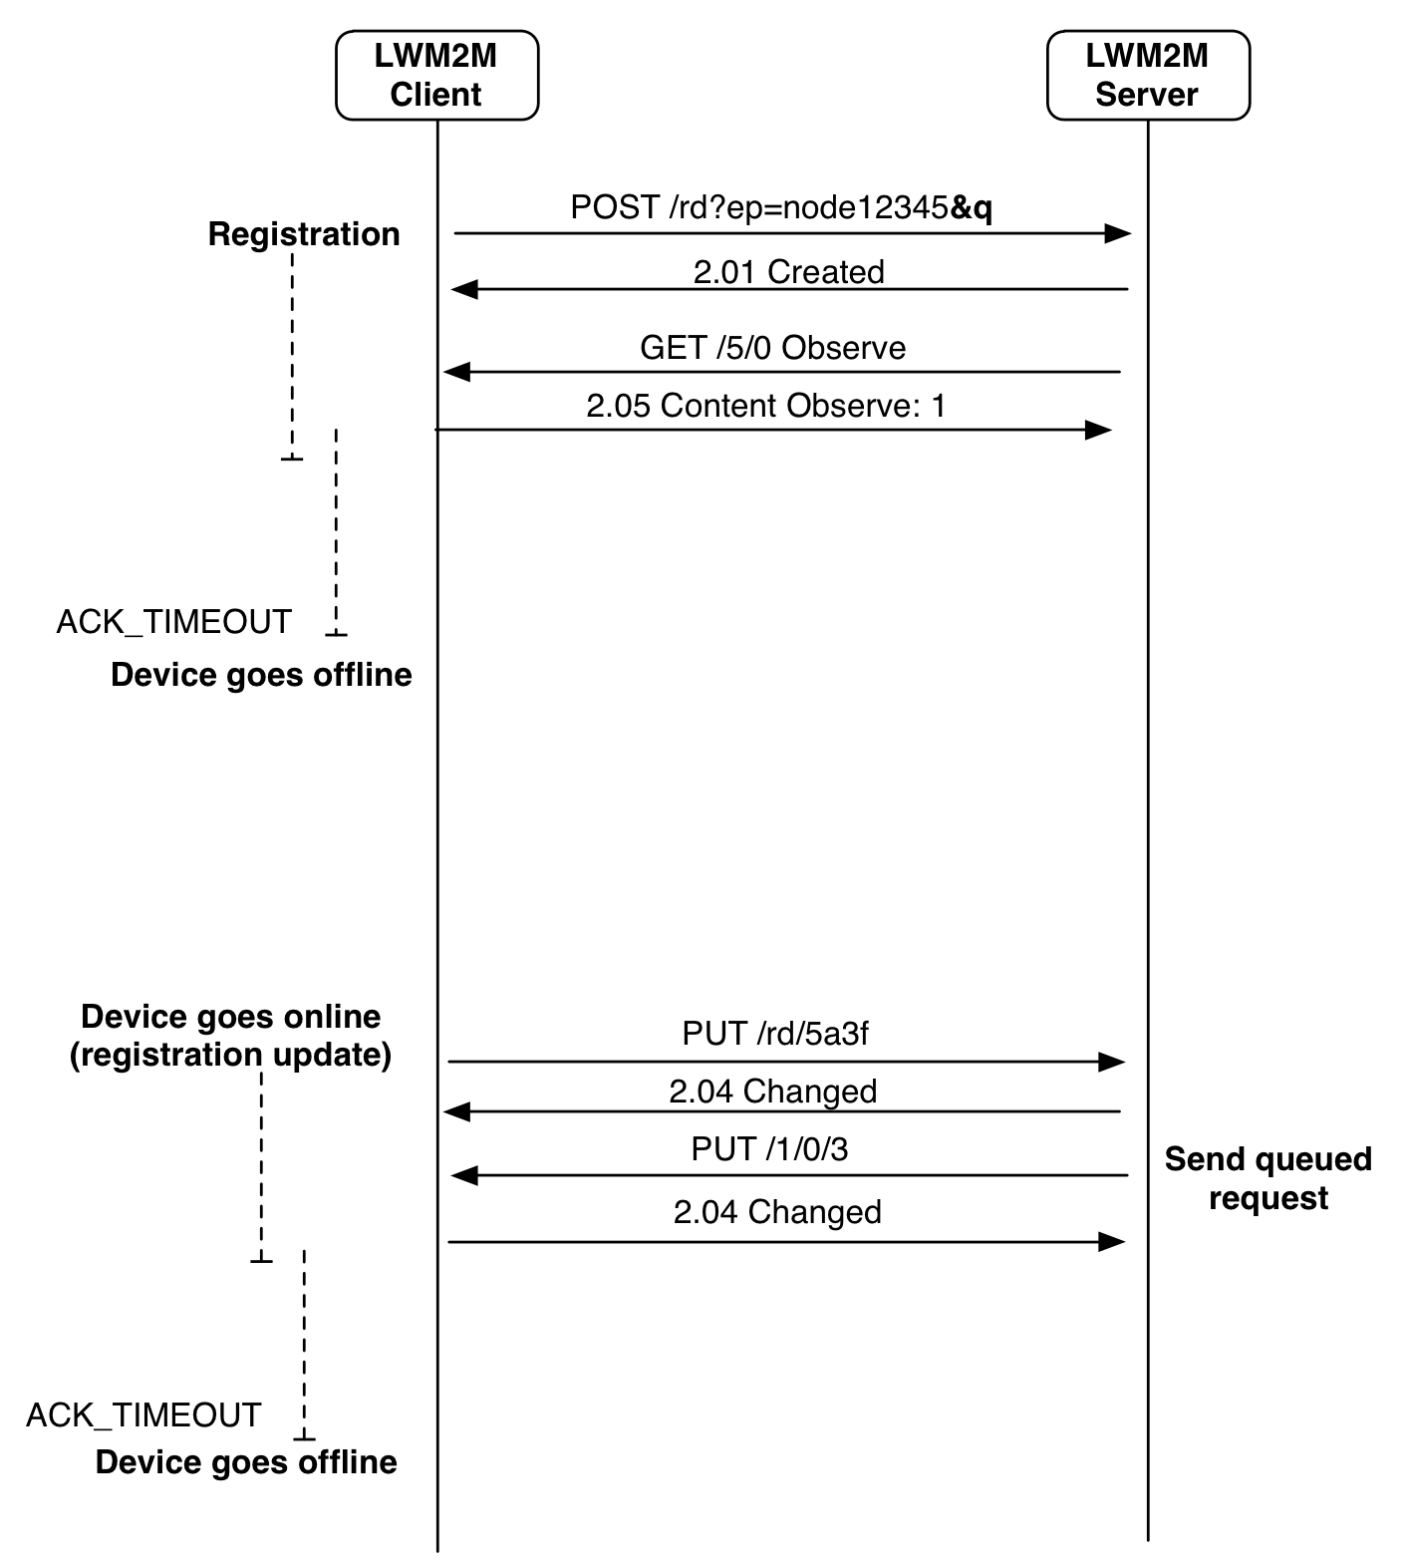
Queue Mode (Sleeping Devices)
©Sensinode 2013

Slide 40

Summary
LWM2M re-uses many IETF specifications. Specifications are publically available for download here.
Implementations and products are available. Example: Leshan (as an open source implementation)
Several plugfests took place already and there the issue list can be found here.
Work on a bugfix release is in progress and the Version 1.1 specification work will be started soon to specification with ongoing IETF work.

Slide 41
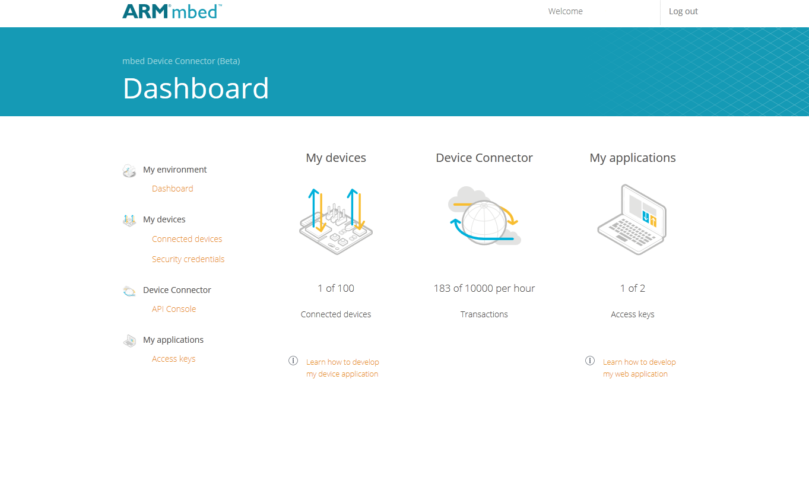
Using LWM2M with ARM
Create your application with mbed Client. Examples:
mbed client (Linux)
mbed client (mbed OS)
Connect your IoT devices to the mbed Device Connector at https://connector.mbed.com
Create your web application with example code or REST API
Links:
Example code
Documentation

