Slide 1
release / milestone
Tag: 1.0.0
Tag: 1.1.0
Tag: 2.0.0
release
SA-team
sprint release / usecase
usecase 1
sprint 2
test
Hot fix (only for SA/TL)
SA/TL
dev
pull source before merge
feature/yyy
feature/xxx
dev team
merge request
fix/xxx
resolve conflict

Slide 2
branch naming convention | branch commit message template
master/staging | Milestone name PRD release version Usecase/feature Ex: [sprint-1][v1] 1995,1783,1691
test | Milestone name Test release version Usecase/feature Ex: [sprint-1][v1] 1995,1783,1691
dev | Milestone name Usecase/feature Ex: [sprint-1] 1995,1783,1691
hotfix/[branchName]/[problem](*) Ex: hotfix/feature/17952_master_data_lead_source/remove_conflict | Milestone name Problem / Change list Ex: [sprint-1] remove code conflict class PipelineService
(*) Only for SA/TL

Slide 3
branch naming convention | branch commit message template
config/[description] (*) Ex: | Milestone name Change list Ex: [sprint-1] Add class OpenApiConfig for descrip swagger
feature/[redmine] /[ft_name] Ex: feature/17952/master_data | Milestone name Function name Usecase/fearture Ex: [sprint-1][code][17952] code get master data of select box lead source [sprint-1][unittest][12552] unit test get master data of select box lead source
fix/[redmine] /[ft_name] Ex: fix/17952/master_data | Milestone name Function name Fix content Ex: [sprint-1][bug][17952] change sql: add order by item [sprint-1][cr][17952] change sort from id to id, name
(*) Only for SA/TL

Slide 4
When start coding:
Update dev branch
2. Checkout branch from dev branch and naming the new branch with naming convention (slide 2,3)
3. Coding and commit your code
4. Update code from dev branch and resolve conflict
5. Rebase squash all commit to one commit
6. Create merge request on gitlab

Slide 5
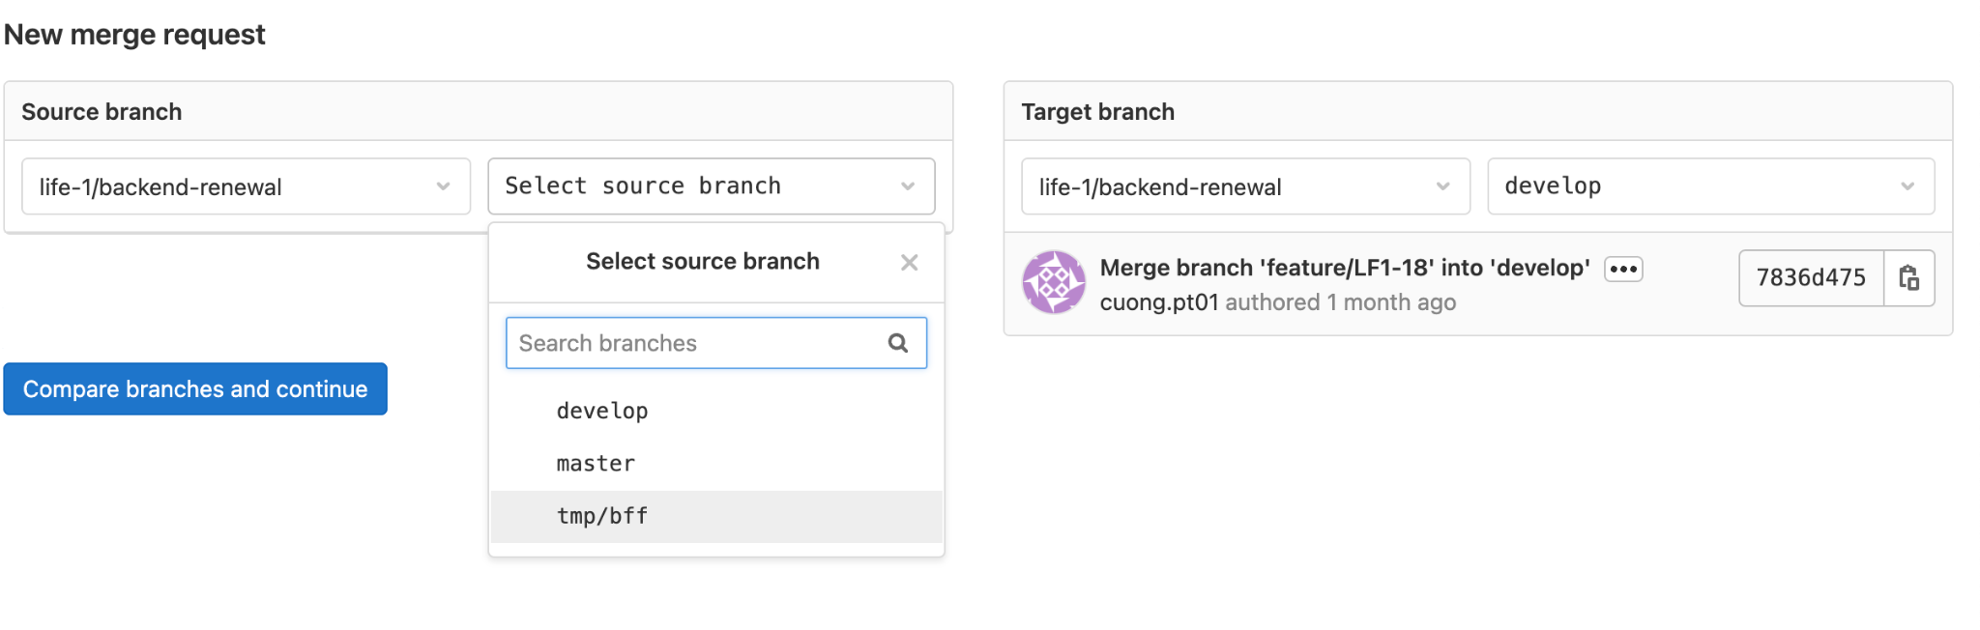
dev branch
Click to create MR
Your branch

Slide 6
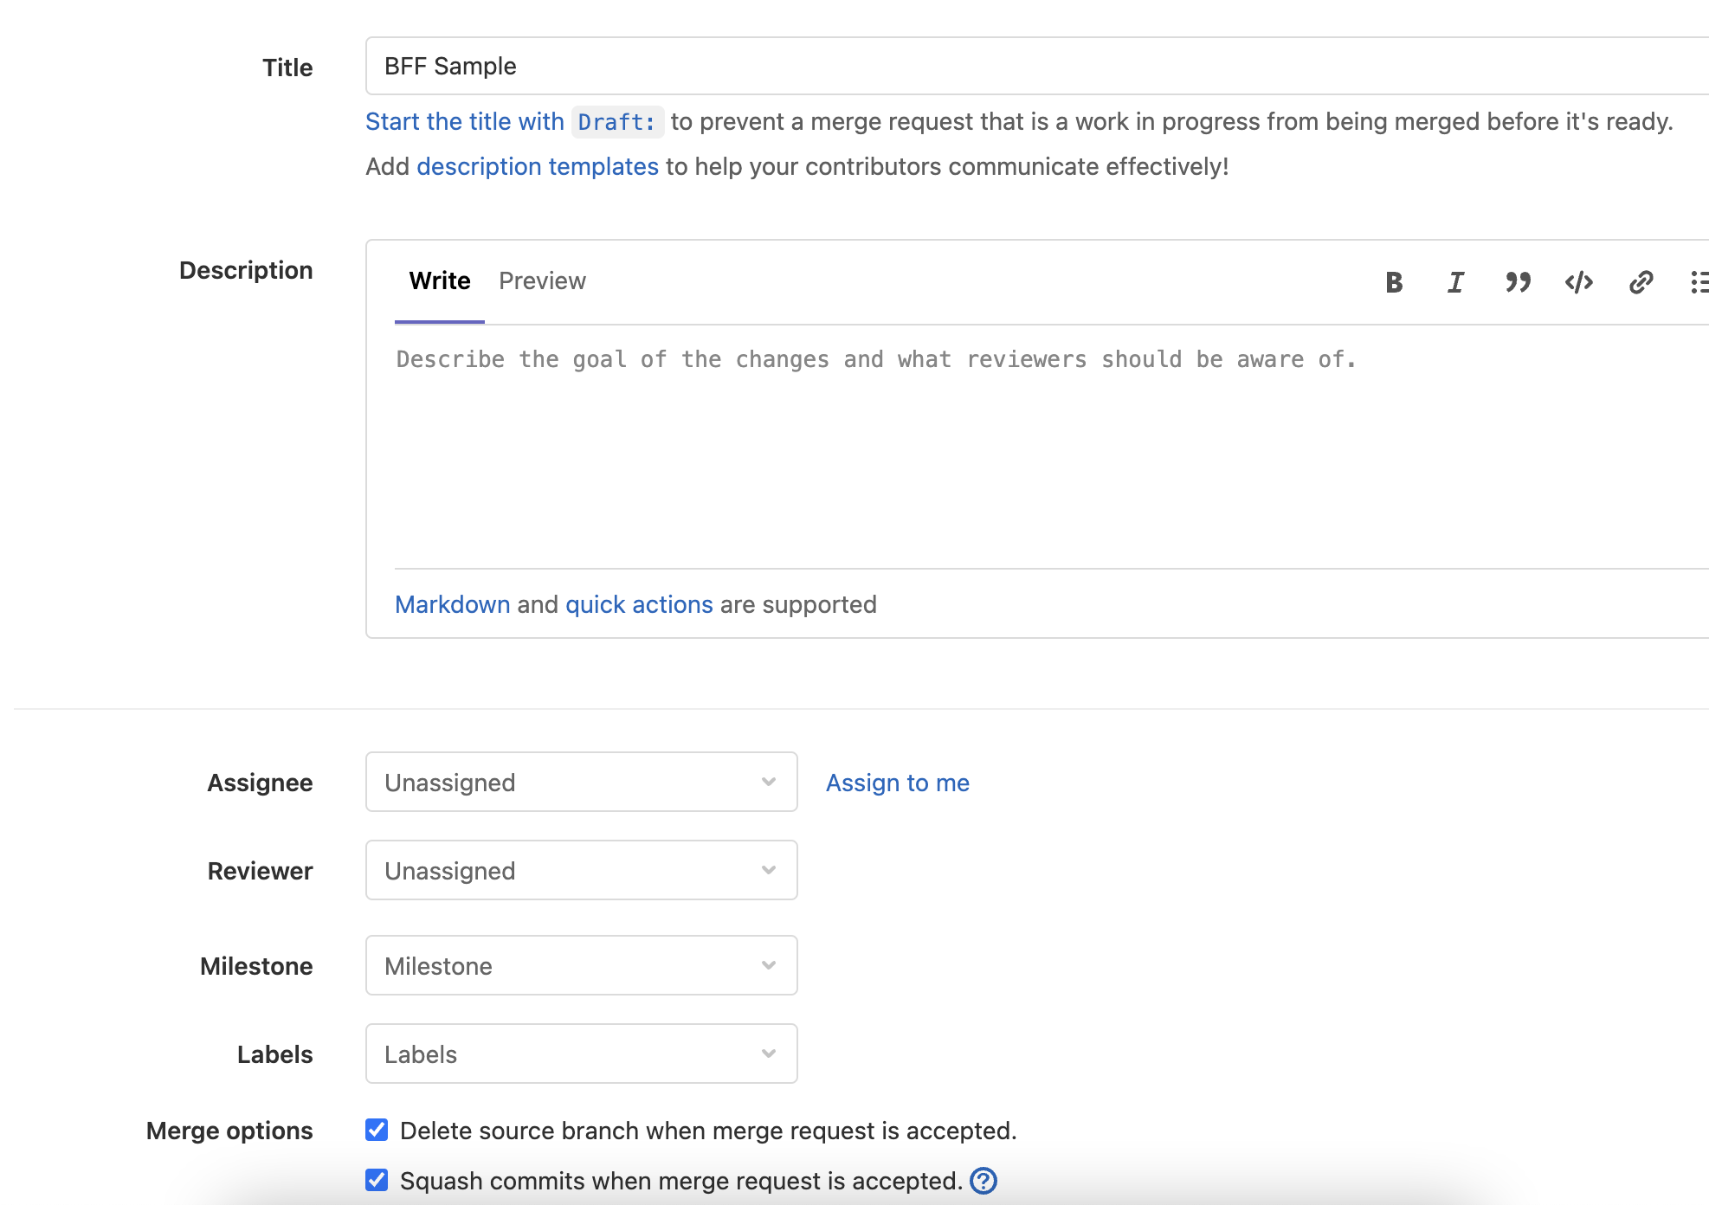
Put merge message (template at slide 3)
Tick
Click Assign to me
Chose reviewer
Chose milestone

Slide 7
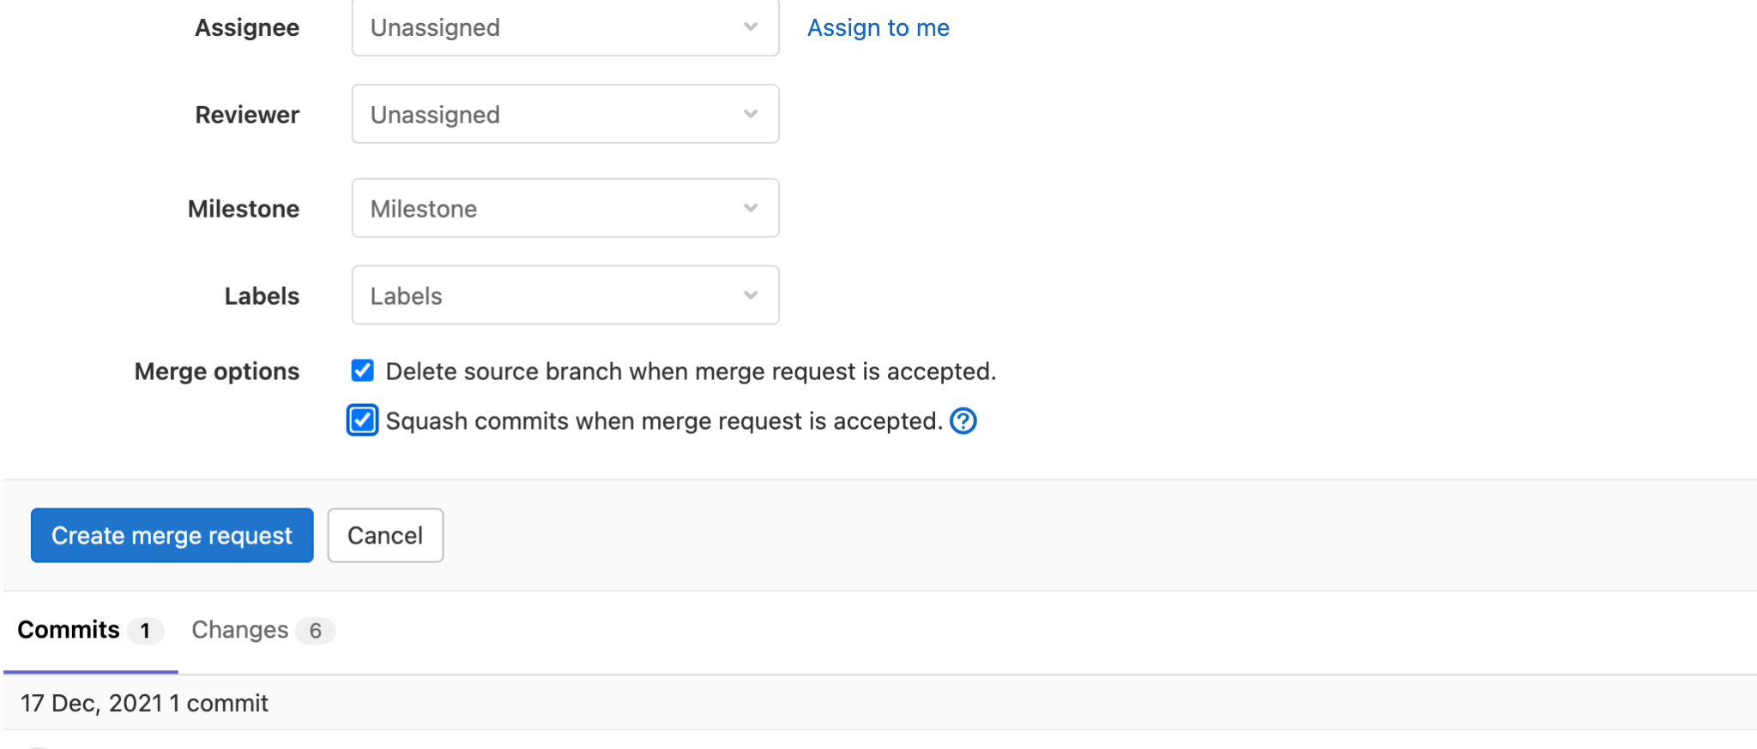
Put merge message (template at slide 3)
Click to create MR
Review your changes

Slide 8
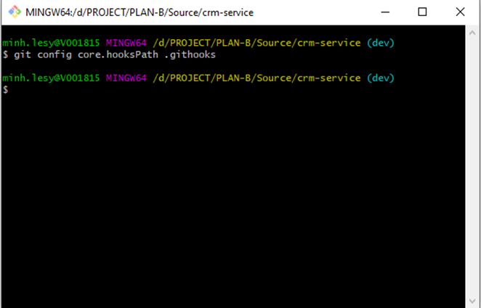
Config githook
Với mỗi source code cần config githook để apply rule message commit và branch name
-> Open gitbash tại thư mục dự án và gõ lệnh "git config core.hooksPath .githooks"

