Slide 1
Attendance System
Using Face Recognition Flow Diagram

Slide 2
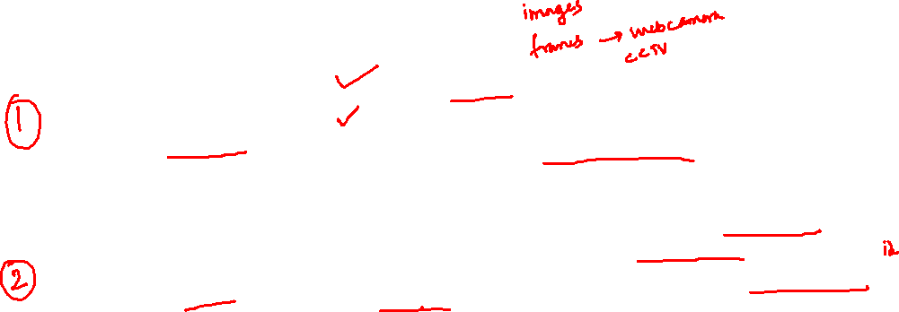
Attendance System
Person Registration
Collect samples pictures of person to register
Store in persons sample Database.
Person Inference
In real-time, camera output feedback to database.
Compare camera frames with database samples.
If person find in database then return the person name else return “Unknown”
Here we are using Redis database to store the samples

Slide 3





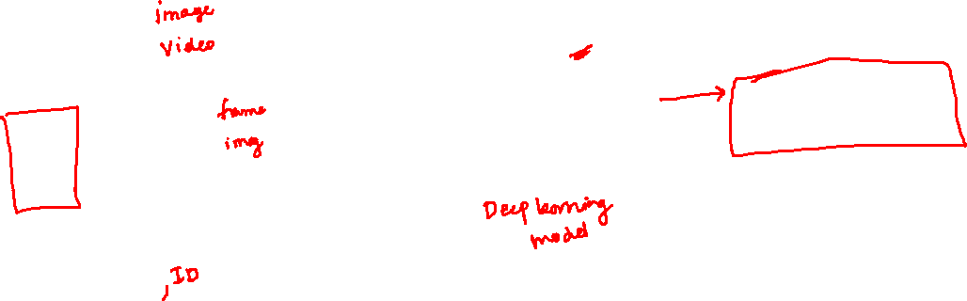
Person Registration
Data
Pre-processing
Encode
values
Person Name

Slide 4

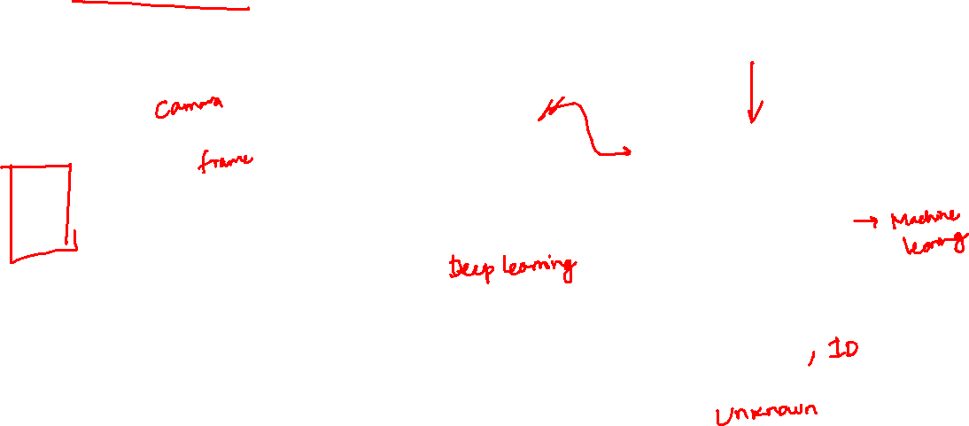
Person Inference
Data
Pre-processing
Encode
values
Compare
Person Name

