Slide 1


Slide 2
What Redis ?
Redis is a database
Blog Post
Images
Bytes
comments
API Server
Notes:
Redis is like any other database where you store information in strings image blog post, comments and bytes like image etc.
After storing information, we can then retrieve it later on by writing queries.
This behaviour is similar to any other databases.
And how redis is different and why do we decide to use right us over any other database ?

Slide 3
Redis is Fast
Why use Redis ?
Notes:
Well, answer is very simple. Often engineers and myself use redis for one reason, it is very fast.
Redis can store and retrieve data extremely quickly ?

Slide 4
Why is Redis fast ?
1
All data is stored in memory
2
Data is organized in simple data structure
3
Redis has simple feature set

Slide 5
Traditional Database
Memory
Hard Drive
Dataset
Fast
Slow
API Server
Notes:
Most databases store all their information between both the memory of a computer and a hard driver.
Accessing data in memory is fast, but getting data that is stored on the hard disk is relatively slow.

Slide 6
Traditional Database
Memory
Hard Drive
Dataset
Fast
API Server
Notes:
Redis makes a simple decision here, rather than storing on hard disk, it keeps all the data in memory.
And that means that accessing any data inside of a registered database is usually a very fast by default.
However, because of this approach there are few limitation of this approach. It means that by default, it can be challenging to work with a dataset that is larger than the amount of memory that you computer has.
For example, if your database has 100 giga bytes of data but you memory is somewhere around 16 giga bytes then this data will not for our database.
This might sound like a tremendous problem, but do not worry about it. There are certain strategies that was available that are working of this limitations.
.

Slide 7
Why is Redis fast ?
1
All data is stored in memory
2
Data is organized in simple data structure
3
Redis has simple feature set
Notes:
Alright, lets move the second reason, the second reason is that Redis stores all of its data or organizes all of its data in simple data structures.

Slide 8
Key Value pair
Link List
Double Linked List
Sorted Sets
Hash maps
Notes:
Like so on.
These different data structures have very well known and very well understood performance characteristic.
We can decide and organize our information in memory.
Hence we have very good idea, how to efficiently query the data.

Slide 9
Why is Redis fast ?
1
All data is stored in memory
2
Data is organized in simple data structure
3
Redis has simple feature set
Notes:
Finally. redis is very is fast because it is very simple in nature

Slide 10
Traditional Data Feature set
Redis Features Set
Enforced data schema
Triggers
Foreign Key constraints
Uniqueness of arbitrary properties
SQL support
Transaction rollback
… Not Much
Notes:
Other databases like say MySQL and so on choose to layer on feature upon feature to make them easier to use.
But all those additional features have big performance problems.
Redis take a different approach
Rather than stuffing in a ton of different features into the database, it is kept very simple on purpose.

Slide 11
Why is Redis fast ?
1
All data is stored in memory
2
Data is organized in simple data structure
3
Redis has simple feature set
Because of these reason Redis is different than other databases !
Notes:
So right away we are under sting here in this video that this is very fast.
Because of 3 reasons, spell it
We use redis because it is fast and it is fast because of these reason right here.
So in order to use Redis, we have to understand how to fit our data or organize it using these simple data structures
And we have to understand how to kind of work ourself around this limited features set.
That really starts and gives you the picture what the redis is
We need to understand how to work with data, how to organize it, and how to work with this simple set.
So with that in mid, let’s go through a little bit of setup in the next video.

Slide 12
Do not skip this video!
Required setup in here, even if you already have a running copy of Redis

Slide 13
Setup
Redis Cloud
redis.com
Redis Install
Install + run on your local computer

Slide 14
Commands
Notes:
In this section, we are going to start to get some hands on experience with Redis.

Slide 15
Data Structures
Notes:
In this section, we are going to start to get some hands on experience with Redis.

Slide 16
Structure Type | What it contains | Structure read/write ability
STRING | Strings, integers, or floating-point values | Operate on the whole string, parts, increment/ decrement the integers and floats
LIST | Linked list of strings | Push or pop items from both ends, trim based on offsets, read individual or multiple items, find or remove items by value
SET | Unordered collection of unique Strings | Add, fetch, or remove individual items, check membership, intersect, union, difference, fetch random items
HASH | Unordered hash table of keys to values | Add, fetch, or remove individual items, fetch the whole hash
ZSET | Ordered mapping of string members to floating-point scores, ordered by score | Add, fetch, or remove individual values, fetch items based on score ranges or member value
https://redis.io/commands/

Slide 17
Commands
Commands are used to save or retrieve data in Redis

Slide 18
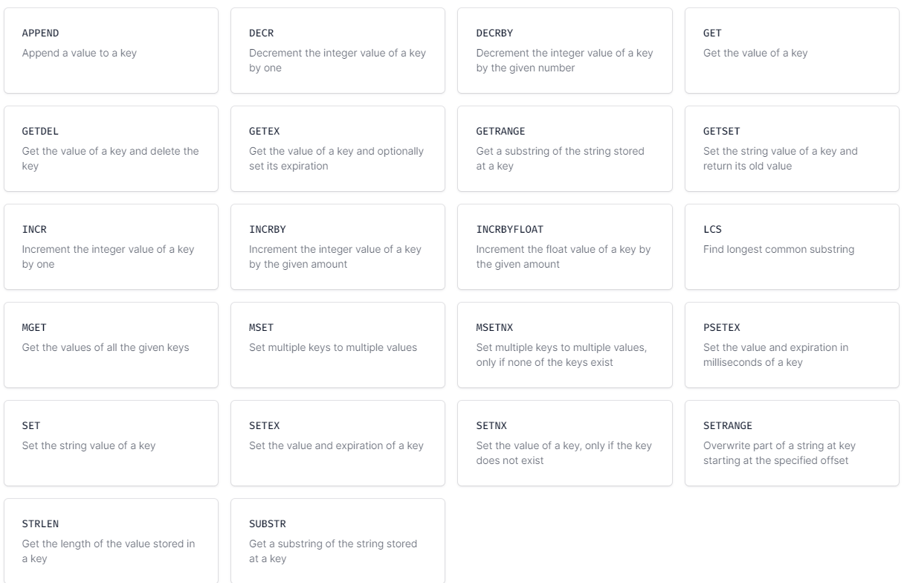
STRINGs commands

Slide 19
App Server
Command
Response
SET MESSAGE “Hello World”
‘OK’
Redis
MESSAGE
‘Hello World’

Slide 20
List

Slide 21
List commands
Create | Retrieve | Remove | Operations
LPUSH
LPUSHX
LINDEX
DEL
LLEN
RPUSH
RPUSHX
LRANGE
LPOP
LPOS
LSET
LINSERT
RPOP
LTRIM
LREM
LMOVE
LMPOP

Slide 22
Set

Slide 23
Set commands
Create | Retrieve | Remove | Operations
SADD
SMEMBERS
DEL
SCARD
SRANDMEMBER
SPOP
SDIFF
SREM
SDIFFSTORE
SINTER
SINTERSTORE
SISMEMBER
SUNION
SUNIONSTORE
SMOVE

Slide 24
Hash

Slide 25
Hash commands
Create | Retrieve | Remove | Operations
HSET
HGET
DEL
HLEN
HMSET
HGETALL
HDEL
HINCRBY
HSETNX
HRANDFIELD
HSTRLEN
HMGET
HVALS
HKEYS

Slide 26
ZSET

Slide 27
Hash commands
Create | Retrieve | Remove | Operations
HSET
HGET
DEL
HLEN
HMSET
HGETALL
HDEL
HINCRBY
HSETNX
HRANDFIELD
HSTRLEN
HMGET
HVALS
HKEYS

