Slide 1
Automatic Fast Face Recognition System

Slide 2




Traditional Face Recognition Model
Training Stage
Person
Images
Feature
Extraction
Machine Learning Model
Or
Deep Learning Model
Save
Model
Support Vector Machines
Neural Network
Convolutional Neural Network

Slide 3
Traditional Face Recognition Model
Training Stage
Person
Images
Feature
Extraction
Machine Learning Model
Or
Deep Learning Model
Save
Model
Person Name
Prediction
New Person Image
Feature
Extraction

Slide 4

Traditional Face Recognition Model
Disadvantages
Required large samples of images for each person to train model
At least 100 to 200 images person.
Once model is trained, we cannot new person details into the model.
Model need to retrain again with whole data
Accuracy of the model decrease as number of persons classifies increase.
High processing time.

Slide 5

Fast Face Recognition Model
Feature Collection
Person
Images
Feature
Extraction
Database

Slide 6

Fast Face Recognition Model
Feature Collection
Person
Images
Feature
Extraction
Database
Inference
Person Name
New Person
Image
Feature
Extraction
Machine Learning
Search Algorithm

Slide 7

Fast Face Recognition Model
Advantages
Less samples.
No model retrain required for new person.
Good Accuracy
Low processing time.

Slide 8

Fast Face Recognition System

Slide 9
Fast Face Recognition Model
Feature Collection
Person
Images
Feature
Extraction
Database
Inference
Person Name
New Person
Image
Feature
Extraction
Machine Learning
Search Algorithm

Slide 10

Fast Face Recognition Model
Feature Collection
Person
Images
Feature
Extraction
Database
Inference
Person Name
New Person
Image
Feature
Extraction
Machine Learning
Search Algorithm

Slide 11
Insightface

Slide 12
Face Detection
Key Point Detection
3d Face Projection
2d Face Projection
Age
Gender
Face Feature Extraction

Slide 13
Face Detection
Key Point Detection
3d Face Projection
2d Face Projection
Age
Gender
Face Feature Extraction

Slide 14
Fast Face Recognition Model
Feature Collection
Person
Images
Feature
Extraction
Database
Inference
Person Name
New Person
Image
Feature
Extraction
Machine Learning
Search Algorithm

Slide 15
Attendance System

Slide 16
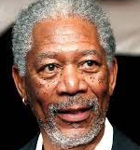
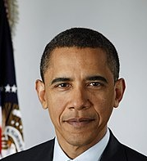

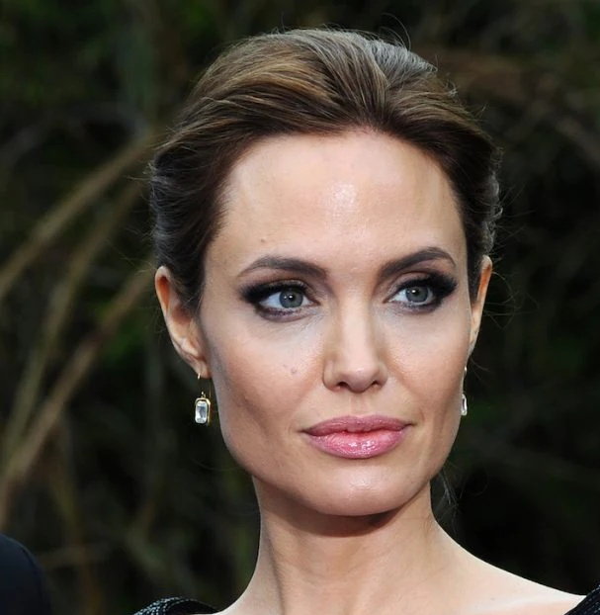
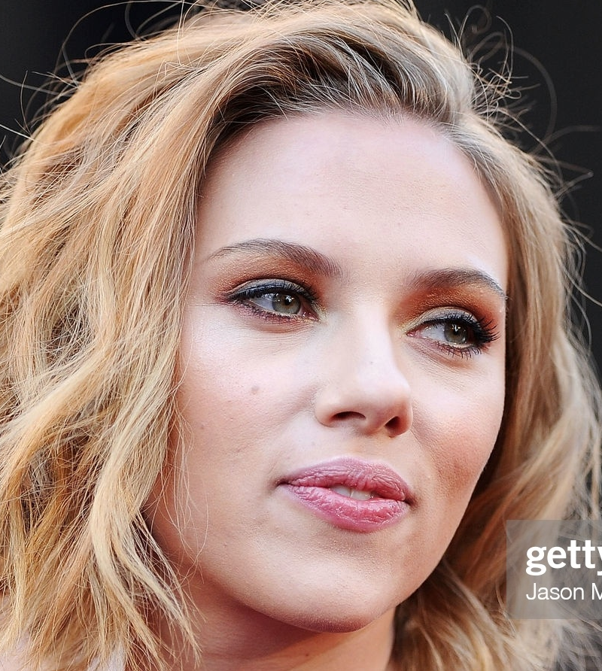

Larn Academy School
Sno | Attendance system features
1 | Automatic Attendance system with Face Recognition Automatically Identifies the person's name
2. | For new students, Principal want Registration form. For Students/teachers who register our application should detection. For person who not register we should detect unknown
3 | Capture In time and Out time in a day
4 | Get the get the daily attendance report for teacher and students.
Morgan Freeman (Principal)
Teacher
Barack Obama
Chris Evans
Students
Angelina Jolie
Scarlett Johansson
Data of students and teachers

Slide 17
Report/Excel
Real-Time
Face Recognition
Face Recognition
Integrate Database
Web App
Registration Form
Dashboard
5
Redis
Database
4
New Students
& Teacher
3
Feature Extraction
ML Search Algorithm
2
1

Slide 18
Report
Face Recognition
Integrate Database
Web App
Registration Form
Dashboard
Streamlit
Webapp
5
Redis
Database
4
New Students
& Teacher
3
Feature Extraction
ML Search Algorithm
2
1
Phase-1
Phase-2
Attendance System: Face Recognition System
Attendance System: Web App

