Slide 1
Attendance System

Slide 2
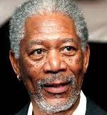
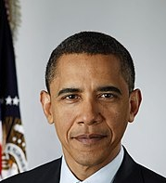
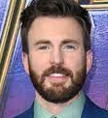
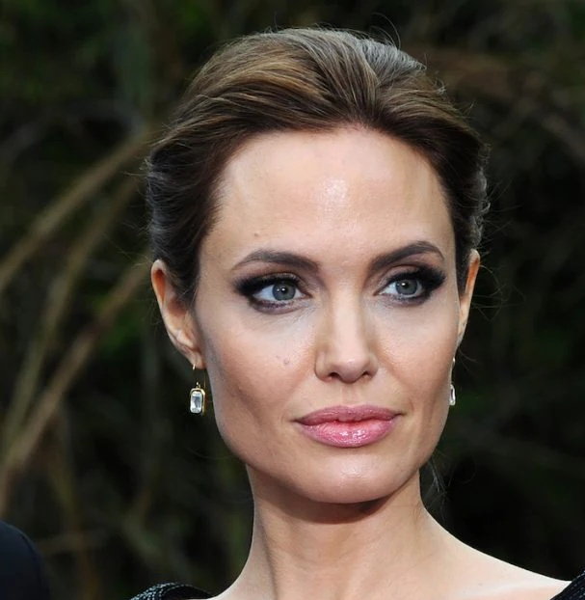
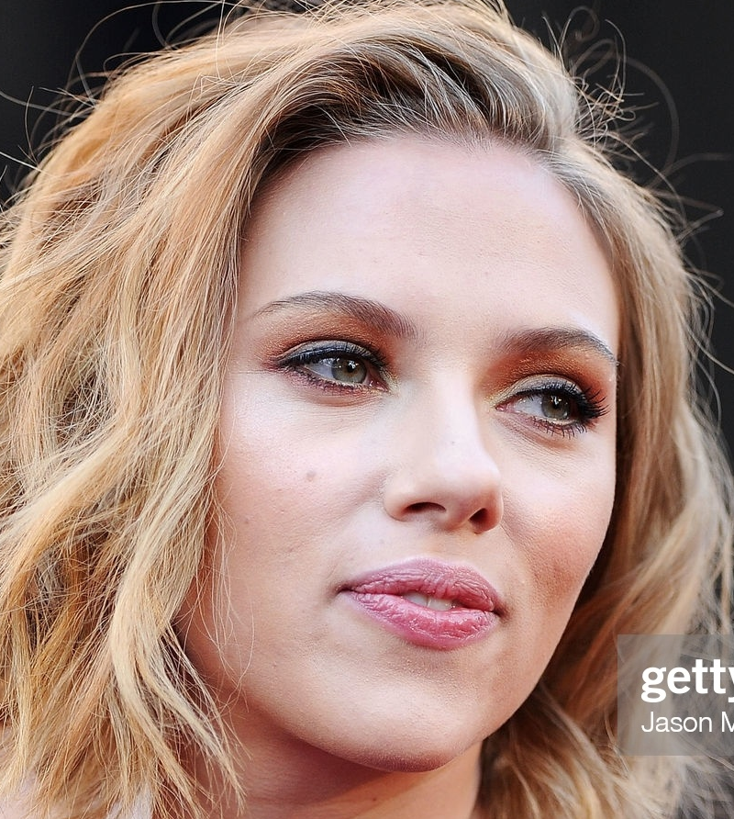

Larn Academy School
Sno | Attendance system features
1 | Automatic Attendance system with Face Recognition Automatically Identifies the person's name
2. | For new students, Principal want Registration form. For Students/teachers who register our application should detection. For person who not register we should detect unknown
3 | Capture In time and Out time in a day
4 | Get the get the daily attendance report for teacher and students.
Morgan Freeman (Principal)
Teacher
Barack Obama
Chris Evans
Students
Angelina Jolie
Scarlett Johansson
Data of students and teachers

Slide 3
Report/Excel
Real-Time
Face Recognition
Face Recognition
Integrate Database
Web App
Registration Form
Dashboard
5
Redis
Database
4
New Students
& Teacher
3
Feature Extraction
ML Search Algorithm
2
1

Slide 4
Report
Face Recognition
Integrate Database
Web App
Registration Form
Dashboard
Streamlit
Webapp
5
Redis
Database
4
New Students
& Teacher
3
Feature Extraction
ML Search Algorithm
2
1
Phase-1
Phase-2
Attendance System: Face Recognition System
Attendance System: Web App

Slide 5
Report
Face Recognition
Integrate Database
Web App
Registration Form
Dashboard
Streamlit
Webapp
5
Redis
Database
4
New Students
& Teacher
3
Feature Extraction
ML Search Algorithm
2
1
Phase-1
Phase-2
Attendance System: Face Recognition System
Attendance System: Web App

Slide 6





Fast Face Recognition Model
Feature Collection
Person
Images
Feature
Extraction
Database
Inference
Person Name
New Person
Image
Feature
Extraction
Machine Learning
Search Algorithm

Slide 7
Machine Learning Search Algorithm

Slide 8
Machine Learning Search Algorithm
Distance
Euclidean Distance
Manhattan Distance
Chebyshev
Minkowski
Similarity
Cosine
Hamming

Slide 9

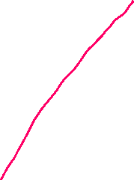


Euclidean Distance
($y_{1}, y_{2})$
($x_{1}, x_{2})$

Slide 10








Euclidean Distance
($y_{1}, y_{2},y_{3})$
($x_{1}, x_{2}, x_{3})$

Slide 11
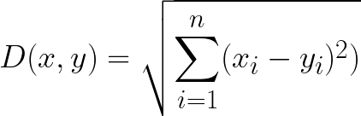
Euclidean Distance
($y_{1}, y_{2},y_{3})$
($x_{1}, x_{2}, x_{3})$

Slide 12






Manhattan Distance
($y_{1}, y_{2})$
$$y_{2}$$
$$x_{2}$$
($x_{1}, x_{2})$
$$x_{1}$$
$$y_{1}$$

Slide 13
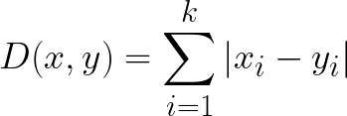
Manhattan Distance
($y_{1}, y_{2})$
$$y_{2}$$
$$x_{2}$$
($x_{1}, x_{2})$
$$x_{1}$$
$$y_{1}$$

Slide 14

Chebyshev Distance
($y_{1}, y_{2})$
$$y_{2}$$
$$x_{2}$$
($x_{1}, x_{2})$
$$x_{1}$$
$$y_{1}$$

Slide 15

Chebyshev Distance
($y_{1}, y_{2})$
$$y_{2}$$
$$x_{2}$$
($x_{1}, x_{2})$
$$x_{1}$$
$$y_{1}$$

Slide 16
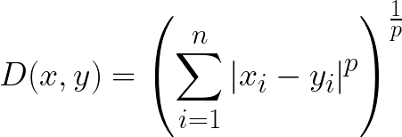

Minkowski Distance
($y_{1}, y_{2})$
$$y_{2}$$
$$x_{2}$$
($x_{1}, x_{2})$
$$x_{1}$$
$$y_{1}$$

Slide 17

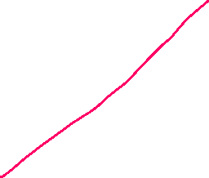
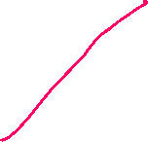



Cosine Similarity
($y_{1}, y_{2})$
($x_{1}, x_{2})$

Slide 18

Cosine Similarity
($y_{1}, y_{2})$
($x_{1}, x_{2})$

Slide 19
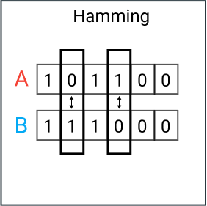

Hamming

Slide 20






Machine Learning Search Algorithm
Distance
Euclidean Distance
Manhattan Distance
Chebyshev
Minkowski
Similarity
Cosine
Hamming

Slide 21
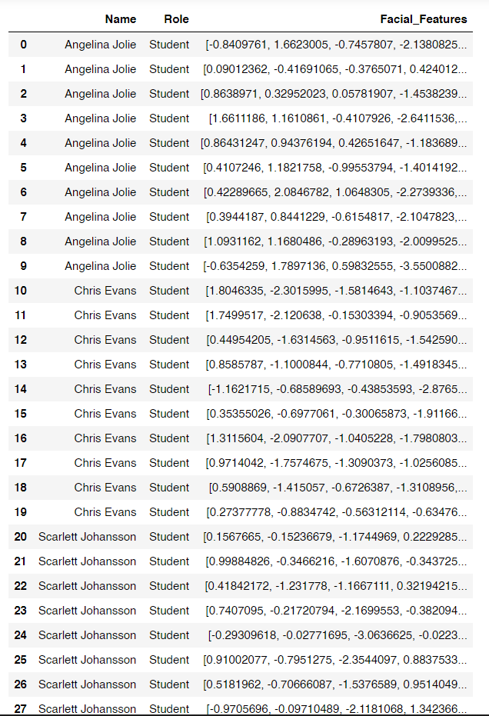
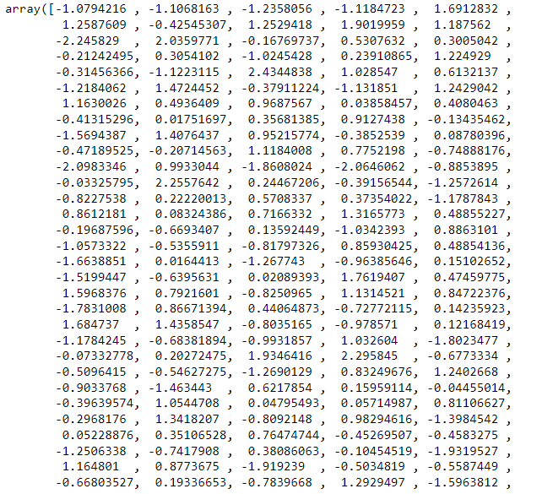

Collected Embedding
512 values
Test Image Embedding
512 values
512 values
512 values

Slide 22



Angelina Jolie
Chris Evans
Scarlett Johansson
Barack Obama
Morgan Freeman

Slide 23


Angelina Jolie
Chris Evans
Test Embedding
Scarlett Johansson
To which one of the sample our point is closet to
Barack Obama
Morgan Freeman

Slide 24





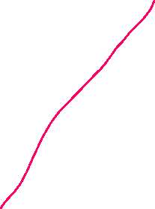
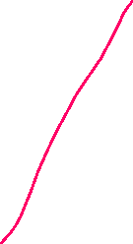
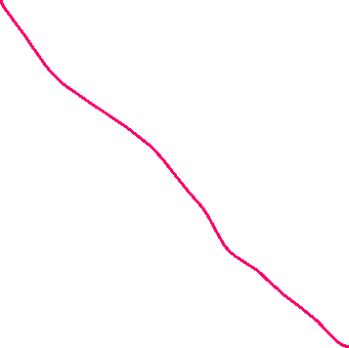


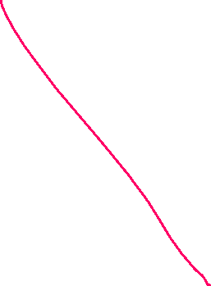

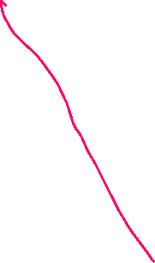

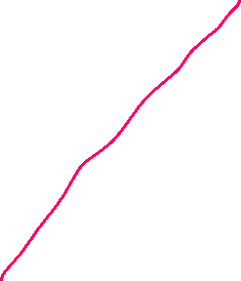
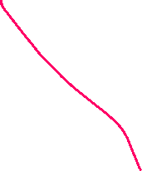

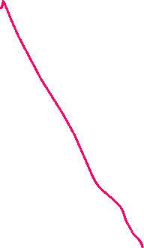






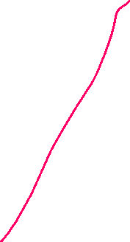

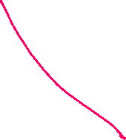

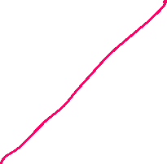



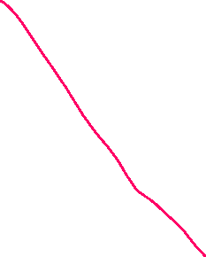


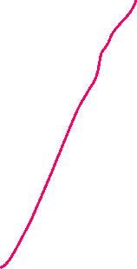



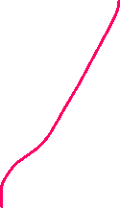




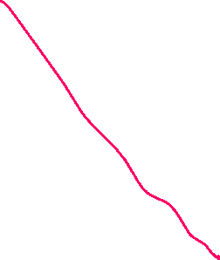

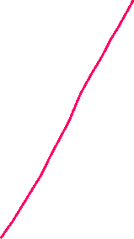
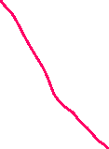


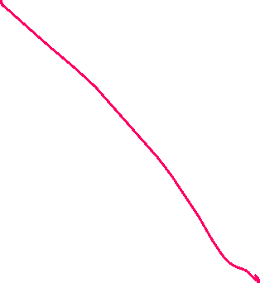



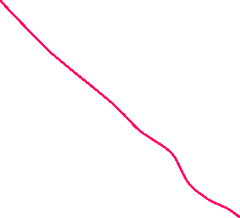
Distance Method
Angelina Jolie
Chris Evans
start
1. Determine the optimal distance (say $d_{opt}$)
2. Find the distance between test point to each sample. (say $d_{ti}$)
Scarlett Johansson
2. Find the distance between test point to each sample. (say $d_{ti}$)
Filter
$d_{ti}<d_{opt}$
Barack Obama
Person Name = argmin($d_{ti}$)
If all distance are > $d_{opt}$
Morgan Freeman
Person = Unknown

Slide 25




Distance Method
Angelina Jolie
Chris Evans
start
1. Determine the optimal distance (say $d_{opt}$)
2. Find the distance between test point to each sample. (say $d_{ti}$)
Scarlett Johansson
2. Find the distance between test point to each sample. (say $d_{ti}$)
Filter
$d_{ti}<d_{opt}$
Barack Obama
Person Name = argmin($d_{ti}$)
If all distance are > $d_{opt}$
Morgan Freeman
Person = Unknown

Slide 26

Distance Method
Angelina Jolie
Chris Evans
start
1. Determine the optimal distance (say $d_{opt}$)
2. Find the distance between test point to each sample. (say $d_{ti}$)
Scarlett Johansson
2. Find the distance between test point to each sample. (say $d_{ti}$)
Filter
$d_{ti}<d_{opt}$
Barack Obama
Person Name = argmin($d_{ti}$)
If all distance are > $d_{opt}$
Morgan Freeman
Person = Unknown

Slide 27
Distance Method
Angelina Jolie
Chris Evans
start
Chris Evans
1. Determine the optimal distance (say $d_{opt}$)
2. Find the distance between test point to each sample. (say $d_{ti}$)
Scarlett Johansson
2. Find the distance between test point to each sample. (say $d_{ti}$)
Filter
$d_{ti}<d_{opt}$
Barack Obama
Person Name = argmin($d_{ti}$)
If all distance are > $d_{opt}$
Morgan Freeman
Person = Unknown

Slide 28

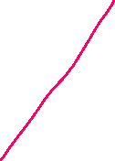

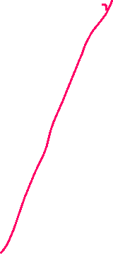

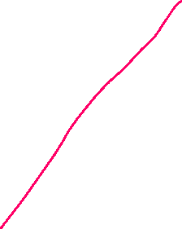












Similarity Method
Angelina Jolie
Chris Evans
start
1. Determine the optimal threshold (thresh = $0.5$)
2. Find the similarity between test point to each sample. (say $S_{ti}$)
Scarlett Johansson
2. Find the distance between test point to each sample. (say $d_{ti}$)
Filter
$S_{ti}<0.5$
Barack Obama
Person Name = argmax($S_{ti}$)
If all similarity are > 0.5
Morgan Freeman
Person = Unknown

Slide 29
Distance Method
Angelina Jolie
Chris Evans
start
Chris Evans
1. Determine the optimal distance (say $d_{opt}$)
2. Find the distance between test point to each sample. (say $d_{ti}$)
Scarlett Johansson
2. Find the distance between test point to each sample. (say $d_{ti}$)
Filter
$d_{ti}<d_{opt}$
Barack Obama
Person Name = argmin($d_{ti}$)
If all distance are > $d_{opt}$
Morgan Freeman
Person = Unknown

Slide 30
Similarity Method
Angelina Jolie
Chris Evans
start
1. Determine the optimal threshold (thresh = $0.5$)
2. Find the similarity between test point to each sample. (say $S_{ti}$)
Scarlett Johansson
2. Find the distance between test point to each sample. (say $d_{ti}$)
Filter
$S_{ti}<0.5$
Barack Obama
Person Name = argmax($S_{ti}$)
If all similarity are < 0.5
Morgan Freeman
Person = Unknown

Slide 31







Distance Method
Similarity Method
start
start
1. Determine the optimal distance (say $d_{opt}$)
1. Determine the optimal threshold (thresh = $0.5$)
2. Find the distance between test point to each sample. (say $d_{ti}$)
2. Find the similarity between test point to each sample. (say $S_{ti}$)
Filter
$d_{ti}<d_{opt}$
Filter
$S_{ti}>0.5$
Person Name = argmin($d_{ti}$)
Person Name = argmax($S_{ti}$)
If all similarity are > 0.5
Person = Unknown
Person = Unknown

