Slide 1

Why humans are better than computers ?

Slide 2
Agenda
The ability to solve problems
Creativity
Feel and express emotions

Slide 3

How computers solve problems
Need to be programmed
Only one way to solve a problem

Slide 4
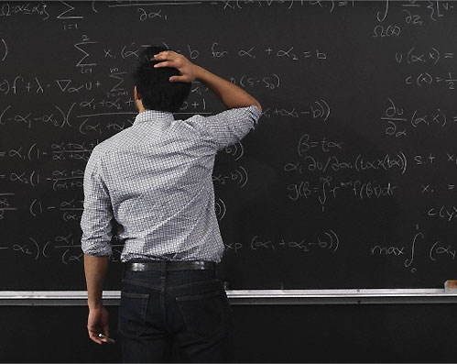
How humans solve problems
Don’t need “progarm”
Flexible problem solving

Slide 5

Computers' creativity
Can't create something new

Slide 6

Humans' creativity
Is unlimited

Slide 7

Computers' emotion
Don't have feelings or emotions

Slide 8
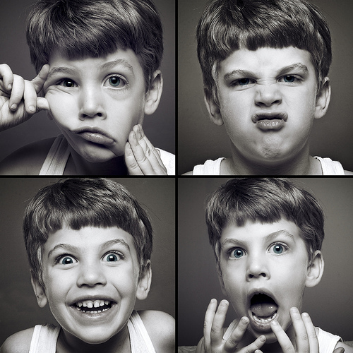
Humans' emotion
Feel and express emotions
Have self–awareness

Slide 9
Conclusion
Because of three elements:
Flexible problem solving
Unlimited creativity
Feel and express emotions

Slide 10
THANK YOU
for listening !

