Slide 1

Angular2 Introduction
About me:
- Solution architect and technical training head at Niteco.
18 years experience in software production.
Work with many technologies: PHP, Java, Ruby … (backend), angular, react, … (frontend)
Skype: phantichhoang
Mail: phantichhoang@gmail.com

Slide 2
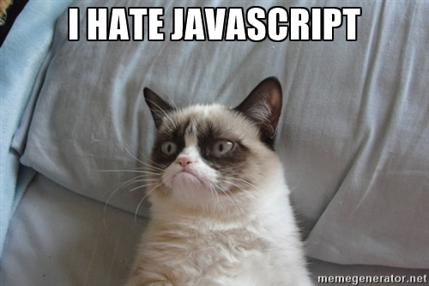
https://stackoverflow.com/research/developer-survey-2016#technology
Notes:
Web development has become more complex as we have new requirements

Slide 3
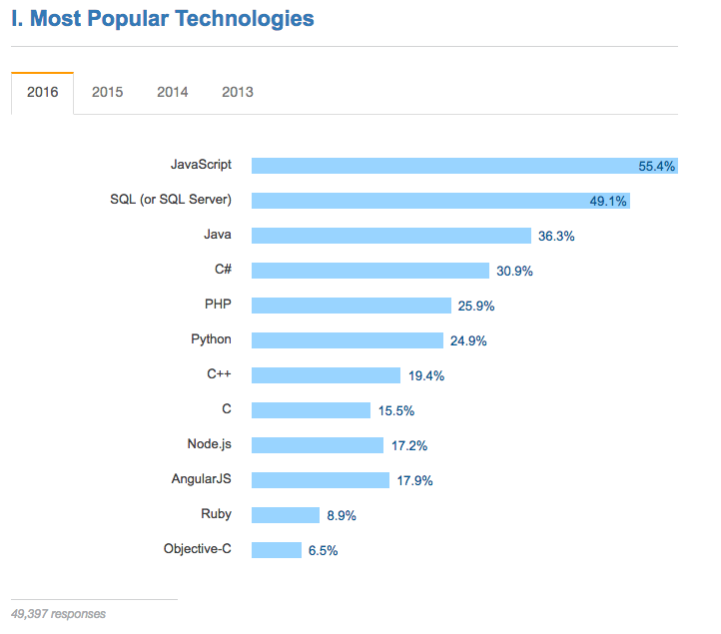
https://stackoverflow.com/research/developer-survey-2016#technology
https://stackoverflow.com/research/developer-survey-2016#technology

Slide 4




Angular2
ES5
ES6
No Types
Types
Notes:
Break the UI into small, maintainable and reusable building blocks

Slide 5
Why Angular2?
Simplicity
Productivity
Separation of concerns
Use of TypeScript
DI
Reactive programming style
Open Source
Community
Notes:
Angular2 fi
Styleguide
Angular 2 community is one of it’s best assets

Slide 6

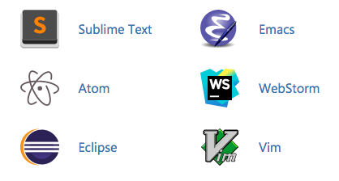
TypeScript
Superset of JavaScript
With optional typing and class-based OOP
Errors at compile time
Better tooling (autocomplete, refactoring…)
Explicitly express intent
Provides features from future JS to current JS engines
Typescript transpiles to pure JavaScript
Notes:
Types have proven ability to enhance code quality and understandability.
Type can be implicit or explicit.
Code completion, refactoring, find references
Transpilation: taking source code written in one language and transforming into another language that has a similar level of abstraction

Slide 7
TypeScript
TypeScript
ES7
- Decorators
- Async / await
ES6
- Classes
- Modules
- Arrow expressions
ES5

Slide 8
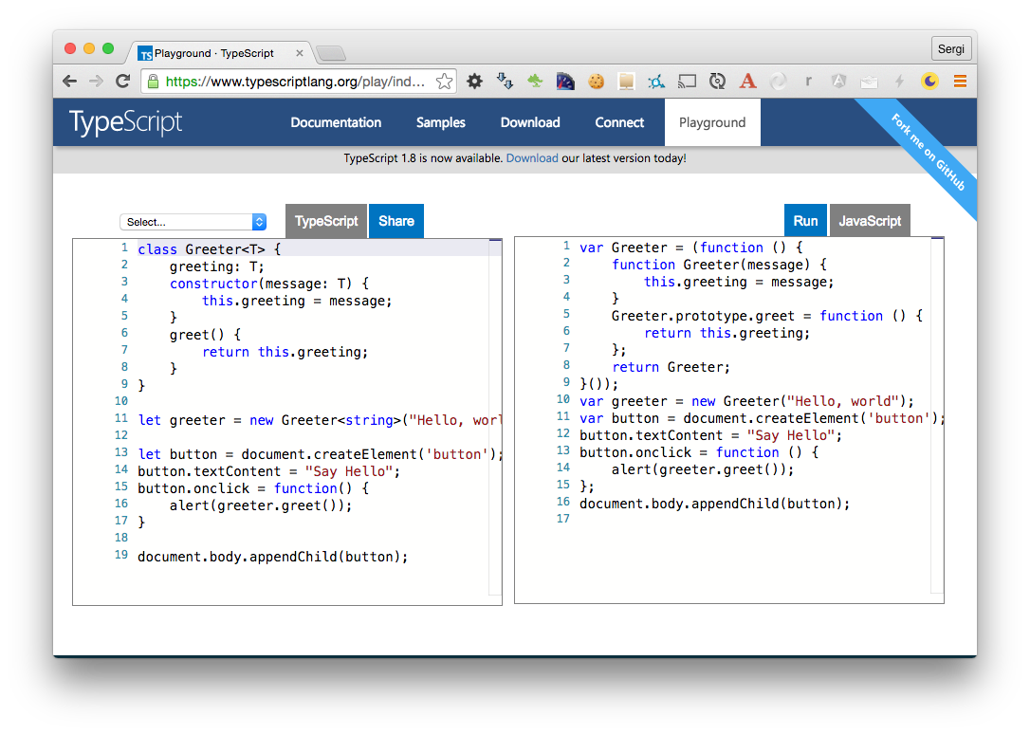
TypeScript Playground

Slide 9
Angular2 Architecture
Template
Directives
Event
Binding
Property
Binding
Metadata
Injector
Service
DI
Component
Service
Service

Slide 10
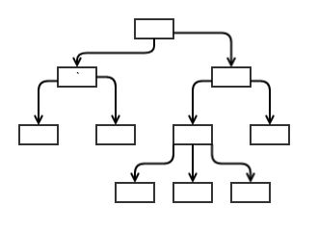
Angular2 Components
One of Angular’s building blocks
Enables having reusable UI
Tree structure
Notes:
Break the UI into small, maintainable and reusable building blocks

Slide 11
Angular2 Components
Header
Nav
Search Input
Result List
Footer
Notes:
Break the UI into small, maintainable and reusable building blocks

Slide 12
Components
<springone-app></springone-app>
@Component({
selector: 'springone-app',
template: `<h1>Welcome to SpringOne Platform 2016</h1>`
})
export class WelcomeComponent {
}
Notes:
@Component decorator, configures your component
selector: defines how the component will be recognized when rendering HTML
Template: this is the view of the component

Slide 13
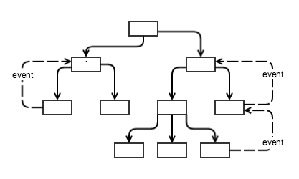
Interaction between components
Data to child, events to parent
@Input()
Fetch data from the parent component
@Output()
Send custom events to outside components

Slide 14
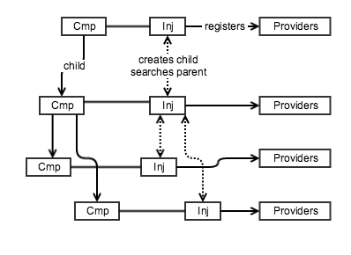
Hierarchical Injectors
Dependencies are singletons within the scope of an injector

Slide 15
DEMO

Slide 16
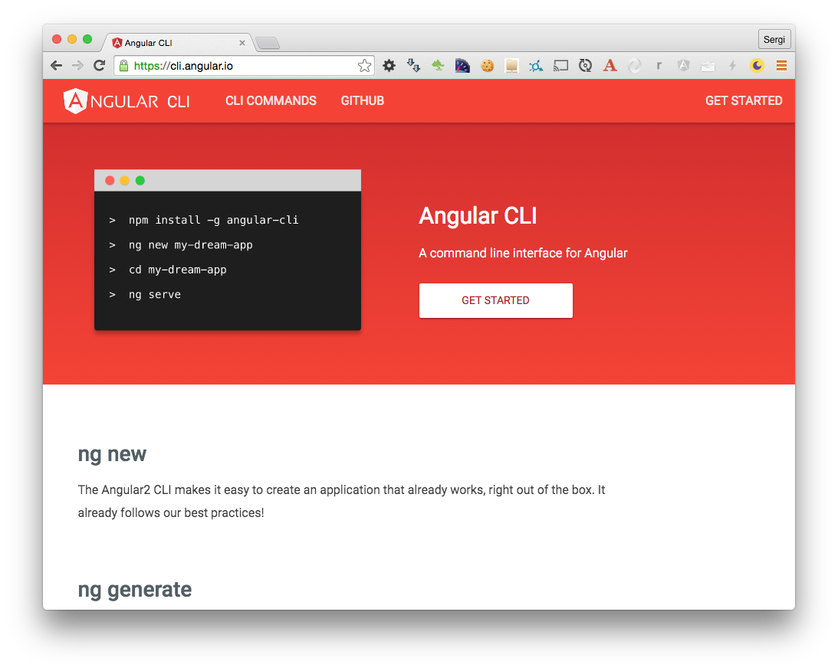
Angular CLI
Notes:
Create a project from scratch is difficult

Slide 17
SEO?
Crawler
http://my.angular.site
<h1>{{title}}</h1>
Notes:
Create a project from scratch is difficult

Slide 18
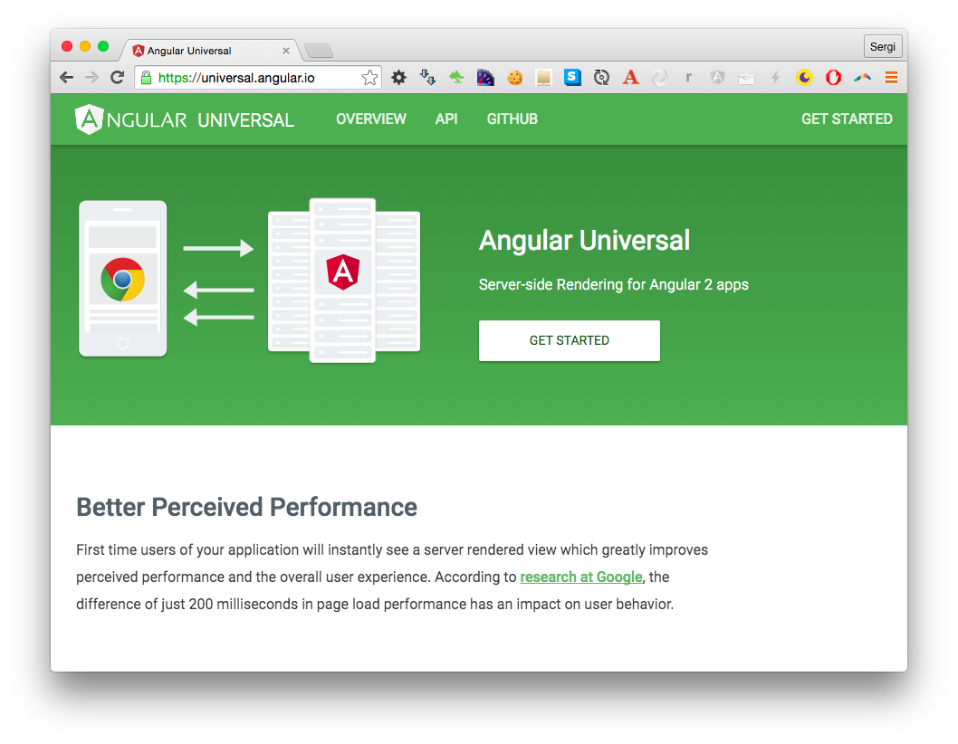
Angular Universal
Should we care about
server side rendering?
Perceived load time
Actual load time
SEO
Link preview
Client side performance
Notes:
Create a project from scratch is difficult

Slide 19
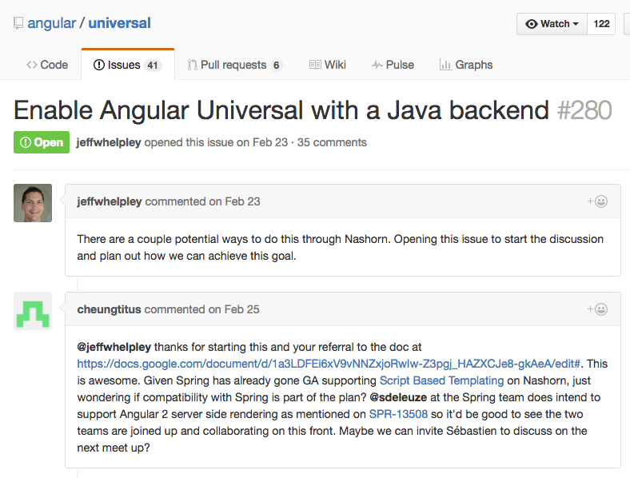
Angular2 Universal love Java, PHP, …
Notes:
Create a project from scratch is difficult

Slide 20
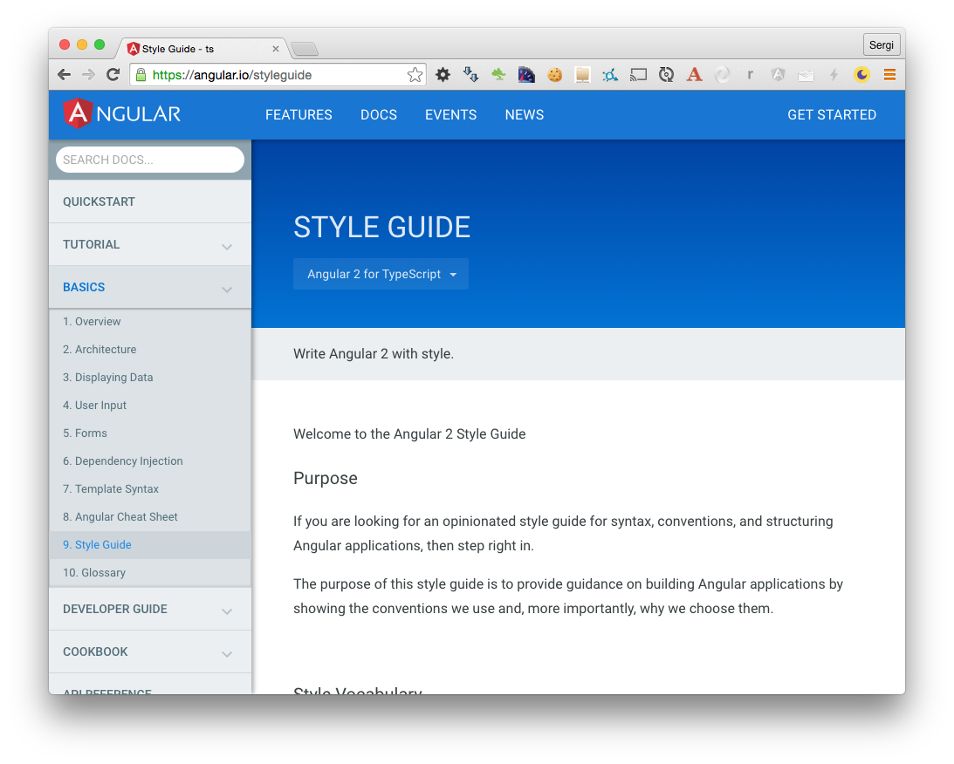
Angular Style Guide
Notes:
Create a project from scratch is difficult

Slide 21
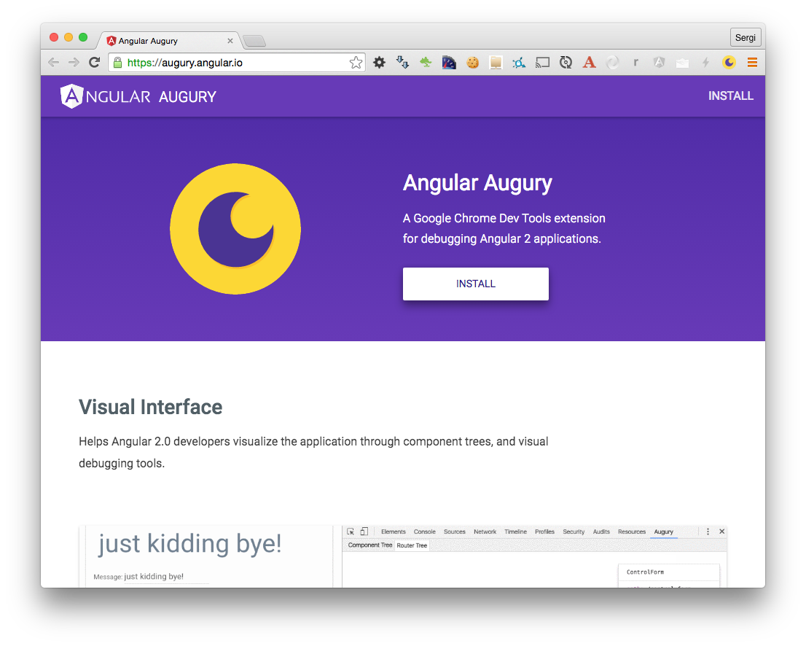
Angular Augury
Notes:
Create a project from scratch is difficult

Slide 22
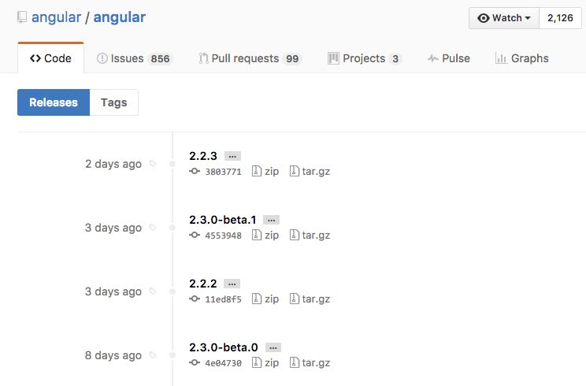
Angular2 Final

Slide 23
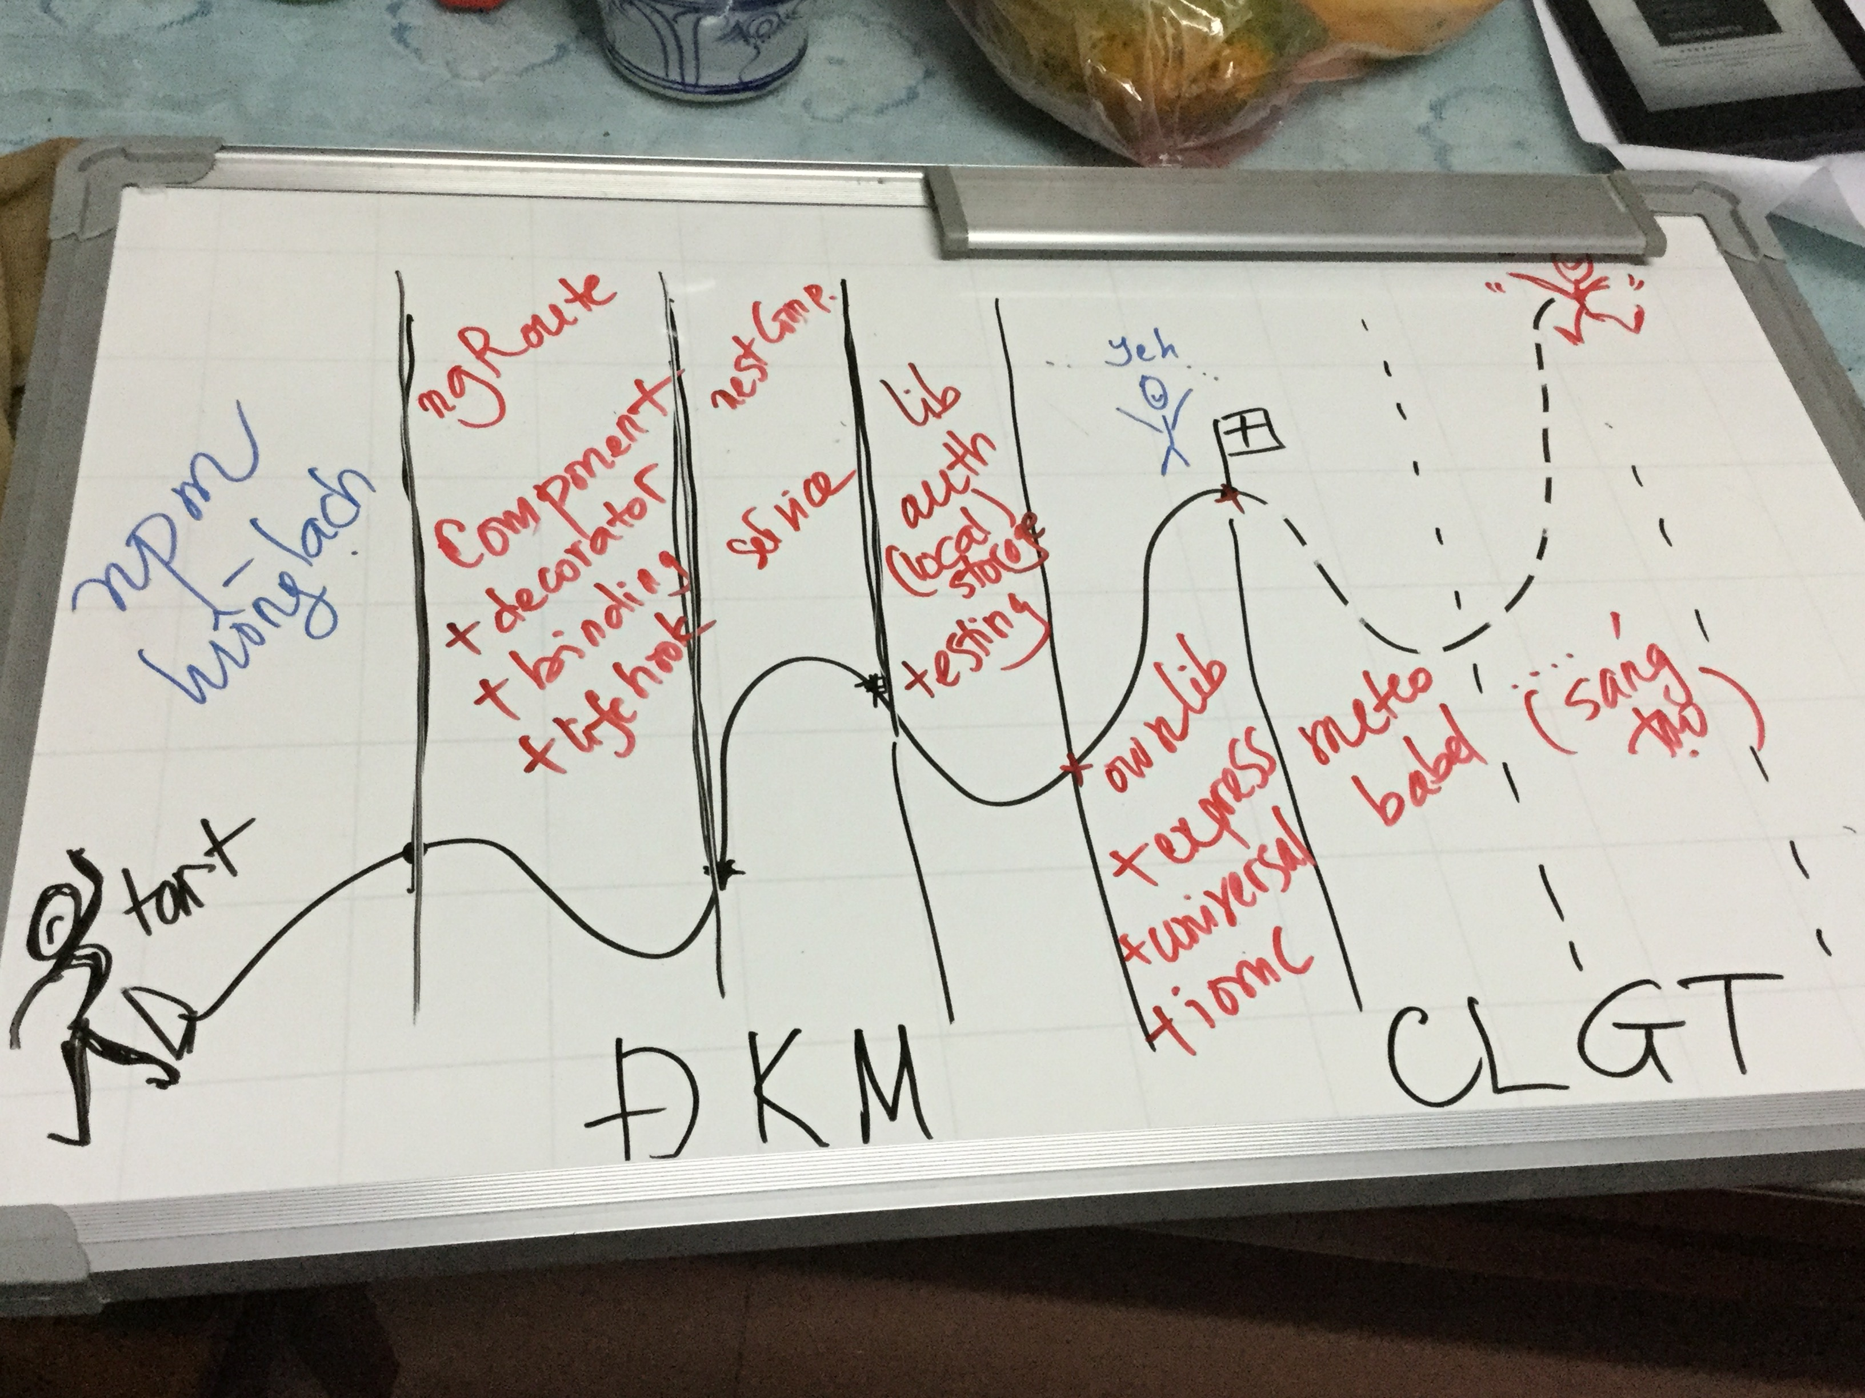
Angular2 Journey
https://github.com/AngularClass/awesome-angular2

Slide 24
Q & A

Slide 25


