Slide 1

An Introduction to Scrum

Slide 2
Guess which film I’m thinking of

Slide 3
We’re losing the relay race
“The… ‘relay race’ approach to product development… may conflict with the goals of maximum speed and flexibility.
Instead a holistic or ‘rugby’ approach - where a team tries to go the distance as a unit, passing the ball back and forth - may better serve today’s competitive requirements.”
Hirotaka Takeuchi and Ikujiro Nonaka, “The New New Product Development Game”, Harvard Business Review, January 1986.
Notes:
would be nice to include a quote from Wicked Problems here

Slide 4
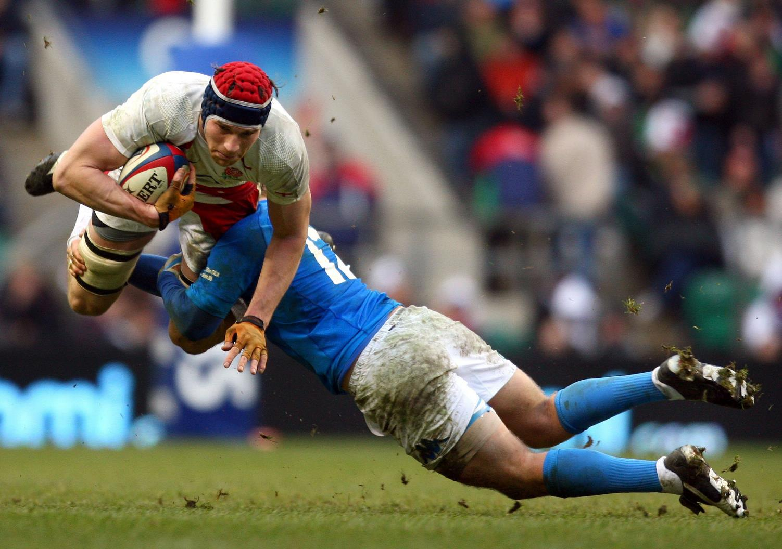

Slide 5


Slide 6
Scrum in 100 words
Scrum is an agile process that allows us to focus on delivering the highest business value in the shortest time.
It allows us to rapidly and repeatedly inspect actual working software (every two weeks to one month).
The business sets the priorities. Teams self-organize to determine the best way to deliver the highest priority features.
Every two weeks to a month anyone can see real working software and decide to release it as is, or continue to enhance it for another sprint.

Slide 7

Scrum origins
Jeff Sutherland
Initial scrums at Easel Corp in 1993
IDX and 500+ people doing Scrum
Ken Schwaber
ADM
Scrum presented at OOPSLA 95 with Sutherland
Author of three books on Scrum
Mike Beedle
Scrum patterns in PLOPD4
Ken Schwaber and Mike Cohn
Co-founded Scrum Alliance in 2002, initially within the Agile Alliance

Slide 8
Scrum has been used by:
Microsoft
Yahoo
Google
Electronic Arts
High Moon Studios
Lockheed Martin
Philips
Siemens
Nokia
Capital One
BBC
Intuit
Intuit
Nielsen Media
First American Real Estate
BMC Software
Ipswitch
John Deere
Lexis Nexis
Sabre
Salesforce.com
Time Warner
Turner Broadcasting
Oce

Slide 9
Scrum has been used for:
Commercial software
In-house development
Contract development
Fixed-price projects
Financial applications
ISO 9001-certified applications
Embedded systems
24x7 systems with 99.999% uptime requirements
The Joint Strike Fighter
Video game development
FDA-approved, life-critical systems
Satellite-control software
Websites
Handheld software
Mobile phones
Network switching applications
ISV applications
Some of the largest applications in use

Slide 10
Scrum Characteristics
Self-organizing teams
Product progresses in a series of short “sprints”
Requirements are captured as items in a list of “product backlog”
No specific engineering practices prescribed
One of the “agile processes”
Uses generative rules to create an agile environment for delivering projects

Slide 11
Inclusive Rules
Most methodologies provide inclusive rules - all the things you could possibly do under all situations.
Teams that follow inclusive rules depend on someone else to name in advance the practices and conditions for every situation.
This usually breaks down quickly.
All the stuff that could happen
Rule
Rule
Rule
Rule
Rule
Rule
Rule
Rule
Rule
Rule
Rule
Rule
Rule
Rule
Rule
Rule

Slide 12
Inclusive Rules
Most methodologies provide inclusive rules - all the things you could possibly do under all situations.
Teams that follow inclusive rules depend on someone else to name in advance the practices and conditions for every situation.
This usually breaks down quickly.
All the stuff that could happen
Here you are ok – but inefficient
Rule
Rule
Rule
Rule
Rule
Rule
Rule
Rule
Rule
Rule
Rule
Rule
Rule
Rule
Rule
Rule

Slide 13
Inclusive Rules
Most methodologies provide inclusive rules - all the things you could possibly do under all situations.
Teams that follow inclusive rules depend on someone else to name in advance the practices and conditions for every situation.
This usually breaks down quickly.
All the stuff that could happen
Here you are screwed
Rule
Rule
Rule
Rule
Rule
Rule
Rule
Rule
Rule
Rule
Rule
Rule
Rule
Rule
Rule
Rule

Slide 14
Generative Rules
A minimum set of things you must do under all situations to generate appropriate practices for special situations.
A team that follows generative rules depends on individuals and their creativity to find ways to solve problems as they arise
All the stuff that could happen
Rule
Rule
Rule

Slide 15
Generative Rules
A minimum set of things you must do under all situations to generate appropriate practices for special situations.
A team that follows generative rules depends on individuals and their creativity to find ways to solve problems as they arise
All the stuff that could happen
People find ways to get things done
Rule
Rule
Rule

Slide 16


The Agile Manifesto - a statement of values
Individuals and interactions
Process and tools
over
Working software
Comprehensive documentation
over
Customer collaboration
Contract negotiation
over
Responding to change
Following a plan
over
Source: www.agilemanifesto.org

Slide 17

Project noise level
Source: Strategic Management and Organizational Dynamics by Ralph Stacey in Agile Software Development with Scrum by Ken Schwaber and Mike Beedle.
Far from
Agreement
Requirements
Close to
Agreement
Technology
Close to
Certainty
Far from
Certainty

Slide 18
Project noise level
Source: Strategic Management and Organizational Dynamics by Ralph Stacey in Agile Software Development with Scrum by Ken Schwaber and Mike Beedle.
Far from
Agreement
Requirements
Simple
Close to
Agreement
Technology
Close to
Certainty
Far from
Certainty

Slide 19
Project noise level
Source: Strategic Management and Organizational Dynamics by Ralph Stacey in Agile Software Development with Scrum by Ken Schwaber and Mike Beedle.
Far from
Agreement
Requirements
Complicated
Simple
Close to
Agreement
Technology
Close to
Certainty
Far from
Certainty

Slide 20
Project noise level
Source: Strategic Management and Organizational Dynamics by Ralph Stacey in Agile Software Development with Scrum by Ken Schwaber and Mike Beedle.
Far from
Agreement
Complex
Requirements
Complicated
Simple
Close to
Agreement
Technology
Close to
Certainty
Far from
Certainty

Slide 21
Project noise level
Source: Strategic Management and Organizational Dynamics by Ralph Stacey in Agile Software Development with Scrum by Ken Schwaber and Mike Beedle.
Far from
Agreement
Anarchy
Complex
Requirements
Complicated
Simple
Close to
Agreement
Technology
Close to
Certainty
Far from
Certainty

Slide 22
Exercise - Drawing

Slide 23

Traditional Approach
Stakeholders not sure what they want
As product develops, minds & business goals change
Planned
B
A
Details often revealed during development
Revised
Internal & external forces lead to changes or enhancements
C

Slide 24
Agile Approach
Planned
B
A
Requirements are gathered over time
Frequent checkpoints
Actual
Revised
Project can adapt to meet business need
C

Slide 25





Scrum
24 hours
Sprint
2-4 weeks
Sprint goal
Return
Sprint backlog
Potentially shippable
product increment
Return
Cancel
Gift wrap
Coupons
Gift wrap
Cancel
Coupons
Product
backlog

Slide 26
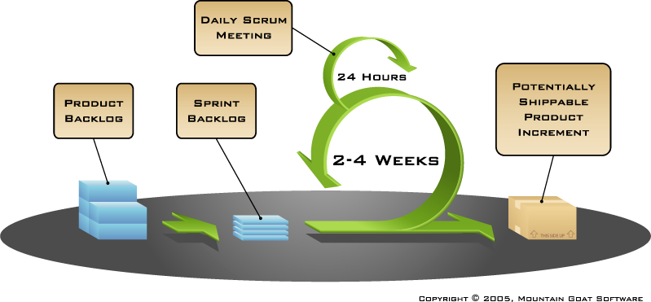
Putting it all together

Slide 27
Sprints
Scrum projects make progress in a series of “sprints”
Analogous to Extreme Programming iterations
Typical duration is 2–4 weeks or a calendar month at most
A constant duration leads to a better rhythm
Product is designed, coded, and tested during the sprint

Slide 28
Sequential vs. overlapping development
Requirements
Design
Code
Test
Rather than doing all of one thing at a time...
...Scrum teams do a little of everything all the time
Source: “The New New Product Development Game” by Takeuchi and Nonaka. Harvard Business Review, January 1986.

Slide 29
No changes during a sprint
Change
Plan sprint durations around how long you can commit to keeping change out of the sprint

Slide 30
Scrum framework
Roles
Product owner
ScrumMaster
Team
Ceremonies
Sprint planning
Sprint review
Sprint retrospective
Daily scrum meeting
Artifacts
Product backlog
Sprint backlog
Burndown charts

Slide 31
End of Session 1

