Slide 1

Welcome to Bkacad

Slide 2
with Bkcacad
Author:
Phan Tich Hoang

Slide 3
Lession 2: Tổng Quan Android OS
Content:
Kiến trúc Android OS
Quy trình phát triển ứng dụng mobile
Cài đặt môi trường phát triển ứng dụng Android
Chương trình hello world

Slide 4




Programming Language?

Slide 5
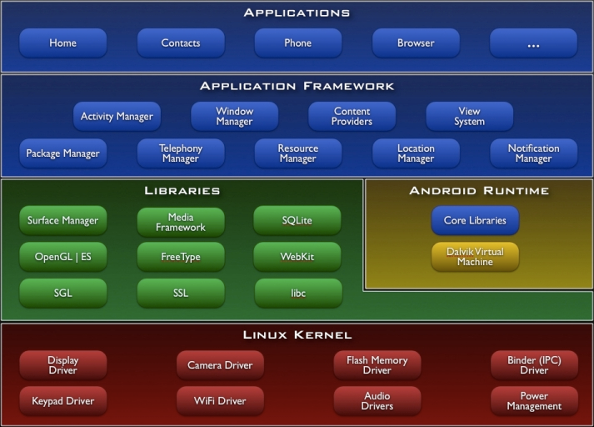
1.Android Architecture

Slide 6

Developer working on ?
Application (New/Porting)
Driver

Slide 7

Want to create app like that ?

Slide 8



2.Mobile development process
Idea, Requirement, UI

Slide 9

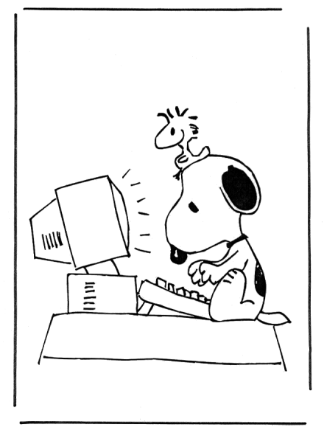

Design, Coding, Test

Slide 10

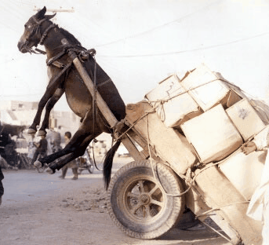

Mobile is difference ?
Memory
Competition
Interact (Speed)

Slide 11

Environment to Develop ?

Slide 12





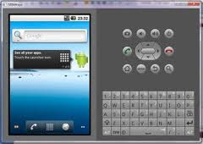
3.Android Development Environment

Slide 13
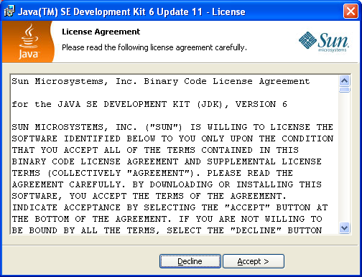
Step 1: JRE/JDK

Slide 14




Step 2: Eclipse IDE

Slide 15
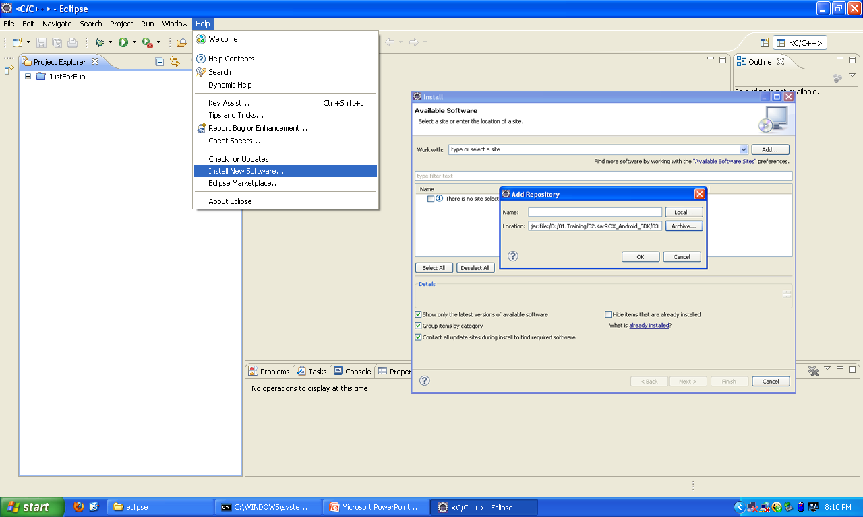
Step 3: ADT Plugin
1
3
2
4

Slide 16
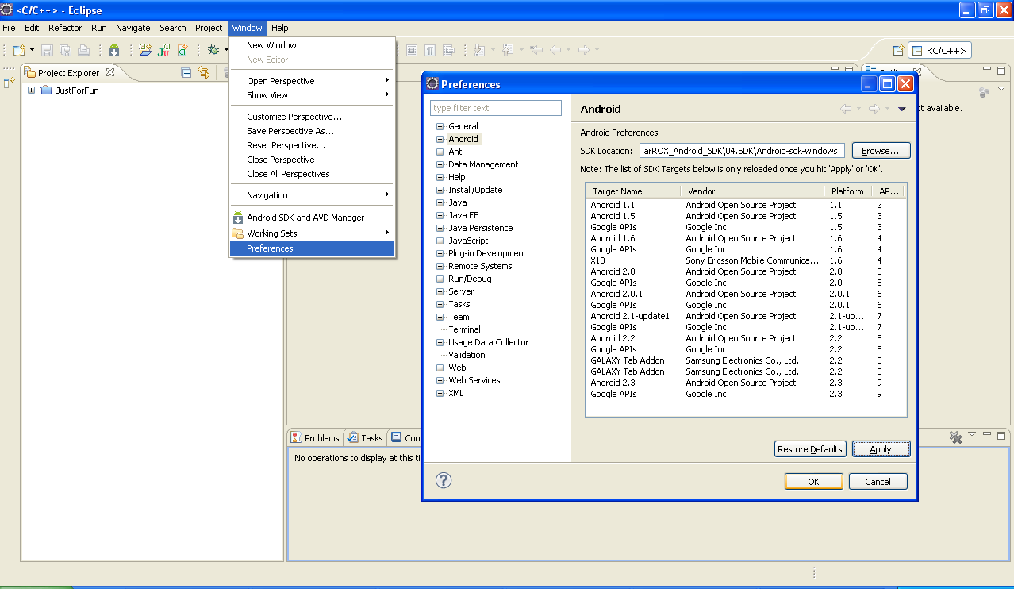
Step 4: Android SDK
1
3
4
2
5

Slide 17


Android Emulator

Slide 18
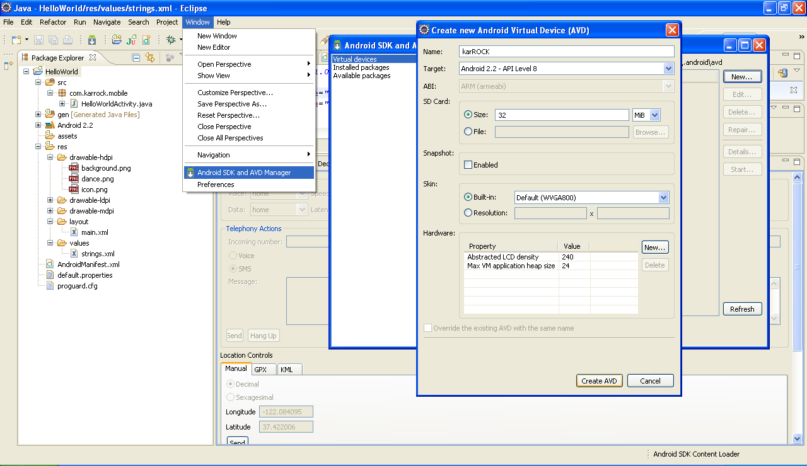
Create Android Device
2
3
1

Slide 19

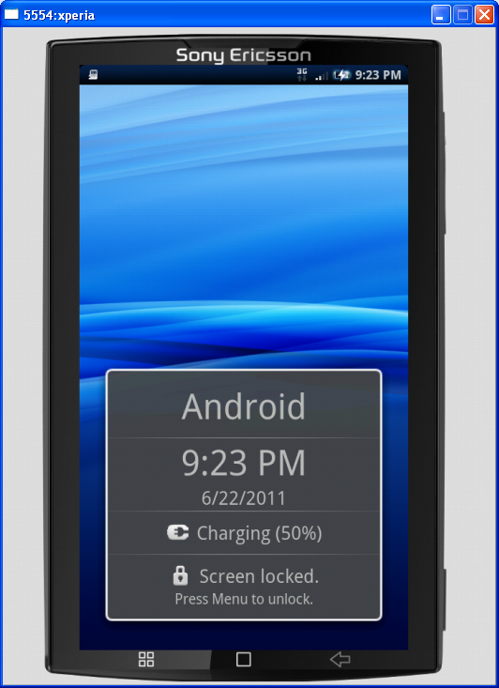
Welcome to Android Emulator !

Slide 20

How to Develop Android App!

Slide 21
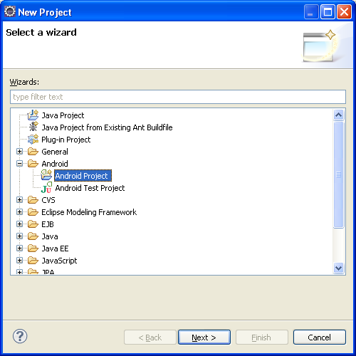
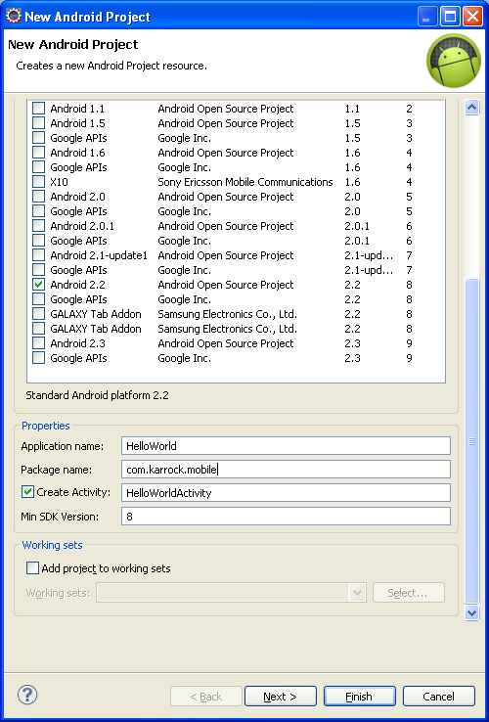
4. Our first Apps

Slide 22
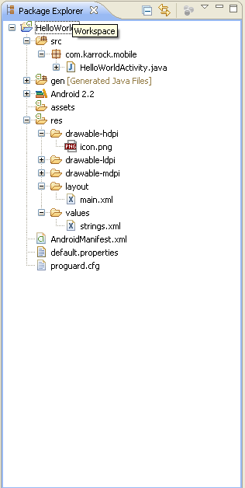
4. Android App Project
Source Code
Drawable Resource
Layout
Manifest

Slide 23
Source Code
package com.karrock.mobile;
import android.app.Activity;
import android.os.Bundle;
public class HelloWorldActivity extends Activity {
/** Called when the activity is first created. */
@Override
public void onCreate(Bundle savedInstanceState) { super.onCreate(savedInstanceState);
setContentView(R.layout.main);
}
}

Slide 24
Manifest
<?xml version="1.0" encoding="utf-8"?>
<manifest xmlns:android="http://schemas.android.com/apk/res/android"
package="com.karrock.mobile"
android:versionCode="1"
android:versionName="1.0">
<uses-sdk android:minSdkVersion="8" />
<application android:icon="@drawable/icon" android:label="@string/app_name">
<activity android:name=".HelloWorldActivity"
android:label="@string/app_name">
<intent-filter>
<action android:name="android.intent.action.MAIN" />
<category android:name="android.intent.category.LAUNCHER" />
</intent-filter>
</activity>
</application>
</manifest>

Slide 25
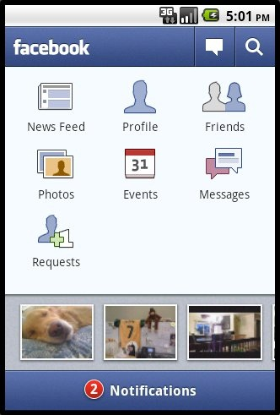
Drawable resource
drawable-hdpi
drawable-mdpi
drawable-ldpi

Slide 26
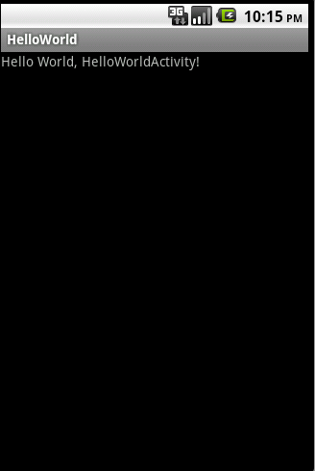
Layout
<?xml version="1.0" encoding="utf-8"?>
<LinearLayout xmlns:android="http://schemas.android.com/apk/res/android"
android:orientation="vertical"
android:layout_width="fill_parent"
android:layout_height="fill_parent">
<TextView
android:layout_width="fill_parent"
android:layout_height="wrap_content"
android:text="@string/hello"/>
</LinearLayout>

Slide 27

Layout (3 lines of code)

Slide 28
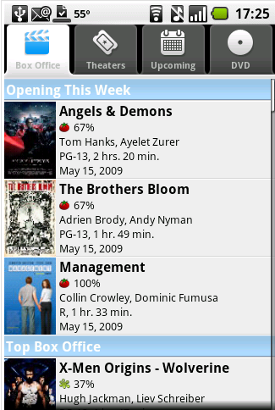
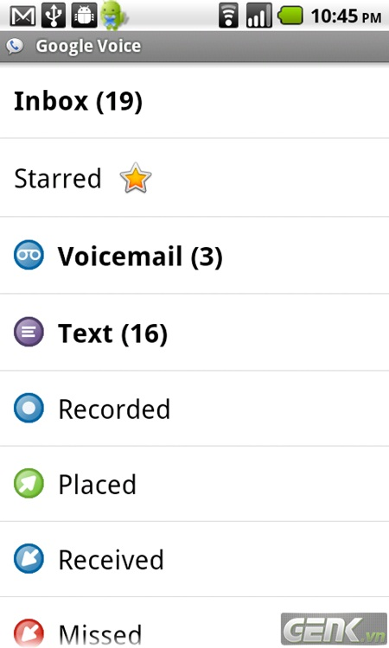
More Layout (To be continued…)

Slide 29
Share Experience
Q&A

Slide 30
Thank you!

