Slide 1

Lesson 8
Table View
Export File Excel with module report_xlsx

Slide 2
Table View

Slide 3






Table View
Link: https://www.cybrosys.com/blog/how-to-create-sql-view-odoo

Slide 4
Export File Excel with module report_xlsx

Slide 5
Table View
Link: https://apps.odoo.com/apps/modules/14.0/report_xlsx
Link: https://www.cybrosys.com/blog/generate-xlsx-report-using-controller-odoo-14

Slide 6

Exercise
Lesson 8
Table View
Create a model report table view, showing the following information
List of Property Buyers, count the number of properties according to corresponding states, total number of offers accepted, rejected, max price, min price by offer
CLICK HERE

Slide 7
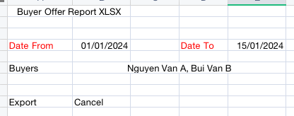
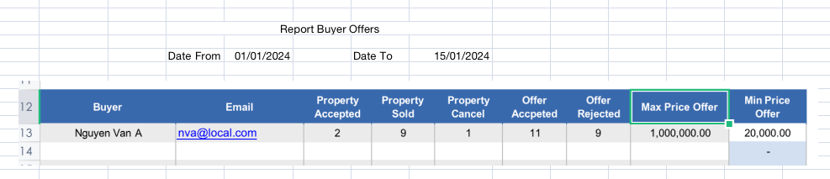
Exercise
Export the above table view as an excel file with the following format:
Lesson 8
Table View
Export Excel

