Slide 1


Slide 2

Section 1
HTML
CSS
UI Basic
Exercise

Slide 3
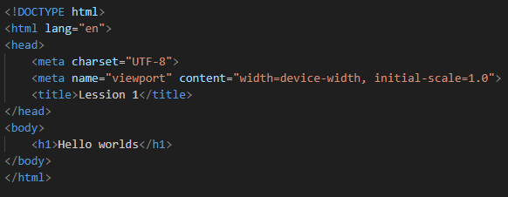
What is HTML ?
HTML stands for Hyper Text Markup Language
HTML is the standard markup language for creating Web pages
HTML describes the structure of a Web page

Slide 4
HTML Elements
An HTML element is defined by a start tag, some content, and an end tag.

Slide 5
HTML Attributes
Attributes provide additional information about elements
Attributes are always specified in the start tag
Attributes usually come in name/value pairs like: name="value"

Slide 6
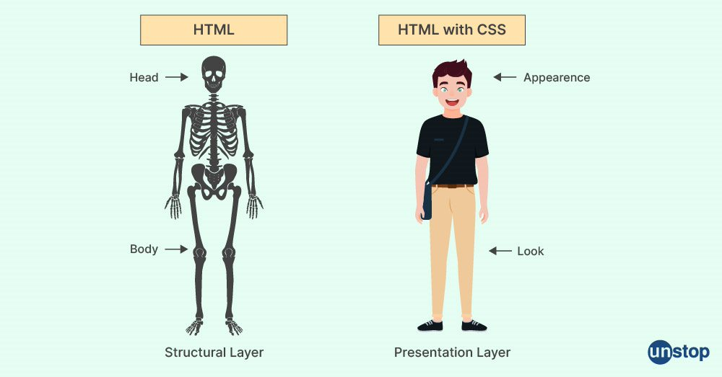
What is CSS ?
CSS stands for Cascading Style Sheets
CSS describes how HTML elements are to be displayed on screen, paper, or in other media

Slide 7
CSS in HTML
Internal
External
Inline

Slide 8
CSS Priority
Internal, External
Inline
#id - 100
.class - 10
tag - 1
inherited

Slide 9
CSS pseudo-classes
:root
:hover
:active
:first-child
:last-child

Slide 10
CSS pseudo-elements
::before
::after
::first-letter
::first-line

Slide 11


CSS display
 | Inline | Block | Inline-block
Display | As an inline element | As a block element | As an inline-block container
Width, height
Margin | Left and right
Padding | Left and right

Slide 12
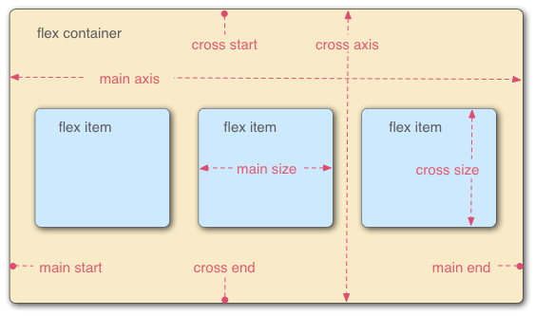
CSS layout
Flexbox playground: https://codepen.io/enxaneta/full/adLPwv/
Grid playground: https://www.cssgridplayground.com/

Slide 13
UI Basic
F-Pattern Rule
Focus on large images or prominent elements
Prefer scrolling over navigating
Ignore banner ads

Slide 14
Exercise
Bake: link
Suggestions
Css: Hover, translate, transition
Js: Counting Number, Lightbox, Carousel
Extensions: image download

Slide 15
Documents
HTML: https://www.w3schools.com/html/
CSS: https://www.w3schools.com/css/default.asp
Grid: https://css-tricks.com/snippets/css/complete-guide-grid/
Flexbox: https://css-tricks.com/snippets/css/a-guide-to-flexbox/

