Slide 1
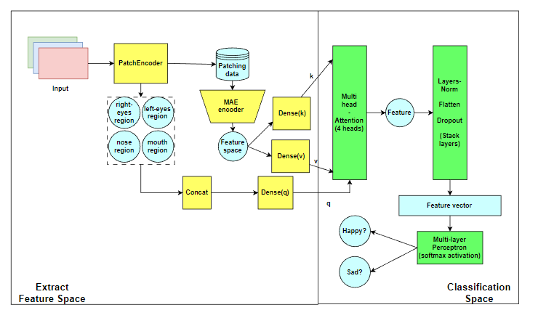
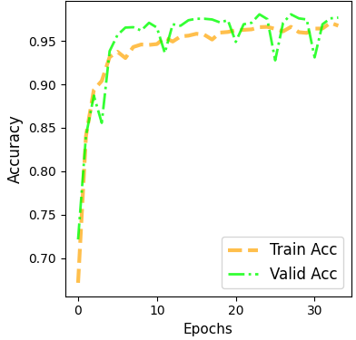
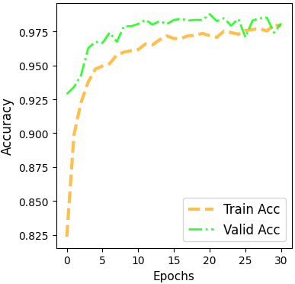
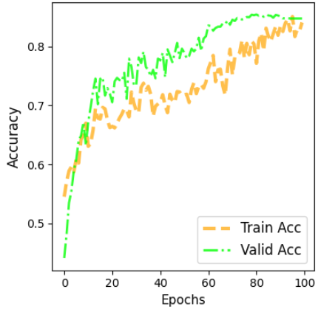
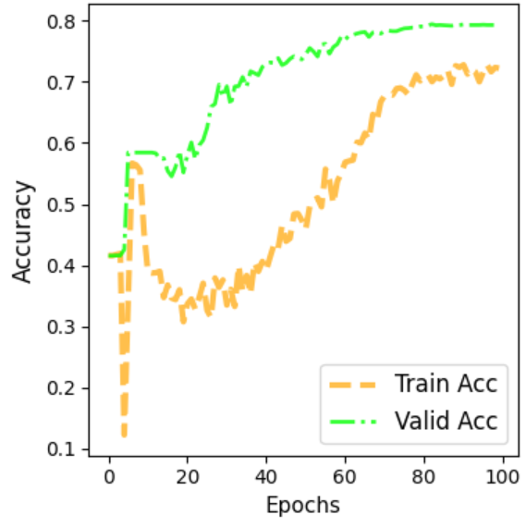
CLASSIFY TIRED AND ALERT IMAGES WITH A TRANSFORMER ENCODER
AND MASK ATTENTION MECHANSIM
Group 1: Nguyen Dac Hoang Phu, Nguyen Anh Minh, Vo Doan Thinh, Phan Thanh Dat, Ngo Duy Thinh
ADEMIC RESEARCH POSTER TEMPLATE
Subtitle for Academic Research Poster (48x36 inches)
Your names and the names of the people who contributed to this presentation
Motivation and overview
Architecture
Model summary
Applying the Vision Transformer model to solve the image classification problem with a dataset of 2 labels, tired and awake.
The goal of the study is to understand the ability of the ViT model in image classification, at the same time apply some Attention mechanisms and finally compare the results with other classification models such as ResNet, VGGNet.
Model \ Res | test accuracy | test-F1-score
VGG19 | 58.6 | 60.2
Res-Net50 | 98.4 | 98.1
ViT (Pretrain-model) | 97.15 | 97.06
ViT (Cross-Attension) | 97.21 | 97.10
ViT (CNNEncoding) | 97.00 | 97.05
VIT + ImageGenerator | 59.60 | 40.20
ViT (posEncoding) | 98.06 | 98.00
MAE (0.75% mask - no face query) | 85.88 | 85.29
MAE (0.75% mask - use face query) | 77.09 | 76.96
MAE (0.5% mask) | 84.87 | 84.21
Dataset
AffectNet & Young AffectNet HQ
Use 2 sets of happy and sad in the 2 datasets above to represent awake and tired respectively.
10,000 images in size 96x96 each class
Training/Validation/Test dataset can be split into a 70:20:10 ratio.
Result
Analysis
ViT (Cross-Attention): uses 2 other image patching sets to extract features, one will learn all the features in the image, the other will learn less components such as eyes, nose and mouth. Then pass both through Transformer Encoder and finally Cross Attention.
Figure 1. Vision Transformer (Cross-Attention).
Use 2 different image patching sets to solve the problem of image classification when the face is tilted or covered.
Figure 2. Vision Transformer (Pretrain-model).
Use a pretrained model on the ImageNet dataset. Then pass 2 Flatten and Dense layers to suit the problem.
Figure 3. MAE (0.75% mask - no face query)
To increase the recognition of images with partially obscured faces.
Figure 4. MAE (0.75% mask - use face query)
The main model matches the problem requirements. MAE to increase the recognition of images with partially obscured faces.
Future work
Conclusion
Models that use Vision Transformer (Pretrained model, Cross-Attention, CNN Encoding) all have quite good accuracy (about 97%). Testing on other models, only ResNet50 model has the same accuracy, MAE (0.75 mask - no face query) has an accuracy of about 86% and finally MAE (0.75 mask - use face query - the main model) has an accuracy of about 77%.
In addition, applying ImageGenerator to increase the training set, the model learns slower and has much worse evaluation metrics than using the DataAugumentation layer.
Testing on the correct dataset with 2 data labels is tired and awake.
Testing on larger data sets, higher resolution.
Test response with noise input images (partially obscured face) and use face landmark detection.
Vision Transformer (ViT) has emerged as a promising architecture for image classification, using self-attention mechanisms to learn global features. Compared to convolutional neural networks (CNNs), ViT has shown competitive performance on benchmark datasets such as ImageNet, and has the potential to generalize to other vision tasks.
VIETTEL DIGITAL TALENT 2023
Department of Geography
buffalo.edu

