Slide 1
SPI Driver
Atom Threads Porting
Testing Documentation
PORTING ON STM8L DISCOVERY
Document Specification

Slide 2

Atom Threads Porting
Testing Documentation
Document Specification

Slide 3
About
Team Member and Project Requiment
API Support
Design flowchar Decription feature
Hard ware
Schematic and PCB Design
Result
Debugging and Report

Slide 4




Nguyễn Trần Kha
Nguyễn Lương Duy Khánh
Lê Trọng Thức
Team Member
Lê Hoàng Phúc
Work on Circuit Schematic and PCB Layout
Team Member
Team Leader
Team Member
Code review and testing
Technical leader work on SPI Driver
Work on SPI Driver

Slide 5
About
Integrated Technologys
About Team
AutoSar 4.0
IAR x.x
Protues 4.x
GIT

Slide 6
About
Team Member and Project Requiment
API Support
Design flowchar Decription feature
Hard ware
Schematic and PCB Design
Result
Debugging and Report

Slide 7
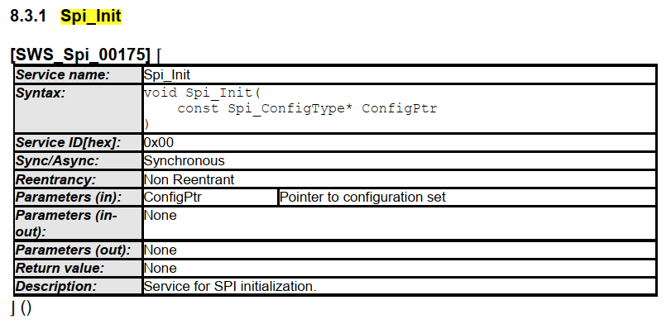
About
Integrated Technologys
About Team
Spi_Init
SWS_Spi_00298
SWS_Spi_00299
SWS_Spi_00013
SWS_Spi_00082
SWS_Spi_00015
SWS_Spi_00151

Slide 8
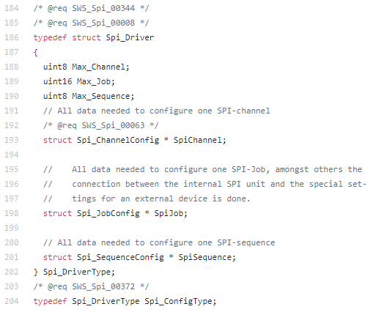
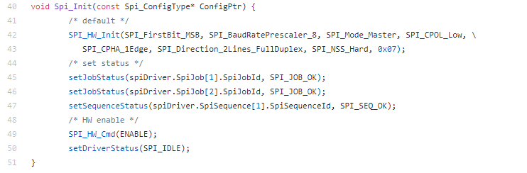
About
Integrated Technologys
About Team

Slide 9
About
Integrated Technologys
About Team
Spi_Init
Spi_DeInit
Spi_WriteIB
Spi_ReadIB
Spi_GetStatus
Spi_GẹtobResult
Spi_ReadIB
Spi_GetStatus
Spi_GẹtobResult
Spi_ReadIB
Spi_GetStatus
Spi_GẹtobResult

Slide 10
About
Cấu hình SPI
MODE
Mode gì ghi nha
Buffer
Buffer rộng bao nhiêu
Chanel
Bao nhiêu chanel

Slide 11
About
Master Flow
Start
Init Clock/Timer/…
Interupt unts nhấn
PrintLCD
READ
write

Slide 12
About
Slave Flow
Start
Init Clock/Timer/…
Interupt nút nhấn
Interupt SPI
PrintLCD
READ
write

Slide 13
About
Team Member and Project Requiment
API Support
Design flowchar Decription feature
Hard ware
Schematic and PCB Design
Result
Debugging and Report

Slide 14
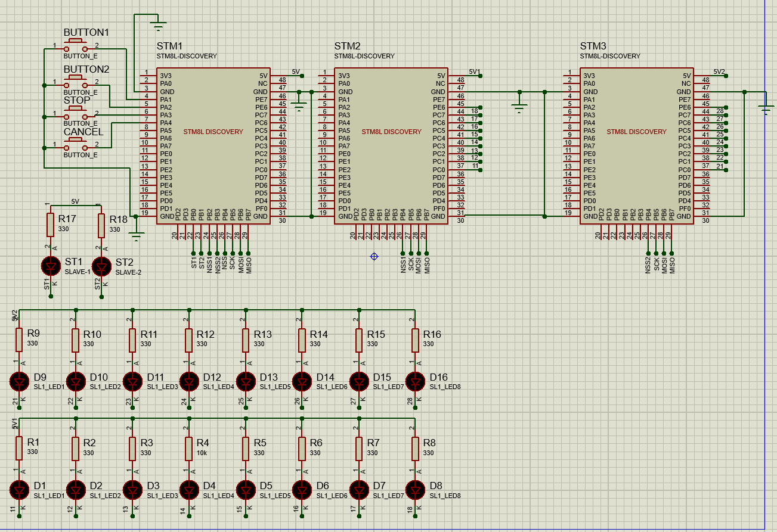
About
Master Flow
BUTTON1
PA1
BUTTON2
Stop
PA2
Cancel
Led 0-7
PC0-7
PA3
PA4
Led Slave1
PB0
Led Slave2
PB1

Slide 15
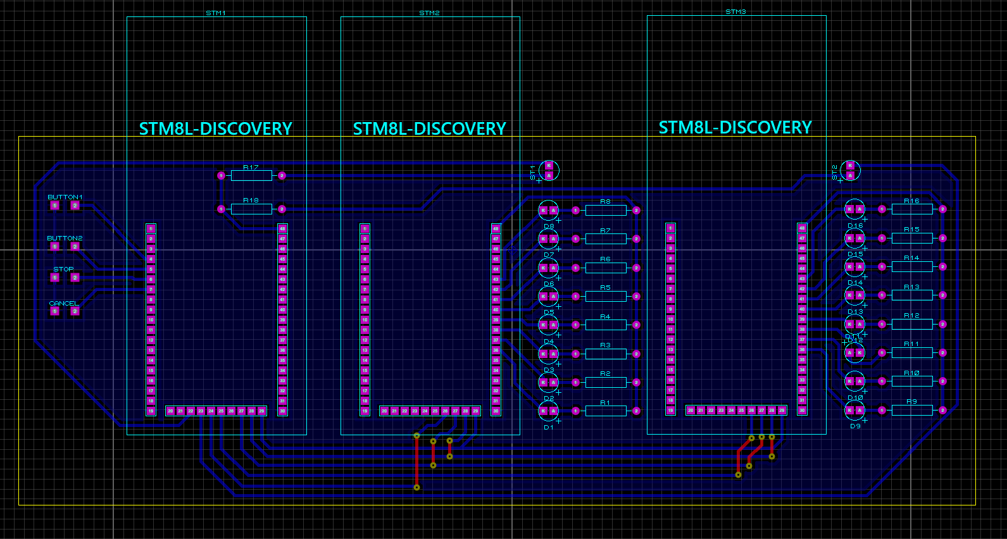
About
Master Flow

Slide 16
About
Hình thực tế

Slide 17
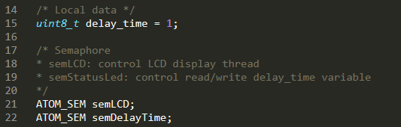
Threads
Led Thread
Button Thread
LCD Thread
Start
Init Clock/Timer/…
Init OS
Print log error
Fail
Success
Create 2 Semaphore
Crash
Success
led_thread
button_thread
display_thread

Slide 18
About
Team Member and Project Requiment
API Support
Design flowchar Decription feature
Hard ware
Schematic and PCB Design
Result
Debugging and Report

Slide 19
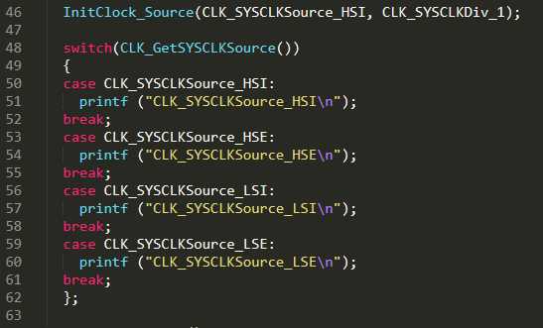
Debugging
Mode DEBUG/RELEASE

