Slide 1
SPI Driver
Atom Threads Porting
Testing Documentation
PORTING ON STM8L DISCOVERY
Document Specification

Slide 2

SPI Driver
Testing Documentation
Document Specification

Slide 3
About
Team Member and Project Requiment
API Support
Design flowchar Decription feature
Hard ware
Schematic and PCB Design
Result
Debugging and Report

Slide 4




Nguyễn Trần Kha
Nguyễn Lương Duy Khánh
Lê Trọng Thức
Team Member
Lê Hoàng Phúc
Work on Circuit Schematic and PCB Layout
Team Member
Team Leader
Team Member
Code review & editor document and testing
Technical leader work on SPI Driver
Work on SPI Driver

Slide 5
About
Integrated Technologys
About Team
AutoSar 4.0
IAR 3.11.1
Protues 8
GIT 2.22.0

Slide 6
About
Team Member and Project Requiment
API Support
Design flowchar Decription feature
Hard ware
Schematic and PCB Design
Result
Debugging and Report

Slide 7
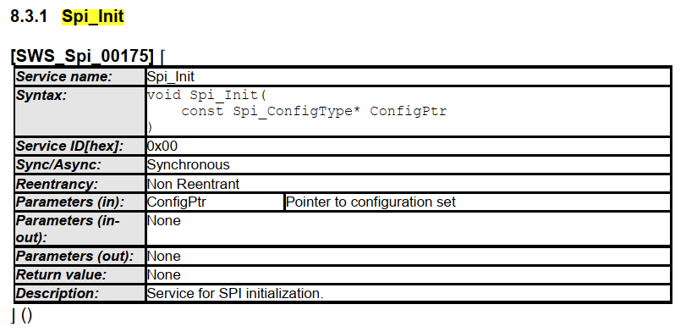
API Support
Design flowchar Decription feature
Spi_Init
SWS_Spi_00298
SWS_Spi_00299
SWS_Spi_00013
SWS_Spi_00082
SWS_Spi_00015
SWS_Spi_00151

Slide 8
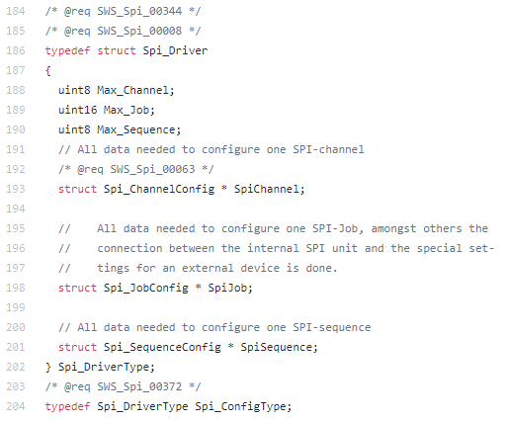
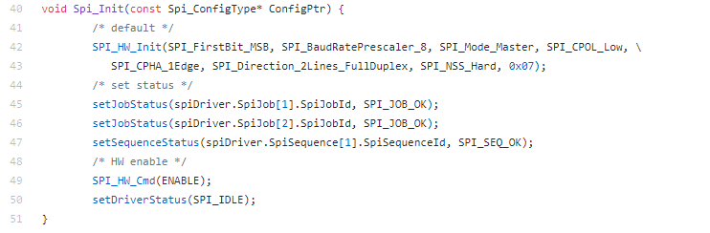
API Support
Design flowchar Decription feature

Slide 9
API Support
Design flowchar Decription feature
Spi_Init
Spi_DeInit
Spi_WriteIB
Spi_ReadIB
Spi_GetStatus
Spi_GetJobResult
Spi_Cancel
Spi_SetAsycMode

Slide 10
API Support
Design flowchar Decription feature
MODE
Full Dupplex
Buffer
254*4 Bytes for chanel1
1*4 Bytes for chanel2
Chanel
254 times chanel1
1 time chanel2
Tranfer
2 chanels

Slide 11
API Support
Master Flow
Start
Init
If(BUTTON1)
Sent(slave1)
If(BUTTON2)
Sent(slave2)
If(STOP)
SentStop(slave1)
SentStop(slave2)
If(CANCEL)
CancelAllSent()

Slide 12
API Support
Master Flow
Interupt Button1
Interupt Button2
Interupt Cancle
Interupt STOP
BUTTON1 flag
BUTTON2 flag
Cancle flag
STOP flag
OUT
OUT
OUT
OUT

Slide 13
API Support
Slave Flow
Interupt SPI
Interrupt CS
Start
Cnt++
OUT
Cnt=0
Init Clock/Timer/…
If(data_read ==‘s’)
activated=0
OUT
If(active)
turn_off_all_led();
If(data_read ==‘b’)
Actived=1
shift_led_effect()
If(cnt==1019)
Send back slave number

Slide 14
About
Team Member and Project Requiment
API Support
Design flowchar Decription feature
Hard ware
Schematic and PCB Design
Result
Debugging and Report

Slide 15
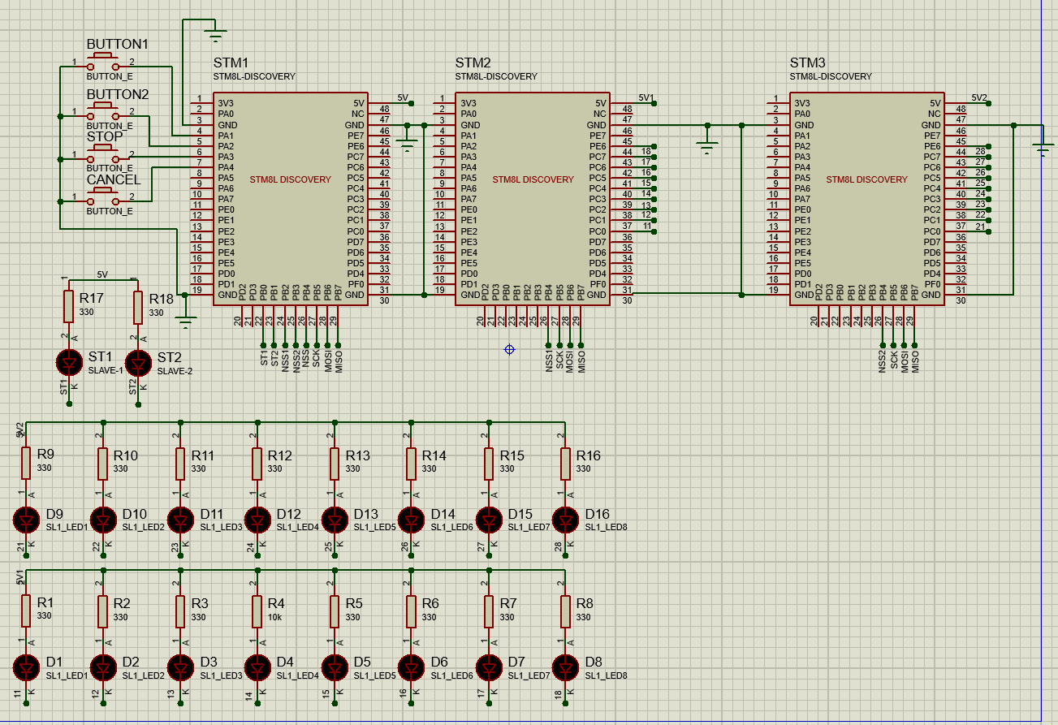
Hard ware
Schematic and PCB Design
BUTTON1
PA1
BUTTON2
Stop
PA2
Cancel
Led 0-7
PC0-7
PA3
PA4
Led Slave1
PB0
Led Slave2
PB1

Slide 16
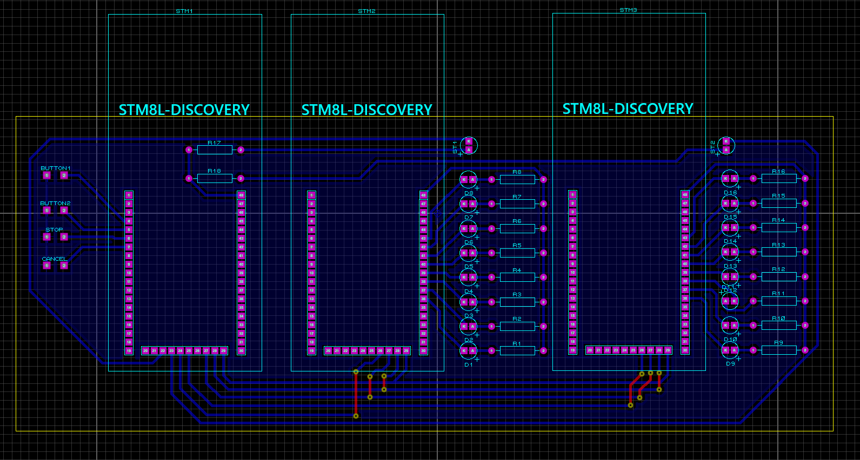
Hard ware
Schematic and PCB Design

Slide 17
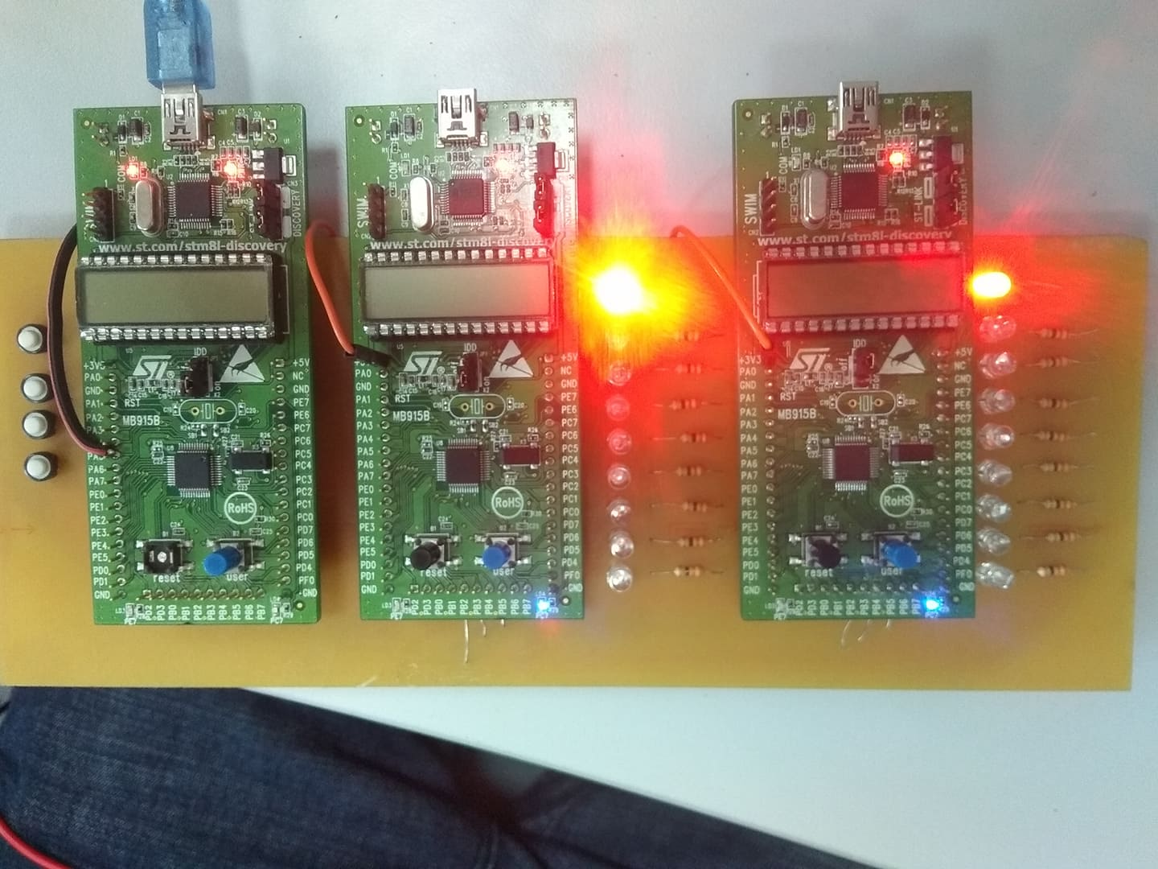
Hard ware
Schematic and PCB Design

Slide 18
About
Team Member and Project Requiment
API Support
Design flowchar Decription feature
Hard ware
Schematic and PCB Design
Result
Debugging and Report

Slide 19
Result

