Slide 1
CS 273 - Data Structures and Algorithm Analysis
Lecture 7: Inheritance and Composition

Slide 2
Today’s Goals
Course Goal 7: To understand and learn basic software engineering paradigms: object oriented programming, inheritance, recursive algorithm design.
Quick Review of O() and Complexity
Review Object Inheritance
Review Object Composition
Hands-on lab

Slide 3
Review: Analyze This Program!
int main() {
for (int i = 0; i < 1000000; ++i) {
// part 1 work!
}
for (int i = 0; i < n; ++i) {
// part 2 work!
}
}
Total Work (part 1+part 2) f(n) =
n + 1000000
Complexity f(n) is O(g(n)) what is g(n) =
O(n) → linear

Slide 4
Inheritance describes IS-A relationships
Cats and Humans are Mammals
Cat “is-a” Mammal
Cat “inherits” from Mammal
Cat is “a kind of” Mammal
Cat is “a specialized” Mammal
Cat is “derived from” Mammal
Cat is a “derived class” of Mammal
Cat is “a subclass” of Mammal
Cat “extends” Mammal
Mammal is the “base class” of Cat
Mammal is the “superclass” of Cat
Mammal
Cat
Human

Slide 5
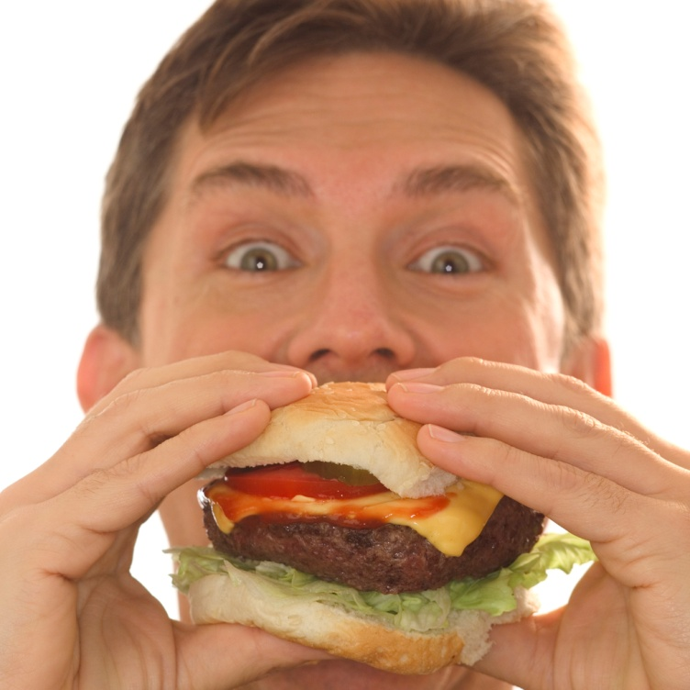
Composition or aggregation describes HAS-A Relationships…
What is the relationship
between my tomato slice
and my sandwich?
Aha! my Sandwich
HAS-A Tomato Slice!
Sandwich
Tomato Slice

Slide 6
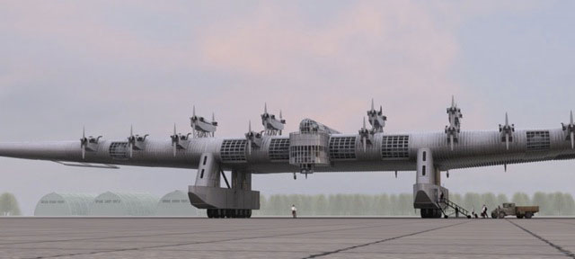
What are the relationships between these classes?
Aircraft
The K7 was a Russian aircraft that had multiple engines.
Engine
inherits
K7
contains

Slide 7
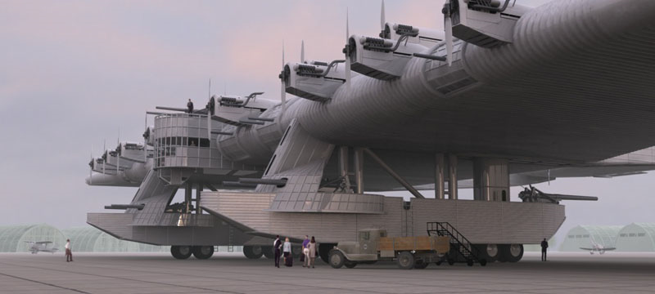
Implementing Class Relationships
class K7 : public Aircraft
{
…
Engine *propellers; // Array
};

Slide 8
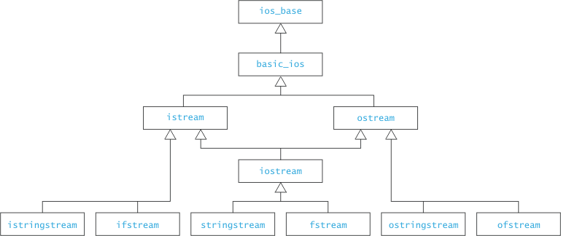
Inheritance enables you create Derived classes that extend and/or refine Base classes (i.e. superclasses)
Base class or superclass
Derived classes or subclasses

Slide 9
Inheritance allows you to “extend” a superclass.
Computer
string manufacturer
int ram_size
int disk_size
+ get_ram_size()
+ int get_disk_size()
+ string get_manufacturer()
Additional properties for class Laptop
(and its derived classes)
Laptop
int screen_size
int weight
+ int get_screen_size()
+ int get_weight()

Slide 10
Inheritance also allows you to “refine” methods in the superclass
Computer
string manufacturer
int ram_size
int disk_size
+ get_ram_size()
+ int get_disk_size()
+ string get_manufacturer()
Behaviors may be modified (overridden) in class Laptop
Laptop
int screen_size
int weight
+ int get_screen_size()
+ int get_weight()
10
+ string get_manufacturer()

Slide 11
Hands-On Time: Let’s revive those C++ muscle memories!
Let’s remind ourselves how to do the following in C++:
Defining inheritance
Incorporating header inclusion guards
Invoking base class constructors from subclasses
Creating objects dynamically
Defining composition
Using access keywords:
private, public, protected

Slide 12
Mammal Project
copy mammals.zip from the class folder and extract it to your Z: drive folder.
We will work with this project throughout this session today!
You will likely want to refer to it as an example in the future!

Slide 13
Let’s first make a Human Class by extending the Mammal Class
Mammal
- BirthYear
+ Age()
Cat
Human
+ Speak()
+ Speak()

Slide 14
Let’s refine our Cat model by overriding Mammal’s Age() method
Mammal
- BirthYear
+ Age()
Cat
Human
I’ve been told 1 Cat year ~ 20 human years
+ Speak()
+ Speak()
+ Age()

Slide 15
So, why all this inheritance, composition, etc…? How does it help us?

Slide 16
Composition is good for code reuse and it make maintenance of code easier
A Mammal HAS-A Brain
Mammal
Brain
- BirthYear
+ Age()
+ Think()
Cat
Human
Let’s modify Humans to think before they speak!
+ Speak()
+ Age()
+ Speak()

Slide 17
Code reuse is achieved by extension and composition
When we extend a base class, we get to automatically reuse code in the base class
When using composition our classes can make easy use of other pre-built classes

Slide 18
Inheritance allows us to enforce and implement interfaces which makes code backwards compatible
TOAST BAGELS GAME KNOWS VERSION 11
SUPER SMASH MUFFINS GAME
KNOWS VERSION 9
GRAPHICS DRIVER VERSION 11
Supports new and old interfaces
VERSION 11
Interface
VERSION 10
Interface
VERSION 9
Interface

Slide 19
Inheritance also enables polymorphism a very powerful concept… but is a topic for next time! Make sure and do the assigned reading before next class!
This diagram is just a teaser… ☺
We won't discuss it in depth today!
Mammal
+ eat()
Cat
Human
+ eat()
+ eat()
for ( auto m : mammals )
m->eat();

Slide 20
Summary
Reviewed Object Inheritance
Reviewed Object Composition
Hands-on lab

