Slide 1
CS 273 - Data Structures and Algorithm Analysis
Kent Jones
Lecture 8: Polymorphism

Slide 2
Objectives for Class
Course Goal 7: To understand and learn basic software engineering paradigms: object oriented programming, inheritance, recursive algorithm design
Polymorphism – the “power” of inheritance
Virtual methods
Abstract Base Classes and Interfaces
Dynamic casting

Slide 3
Hands on With Polymorphism
Copy zoo.zip from the class folder and extract it to your desktop

Slide 4

A derived class can use inheritance to override (i.e. refine) a virtual method specified in the base class.
Clock
+ virtual void ShowTime()
+ void ShowTime()
ShowTime for a digital clock is different than ShowTime for a cuckoo clock!
DigitalClock
CuckooClock
GrandpaClock
void ShowTime()
void ShowTime()
void ShowTime()
Each of the methods in the derived classes are refined so they are true to the behavior of the derived class.

Slide 5

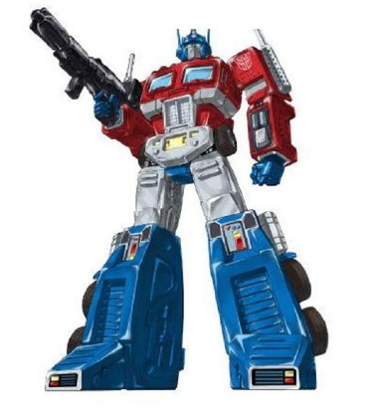
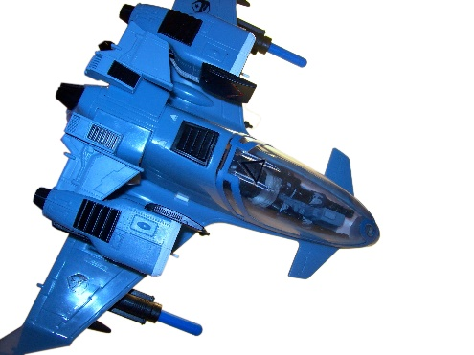
Polymorphism means “The quality of having many forms or shapes”
Each derived class fires differently. One fires bullets, one missiles, one spike strips
TRANSFORMER
+ virtual void Fire()
BigTruck
BigRobot
Jet
+ void Fire()
+ void Fire()
+ void Fire()

Slide 6
C++ will call the correct method even if you store the address of your new object in a pointer to the object's base class
Transformer * robot1 = new BigTruck();
Transformer * robot2 = new Car();
Transformer * robot3 = new FighterJet();
Robot1->Fire();
Robot2->Fire();
Robot3->Fire();
Fire() for a BigTruck is different than Fire() for a FighterJet!

Slide 7
Abstract Base Classes work well for implementing interfaces.
TOAST BAGELS GAME KNOWS VERSION 11
SUPER SMASH MUFFINS GAME
KNOWS VERSION 9
GRAPHICS DRIVER VERSION 11
Supports new and old interfaces
VERSION 11
Interface
VERSION 10
Interface
VERSION 9
Interface

Slide 8
An Abstract Base Class (Interface)
A base class that defines “WHAT” methods must be implemented, and lets the subclasses determine “HOW” to implement those methods.
class Pedal{
public:
virtual void Add_Gas() = 0;
};
An Abstract Base Class must define at least one pure virtual function
Pure virtual function or abstract method

Slide 9
An Abstract Base Class must define at least one abstract method (i.e. pure virtual function)
Example
virtual void treat_patient() = 0;
You can’t create an instance of an abstract class that has pure virtual functions, e.g.
Physican myDoctor; // illegal
You can however, define a reference or a pointer to an abstract class, e.g.
Physican *myDoctor;

Slide 10
Comparison between Actual Classes and Abstract Classes (page 204 in your textbook)

Slide 11
Polymorphism In Practice: Zoo Tycoon Simulation
We want to make a Zoo Tycoon Game
We want to easily simulate all animals in the zoo
Development Goal: Make our software easily extensible because we don’t know what types of animals we want to add to our zoo in the future

Slide 12
The Zoo HAS-A collection of Animal objects. Animals have brains. Cat and Human are Animals
Zoo
Animal
Brain
- vector<Animal> collection
+ void AddAnimal(Animal *)
+ void SimulateAnimals()
Cat
Human

Slide 13
The Animal Class is an Abstract Base Class and defines an Interface for all Animals
Animal
Abstract Base Class
- BirthYear
+ Age()
+ Speak() = 0
Brain
+ Think()
Cat
Human
Rabbit
+ Age()
+ Speak()
+ Speak()
+ Speak()

Slide 14
But Humans like to Complain!
Animals
Brain
- BirthYear
+ Think()
+ Age()
+ Speak() = 0
In Zoo::SimulateAnimals() only Humans are allowed to complain!
Cat
Human
Rabbit
+ Age()
+ Speak()
+ Speak()
+ Complain()
+ Speak()

Slide 15
To determine the actual type of a base class pointer use typeid (i.e. known as type introspection )
for (auto animal : collection) {
animal->Speak();
if ( typeid(Human) == typeid(*animal) ) {
dynamic_cast<Human*>(animal)->Complain();
}
}

Slide 16
When stepping through each animal, if we find an object that’s truly human, we need to convert (i.e. dynamically downcast) the animal pointer into a human pointer so that we can use it to access the complain member function for the human object. NOTE: if it’s a cat or a rabbit, it does not have a complain method!
if ( typeid(Human) == typeid(*animal) ) {
dynamic_cast<Human*>(animal)->Complain();
}
Only humans can complain! So, that’s why we have to check before casting this pointer!
We use a dynamic cast so we can treat this particular animal pointer like the human pointer that it really is!

Slide 17
Summary
Polymorphism – the “power” of inheritance
Virtual methods
Abstract Base Classes and Interfaces
Dynamic casting
Type Introspection
Tips on Hospital Example Follow…

Slide 18

Enforcing Software Contracts
Another example:
Imagine writing software to simulate a hospital.
Requirements:
A hospital hires physicians.
ALL physicians MUST treat patients.
Physicians may also perform research related to their field.

Slide 19
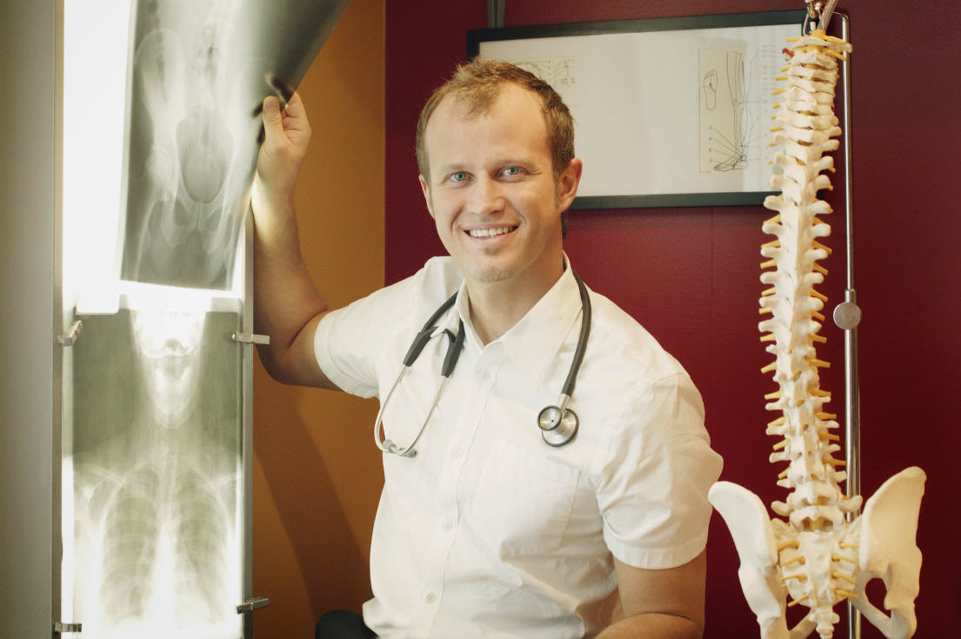
Abstract Base Classes
AN ABSTRACT BASE CLASS
SPECIFIES REQUIRED METHODS FOR ALL PHYSICIANS
AN ORTHEPEEDIC PHYSICIAN
OPERATATES DIFFERENTLY THAN
AND NEUROSURGEON!

Slide 20
Abstract base classes force subclasses to implement specific methods.
#include <iostream>
using namespace std;
class Physician
{
private:
string name;
public:
// pure virtual function
virtual void treat_patient() = 0;
};
class Neurosurgeon : public Physician
{
public:
void treat_patient() { cout << “Slice neurons!\n"; }
};
class Radiologist : public Physician
{
public:
void treat_patient() { cout << “Take x-rays!\n"; }
void research() {cout << “researching x-rays\n”; }
};
int main()
{
Physician *aPhysician[2];
aPhysician[0] = new Neurosurgeon();
aPhysician[1] = new Radiologist();
for(int i = 0; i < 2; i++)
aPhysician[i]->treat_patient();
}
All classes that inherit from the Physician class must implement the treat_patient( ) method!

