Slide 1


DEPLOYING AN XDR SOLUTION FOR NETWORK SECURITY WITH WAZUH

Slide 2

CONTENTS
01
INTRODUCTION
02
TECHNOLOGY
03
DEPLOYMENT MODEL
04
DEMO

Slide 3


01. INTRODUCTION
Background
In today's technological era, the rapid growth of digitized systems, cloud computing, IoT and remote-work models has created an increasingly complex digital environment.
Businesses face not only a growing number and sophistication of cyberattacks (from ransomware and phishing to APT attacks...) but must also protect enormous volumes of data across many different platforms.

Slide 4
01. INTRODUCTION
Challenges
Lack of the ability to detect and respond to threats quickly and in a timely manner.
Fragmentation and lack of synchronization among existing security solutions.
A shortage of cybersecurity experts.

Slide 5
01. INTRODUCTION
Solution
XDR (Extended Detection and Response) is an advanced security solution designed to detect, analyze and automatically respond to cybersecurity threats in a comprehensive and effective way.
XDR integrates data from many different sources, including endpoints, networks, applications, cloud and other environments in the enterprise's digital ecosystem.

Slide 6
01. INTRODUCTION
Features
XDR acts as a unified platform, collecting and analyzing data from these different sources to provide a comprehensive view of the entire attack chain. This helps detect complex, hard-to-find threats that individual solutions might miss.
In addition, XDR supports automating incident response and handling, helping save time and cost and reducing the risk of human error for the business.

Slide 7

01. INTRODUCTION
Wazuh Technology
Wazuh is a free, open-source security platform that unifies the capabilities of XDR and SIEM.
Wazuh can be deployed on various operating systems such as Windows, Linux, macOS and many virtualization platforms.

Slide 8

01. INTRODUCTION
Scope of Implementation
Simulate an enterprise network environment and deploy Wazuh integrated with security technologies including Snort, Suricata, Mod Security, VirusTotal and ClamAV, to build a system that monitors, detects and automatically responds to incidents.

Slide 9


02. TECHNOLOGY
DVWA: Damn Vulnerable Web Application is a deliberately vulnerable web application used to practice web application security skills.
Mod Security: A powerful WAF tool that helps protect web applications from attacks and security threats, while also providing activity monitoring and logging.

Slide 10


02. TECHNOLOGY
Snort/Suricata: Powerful and flexible IDPS tools, widely used to monitor and detect abnormal network activity and prevent intrusions.

Slide 11


02. TECHNOLOGY
VirusTotal: An online tool that analyzes suspicious files and URLs to detect malware and malicious content using anti-virus engines and website scanners.
ClamAV: Open-source, cross-platform anti-virus software. The main purpose of ClamAV is to detect various types of malware such as viruses, worms, trojans and rootkits.

Slide 12
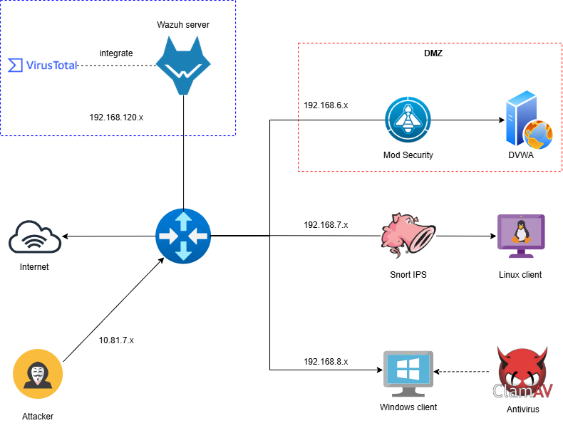
03. DEPLOYMENT ARCHITECTURE

Slide 13

04. DEMO

Slide 14
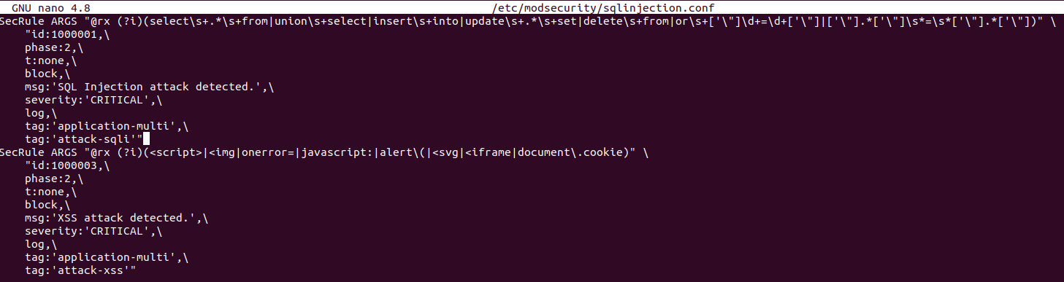
1. INTEGRATING MOD SECURITY AND WAZUH SERVER
This scenario simulates common web attacks against the DVWA machine. Mod Security is then used to block the attacks, and the logs are checked as they are pushed to the Wazuh Dashboard
Use rules on ModSecurity to prevent attacks against DVWA

Slide 15
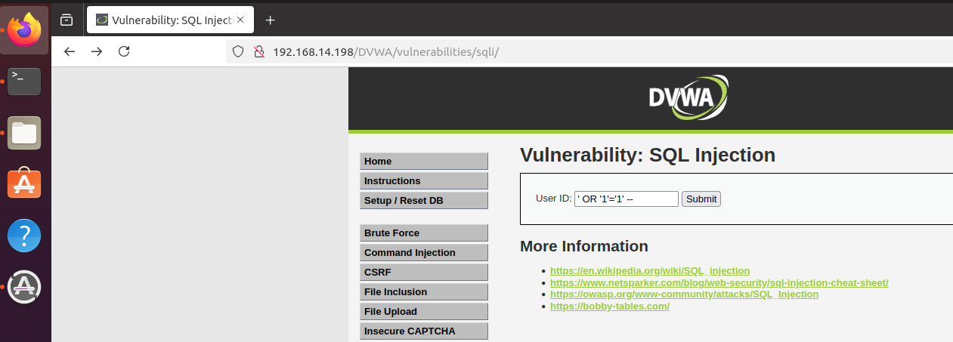
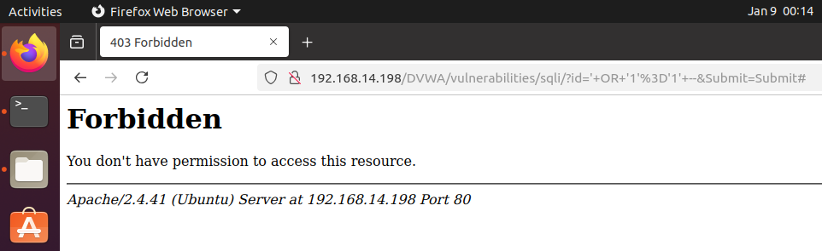
1. INTEGRATING MOD SECURITY AND WAZUH SERVER
Carry out an SQL Injection attack against the machine running DVWA. This attack is blocked and logged by Mod Security.

Slide 16
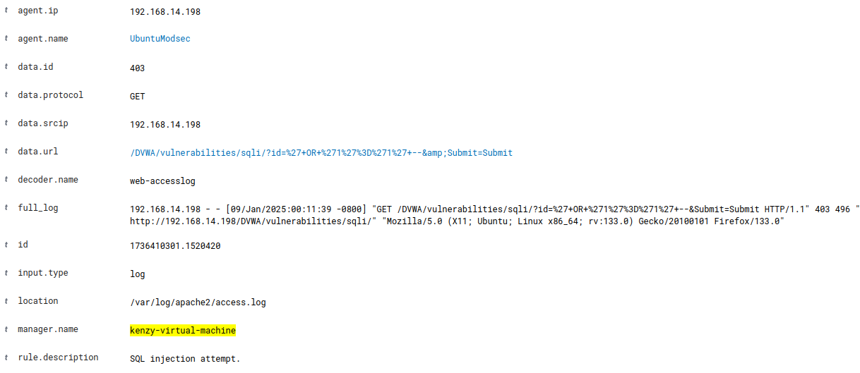
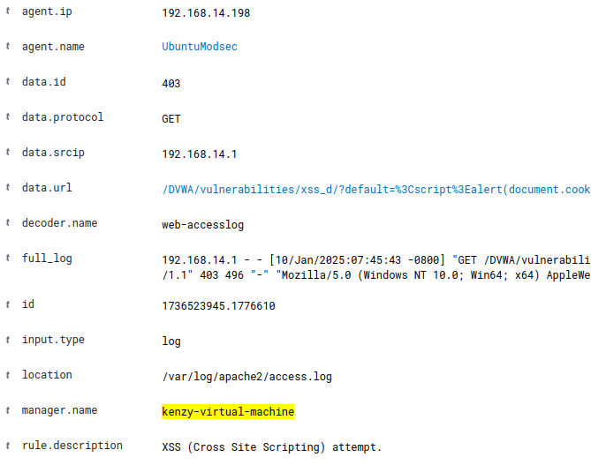
1. INTEGRATING MOD SECURITY AND WAZUH SERVER
Mod Security logs are pushed to the Wazuh Server Dashboard

Slide 17
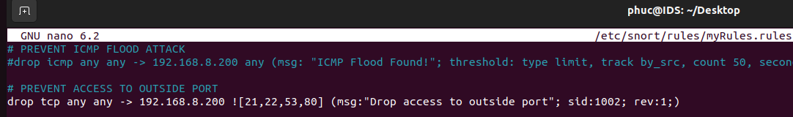
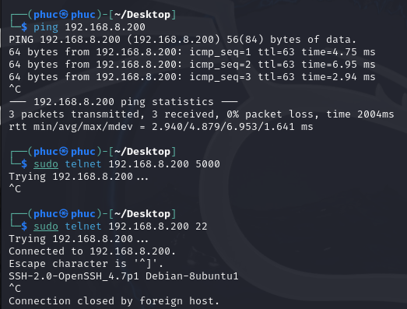
2. INTEGRATING SNORT AND WAZUH SERVER
Configure a Snort rule so that only ports within a predefined range can be accessed.
The attacker is blocked if they try to access ports outside the specified range.

Slide 18
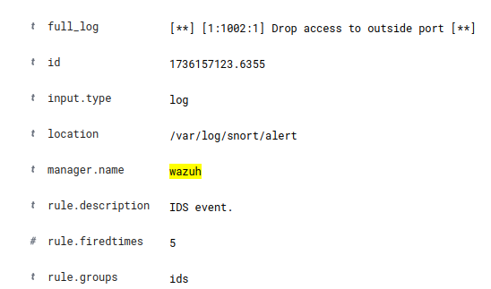
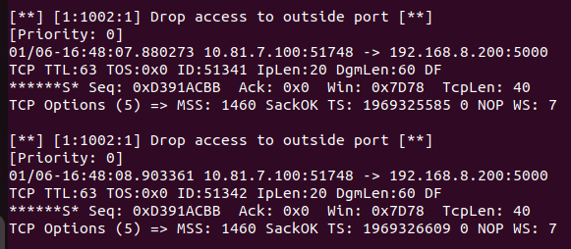
2. INTEGRATING SNORT AND WAZUH SERVER
Wazuh receives Snort's alert and displays it on the dashboard
Detailed alert from Snort

Slide 19


2. INTEGRATING SNORT AND WAZUH SERVER
The Snort rule blocks the ICMP flood attack if it detects any source sending 100 packets/5s to the victim machine
The attacker connects to the victim and uses hping3 to launch an ICMP flood attack

Slide 20
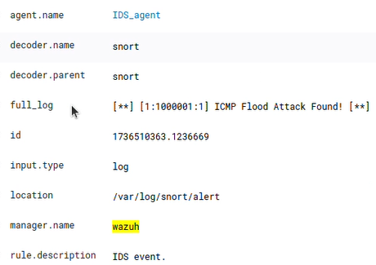
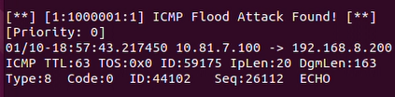
2. INTEGRATING SNORT AND WAZUH SERVER
Wazuh displays the alert from Snort
Snort log detail

Slide 21
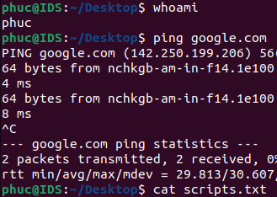
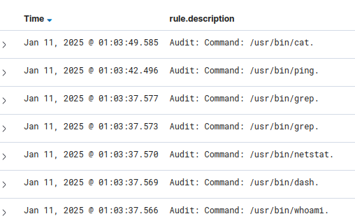
3. MONITORING COMMANDS ON LINUX
Use the tool auditd to help collect commands on Linux.
It collects not only commands entered by the user but also commands run in the background by the system, generated by the OS, or from system health checks

Slide 22
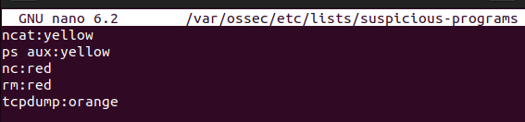
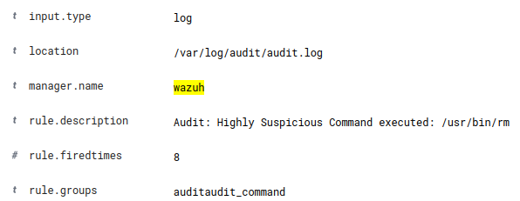
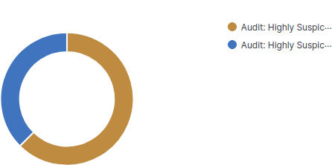
3. MONITORING COMMANDS ON LINUX
On the Wazuh server, apply a custom configuration to create a list of commands that are dangerous to the system
Wazuh sends a special alert if any of these commands are executed

Slide 23
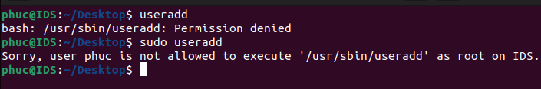
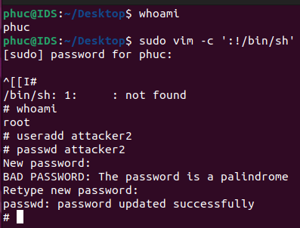
3. MONITORING COMMANDS ON LINUX
The user 'phuc' does not have permission to use the useradd command, even as root
Exploit vim to escalate privileges. Now the user 'phuc' can execute the useradd command with root privileges

Slide 24
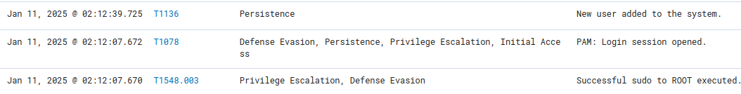
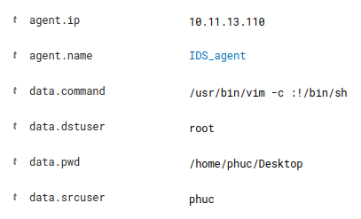
3. MONITORING COMMANDS ON LINUX
Wazuh detects the privilege escalation and raises an alert under the MITRE ATT&CK section

Slide 25
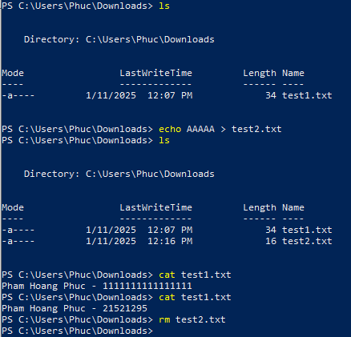
4. FILE INTEGRITY MONITORING (FIM)
Use Wazuh's FIM module to monitor the Downloads folder on the Windows 10 machine
Add, delete and modify files in the Downloads folder

Slide 26
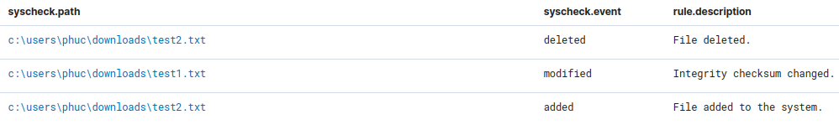
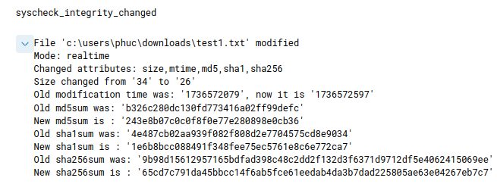
4. FILE INTEGRITY MONITORING (FIM)
Wazuh has logged every add, delete and modify action on the folder

Slide 27
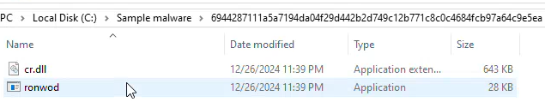
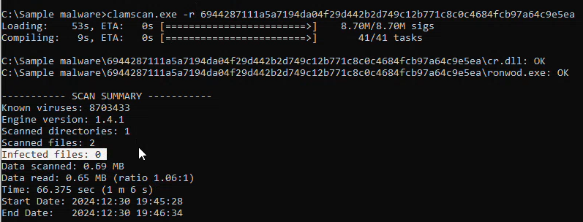
5. VIRUSTOTAL INTEGRATION & IOC DEVELOPMENT
On the Windows machine, prepare a piece of malware taken from the database of MalwareBazaar
ClamAV cannot detect this malware because it is not in signature database

Slide 28
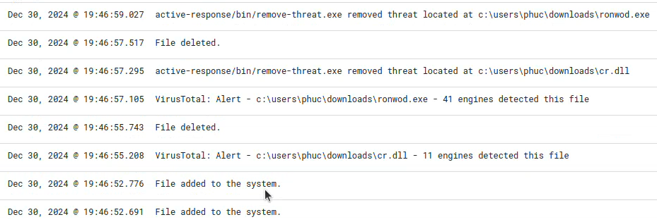
5. VIRUSTOTAL INTEGRATION & IOC DEVELOPMENT
The hash of the downloaded file is sent to the Wazuh server integrated with VirusTotal for scanning.
If VirusTotal identifies it as malware, the Wazuh dashboard sends an alert. At the same time, the wazuh-agent on the infected machine triggers a script to automatically delete the malicious file

Slide 29
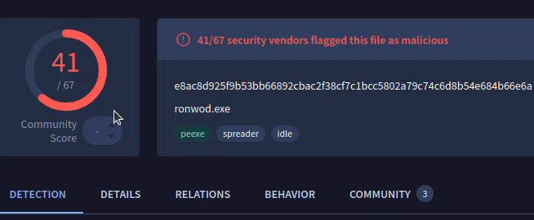
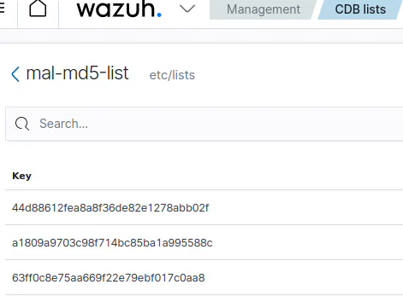
5. VIRUSTOTAL INTEGRATION & IOC DEVELOPMENT
Re-check the malware hash on the VirusTotal website
Save the malware hash to improve ClamAV's signature database

Slide 30
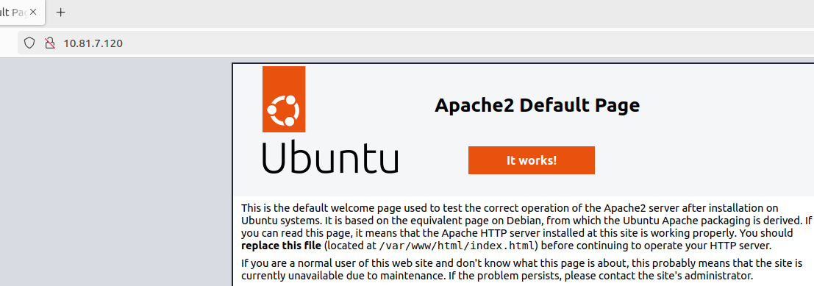
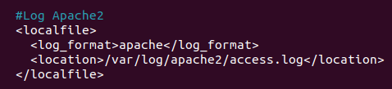
5. VIRUSTOTAL INTEGRATION & IOC DEVELOPMENT
Simulate an SQL injection attack against the Apache web server
Homepage of the Apache web server on the DVWA machine
Configure the ossec.conf file to collect the Apache access.log

Slide 31
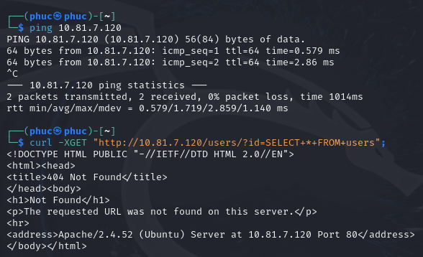
5. VIRUSTOTAL INTEGRATION & IOC DEVELOPMENT
The attacker carries out an SQL injection attack

Slide 32
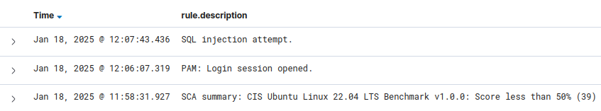
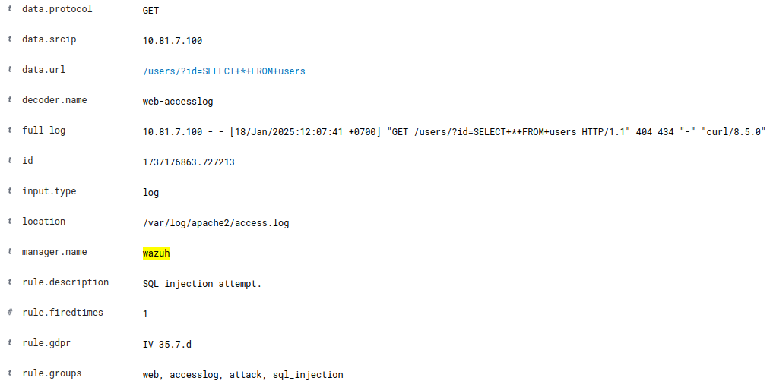
5. VIRUSTOTAL INTEGRATION & IOC DEVELOPMENT
Wazuh alert is triggered
Detailed description of the alert, including the attacker's IP and the attack payload

Slide 33
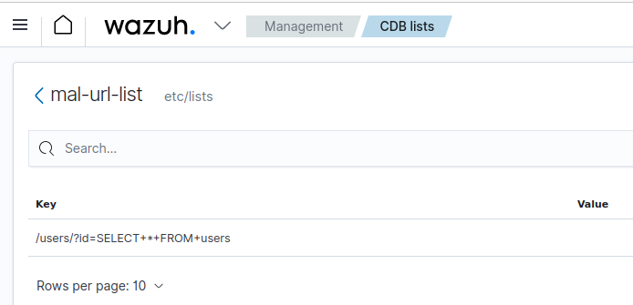
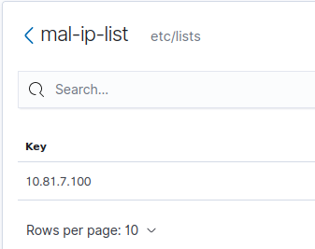
5. VIRUSTOTAL INTEGRATION & IOC DEVELOPMENT
The URL containing the attack payload has been saved
The attacker's IP is also saved

Slide 34
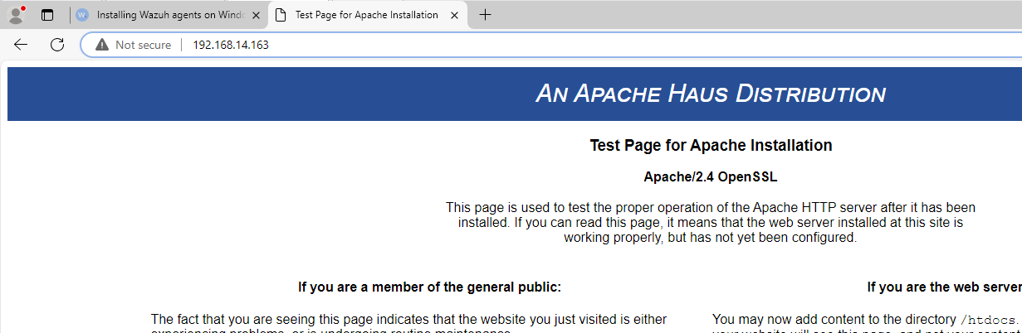
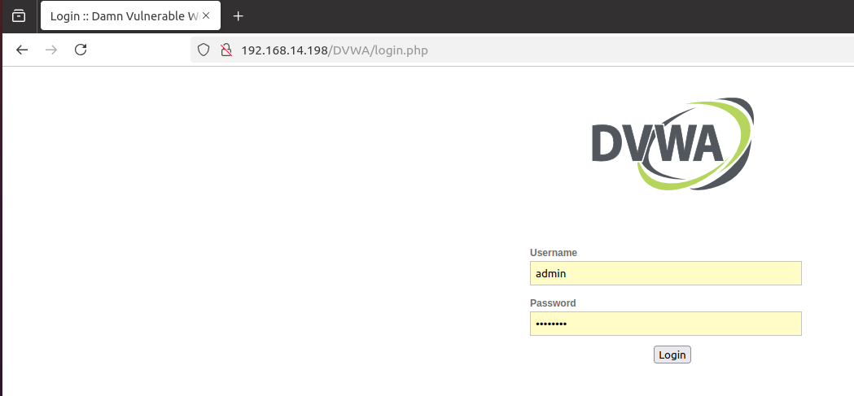
6. BLOCKING KNOWN MALICIOUS ACTORS
Use Wazuh's active-response feature to monitor and block malicious IP addresses, protecting web resources on the endpoints
Run the Apache web server on 2 endpoint machines
namely Windows 10 and Ubuntu

Slide 35
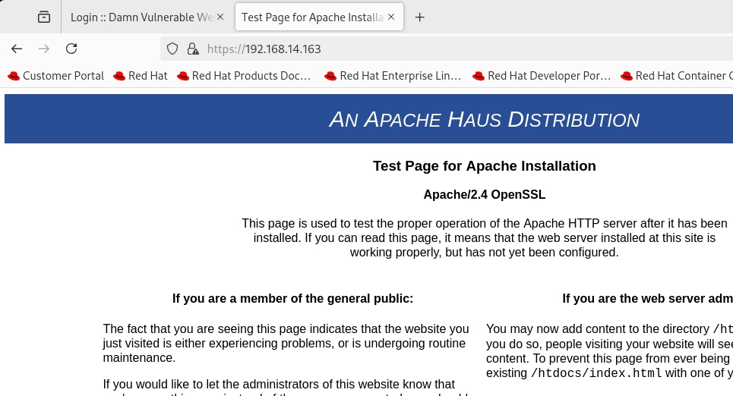
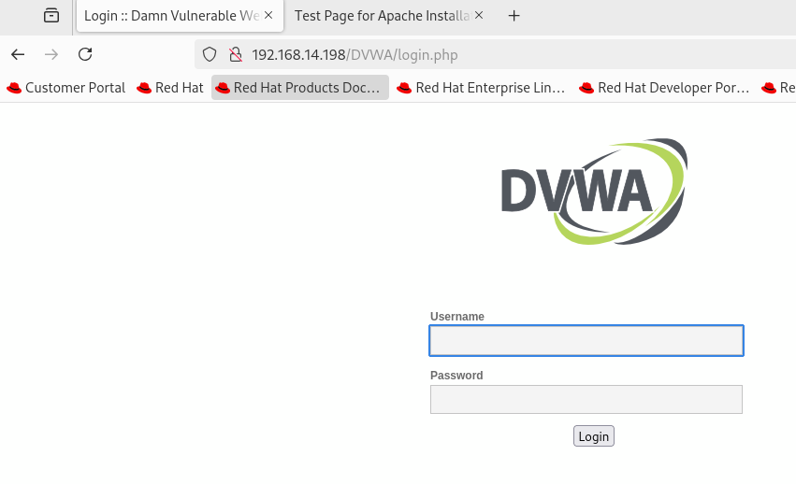
6. BLOCKING KNOWN MALICIOUS ACTORS
Use a RHEL 9.0 virtual machine to simulate the attacker, connecting to the victim's 2 web servers

Slide 36
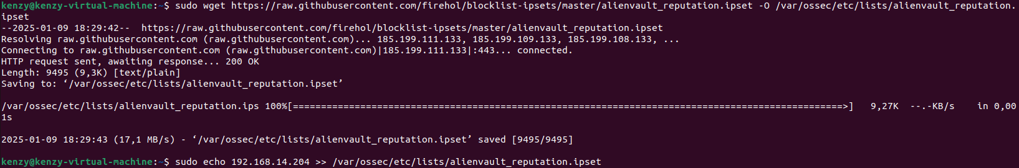
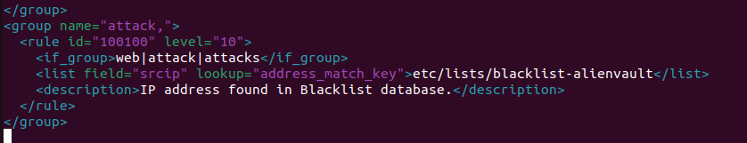
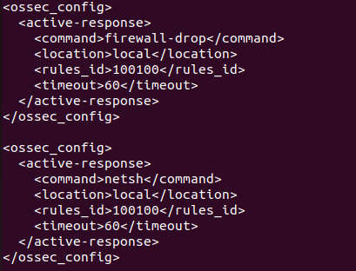
6. BLOCKING KNOWN MALICIOUS ACTORS
From here, we configure Wazuh to recognize and flag the RHEL attacker machine's IP as a malicious attack
Configure active-response to automatically block the malicious IP within 60s

Slide 37
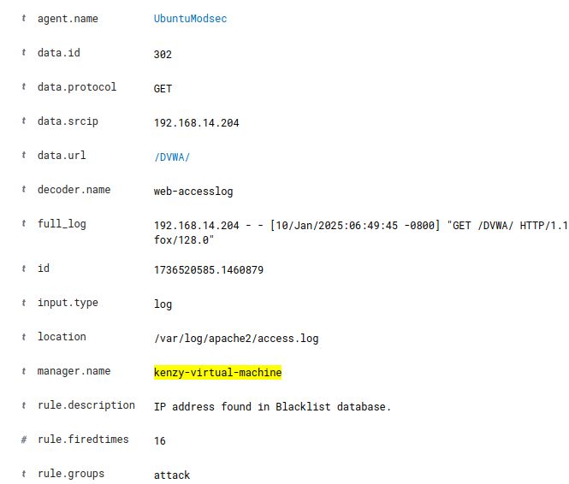
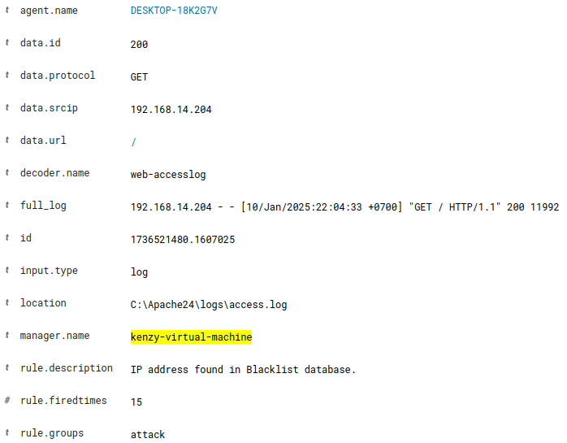
6. BLOCKING KNOWN MALICIOUS ACTORS
We try to access again from the RHEL machine and Wazuh receives the access log

Slide 38
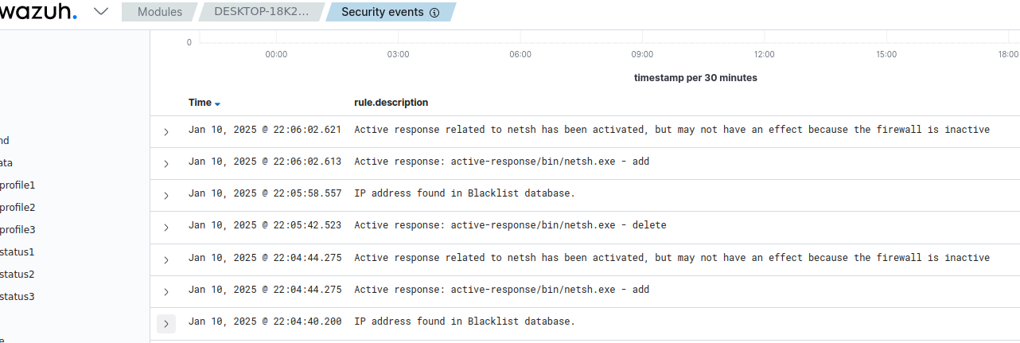
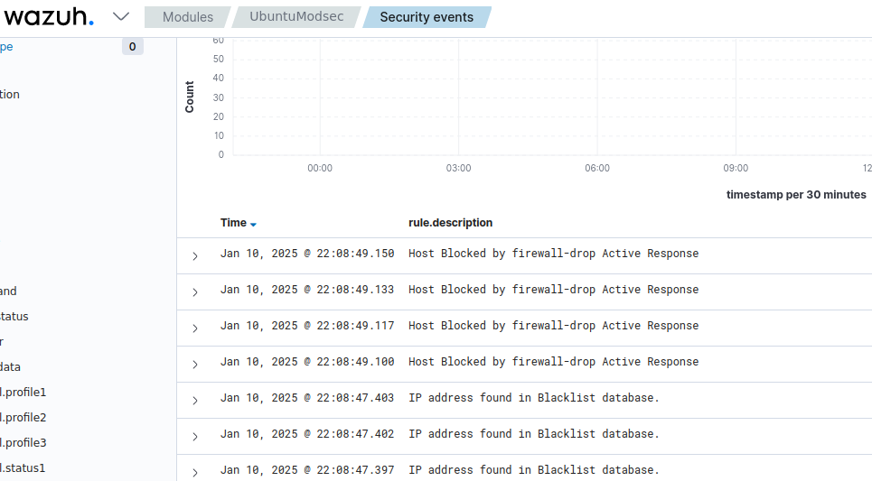
6. BLOCKING KNOWN MALICIOUS ACTORS
The IP has been blocked automatically

Slide 39
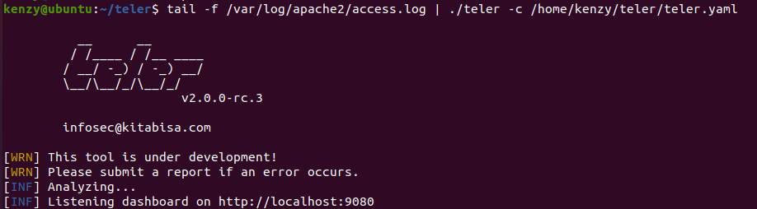
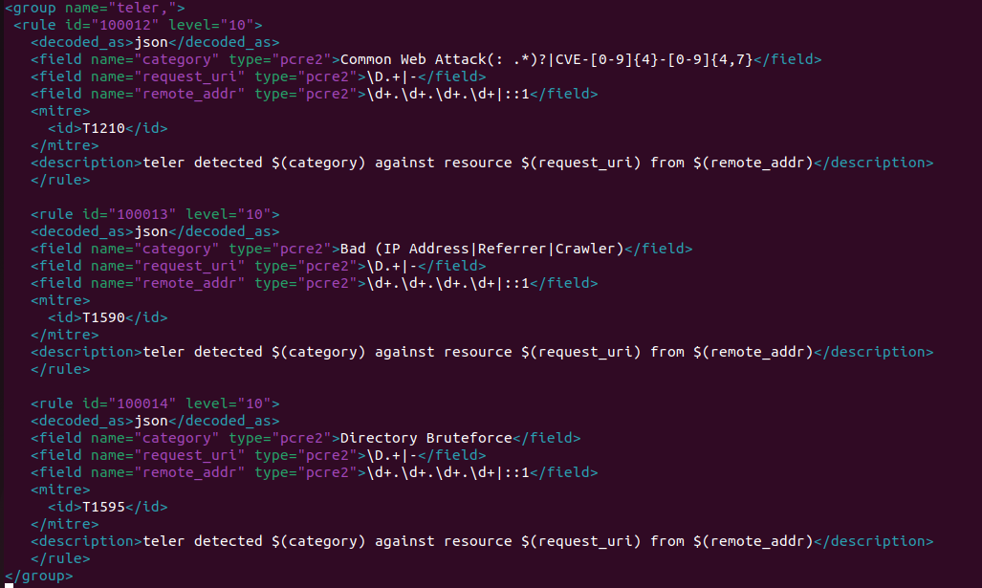
7. ATTACK DETECTION WITH WAZUH AND TELER
Configure Teler on the machine hosting DVWA
Add rules so that Wazuh works
together with the rules built into Teler

Slide 40
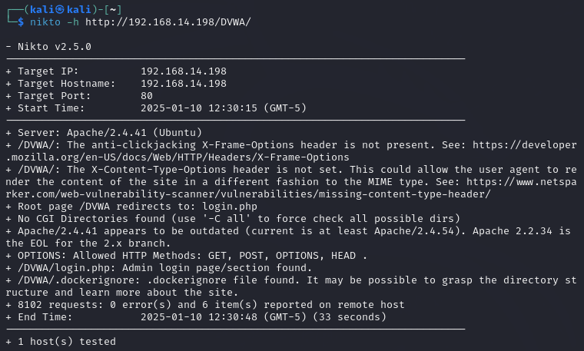
7. ATTACK DETECTION WITH WAZUH AND TELER
Use the nikto tool on Kali to simulate the attack

Slide 41

7. ATTACK DETECTION WITH WAZUH AND TELER
Alerts from Teler are pushed to the Wazuh dashboard

Slide 42


8. INTEGRATING SURICATA IDS WITH WAZUH
Install and configure Suricata

Slide 43


8. INTEGRATING SURICATA IDS WITH WAZUH
Simulate a network attack

Slide 44


8. INTEGRATING SURICATA IDS WITH WAZUH
Logs from Suricata are pushed to Wazuh

Slide 45

THANKS FOR WATCHING

